Slide 1
A Shared Vision for Change: Strategies, Approaches, and Techniques

Slide 2
Culture Change in the Organization
Why change?
Who do we need/want to be in the future?
What is the vision?
Tools and Techniques to Facilitate Change
Design Thinking
Liberating Structures
UK Visual Explorer Activity
Developing/Identifying the Skills in Others
Notes:
1)UW sets up the context for Culture change
Why - Crisis or driving need, how do direct the organization into an identified “new” state.
Leadership sets the vision (often controversial - which direction/who’s involved)
What’s in scope?
Identifying the team
Roles/Responsibilities
Timeline
Milestones
2a) Edinburgh highlights one technique “Visual Explorer”
2b) UW adds other examples.. Liberating Structures, Design Thinking,
3) UW shares approaches for developing/identifying skills in others

Slide 3
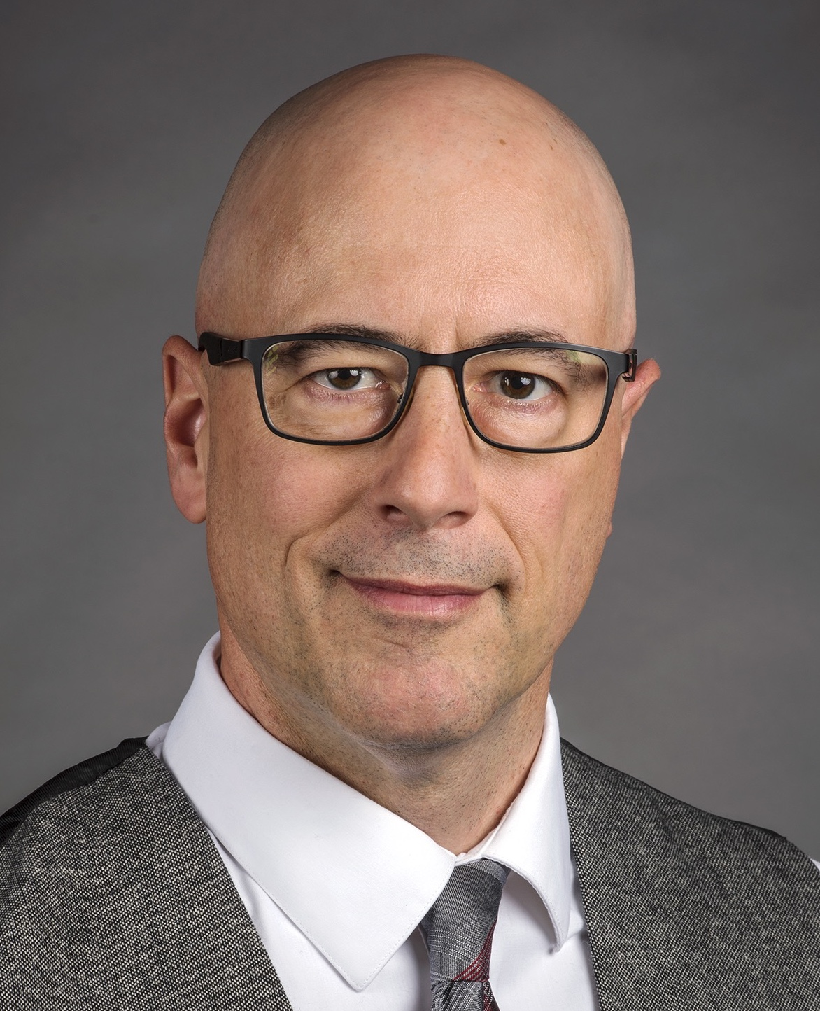
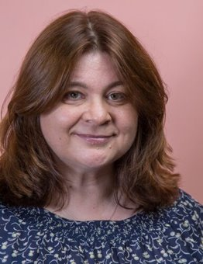
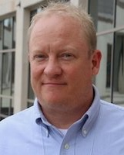
Ron Cramer
Learning Technology Consultant
DoIT-Academic Technology
University of Wisconsin-Madison
Rhian Davies
Head
Project Management Office
University of Edinburgh
Blaire Bundy
Service Lead for Consulting
DoIT-Academic Technology
University of Wisconsin-Madison

Slide 4
As the pace of discovery of new knowledge accelerates, we are entering a period in which the capacity to nourish and manage change will be one of the most important abilities of all.
-- James Duderstadt
A University for the 21st Century (2000)

Slide 5
All Play:
What are the most prominent forces driving change in higher education today?

Slide 6
FORCES DRIVING CHANGE IN HIGHER EDUCATION
Financial Constraints/Revenue Pressures
Student Expectations and Engagement
Responding to Shifts in Learner Demographics
Technology Trends and Advancements
Competitive Educational Models (New Markets)
Growing urbanization
Turnover in University Leadership
New Directions in Academic Disciplines
Notes:
What are Forces Driving Education Change Today?
Technology (Duderstadt, J. (2000). A university for the 21st century. Ann Arbor, MI: University of Michigan Press.
Changing Financial Environments Goethals, G.R., & Frantz, C. M. (1998). Thinking seriously about paying for college.
AAHE Bulletin, 51(2), 3-7.

Slide 7
All Play:
What are the obstacles to institutional change in higher education?

Slide 8
OBSTACLES TO CHANGE IN HIGHER EDUCATION
Cultural Resistance, fear, vulnerability Eckel, P., & Kezar, A. (2003).
Operational Policies (accumulation of additional missions w/o refining) Duderstadt, J. (2000).
Political Opposition Walvoord, B.E. & Casey, A. K. (2001).
Governance (geared toward preservation rather than the future) Eckel, P., & Kezar, A. (2003).
Notes:
What are obstacles to change in higher education today?

Slide 9
OBSTACLES TO CHANGE IN HIGHER EDUCATION
Debate surrounding institutional identity and mission
Administrative turnover
Salary and equity concerns
Campus politics
Working across departments and disciplines
Resource Environment
Brophy, M. (2006).

Slide 10
RESISTANCE, FEAR, & VULNERABILITY
Transformation is about changing institutional cultures.
Culture consists of shared assumptions, values, beliefs ideologies, meanings, perceptions and feelings that individuals share and help shape the institution.
Adjusting and responding to emerging cultural challenges confronting faculty and the organization requires understanding change and culture.
Eckel, P., & Kezar, A. (2003).

Slide 11
INFLUENCING PRINCIPLES
Empathy
Building Trust
Collaboration is not just about the technology
Shared problem-solving and outcomes
Transformation (lasting change)
Reframing Change: A new orientation
(DoIT AT SLTC, 2018)
Notes:
Ron: These are just from all of our many conversations as a group!

Slide 12
How do we facilitate change?
Using images to develop a shared vision for change
Images © The University of Edinburgh

Slide 13
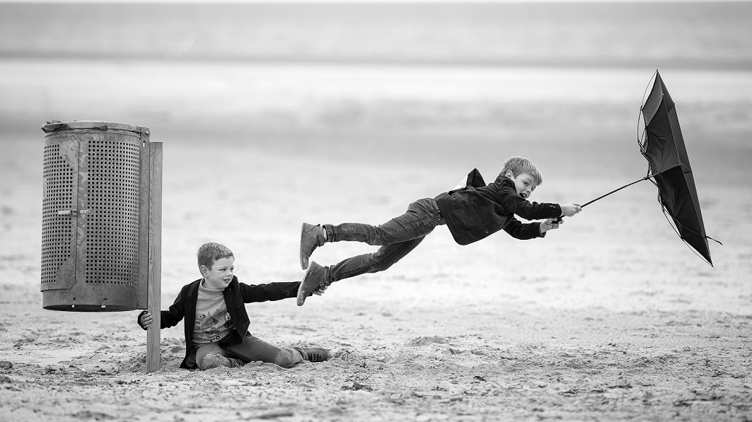
FORCES DRIVING CHANGE

Slide 14
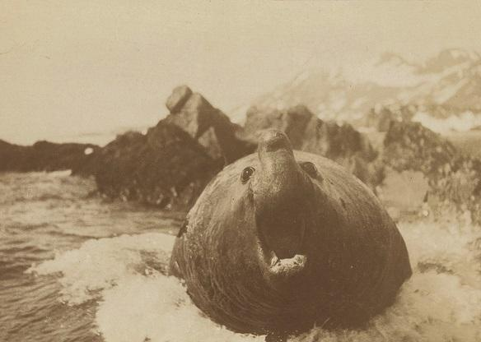
OBSTACLES TO CHANGE

Slide 15
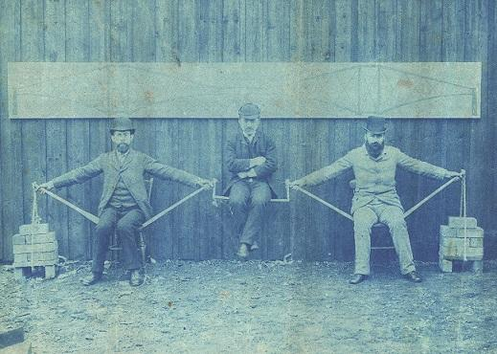
COLLABORATION

Slide 16
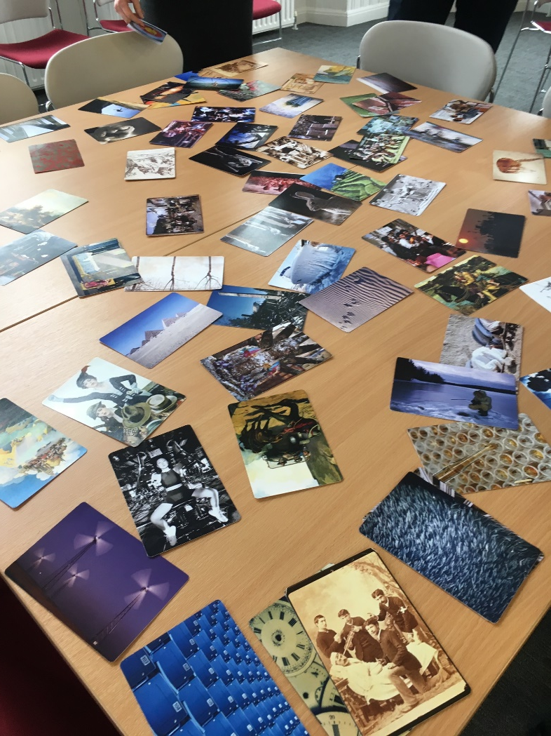
VISUAL METAPHOR CARDS
A collection of cards with different images
Used to stimulate discussion

Slide 17
WHY USE THE CARDS?
Inclusive
Creative
Expressive
Transparent
Involves everyone in discussion
Makes you think differently
Helps to articulate ideas
Clearly understood process

Slide 18
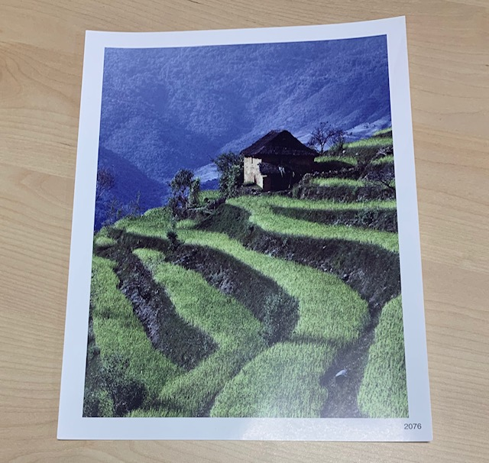
STEP 1: CHOOSE IMAGE
Ask everyone to select a picture they think symbolizes the vision they would most like to be part of creating.

Slide 19
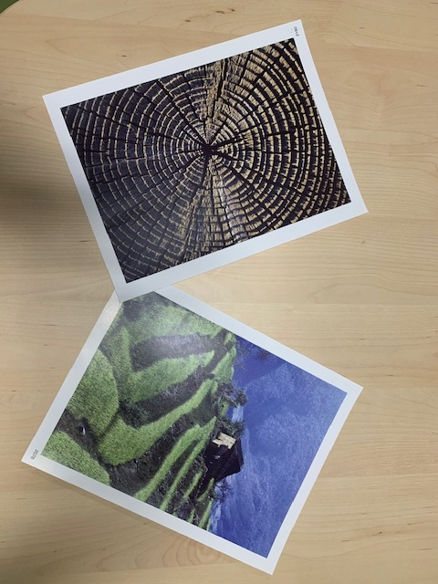
STEP 2: IN PAIRS
Ask the pairs to discuss why they have chosen their pictures and how these reflect their vision.
Ask them to agree which picture they think best describes their shared understanding.

Slide 20
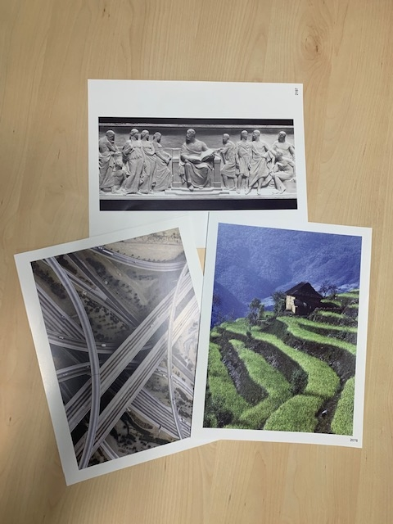
STEP 3: IN SMALL GROUPS
Repeat the same process, this time in groups of 4 or 6.
Following discussion, ask the groups to agree which picture they think best describes their shared understanding.

Slide 21
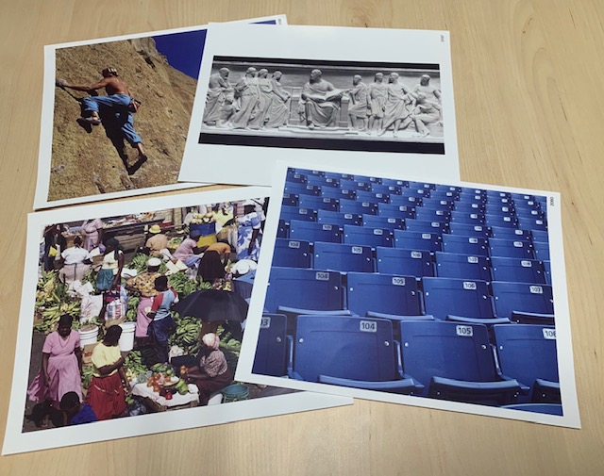
STEP 4: WITH EVERYONE
Come together as a group.
Following discussion, ask the group to agree which picture they think best represents the consensus view.

Slide 22
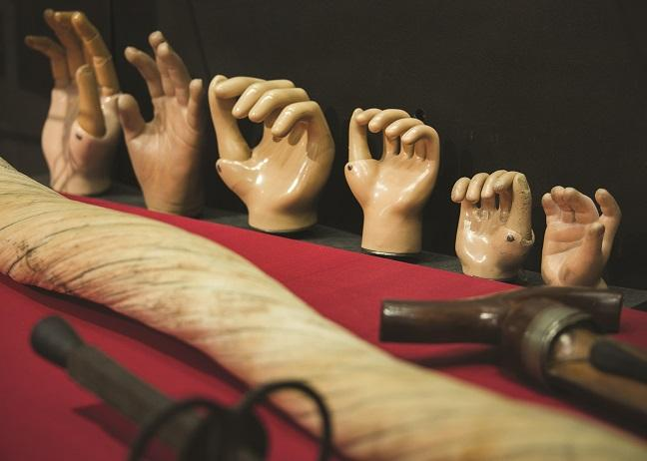
HANDY TIPS
Make it easy to view and select cards
Choose multiple cards if there are multiple elements, e.g. staff and students
Useful for all types of discussion
Provide pre-reading if required

Slide 23


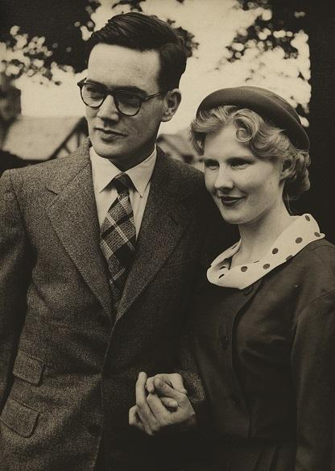
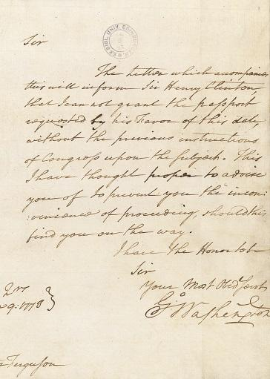

WHY NOT MAKE YOUR OWN?
Old College, completed in 1827
Romeo and Juliet, published in 1599
Noreen and Kenneth Murray, developers of Hepatitis B vaccine
Letter from George Washington, sent in 1778
https://blogs.ed.ac.uk/isintern/2018/08/07/eddie-barnes-uncovering-the-past/

Slide 24
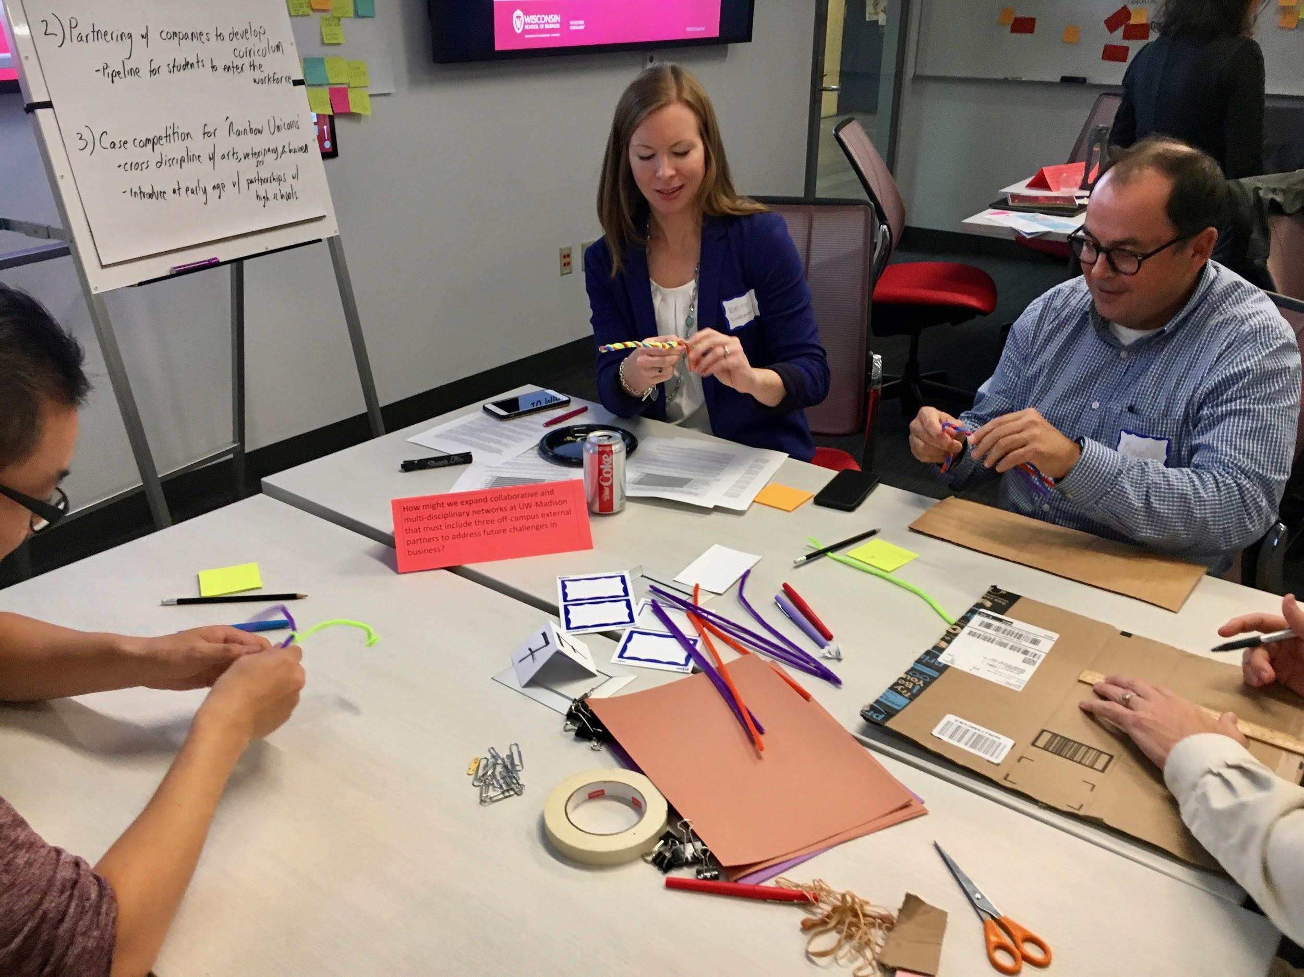
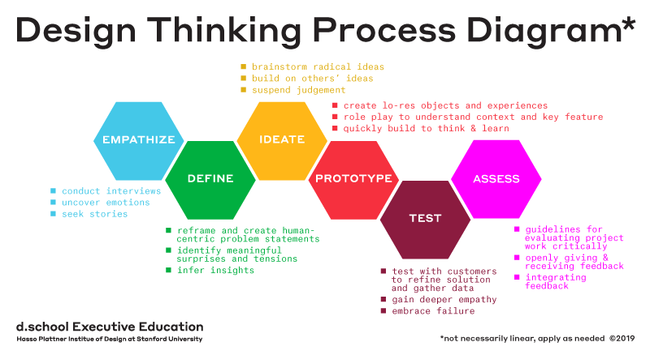
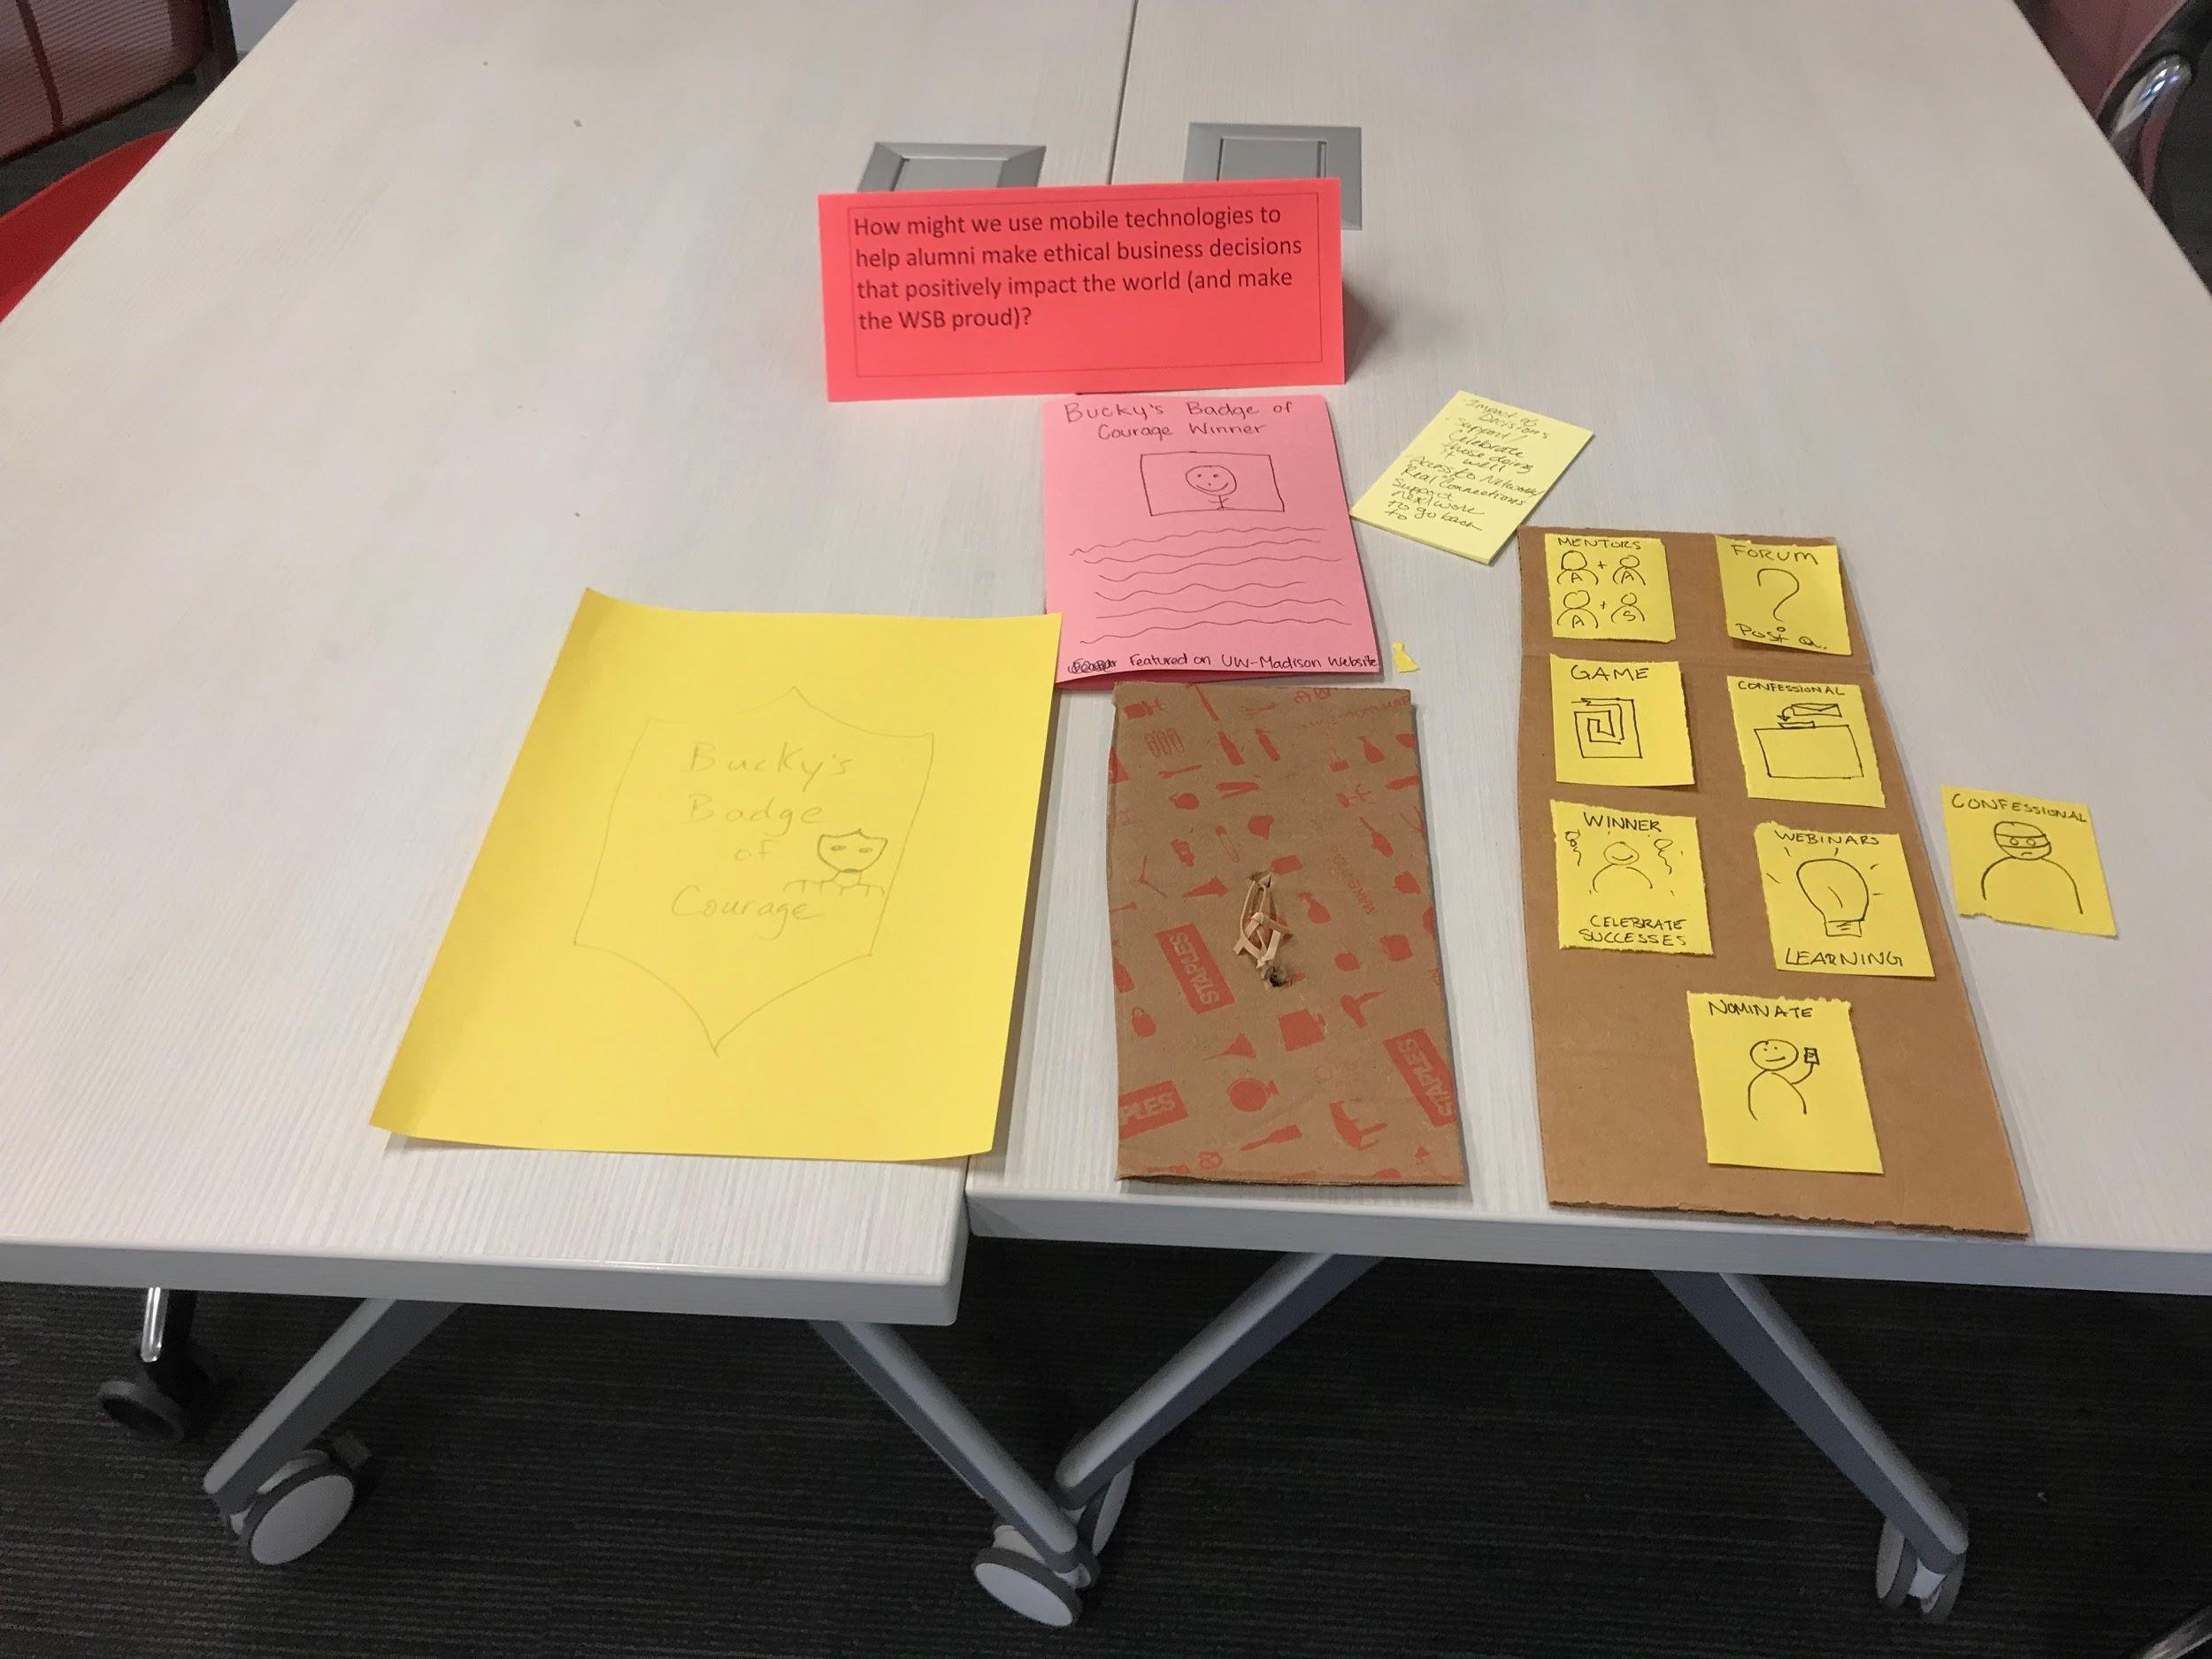
DESIGN THINKING

Slide 25
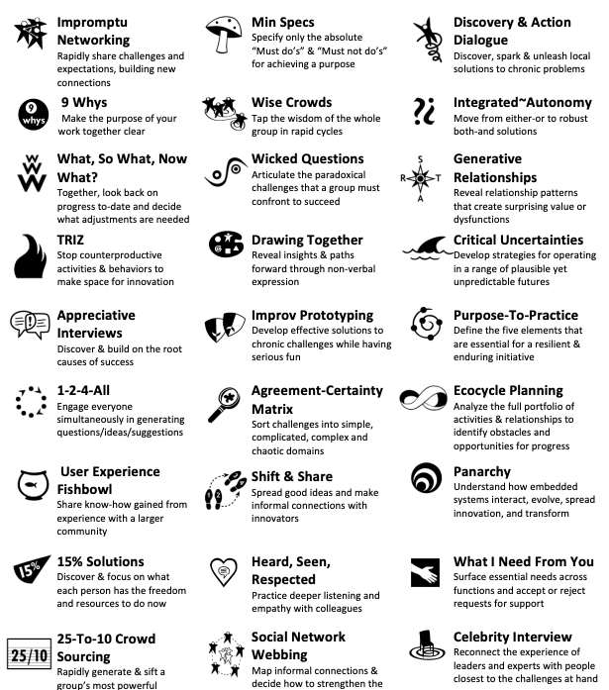
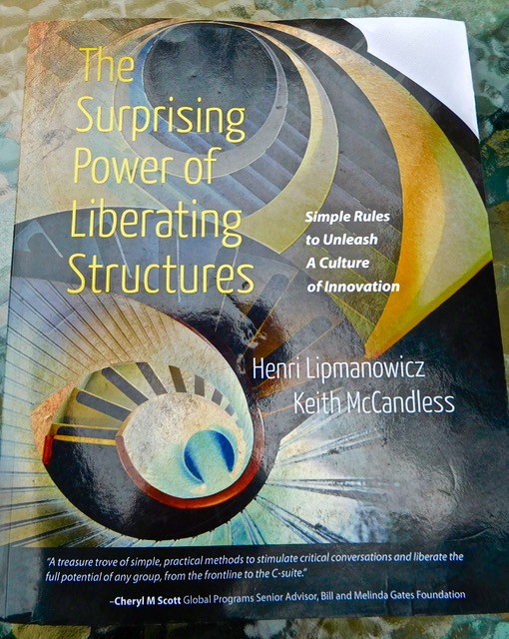
LIBERATING STRUCTURES
www.liberatingstructures.com

Slide 26
1-2-4-All
Silent self-reflection by individuals on a shared challenge, framed as a question | 1 min.
Generate ideas in pairs, building on ideas from self-reflection | 2 min.
Share and develop ideas from your pair in foursomes (notice similarities and differences). | 4 min.
Ask, “What is one idea that stood out in your conversation?” Each group shares one important idea with all (repeat cycle as needed). | 5 min.

Slide 27
How do we identify or develop people who can help manage change?

Slide 28
Identifying Skills in Others
Emotional Intelligence
Awareness (cultural ethnography)
Experience + reflection
Global mindset
Ability to seek guidance
Identify professional development
Delayed gratification

Slide 29
Identifying Skills in Others
Design Approach
Authentic learning and assessment
Evaluation
Data informed and research-based
21st century learning to enable quality teaching and learning through evidence-based faculty development and curricular planning

Slide 30
Identifying Skills in Others
Facilitation
Hold the tension of uncertainty
Patience
Recognize opportunities to add value across the organization
Effective listening, engagement and reporting out to a range of stakeholders

Slide 31
Identifying Skills in Others
Change Management
Flexibility
Navigating uncertainty
Fostering listening, trust, empathy, and capacity building
Willingness / eagerness to share expertise

Slide 32
Developing Skills in Others
Capacity to build trust, relationships, partnerships with the skill to model collaborative practices and foster capacity in others to further implementation of at-scale organizational change management strategies
Ability to communicate effectively between people with differing areas of expertise, to align pedagogical, structural, and technical objectives related to systems, processes, or human capital resources

Slide 33
Developing Skills in Others
Expert skills and methods for strategically facilitating the implementation of educational initiatives that promote effective teaching and learning practices for online, blended, and classroom instruction
High degree of Emotional Intelligence and awareness of self and of others with an ability to manage personal emotions and the emotions of others, both individually and in groups
(DoIT AT SLTC, 2019)

Slide 34
THANK YOU!

Slide 35
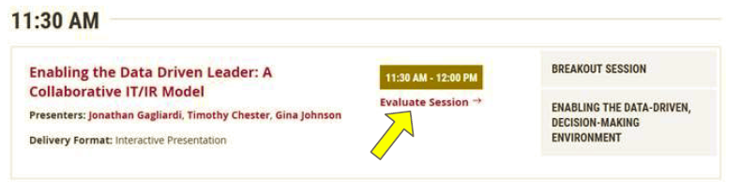
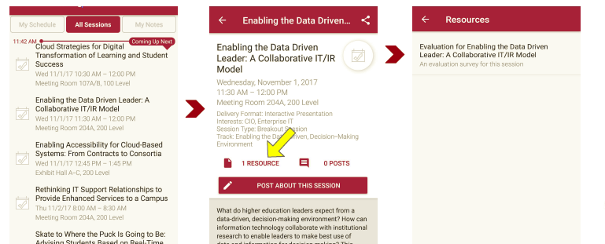
Session Evaluations There are two ways to access the session and presenter evaluations:
1
2
In the online agenda, click on the “Evaluate Session” link
From the mobile app, click on the session you want from the schedule > then scroll down or click on the associated resources > and the evaluation will pop up in the list

Slide 36
Contact Information
Rhian Davies – rhian.davies@ed.ac.uk
Ron Cramer – ron.cramer@wisc.edu
Blaire Bundy – blaire.bundy@wisc.edu
NOTE: This presentation leaves copyright of the content to the presenter. Unless otherwise noted in the materials, uploaded content carries the Creative Commons Attribution 4.0 International (CC BY 4.0), which grants usage to the general public, with appropriate credit to the author.

Slide 37
Citations
Brophy, M. (2006). A grounded theory of leadership practices that contribute to the development and implementation of successful academic programs. Doctoral Dissertation. University of Wisconsin-Madison. Duderstadt, J. (2000). A university for the 21st century. Ann Arbor, MI: University of Michigan Press. Eckel, P., & Kezar, A. (2003). Taking the reins: Institutional transformation in higher education. Westport, CT: American Council on Education and Praeger Publishers. Diamond, J. (2005). Collapse: How societies choose to fail or succeed. New York: Viking Penguin. Walvoord, B.E. & Casey, A. K. (2001). Academic departments: How they work, how they change. San Francisco: Jossey-Bass.

