Slide 1
Organizational Silos Don’t Break them Connect them
Notes:
Can anyone relate to sending an email to a department, such as HR, and not hearing back? Is the person I emailed on out sick, on vacation, do they even work here anymore? I see some nodding heads, I’m sure we can all relate.
We partnered with HR and listened to their concerns and the concerns of our employees. There was a lot of shopping around taking place. Meaning users would call person to person in HR until someone answered the phone. In the meantime, the first person they called may have called back and provided an entirely different answer. There was a disconnect between users and what was happening in the background because there was not transparent communication. There were also the dreaded paper approvals which shuffled from office to office waiting signatures.

Slide 2
Silos: The Good And Bad
Silos, why do they exist
We build them as we build our organizations
Part of a natural progression
Build divisions, departments
We build them into projects
Task teams
Developers
Testers
Trainers

Slide 3
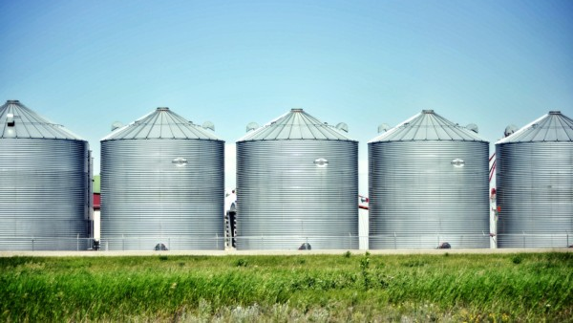
Where Silos Breakdown
Lack of information being shared by a department/team
Information is shared up and down and not outward
Lack of synergy

Slide 4
Problems
Communications
How process work?
Who makes decisions?
Who is responsible for what?
Status Updates?
Transparency
What is the department doing?
Where are the request coming from?
Who is doing the work?
What services my department provide
How to access services

Slide 5
What is ITSM?

Slide 6
ITSM Best Practices
Reporting
Managing work
Workflows – Approvals
Tracking
Requests
Incidents
Projects
Assets
Tracking incidents
Customer Satisfaction
Timeline breakdown

Slide 7
Why ESM?
Catalog of Services
Manage work
Workload
Reports
Digitize Workflows
Collect data
Finding gaps/trends
Transparency

Slide 8
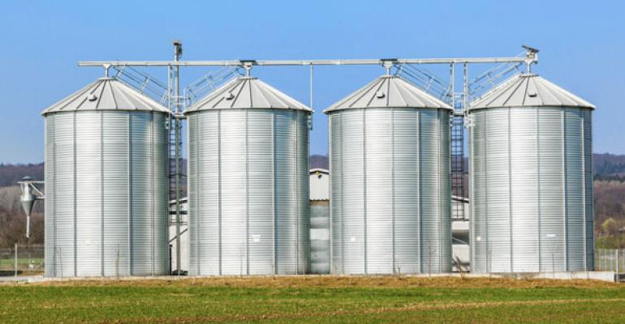
Unified Communications
Implemented a suite of collaborative tools that cross functional team to use to:
Chat, Both asynchronously and synchronously
Whiteboarding
Document collaboration
Teleconferencing
Document storage

Slide 9
Partnerships

Slide 10
Development
Guidance
Provide consultation assistance
Find best ways to meet their needs
Determine best available tool/system
High-level outcomes
Transparency
Understand their work
Short path for information
Data collection

Slide 11
After Implementation

Slide 12
Example
Phase approach
Fast results for the team
Customers Self-Service
Workload improvement across the department

