Slide 1
Journeys to cultivate a “One IT” culture
Today’s speakers:
James Dudek, Employee Experience Lead & Senior Organizational Strategist – University of California, Berkeley
Cathy Curley, CIO – College of Literature, Science, and the Arts, University of Michigan

Slide 2
Case Study: Creating “One IT” at Berkeley
Definition of “One IT”
How to Begin
Governance
Where are we now?

Slide 3
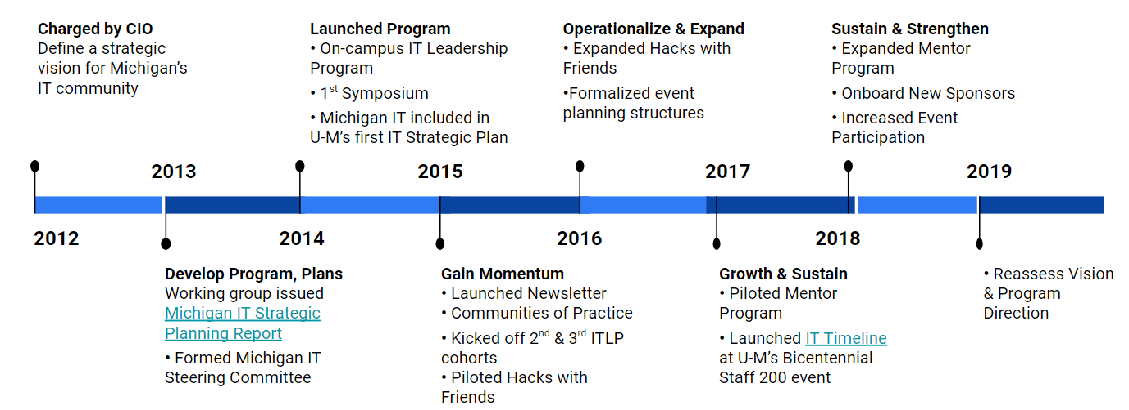
Michigan IT: A Brief History

Slide 4
Michigan IT Vision
Collaboratively providing unparalleled IT services that constantly adapt to best meet evolving campus needs.

Slide 5
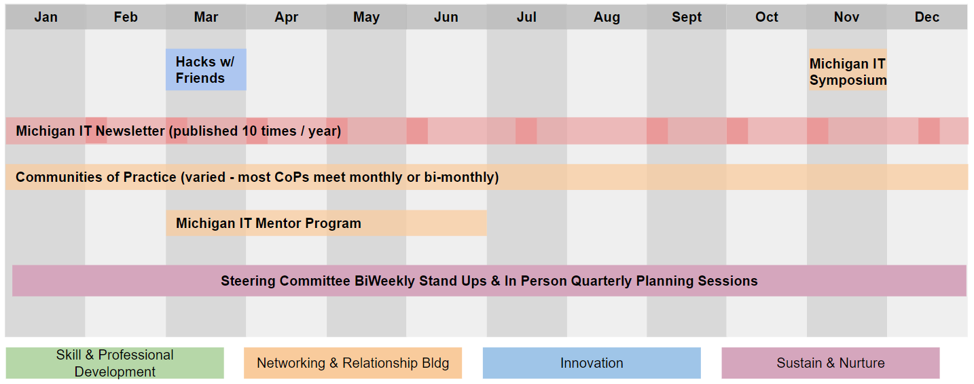
Michigan IT Annual Event Schedule

Slide 6
Value & Results

Slide 7
Time to Reassess our Vision
What are tomorrow’s challenges that we need to be better prepared for?
What should our community of Michigan technology leaders be working together towards so that Michigan can achieve its goals?
In the era of technology consumerism, how can we be a more inclusive community?

Slide 8
“One IT” Recommendations
Solving complex problems is easiest when relationships are a strong foundation
Leverage the people and grass roots enthusiasm to lead
Make it easy for Executive Sponsors to support

Slide 9
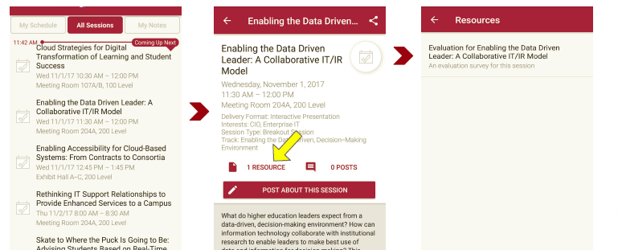
Session Evaluations There are two ways to access the session and presenter evaluations:
1
2
In the online agenda, click on the “Evaluate Session” link
From the mobile app, click on the session you want from the schedule > then scroll down or click on the associated resources > and the evaluation will pop up in the list

Slide 10
Contact Information
Connect with us via BrainDate
Leading and Partnering Across the Institution
Keywords: Collaboration, One IT, Partnering
James Dudek – jdudek@berkeley.edu
Cathy Curley – cacurley@umich.edu
NOTE: This presentation leaves copyright of the content to the presenter. Unless otherwise noted in the materials, uploaded content carries the Creative Commons Attribution 4.0 International (CC BY 4.0), which grants usage to the general public, with appropriate credit to the author.

