Slide 1
Course Design as Learning Analytics Variable – and Intervention
John Fritz & Tom Penniston
University of Maryland, Baltimore County (UMBC)
Educause Lightning Round
Oct. 15, 2019
Notes:
John

Slide 2
An Issue -- And Opportunity?
We think we know that . . .
LMS course design is related to higher student LMS usage.
Higher student LMS usage is related to better student outcomes.
However, we cannot yet establish that . . .
LMS course design is related to better student outcomes (i.e., an “intervention”).
Does faculty use of the LMS not matter to student success?
Notes:
John

Slide 3
How Faculty Use an LMS
User & Document Management
Auto course creation and enrollment
Password-protected class & group space
Attach or Copy/Paste Documents, perhaps with expiration dates.
Interactive Tools
Announcements
Email, Messages
Discussion & Chat
3. Assessments
Electronic assignment delivery & collection
Quizzing, surveys, online grade center.
Adaptive release of content based on prior action or grades.
Literature & Practice
J. Campbell, 2007
Dawson et al., 2008
Macfadyen & Dawson, 2012
Whitmer, 2012
Fritz, 2013
Fritz & Whitmer, 2017
Notes:
John

Slide 4
July 28, 2018
blog.blackboard.com/combining-data-to-improve-student-success-predictions
Notes:
John

Slide 5
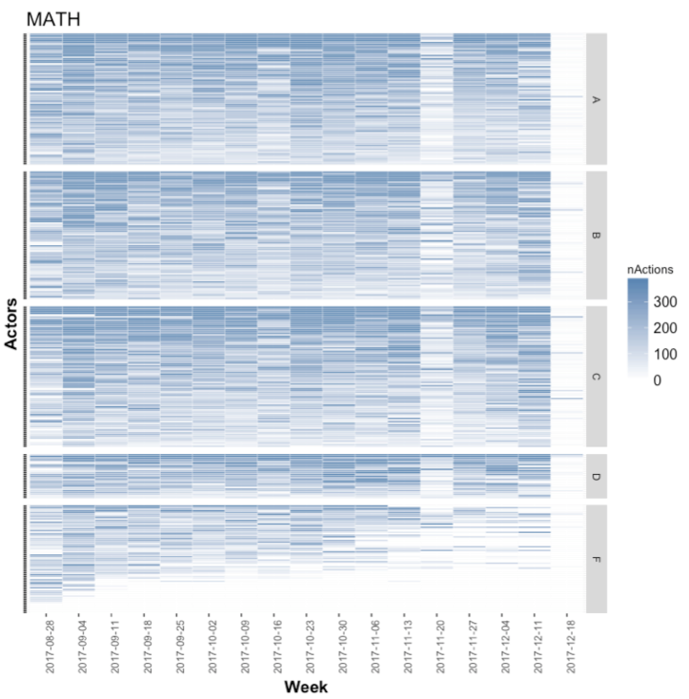
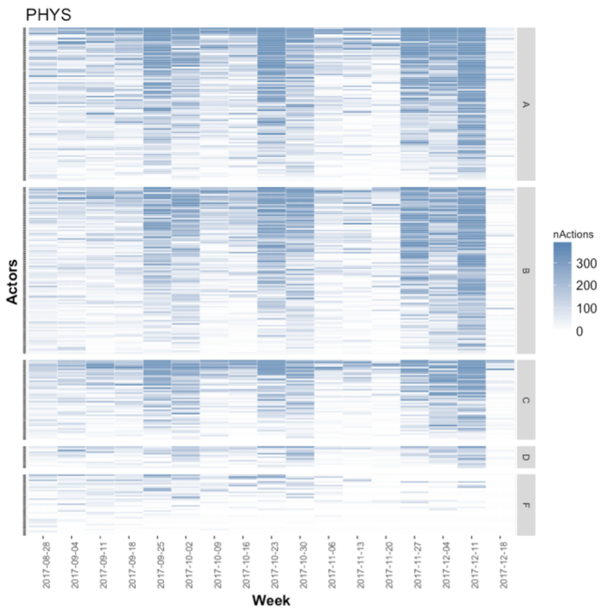
A Key Finding: Student Tool Use & Final Grade Varies by Class
Notes:
John

Slide 6
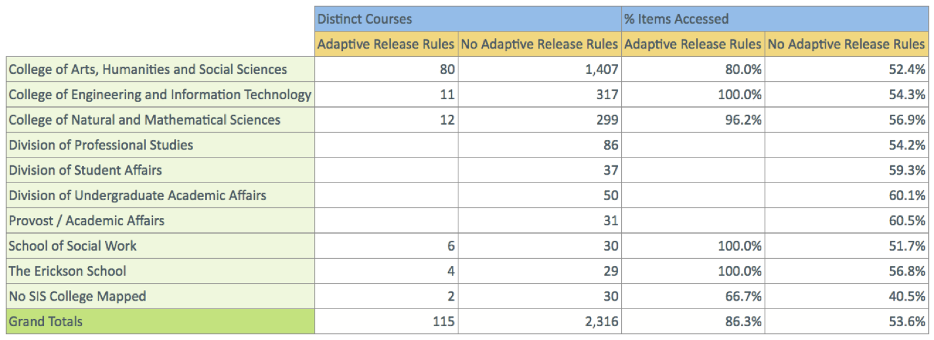
UMBC Adaptive Release Usage (2015)
Notes:
John

Slide 7
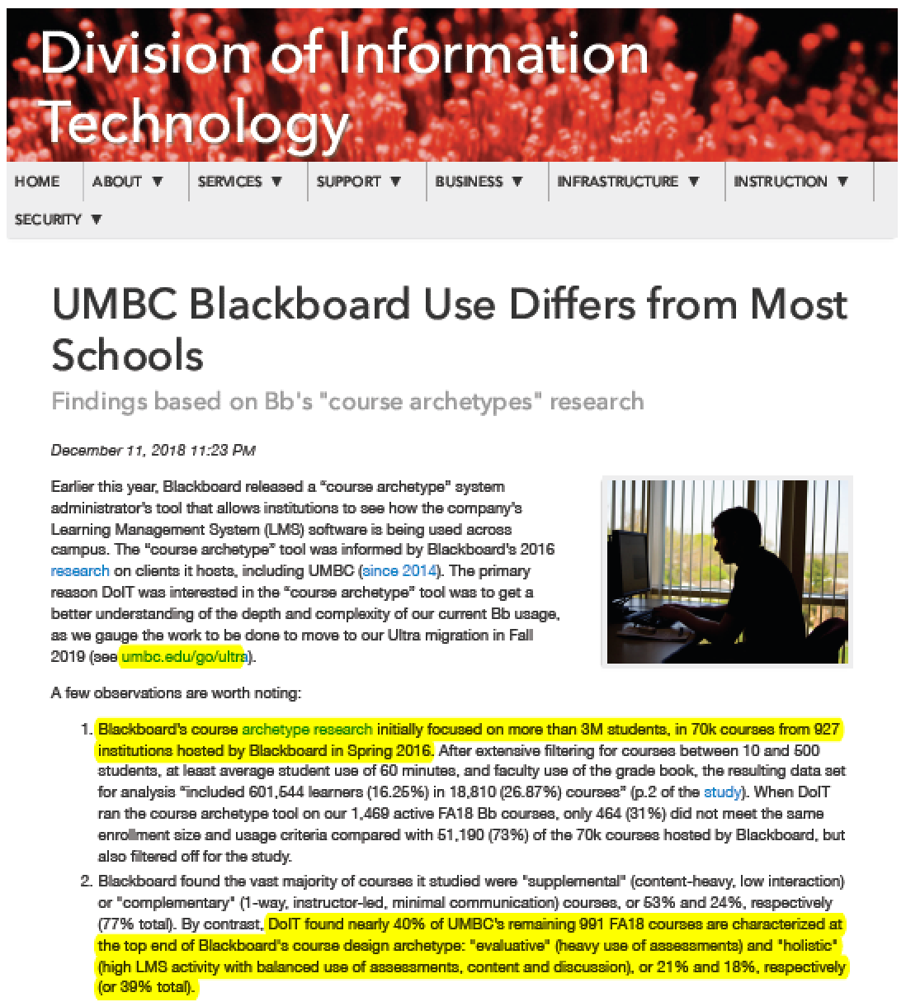
Bb Course Archetypes
https://doit.umbc.edu/news/?id=80996
Whitmer, J., Nunez, N., Harfield, T., & Forteza, D. (2016). Patterns in Blackboard Learn tool use: Five Course Design Archetypes [Blackboard Blog]. Retrieved from https://www.blackboard.com/images/21/Bb_Patterns_LMS_Course_Design_r5_tcm21-42998.pdf
Notes:
Tom
Holistic 3x
Key point: UMBC’s Holistic & Evaluative courses (39%) are 3x Blackboard’s (12%)

Slide 8
Mean DFW Rates (Course #) by Course Archetype
Archetype | All Courses | Upper Divisional | >Median Enrollment | >90% Enrollment
Supplemental | 11.01 (852) | 9.48 (522) | 11.85 (425) | 15.17 (60)
Complementary | 11.15 (1,004) | 8.76 (607) | 11.56 (534) | 15.51 (107)
Social | 9.26 (147) | 6.73 (110) | 8.62 (12) | NA
Evaluative | 8.93 (508) | 7.89 (329) | 9.66 (238) | 12.77 (38)
Holistic | 12.83 (645) | 8.84 (348) | 14.10 (374) | 17.50 (119)
Unknown | 7.7 (167) | 9.88 (83) | 7.11 (66) | 12.76 (4)
Notes:
Tom
Key points: This represents 3 terms (FA17, SP18 & FA18). Caution: Don’t get sucked into the weeds.

Slide 9
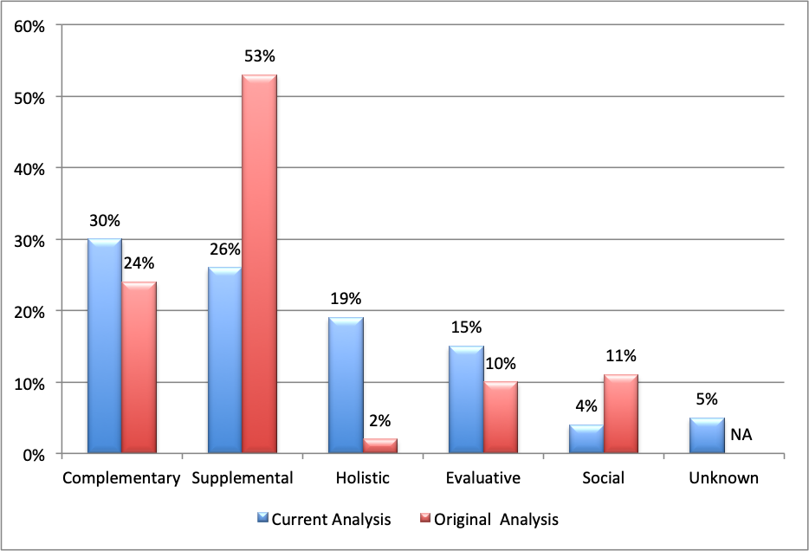
Current and Original Archetype Distribution
Notes:
Tom

Slide 10
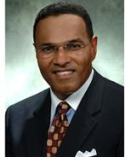
Redefining Student Success
“Student success is not only passing a course, but also passing the next one that requires it.”
Freeman A. Hrabowski, III President, UMBC
Notes:
Tom

Slide 11
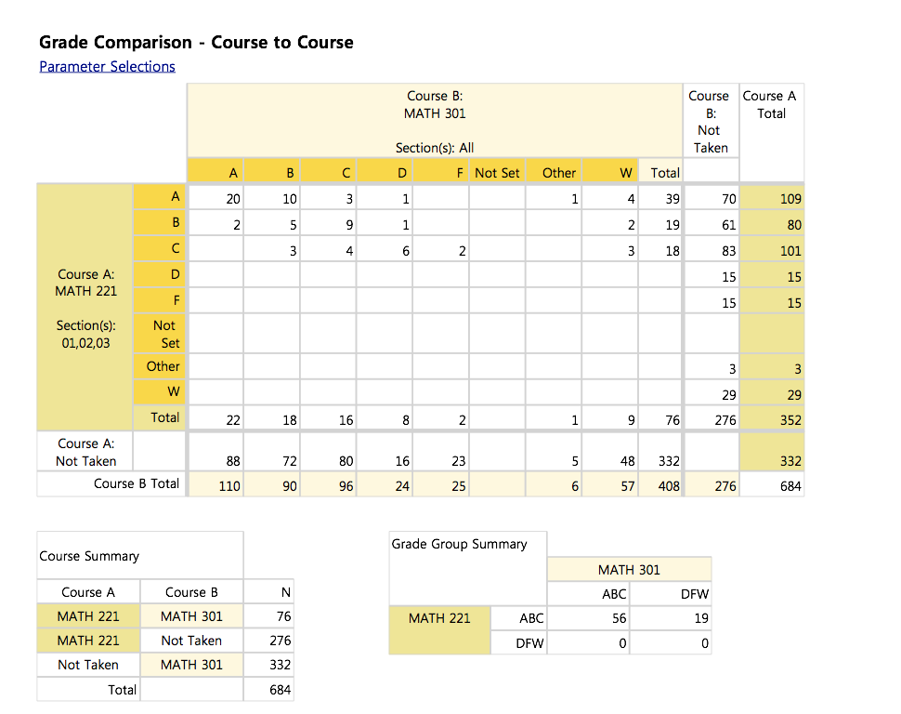
Notes:
Tom

Slide 12
Testimonial
“We are really excited about this report - it has helped justify changing our pre-requisites and we have also been able to look at teaching strategies which proved most effective for the success of students in a follow up course.”
Taryn Bayles, Prof. of the Practice, Chem. Engineering
Notes:
Tom

Slide 13
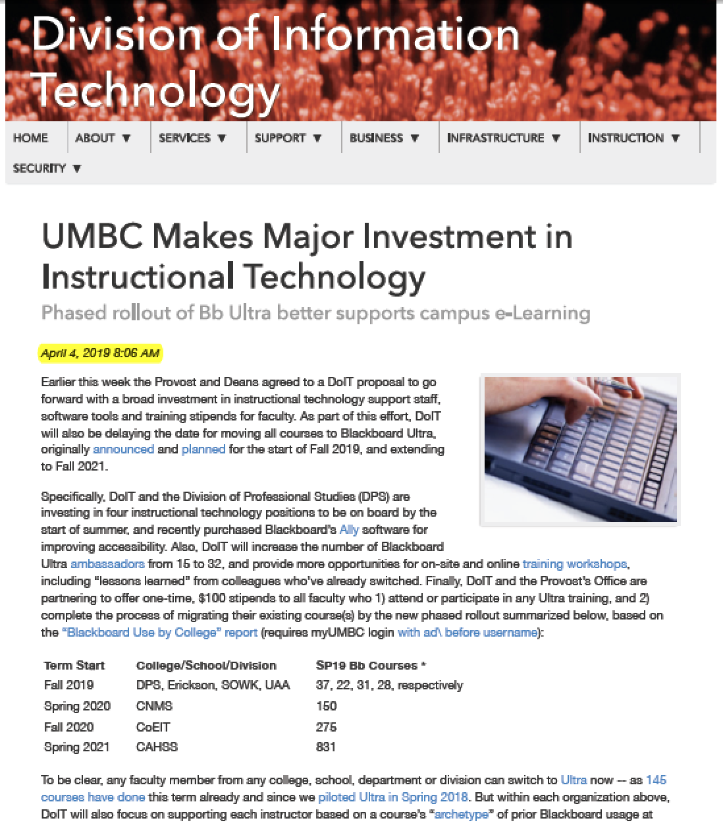
Phased Rollout
https://doit.umbc.edu/itnm/?id=83448
Getting the word out:
FacSen: 4/5/19
UPDs: 4/16-17/19
IT Steering: 4/19/19
UMBC Bb Update: 5/9/19
USG Program Dirs.: 5/16/19
FA19 Inst. Tech Update: 8/20/19
FacSen: 9/10/19
GPDs: 9/11/19
Discussed at AY18-19 FacSen CPC Mtgs.
tinyurl.com/umbcfacsencpc

Slide 14
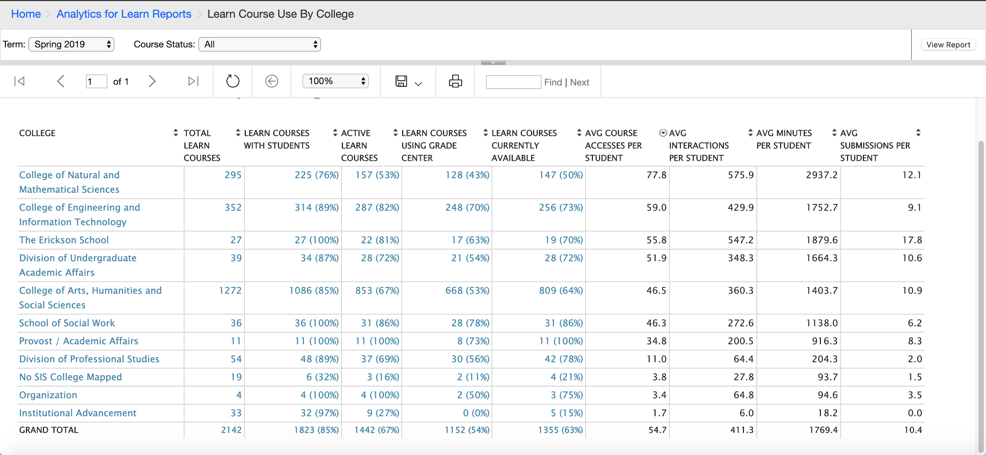
Student Bb Use Always Highest in CNMS Courses
Notes:
John

Slide 15
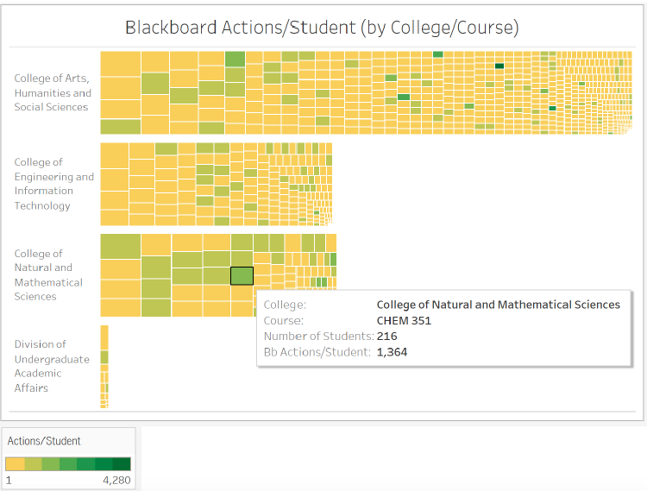
Why is CNMS Student Bb Use So High?
The tree map shows all courses in each college (box size = number of students/course, SP19)
Greener box mean more actions/student per course.
CNMS has relatively more green boxes due to CHEM, BIOL, PHYS that use quizzes/assessments.
Other colleges have relatively fewer green courses as well as other courses that “weigh down” avg. number of actions/student.
Notes:
John

Slide 16
How faculty beliefs about their teaching evolve
Egocentrism — focusing mainly on their role as teachers
Aliocentrism — focusing mainly on the role of learners
Systemocentrism — focusing on the shared role of teachers and learners in a community
Robertson, D. L. (1999). Professors’ perspectives on their teaching: A new construct and developmental model. Innovative Higher Education, 23(4), 271–294. https://doi.org/10.1023/A:1022982907040
Notes:
John
If this evolution of belief and practice occurs among teachers, Robertson identified telltale signs of the transformation. First, as faculty move from one stage to the next, they bring the benefits and biases of the previous stage. Second, they typically change their beliefs and practices only when confronted by the limitations of a current stage, which is brought about by "teaching failures." Finally, their desire for certainty, stability, and confidence either keeps faculty frozen in a status quo framework or drives their evolution into the next stage in an effort to avoid a paralyzing and stagnant neutral zone consisting of "a familiar teaching routine that they have deemed inappropriate and with nothing to replace it."

Slide 17
Conclusions
A good farmer first salts the horse’s oats.
Nobody learns from a position of comfort -- including faculty?
Course design can be the most scalable form of institutional intervention (e.g., afflict the comfortable and comfort the afflicted).
Notes:
John

Slide 18
Questions?

