Slide 1
Predictive Models for Students: Ethical and Practical Considerations
Anna Smith, Jane Russell, Nick Seedorff

Slide 2
Predictive Models in Educational Settings
Primary focus on identifying at-risk students
Poor performance (Chui et al., 2018; Hu et al., 2014; Lakkaraju et al., 2015)
Drop out (Duarte et al., 2014)
Audience of instructors and advisors
Demographics
LMS Activity
Black-Box
Pass/Fail,
Retention
Performance
Prior Learning

Slide 3
Two Approaches
Elements of Success
Predictive Models
Demographics
Performance
Grade Dist
Current Standing
LMS Activity
Black-Box
Predicted
Grades
Performance
Prior Learning

Slide 4
Objectives
Evaluate accuracy of the two approaches
Examine the ethical and practical considerations
Accuracy within a Letter Grade (Week 5)

Slide 5
Performance: Correct Letter Grades

Slide 6
Performance: Major Error

Slide 7
Grade “Prediction” Frameworks
Predictive Models
Elements of Success
Substantial overhead for developing framework
Likely to offer superior performance early in the semester
Not a direct link between performance and prediction
Straight forward given student points and grade distribution
Training/Testing Data
Canvas
EoS
SIS

Slide 8
Conclusions
The best ML model outperformed EoS early in the semester
Best models contained prior learning variables
EoS (Current Standing) performed well later in the course
Offers a “current standing” message

Slide 9
References
Y.H. Hu, C.L. Lo, S.P. Shih. Developing early warning systems to predict students' online learning performance. Computers in Human Behavior, 36 (2014), pp. 469-478
H. Lakkaraju, E. Aguiar, C. Shan, D. Miller, N. Bhanpuri, R. Ghani, et al. A machine learning framework to identify students at risk of adverse academic outcomes. Proceedings of the 21th ACM SIGKDD international conference on knowledge discovery and data mining (2015), pp. 1909-1918
R. Duarte, A. Ramos-Pires, H. Gonçalves. Identifying at-risk students in higher education. Total Quality Management and Business Excellence, 25 (7–8) (2014), pp. 944-952

Slide 10
Questions?

Slide 12
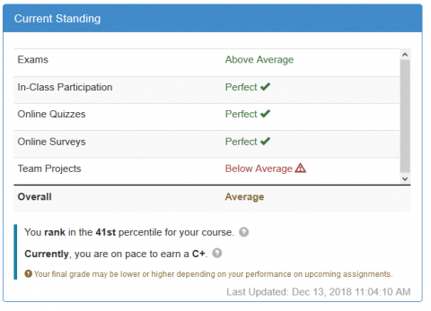
Elements of Success
Gives students estimated grades based on their current standing

Slide 13
Course 1: Correct Letter Grades

Slide 14
Grade “Prediction” Frameworks
Predictive Models (ML)
Elements of Success
Gradient boosted machines (XGBoost) to predict scores for a new semester
Created four models with different subsets of features
Uses current standing in the course and the grade distribution to estimate grades
Performance
Grade Dist
Current Standing

Slide 15
Introduction
Background info
Objectives
Results
Ethical and Practical Considerations
Conclusions

Slide 16
Courses
Course 1
Course 2
First year seminar
Training Data: N > 500
Testing Data: N > 200
Second year seminar
Training Data: N > 250
Testing Data: N > 200

Slide 17
Feature Sets
Demo
Gender
Ethnicity
Parents' education
State of residence
Simple
Within course data
Current percent
exam scores
Webpage usage
Full
Simple +
Demo +
Prior
Prior
HS GPA/Rank
UIowa GPA
ACT
ACT subscores

Slide 18
Grade Prediction Procedure
Train a regression model (XGBoost) using historic data (Fall 2018)
Outcome is percent in the course
Fall 2018
Data
Algorithm
Trained Model
2. Apply model to new data (Spring 2019) to get percentages
3. Rank students based off predicted points
4. Apply scores to the specified grade distribution
Spring 19
Data
Model
Predicted Percent
Rank
Predicted Ranks
Distribution
Predicted Grades

Slide 19
Feature Sets
Simple
Within course data
Current total, exam scores, gradebook and EoS usage
Demographics (Demo)
Simple features + Demographics
Gender, ethnicity, parents' education, state of residence
Prior Learning (Prior)
Simple + prior learning variables
HS GPA, HS Class Rank, UIowa GPA, ACT, ACT subscores
Full
Simple + demographic + prior learning variables

Slide 23
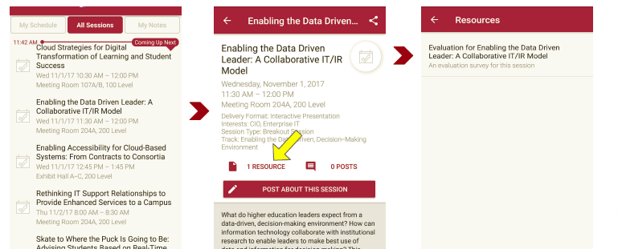
Session Evaluations There are two ways to access the session and presenter evaluations:
1
2
In the online agenda, click on the “Evaluate Session” link
From the mobile app, click on the session you want from the schedule > then scroll down or click on the associated resources > and the evaluation will pop up in the list

Slide 24
Contact Information
NOTE: This presentation leaves copyright of the content to the presenter. Unless otherwise noted in the materials, uploaded content carries the Creative Commons Attribution 4.0 International (CC BY 4.0), which grants usage to the general public, with appropriate credit to the author.

