Slide 1
Increase Faculty Adoption of Learning Analytics in Teaching and Learning
Jae-eun (Jane) Russell, University of Iowa
Sean DeMonner, University of Michigan
Jason Kaetzel, Indiana University

Slide 2
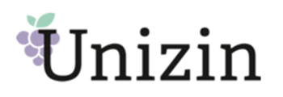
Power of Big Data and Consortium Approach
Control over Learning Data
Common Data Model
Share Strategies

Slide 3
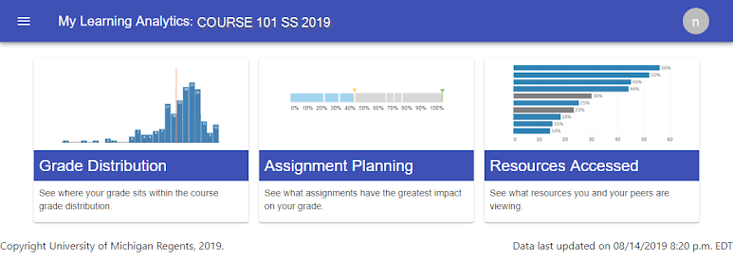
Appropriately skeptical faculty culture
Faculty & student change management is different
Efficiency vs. effectiveness propositions

Slide 4
Faculty Visualizations
Aggregated Demographics
Interaction Summary
Module Progression
Providing faculty views not previously seen
Collecting and presenting in one place
Visualizing how students are moving through modules

Slide 5
Supporting faculty in data-informed decision making
Saving faculty administrative time
Supporting faculty LA Community of Practice

Slide 6
Questions & Resources
Contacts:
Jane Russell, University of Iowa jae-russell@uiowa.edu
Sean DeMonner, University of Michigan demonner@umich.edu
Jason Kaetzel, Indiana University jkaetzel@iu.edu
Resources:
Unizin Data Platform: docs.udp.unizin.org
Common Education Data Standards Model: https://ceds.ed.gov/dataModel.aspx
Unizin Consortium: https://unizin.org
Additional Session:
5 Ways to Create a Fail-Proof Data Warehouse for Student Success
Room: W184BC, LEVEL 1, 2:15 pm CT

