Slide 1

Getting 100,000 University
Community Members to
Use Two-Factor
Office of the Vice President for Information Technology and Chief Information Officer
Information and Technology Services
Kyle Cozad
Business Systems Analyst Senior
Identity and Access Management
Dana Fair
Senior Marketing Communications Specialist
Communications Team
Notes:
Introduction

Slide 2


Overview for This Section
Getting to Know U-M
Identifying the Problem
Developing the Solution
Managing the Culture
Driving Toward the Finish

Slide 3

Getting to Know U-M
Ranked #3 Top Public University (2020)
64,500 students
  19,000 student employees
13,000 faculty | 56,000 staff
  2,500 IT staff
12,000 sponsored affiliates
Ann Arbor (main campus)
  Satellite campuses: UM-Dearborn and UM-Flint
  Health system: Michigan Medicine

Slide 4
Identifying the Problem
What problem was U-M trying to solve?

Slide 5

Being Clear About the Problem
The university’s data and digital assets, and the personal information of university community members needed better protection
University community members needed to act differently toward IT security
Notes:
To better protect the university’s data and digital assets, and the personal information of university community members
To get university community members to act in a different way toward IT security (change management)

Slide 6
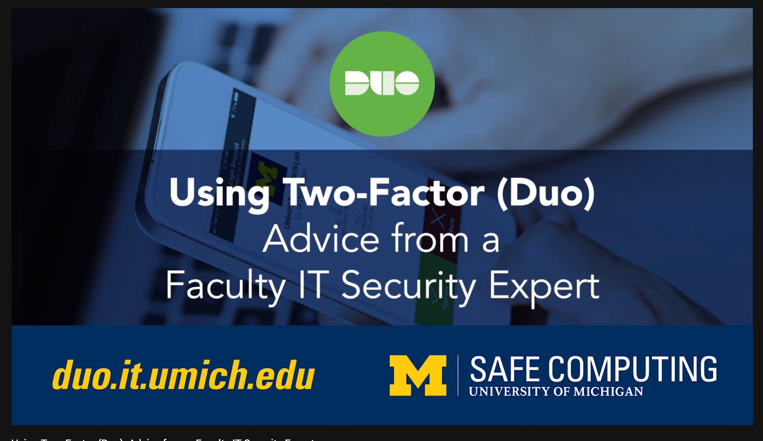
Developing the Solution
How did U-M go about solving the problem?

Slide 7

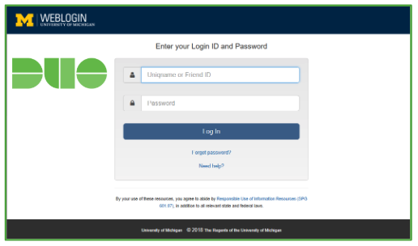
Started with the Desired Goal in Mind
Turn on Two-Factor
for Weblogin
Enhance the U-M IT security posture by getting over 100,000 faculty, staff, student employees, and sponsored affiliates to undertake and/or accept a common action by Jan 20, 2019:
(Timeline – 8 months from concept to completion)

Slide 8
Worked Toward Achieving the Goal
Understanding each group at a macro and micro level
  Doing an audience analysis
Identifying opportunities for improving user experiences
  Empaneling an advisory group
Engaging with university users and stakeholders
  Identifying perceived barriers and addressing them

Slide 9
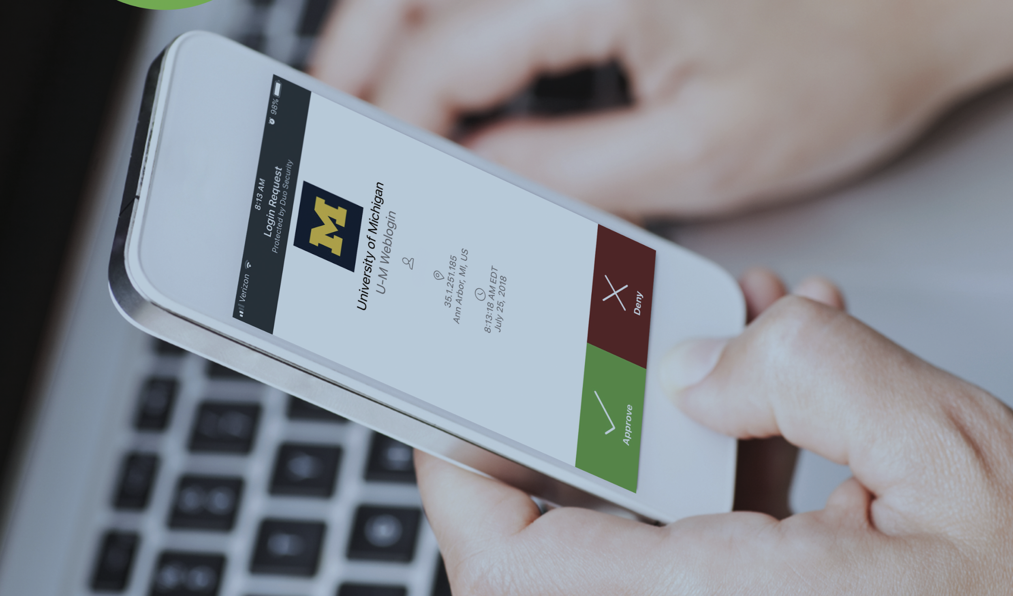
Worked Toward Achieving the Goal
Changing IT operations and materials where needed
  Being flexible and adaptable to reduce impediments
Communicating the benefits
  Sending targeted emails & increasing the pressure, while making it easy

Slide 10
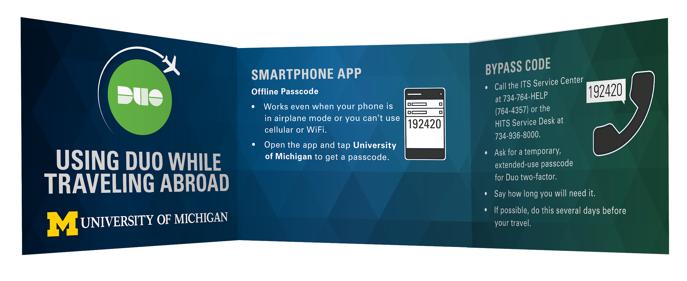
Managing the Culture
How did U-M leverage the culture to achieve its goal?

Slide 11
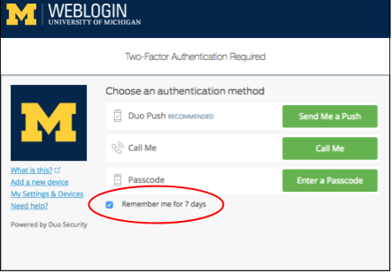
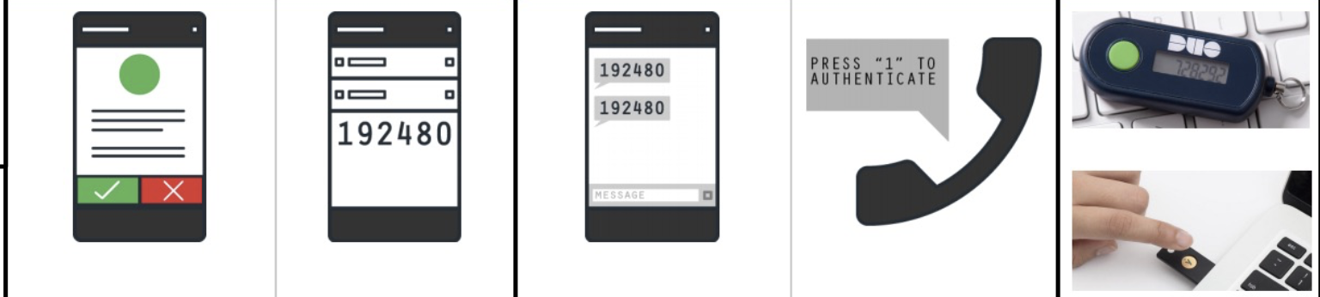
Gave Users What They Needed and Wanted
1-click Enrollment App
7-day Remember Me
Authentication Options
Phone push
Phone call
Codes
Tokens
YubiKeys

Slide 12
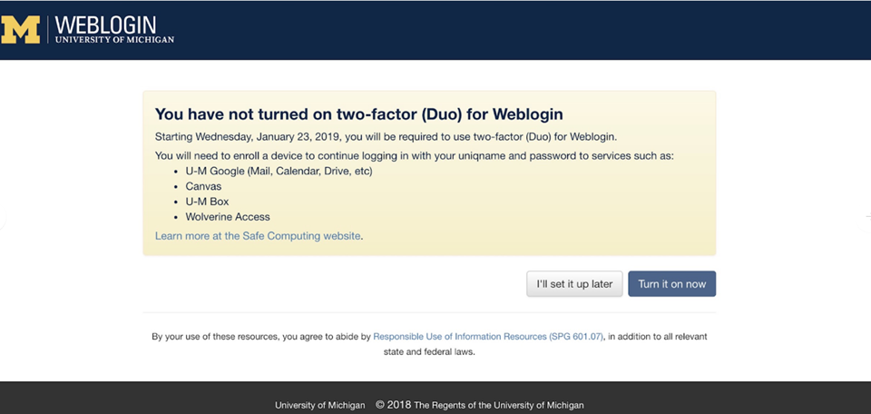
Got in Front of Those Who Hadn’t Complied Yet
Interrupt Screen
The University’s Weblogin

Slide 13
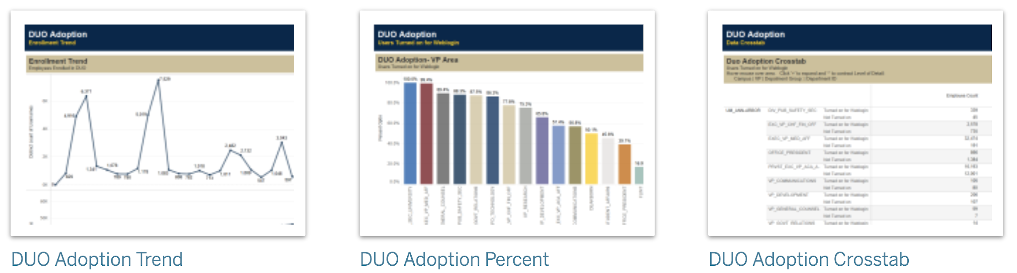
Created Friendly Competition Among Leaders
Duo Dashboard
Tableau Server

Slide 14
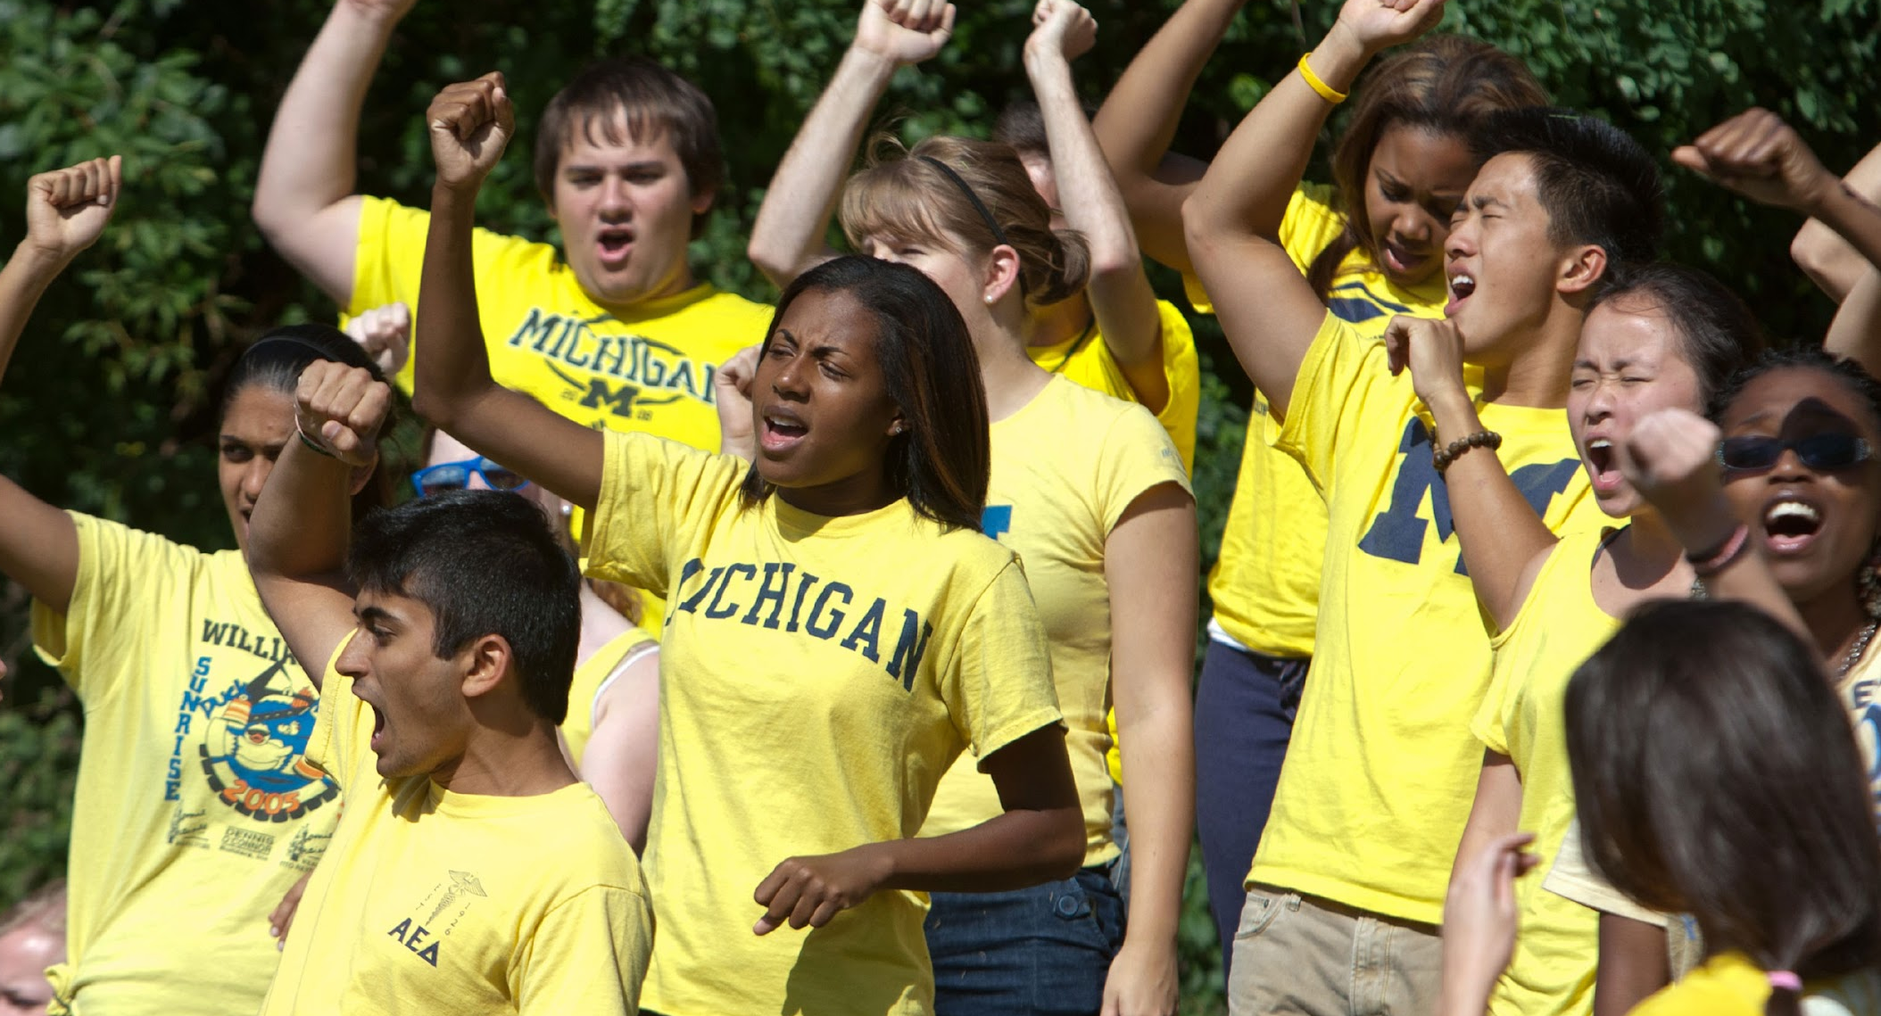
Driving Toward the Finish
Working to get all students to use two-factor by Jan 29, 2020

Slide 15


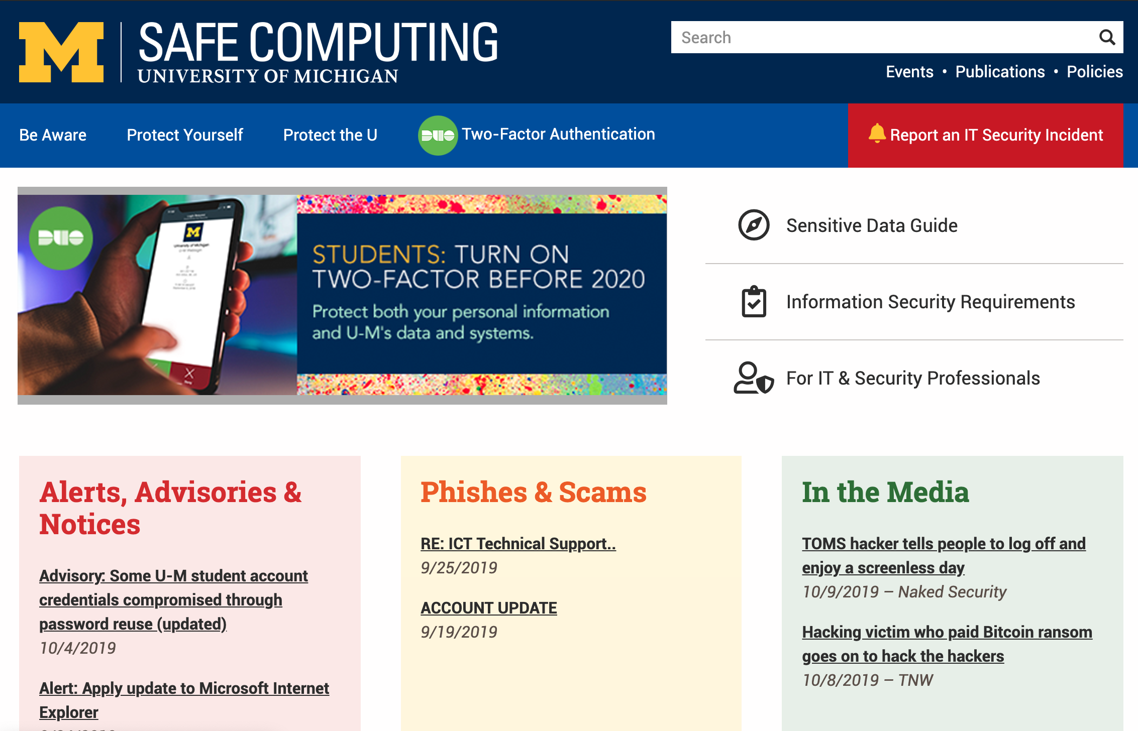
safecomputing.umich.edu
Visit the Information Assurance Website
Please take whatever might be useful for your institution
duo-feedback@umich.edu

