Slide 1
AI-based Virtual Assistants Improve Life on Campus
Lightning Round: Transforming the Student Experience
noHold Inc. © 2019

Slide 2
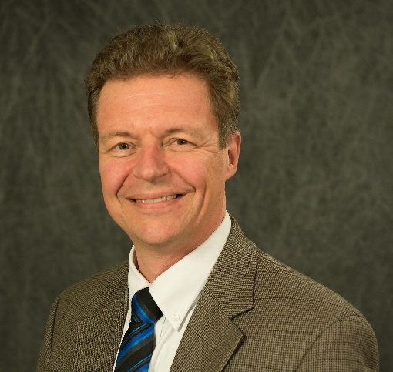
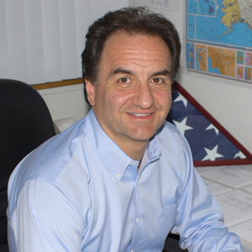
The Speakers
Borre Ulrichsen
CIO at Gonzaga University
Diego Ventura
CEO at noHold, Inc.

Slide 3
Gonzaga Project Goals
A limited up-front investment in Artificial Intelligence Proof of Concept (Low Risk)
Decrease tickets through self-service (Positioning)
Increase end user satisfaction (Content Maintenance)
Capture the voice of the student/staff (Metrics)

Slide 4
Surveyed Students
Students participating have been attending school 1 to 5 years for various Majors.

Slide 5
Results
Overall the Virtual Assistant concept received an average helpfulness rating of 3 out of 4.

Slide 6
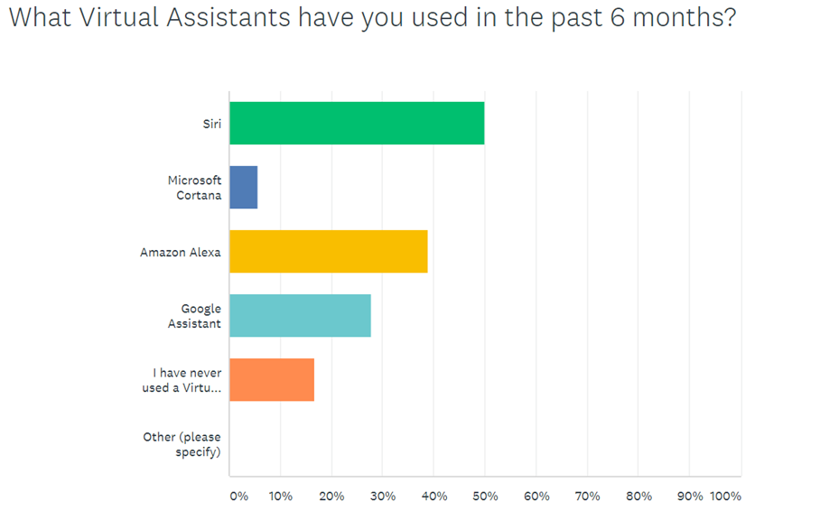
Results

Slide 7
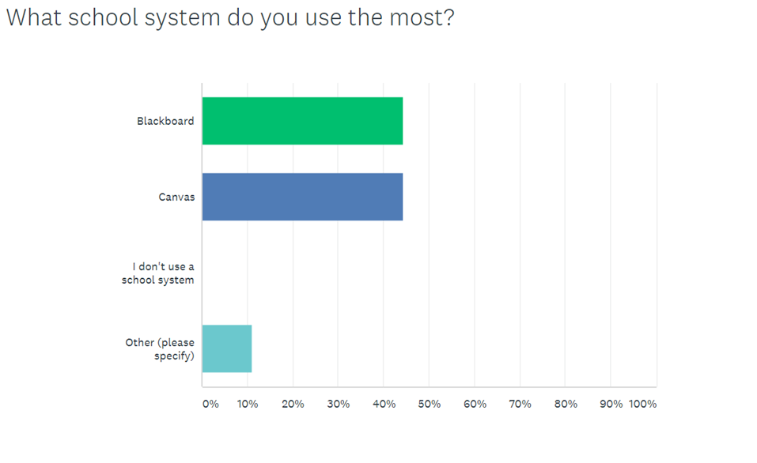
Results

Slide 8
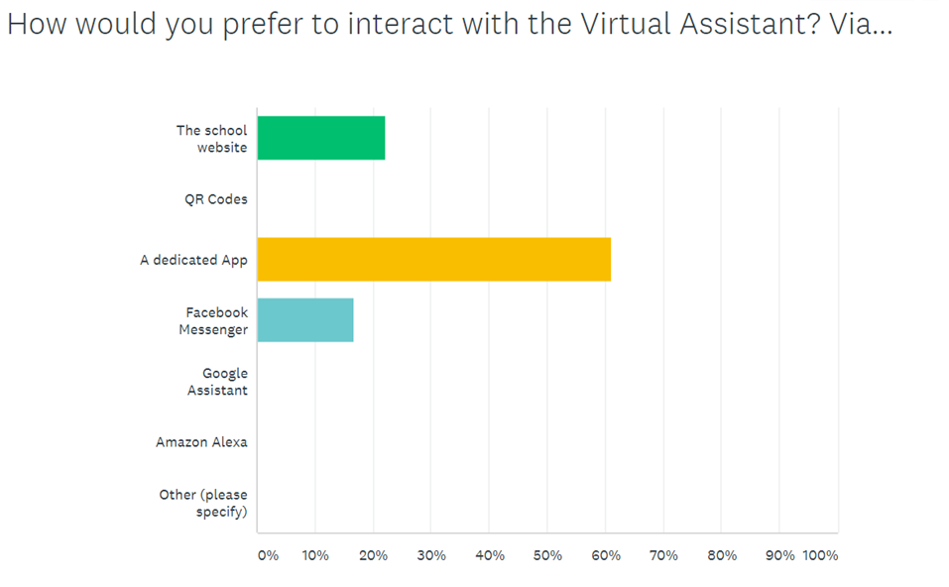
Results

Slide 9
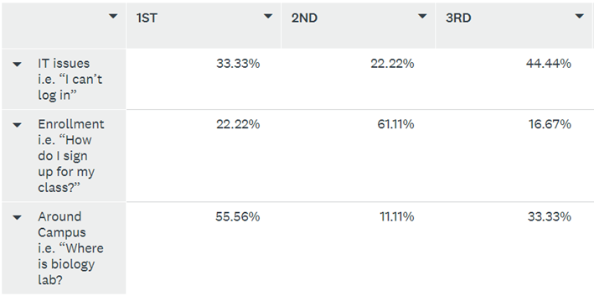
Results

Slide 10
Feedback

Slide 11
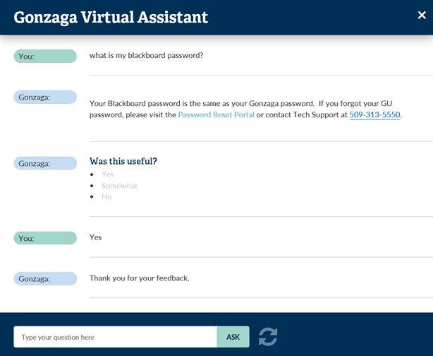
Summary
Covering
Password / login assistance
Software installation
Voicemail / Email assistance
Blackboard
Requesting a work study account
Accessing department drive
Banner
Connecting (IoT) devices / computers
Remote access
Work study
Software assistance
Next Gen Tech Bar
Positioning
myGU
Deployment
Using noHold API

Slide 12
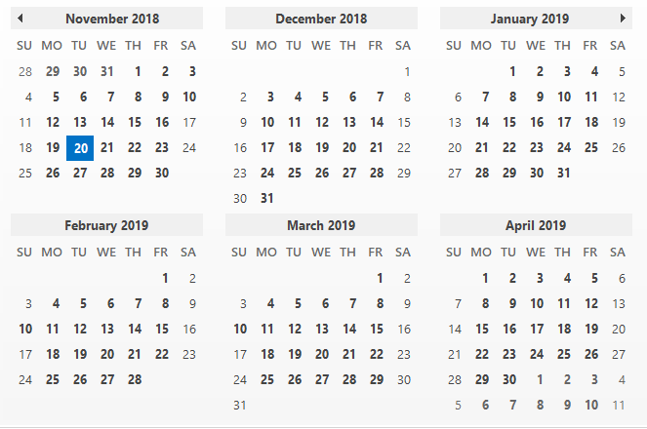
Timeline
Integrated in ITS home page
Spring Semester Start
Kick off meeting

Slide 13
Knowledge Gaps
Wifi / Wireless / Internet Access
cant connect to guest wifi
connect to wireless
guest wifi
how do I connect to wifi?
how do I enter my wifi credentials
how to connect to school wi-fi with an ethernet cable
how to i connect to the community wifi
Email
email placed on hold
how email android
incoming email placed on hold
staff email android
email server settings
Connecting Devices
how do I register / connect my xbox
PS4 wifi connection
google Home
Phishing / Scam / Hacked
hack information
hacked
i got an email from GonzagaWeb Services about “scam activity”
phishing
report phishing scams
Phone Number
IT phone number
phone number
what is your phone?
Download Microsoft Office

Slide 14
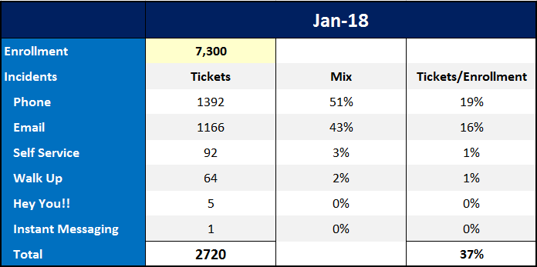
Key Performance Indicators (KPIs)

Slide 15
Nurturing Adoption

Slide 16
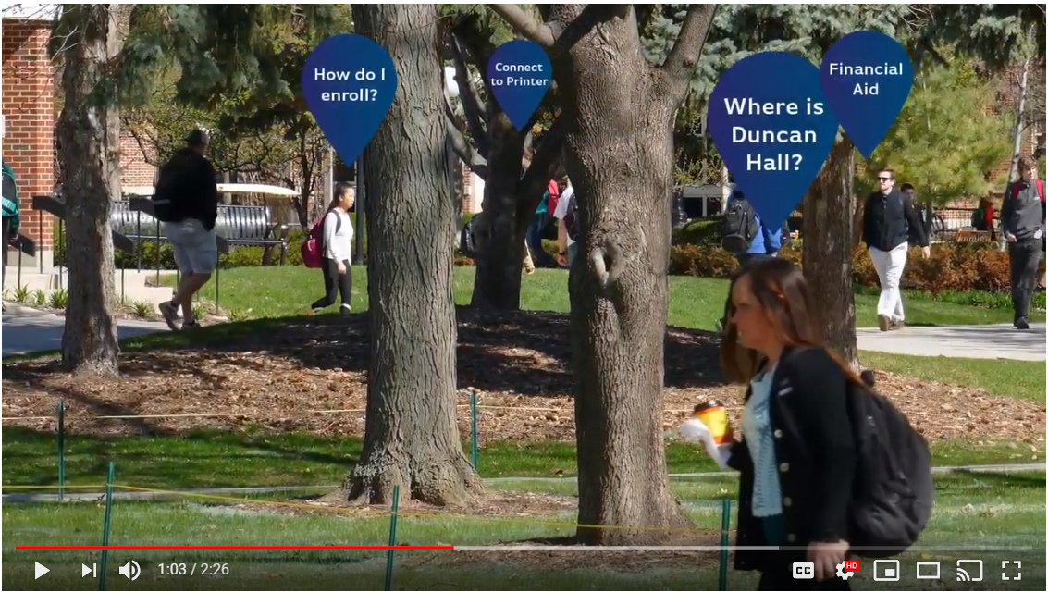
Introduction Video

Slide 17
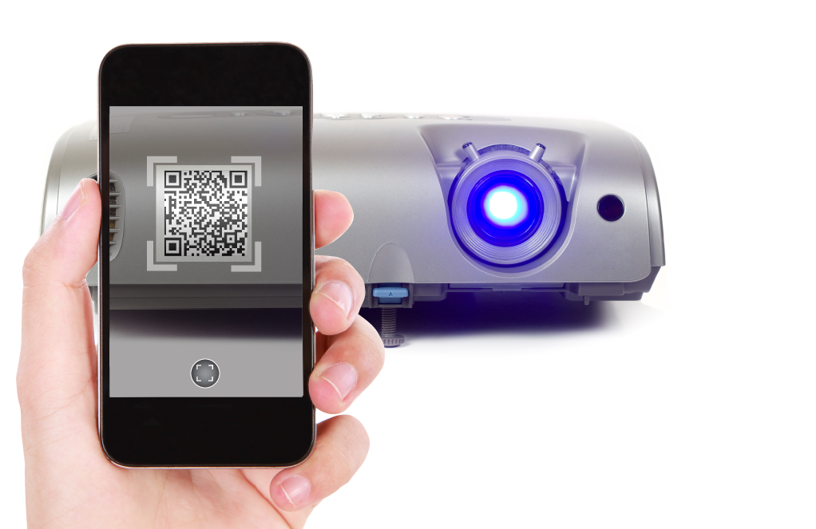
QR Codes

Slide 18
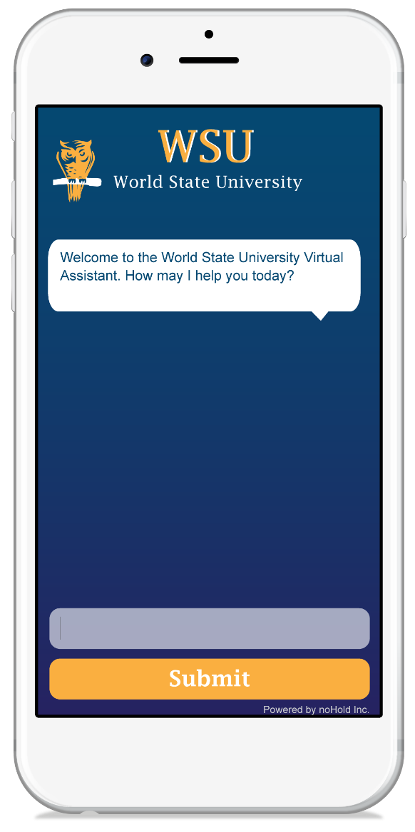
Pre-empt Contact Channels
Call Center
Live Chat
Registrar's Office
Email
Contact Us Page

Slide 19
Hold Messages
You are 15th in the queue. If you would like immediate help please try our Virtual Assistant on the website.

Slide 20
“What’s new with…” Weekly Email

Slide 21
Link in Collaboration Platforms

Slide 22
Link to All Platforms

Slide 23
Lessons Learned
Easy and contextual escalation to human help
Content needs to be ready for prime time

Slide 24
Q&A
Is your knowledge base ready for prime time?
Will AI take over your school?
Do you believe that Virtual Assistants can help with adoption of existing programs and systems?
What about Athletics (store) and Alumni activities (donations)?
Will AI become a requirement for students to master?
Should you be polite to AI?
Get AI to work for you here: www.nohold.com (click on EDUCAUSE)
You can find me at the ALE booth #1839

Slide 25
Trusted By
Press
Analysts
Speeches

Slide 26
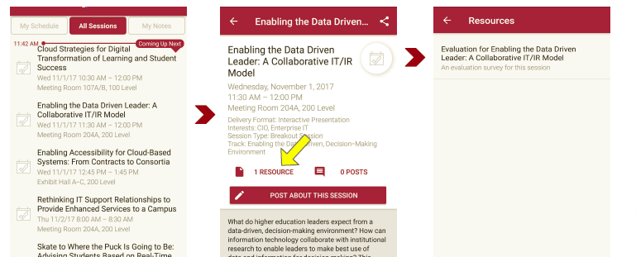
Session Evaluations There are two ways to access the session and presenter evaluations:
1
2
In the online agenda, click on the “Evaluate Session” link
From the mobile app, click on the session you want from the schedule > then scroll down or click on the associated resources > and the evaluation will pop up in the list

Slide 27
Contact Information
Diego Ventura
noHold Inc.
CEO
408-472-2764
diego@nohold.com
www.nohold.com
Borre Ulrichsen
Gonzaga University
CIO
ulrichsen@gonzaga.edu
www.gonzaga.edu
NOTE: This presentation leaves copyright of the content to the presenter. Unless otherwise noted in the materials, uploaded content carries the Creative Commons Attribution 4.0 International (CC BY 4.0), which grants usage to the general public, with appropriate credit to the author.

