Slide 1
Lightning Round Session: Transforming the Student Experience

Slide 2
Alexa @ The University of Texas Dallas
Frank Feagans, Vice President and Chief Information Officer
Kishore Thakur, Senior Director – Innovation, Cloud and Platform Services

Slide 3
Agenda
UT Dallas
UT Dallas IT Strategic Pillars
Strategic Opportunities for Voice @ UTD
Alexa Pilots
Student Development
Challenges

Slide 4
UT Dallas Points of Pride
Created in 1969 by the entrepreneurs who started Texas Instruments.
A quarter of our undergrads are first generation college students.
A rapidly growing STEAM university producing top talent and quality research.
Top 25 for ethnically diverse campuses.
89% graduate in engineering, science, mathematics & business.
Carnegie R1 Research University
Two-thirds of graduates stay in DFW Metroplex.
THE UNIVERSITY OF TEXAS AT DALLAS

Slide 5
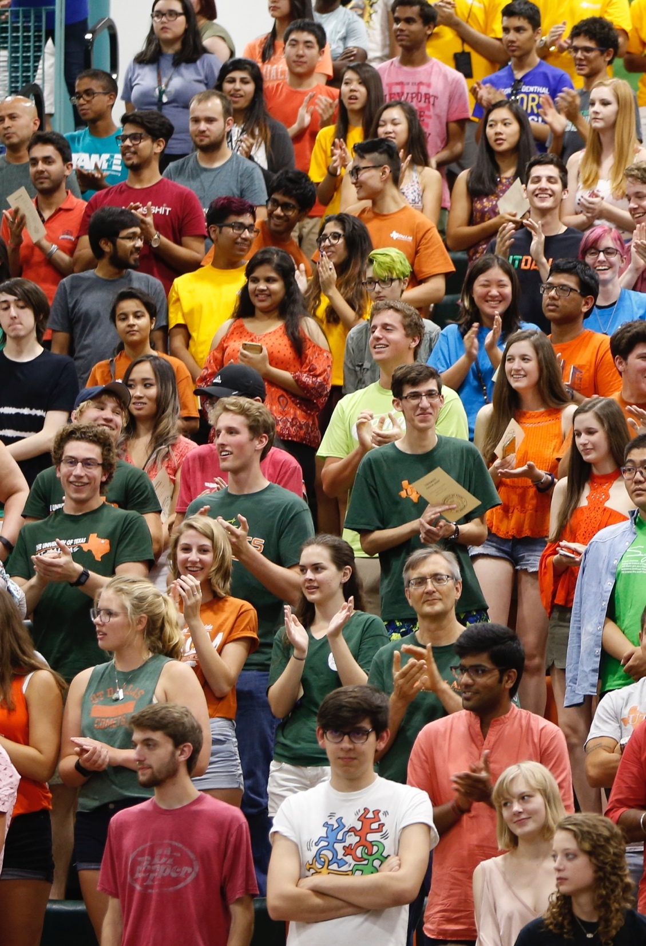
4th fastest growing public doctoral university in the country
3,862
Freshmen
28,755
Fall 2018
Total Enrollment
172
National Merit Scholars are among our freshman class
#1 among Texas public universities
#15 among U.S. public universities (tied)
#31 overall among U.S. universities (tied)
-Forbes

Slide 6
UT Dallas IT Strategic Pillars
Be the cyber-infrastructure (CI) catalyst for accelerating research
Reduce administrative burden, increase availability, and boost decision making
Provide a rewarding and valuable student UTD experience
Fortify the UTD IT service foundation

Slide 7
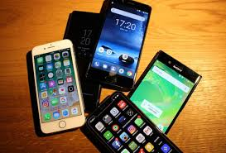
Voice: The Next Disruptive Technology

Slide 8
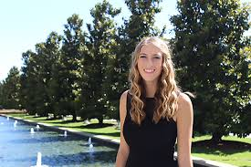
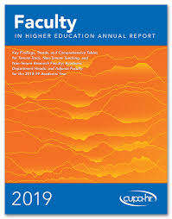
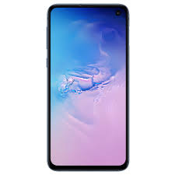
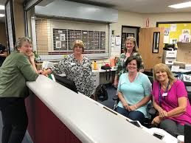
Alexa: an Indispensable Assistant

Slide 9
Our Alexa “Skills roadmap” approach
Personalized
Community-based
Shared spaces
Public-available

Slide 10
Alexa.edu opportunities
2019 Pilots
Student Life
Student Outcomes
Safety
Administrative
Public
UTD public information
Health care
Residence hall life
Personal (info look up, calling, music, to-do lists, etc.)
Parking
FAQ
TBD by students
Academic advisor
Tutor, study buddy
Instructor’s office hours & questions
Class schedule
Homework and test reminders
Study guides
Emergency notifications
Emergency alerting
Emergency instructions
Emergency communications
Emergency navigation
Conferencing
Room scheduling
Incident reporting
Integrate monitoring with call centers
Predictive analytics
Calendar of events
Sports updates
Weather
Directories
Navigation

Slide 11
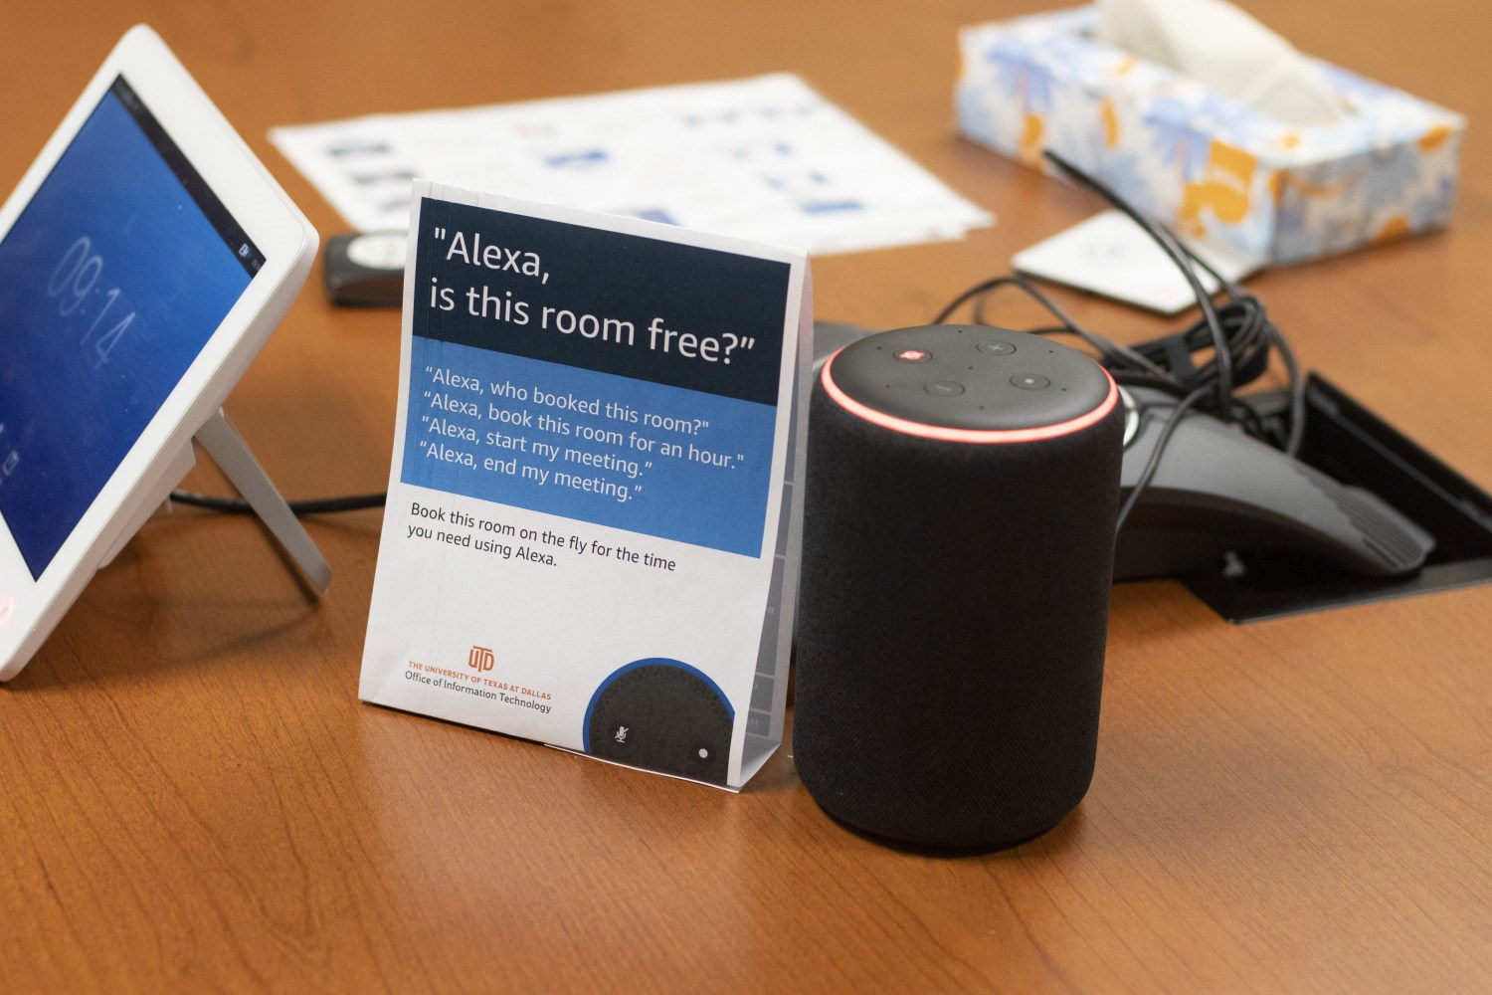
OIT Conference Rooms
Alexa for Business simplifies meeting room experiences for university employees.
7 conference rooms - shared devices
20 enrolled users – personal devices
Simplified meeting room experience
Integrations with Exchange, Calendar
Cisco WebEx, Microsoft Teams
“Alexa, call helpdesk” – phone book
“Alexa, join my meeting”
Increased productivity

Slide 12
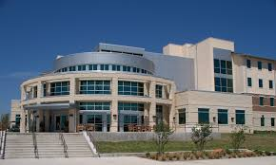
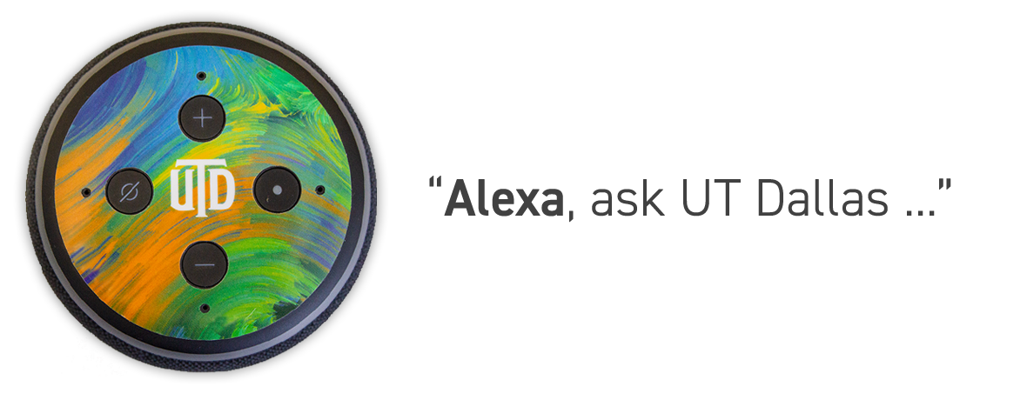
Residence Hall South
144 shared suites – shared devices
Eight study rooms – shared devices
Two class rooms – shared devices
Partnerships
Student government association
Student affairs & university housing
University communications
Students clubs

Slide 13
Students Development Efforts
HACK UTD
500+ student participants
https://hackutd2019.devpost.com/
Build for UTD – Alexa skill
17 - Alexa skills developed by student group
Events
Parking
Alexa AR
Comet helper
FAQ’s
Training opportunities
Skills development
Certifications
Internships

Slide 14
Challenges
Skill development
Third party versus in-house
Alexa blueprints
Students and Staff
Information Resources
Privacy: fact and fiction
Individual privacy (a really big deal!)
White paper - Alexa privacy and data handling overview
Staying aligned with other institutions
Proactive student government engagement
Prioritization
Organize with purpose

Slide 15
Frank Feagans - Frank.Feagans@utdallas.edu
Kishore Thakur - Kishore.Thakur@utdallas.edu

