Slide 1
Enhancing the Performance of Cross Functional Teams
2019 Educause National Conference
Chicago, Illinois
October 15, 2019
Gale Fritsche
Bill Bettermann
Lehigh University
Library and Technology Services

Slide 2
Founded in 1865, Private Research University, located 90 miles west of New York City
5034 undergraduates, 2057 graduate students, 506 full-time faculty and approx. 1200 staff
Library and Technology Services is a merged organization including Technology and Libraries
Five Colleges – Arts & Sciences, Business, Education, Engineering, and Health
Lehigh Overview
Notes:
Bill: located in Bethlehem, PA ; close to New York City, Philadelphia and Baltimore; four colleges and plans underway for a fifth, a Health Studies college

Slide 3
Vice Provost
Library & Technology
Chief Info. Security Officer
Chief Technology Officer
Assoc. Vice Provost (CITL)
Executive Director Libraries
Director Business Services
Identity Management
Technology Infrastructure
Instructional Technology
Special Collections
Enterprise Systems
Distance Ed Online Learning
Library Technology
HelpDesk Student Support
Research Computing
Collections Scholarly Communication
Computing Support Teams
Learning Space Tech. & Design
Library Access Services
Library and Technology Services
Notes:
Gale - recently restructured (creation of a CIO) and Executive director of the libraries

Slide 4
Characteristics
Membership - different functional areas
Sometimes project teams – often temporary
Sometimes permanent organizational teams
Members often at similar organizational levels

Slide 5
Advantages
Improved problem solving (broader perspective)
Increased organizational performance (diversity)
Little “throw it over the wall mentality”
Streamlined and more thorough decision making
Challenges
Diversity causes challenges in communication
Difficulty understanding terminology
Perceived differences in credibility
Different perspectives on how the work gets done

Slide 6
Successful Management
Set objectives and clarify
Build upper management support
Persuasive leadership (not controlling)
Know when to allow functional experts take the lead
Know when to heed the advice of non-functional experts
Set clear timelines for deliverables
Communicate clearly, motivate (be positive)
Make sure all members have opportunities to offer input
Understand the stages of team development

Slide 7
Build the Team
Communicate Clear Objectives
Establish working guidelines or rules (clear expectations)
Define Roles (select the best team members for each role?)
Communication skills
Decision making skills
Technical skills
Leadership Skills
Identify and secure required resources (Network access, hardware, software meeting space, etc.)
Do not choose team members who have known “conflicts”
Consider the project as an opportunity to enhance inter-group cohesion (breaking silos)

Slide 8
You have been asked to create a cross functional project team tasked to evaluate software delivery systems, including cost, and implement the most effective system for the University. The project team needs to include a mix of individuals who will be able to handle the technical implementation of the system as well as deal with software licensing contracts and legal issues, academic labs, faculty and staff support, documentation, packaging applications, as well as system administration.
From the following slide, assemble a six member team out of the 12 individuals listed. Select the members who you feel would be best suited to work together on the project, based on the parameters detailed above.
While you consider the choices, reflect on:
Why you chose each person
What characteristics of your selections were most important
What were the liabilities of those you did not select
Was there an individual you considered essential / an individual you considered absolutely non-essential?

Slide 9
1 John Blue Director, Network Services 20 years at institution 4 years in current role Assertive Good Listener Serves on many teams | 2 Joe Smith Subject Librarian 25 years at institution 25 years in current role Friendly Very organized Very punctual | 3 Mary Rhodes Help Desk Consultant 4 years at institution 4 years in current role Quiet Energetic Current with new technology | 4 Lois Clark Subject Librarian 12 years at institution 10 years in current role Friendly Thorough Working on advanced degree
5 Rich Melon Network Administrator 2 years at institution 2 years in current role Confident Laid back Alumnus | 6 Kay Sears Desktop Support 30 years at institution 10 years in current role Decisive Energetic Plans to retire within two years | 7 Donnie Scott Desktop Support 1 year at institution 1 year in current role Assertive Very intelligent No experience with cross-functional teams | 8 Bob Bowie Enterprise Systems Analyst 10 years at institution 8 years in current role Considerate Approachable Always the first to volunteer
9 Jean Cash Instructional Technologist 5 years at institution 5 years in current role Energetic Detailed Working on advanced degree | 10 John Thrace System Analyst 25 years at institution 22 years in current role Assertive Vocal Little experience with cross-functional teams | 11 Holly Poole Help Desk Supervisor 15 years at institution 15 years in current role Approachable Laid back Serves on many teams | 12 Tim Axell Director, Client Services 20 years at institution 10 years in current role Friendly Thorough Alumnus

Slide 10
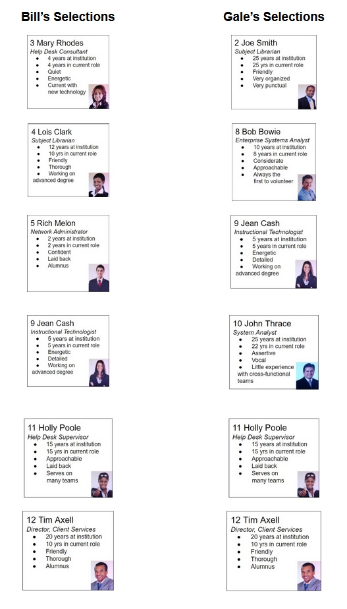

Slide 12
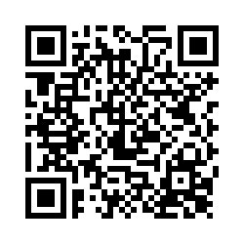
Questions?
…and the survey!
https://lehigh.co1.qualtrics.com/jfe/form/SV_ba0KnfnB3UwlwnH

Slide 13
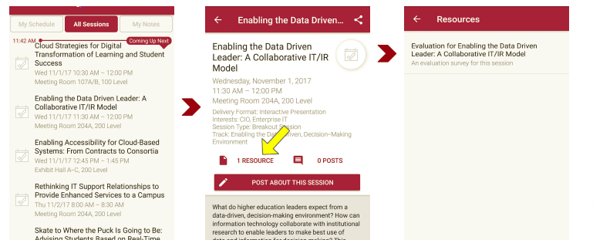
Session Evaluations There are two ways to access the session and presenter evaluations:
1
2
In the online agenda, click on the “Evaluate Session” link
From the mobile app, click on the session you want from the schedule > then scroll down or click on the associated resources > and the evaluation will pop up in the list

Slide 14
Contact Information
Gale Fritsche, Assistant Director, Computing and Distributed Support Services
gdf2@lehigh.edu
Bill Bettermann, Manager & Senior Computing Consultant, Arts & Sciences Team
wab3@lehigh.edu
NOTE: This presentation leaves copyright of the content to the presenter. Unless otherwise noted in the materials, uploaded content carries the Creative Commons Attribution 4.0 International (CC BY 4.0), which grants usage to the general public, with appropriate credit to the author.

