Slide 1
Changing Team Culture to Get Solid Data

Slide 2
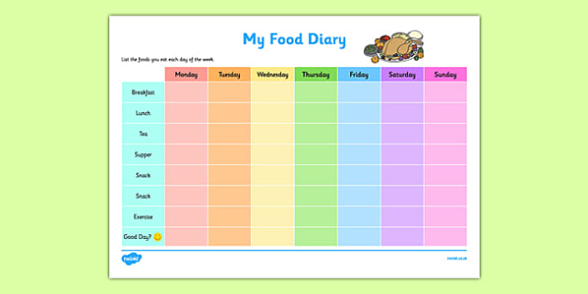
All kinds of data

Slide 3
Big Brother is watching what you do

Slide 4
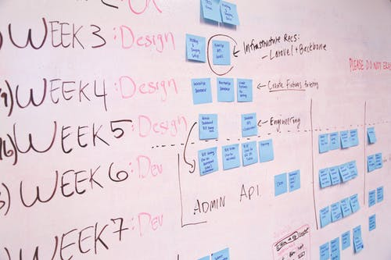
Where we started

Slide 5
Where we started
Talked to people
What we wanted to know
Why we wanted to know it – “It’s not about you; it’s about the data”
“We trust you to continue doing the same excellent work you have always done”

Slide 6
How we did it
Trusted people
Set regular periods for reviewing time (for us it was monthly initially but we moved to weekly reviews so people didn’t get too far behind)
Trusted people to keep time accurately
Reviewed data, not people. Only asked about time if, when looking at the data, it looked like time was missing. Always assumed the person recorded time but just forgot to enter it
If some people repeatedly didn’t record time or if they kept it sloppily to begin with, tried to understand why and coached them – focused on the big picture not on them

Slide 7
How we did it
Recognized that strategies for keeping time are individual
Precise start-stop people
Holistic, more relaxed people
Determined what tools we needed
Free or relatively cheap online toggle tools
Excel docs
Project management software
Company-owned system

Slide 8
What we found out
Projects are:
apples to oranges …
to pears …
to lemons…
--and some are just bananas!
The common denominator for us is HOURS

Slide 9
Our next steps
We applied lots of tags
Project types
Deliverable types
Client types
Program types
LMS types

Slide 10
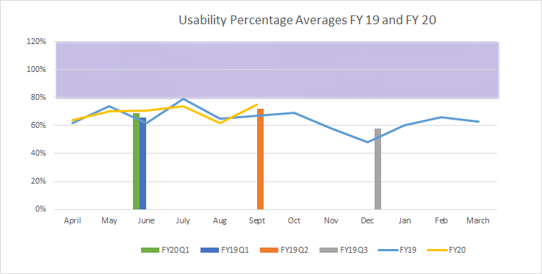
Our next steps
We started testing and interpreting the data
Usability Team Avg 75%

Slide 11
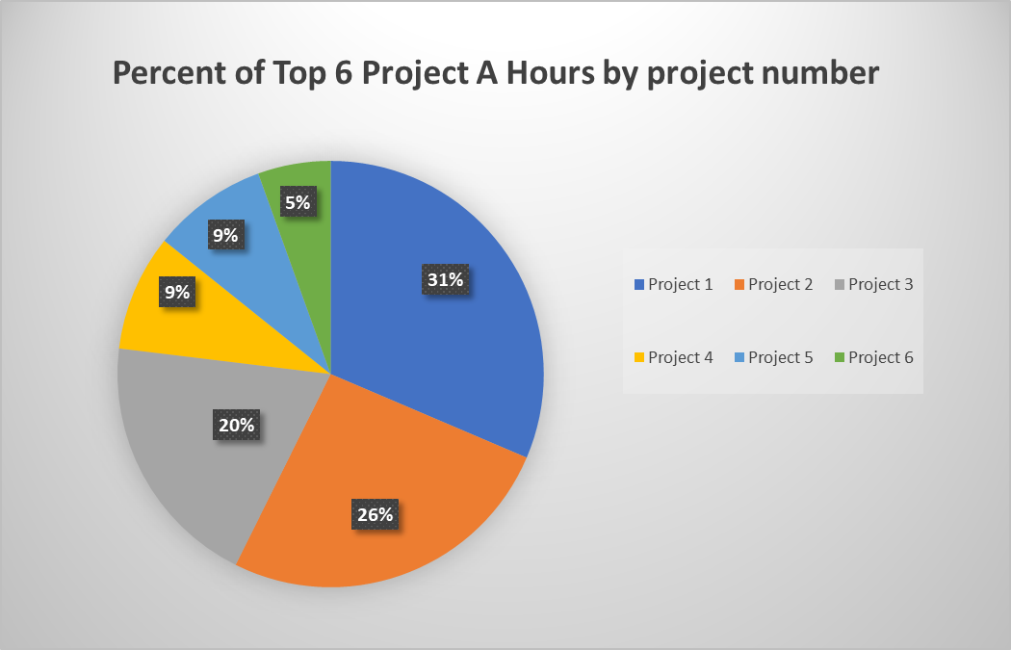
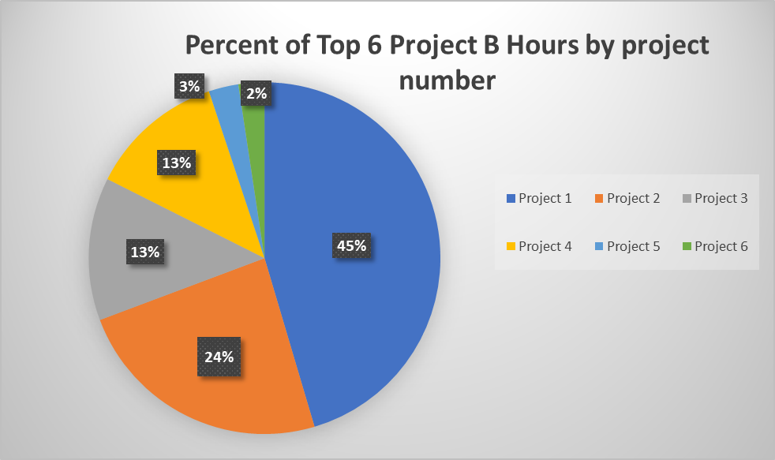
Our next steps

Slide 12
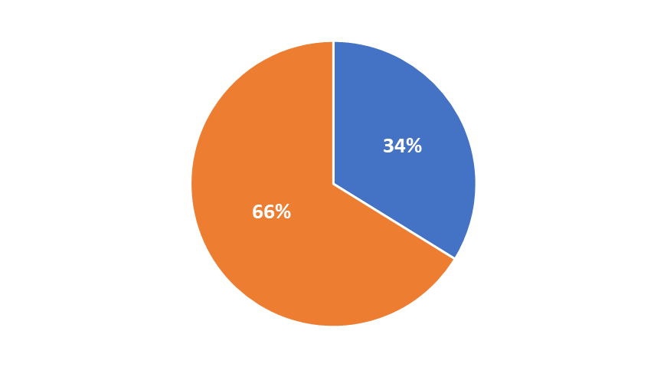
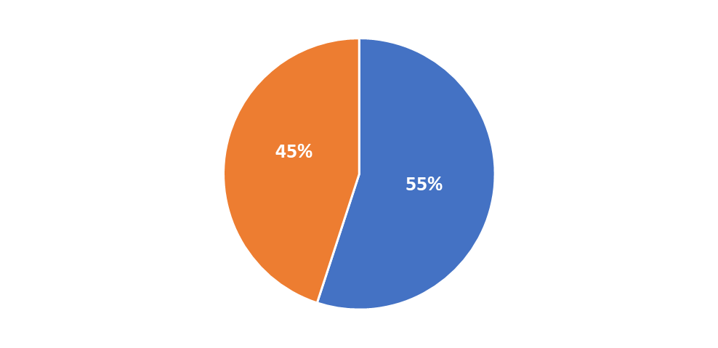
Our next steps
FY18
FY19
FY20

Slide 13
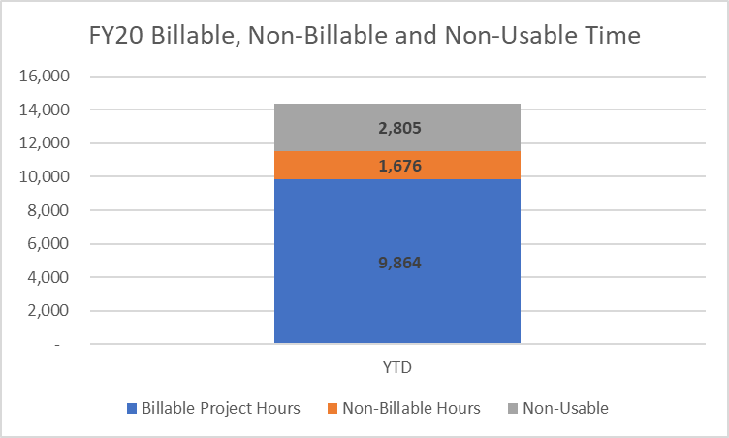
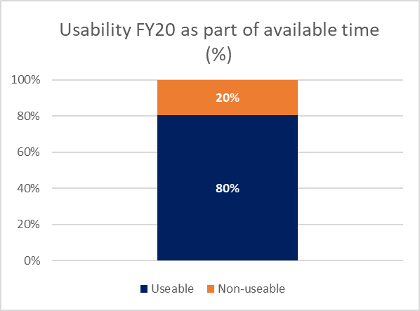
Our next steps

Slide 14
What we began to see happening
People other than us valuing the data
Individuals wanted to see how their time added up week over week, month over month (some even wanted to track time that we didn’t care about!)
Managers wanted to see the data so they could determine how to best assign projects
Project managers wanted to see the data so they could review and report on current or completed budget health

Slide 15
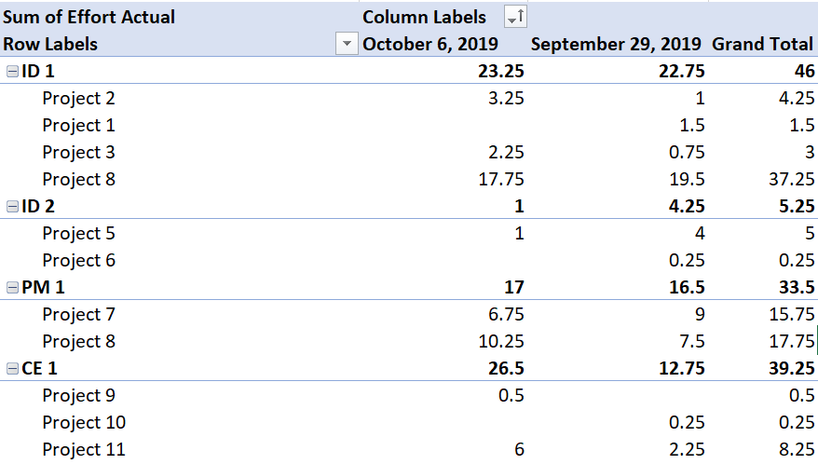
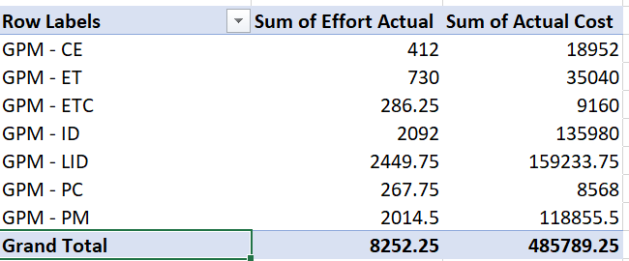
Our next steps
Sharing
Trust the data
Trust people to see the data
Share the data appropriately
Trust people to use the data appropriately

Slide 16
What we began to see happening
What people were saying
Before
I wonder how long it would take you to do X
I wonder how many of these X projects we can do between now and X month
Now
Let’s see how long it took us last time
We have X total of hours available in the time remaining (this year, this month, whatever you want to measure)
We know it took each person X hours to do this last time
Based on that data, we estimate it to take X hours this time
So the definitive answer is “yes, we can!”

Slide 17
What else we saw happening
People other than us valuing the data
People on other teams started coming to us to ask how we were building the data culture, gathering the data, reporting on it

Slide 18
In summary –
Basic understanding of what we were trying to accomplish by collecting the data
Management support
A tool for tracking the data
A vision of how to show the data to different people for different use cases
People willing/trained to track and report

Slide 19
Contact Information
Lois Harrison, Cengage Learning Inc., Instructional Design and Delivery
Manager, Project Management
Lois.Harrison@cengage.com
Lisa Trumble, Cengage Learning Inc., Instructional Design and Delivery
Supervisor, Project Management
Lisa.Trumble@cengage.com
NOTE: This presentation leaves copyright of the content to the presenter. Unless otherwise noted in the materials, uploaded content carries the Creative Commons Attribution 4.0 International (CC BY 4.0), which grants usage to the general public, with appropriate credit to the author.

