Slide 1


Re-imagining public higher education for the 21st century
October 15, 2019

Slide 2
WHERE ARE WE

Slide 3
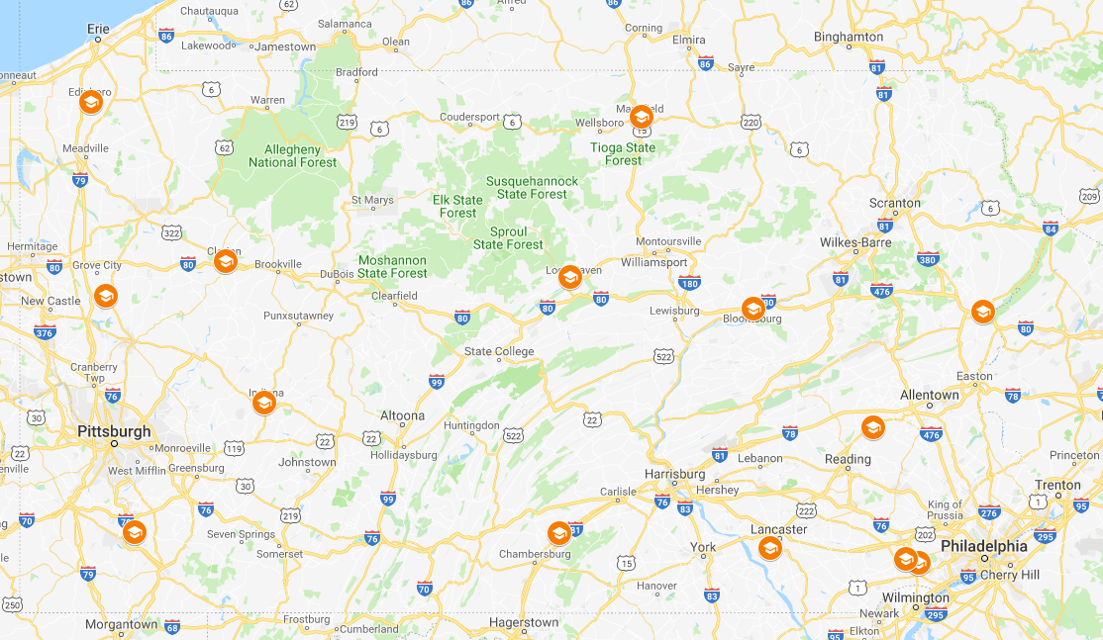

14 public universities and campuses…
PASSHE University,
Main Campus
Branch Campuses
Dixon University Center
Center City
3

Slide 4
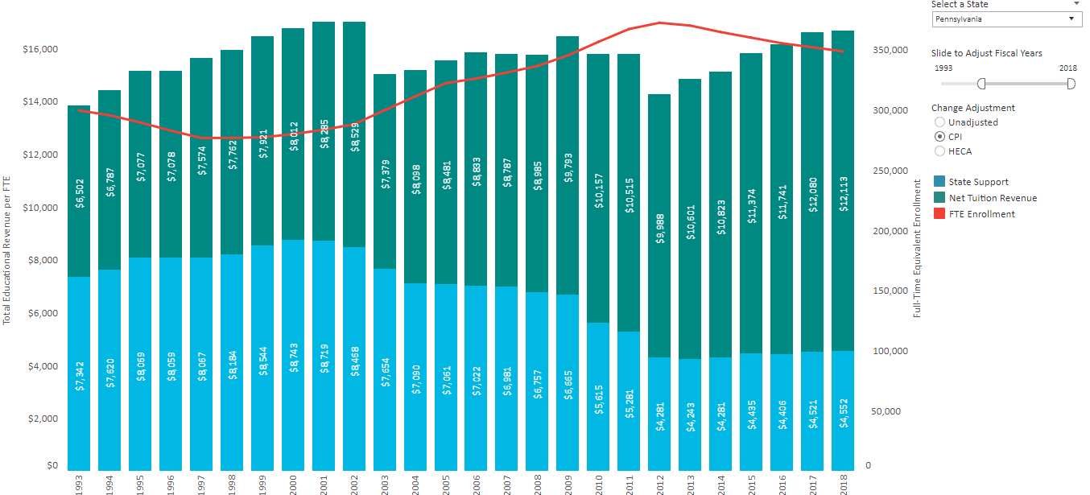
experiencing state divestment that drives tuition increases…
Pennsylvania, FY 1993-2018, Constant Dollars Adjusted by CPI
$16,665
53% from
State
27% from
State
Source: State Higher Education Executive Officers Association
Notes:
In PA, this is only 27

Slide 5
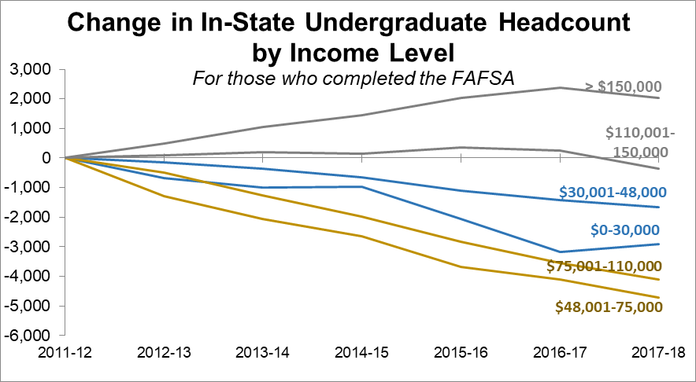
impacting our students differentially…

Slide 6
and resulting in enrollment declines…
In-state enrollment consistently is 88% of total enrollment.
Source: Student Data Warehouse; student submission official fall freeze, end of 15th day
*2019 is estimated based on first day of class with 0.4% growth based on 5-year historical trend.
Notes:
Note: Includes all enrollments--undergraduate, graduate, full-time, part-time; freeze date is 15th day of classes.
Source: Data Warehouse, Student Data Submission
Official Reporting Date: End of the 15th day of classes
*2019 is estimated based on first day of class with 0.4% growth based on 5-year historical trend
Note: Includes all enrollments--undergraduate, graduate, full-time, part-time; freeze date is 15th day of classes.
Source: Data Warehouse, Student Data Submission
Official Reporting Date: End of the 15th day of classes
*2019 is estimated based on first day of class with 0.4% growth based on 5-year historical trend

Slide 7
that are hard to get given shrinkage in the size of the high school leaving population…
Support Groups

Slide 8
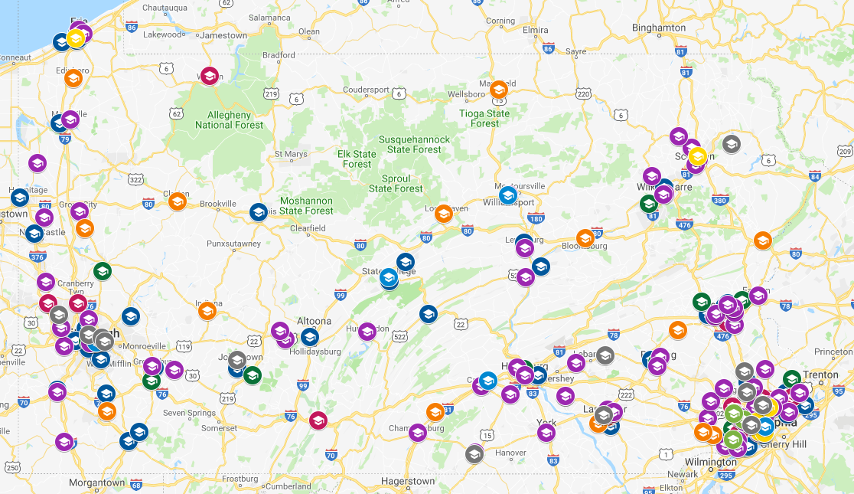
and the overcrowded marketplace of higher ed providers
PASSHE
Community Colleges
State-Related
Thaddeus Stevens
Private State-Aided
Private Colleges/Universities
Theological Seminaries
Private 2-Year Colleges
Specialized Associate Degree
Institutions
Out-of-State Provider
Source: Pennsylvania’s Department of Education
8

Slide 9
All of this shows up in System finances.
State System E&G Revenues and ExpendituresTransfers (dollars in millions)
Gap: Annual Cumulative
2019/20 $80 $80
2020/21 88 168
2021/22 89 257
2022/23 104 361
2023/24 113 474
2024/25 120 594
2025/26 130 724
2026/27 139 863
2027/28 149 1,012
$149M
$113M
Projections based on Budget Estimator Tool:
Out-year annual change of approximately 1.6% for revenues and 2.0% for Expenditures/Transfers
Source: Historical trends from university FINRPTs
9
Notes:
These assumptions are consistent with:
Our budget instructions for the request and out years
Enrollment projections for out years are consistent with those used when this was first run in December 2018
FY 2019/20 FY 2020/21 FY 2021/22 FY 2022/23 FY 2023/24 FY 2024/25 FY 2025/26
Projected Change in Overall Enrollment (In-state undergraduate only): 0.00% -2.00% -1.00% -0.50% 0.00% 0.30% 0.00%
Projected Change in First Time Freshmen/Transfers: 0.00% 0.00% 0.00% 0.00% 0.00% 0.00% 0.00%
Projected Change in Continuation Rate (Undergraduates only): 0.00% 0.00% 0.00% 0.00% 0.00% 0.00% 0.00%
Projected Change in Graduate Enrollment: 0.00% 0.00% 0.00% 0.00% 0.00% 0.00% 0.00%
Projected Change in Tuition Rate (All Students): 0.00% 1.50% 1.50% 1.50% 1.50% 1.50% 1.50%
Projected Change in Institutional Aid to "Hold Harmless": 0.00% 0.00% 0.00% 0.00% 0.00% 0.00% 0.00%
Projected Change in State Appropriation: 0.00% 2.00% 2.00% 2.00% 2.00% 2.00% 2.00%
Projected Change in Unrestricted Fundraising: 0.00% 2.00% 2.00% 2.00% 2.00% 2.00% 2.00%
Projected Change in Employee Pay (All employees): 0.00% 0.00% 0.00% 2.00% 2.00% 2.00% 2.00%
Projected Change in Healthcare: 0.00% 4.00% 4.00% 4.00% 4.00% 4.00% 4.00%
Projected Change in Nonpersonnel Costs: 0.00% 1.50% 1.50% 1.50% 1.50% 1.50% 1.50%
Because we now have actual data for 2018/19, we have better data for 2019/20, and we've updated our projections. Projections include no pay adjustments for nonAFSCME for 2-3 years, healthcare increaseing 4% raher than 5.5%, etc. See notes section on each page...assumptions are listed.

Slide 10
WHERE ARE WE GOING

Slide 11
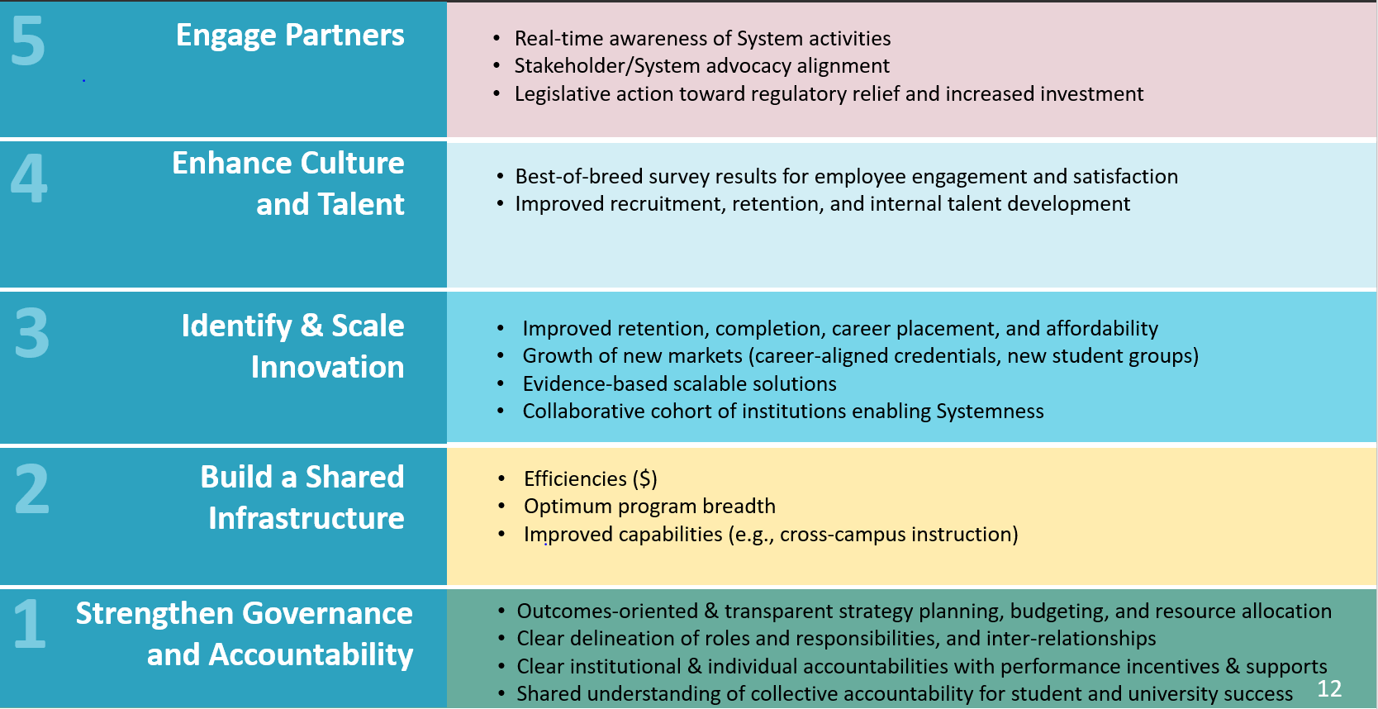
- address immediate challenges
- while transforming education and business so all Pennsylvanians have access to affordable, quality, and relevant postsecondary into the 21st century
System Redesign. Leveraging our operating scale through work in five areas to:
Notes:
Yes. The blue bar coincides to the new primary reserve definition. For these discussions, the gold bar is relevant as it excludes auxiliaries.
Primary Reserve Ratio Indicator―The primary reserve ratio is an important indicator of financial health showing how long an institution could function using its expendable net assets. It is recommended by NACUBO that the primary reserve ratio be 0.40x or 40 percent or greater.
Primary Reserve Ratio: Expendable financial resources (unrestricted plus temporary restricted) divided by annual operating requirements (total expenses).
Answers the question: How long into the new year could university’s function with no new resources?
Definition: Expendable financial resources (unrestricted plus temporary restricted) divided by annual operating requirements (total expenses).​
Recommended Minimum: 5 months (40%)

Slide 12
1. Strengthening governance and accountability
Multi-year student and university success goals and strategies for achieving them
Budgeting, budget allocation and appropriation
Tuition decisions
Institutional accountability
Individual Accountability
Strategic and liquidity investment procedures
New program approval
Support Groups
Notes:
Just to remind them we have a team and deliverables are at varying stages

Slide 13
2. Building a shared infrastructure
Key infrastructural components
Guiding principles
Shared Services
  HR, payroll, benefits, procurement, digital library, facilities (possibly)
Shared IT environment
  Tiered IT governance, systemwide cybersecurity, standardized IT chart of account, common SIS and LMS, cloud strategy, continuous applications / software rationalization
Shared academic programing (including a consortial approach to delivery of online learning
Optimize for student and university success
Technology as enabler, not driver
Phase rollout of initiatives, use stage gates to evaluate progress v key indicators before proceeding further

Slide 14
3. Piloting innovations to scale
Areas in which we are working
Guiding principles
High-school dual enrollment
Developmental education
Transfer pathways
Holistic advising
Student health and wellness
Student financial aid and affordability
Shared academic programming
Workforce aligned credentials
Stage-gated, fail-fast piloting approach
Using clear hypotheses about costs and outcomes and common metrics to assess them
Driven by empowered, inclusive teams
Leveraging state, philanthropic, partnership investments and cost savings resulting from shared services

Slide 15
4. Enhancing culture and talent
Embarking now on a longer journey by:
Building a systemwide leadership team
Strengthening faculty shared governance
Addressing our most acute internal tensions through deliberate transparency and inclusion
Gathering baseline data about our organization’s health and culture, and its readiness, willingness, and ability to change
Seeking to establishing an institute to focus on leadership, faculty, and professional development

Slide 16
We have work to do…
We are more ready (75%), than willing (55%), and able (39%) to change
Most likely to agree items (90% or higher)
Our university is facing significant competitive challenges
We need to improve our university’s performance to assure future success
I am willing to accept changes to my role if it helps improve our performance
Least likely to agree items (30% or lower)
We are confident we will get the support and resources needed to effectively implement changes
We have a good track record implementing change
We have the necessary culture (behaviors) to implement change
16

Slide 17
but are decidedly on our way…
17

Slide 18


