Slide 1
Mobile Blueprint for Improving Student Engagement and Success

Slide 2
About Central Carolina Technical College
Central Carolina Technical College rekindled communication efforts and implemented a new mobile technology platform to engage students before they even step foot on campus.
At Central Carolina Technical College, we brought Public Information, SIS, Student Email, and other campus resources together on one mobile platform and put it into the hands of the students; equipped with a targeted messaging system, it facilitates campus-wide communication, provides students with direct access to their college records and tools, and ultimately improves student success outcomes.

Slide 3
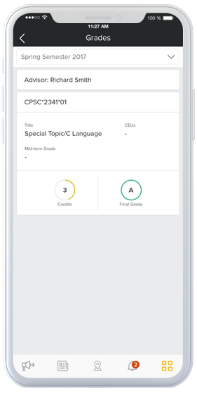
Apps
Grades
We connected a variety of applets to integrate with the public website, Student Information System (SIS), and student portal resources to provide access to:
Grades
Course schedules
Transcripts
Financial information
Record holds
News, Event Calendar, Employee Directory, and Campus Maps
Authenticated logins ensure data from critical applications is only accessible to the institution’s students, faculty, and staff based on account and role.

Slide 4
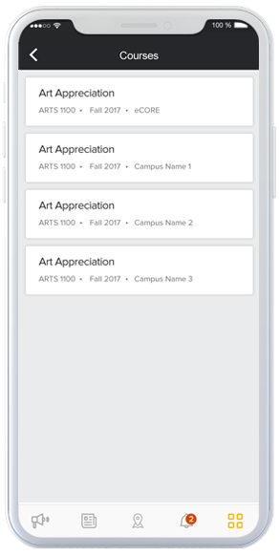
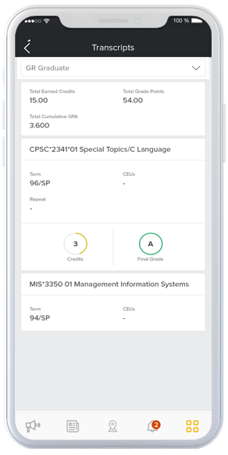
Apps
Course Schedule
Transcripts

Slide 5
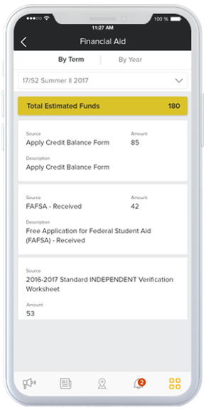
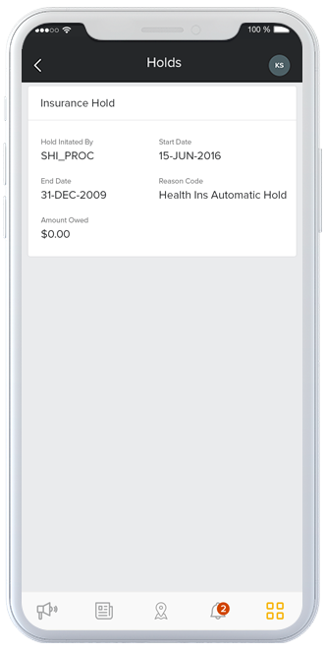
Apps
Financial Information
Record Holds

Slide 6
Requirements and Challenges
The mobile solution should provide a College-branded, native mobile application for Apple iOS and Android devices and be available for free download in the Apple® App / Google® Play Store;
The mobile solution must provide a set of applets for fully-functional integration with Ellucian Banner® as well as provide integration with and access to public information such as the Calendar of Events, Campus News, Employee Directory, and Campus Maps;
The mobile solution must provide detailed usage analytics via a web-portal to ascertain delivery platforms, concurrent and total users, usage by applet, and number of devices/downloads); and
The mobile platform should be applet-based, providing IT administrators with the capability of enabling, disabling, or removing services on an individual basis while maintaining the overall operational functionality of the mobile app.

Slide 7
The Mobile Application Solution
Central Carolina Technical College (CCTC) selected Unifyed as it’s mobile platform vendor. The app went live on September 7, 2017 and CCTC now has a mobile application platform for use by its students, faculty, and staff;
The mobile platform provides users of the solution with a single, seamless interface to College applications and data appropriate for their role. It has been well received by students, faculty, and staff with over 4,600 downloads to date;
Student and Faculty/Staff input is collected each year through the college’s annual survey process which provides a customer-driven roadmap for feature enhancements and requests; and
Future enhancements will focus on leveraging mobile capabilities such a Bluetooth beaconing and GPS-driven maps.

Slide 8
Contact Information
Brian Davis Director of Information and Learning Technologies 506 N Guignard Drive, Sumter, SC 29150, USA
Email: davisjb@cctech.edu Phone: +1 803-778-1961
NOTE: This presentation leaves copyright of the content to the presenter. Unless otherwise noted in the materials, uploaded content carries the Creative Commons Attribution 4.0 International (CC BY 4.0), which grants usage to the general public, with appropriate credit to the author.

