Slide 1
Building a Diverse Pipeline of Student Workers in IT
Jack Suess - UMBC
Damian Doyle - UMBC
Deborah Keyek-Franssen - University of Colorado
www.menti.com code 123456
Notes:
We want you to walk out with at least one practice you can put into place to diversify your student workforce
Learn how to partner with campus organizations to build student pipelines that encourage diverse students to apply for student IT positions;
Learn how these diversity initiatives can extend from community college transfers through graduate students; and
Encourage diverse students to apply for full-time positions in the division.

Slide 2
Who We Are (And Why This Matters To Us)
Damian Doyle - AVP Enterprise Infrastructure, UMBC
Deborah Keyek-Franssen - AVP for Digital Education & Engagement University of Colorado System
Jack Suess - VP for IT & CIO, UMBC

Slide 3
Why this topic is critical for the higher education workforce
Notes:
Jack

Slide 4
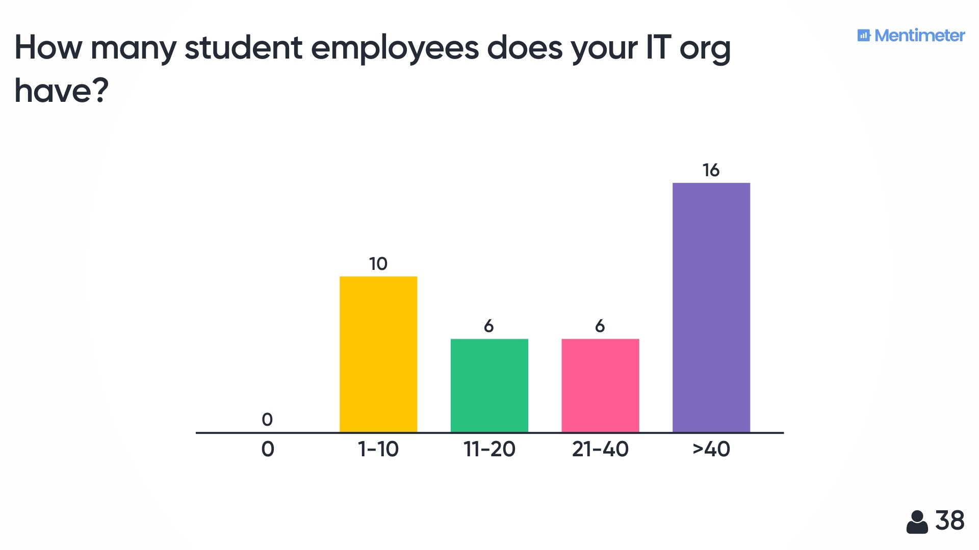
Audience Poll
How many student employees do you have in your IT org?
0
1-10
11-20
21-40
40+
How important is it that your student employment experience is diverse, equitable and inclusive?
Not important
Somewhat important
Very important
Notes:
Deb

Slide 5
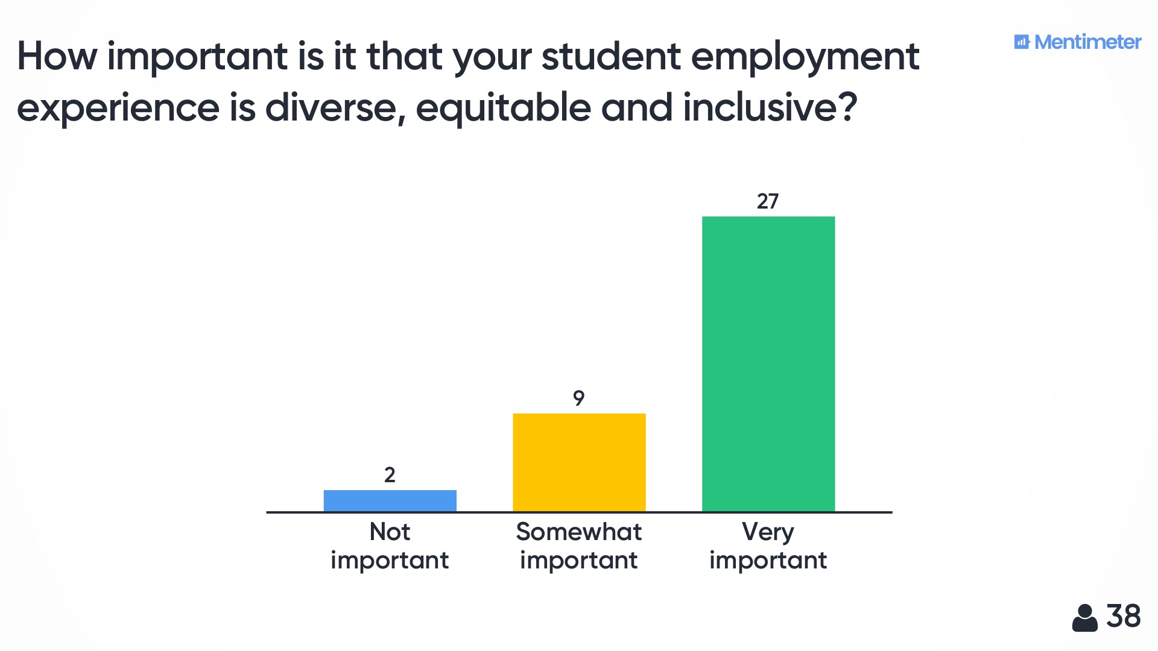

Slide 6
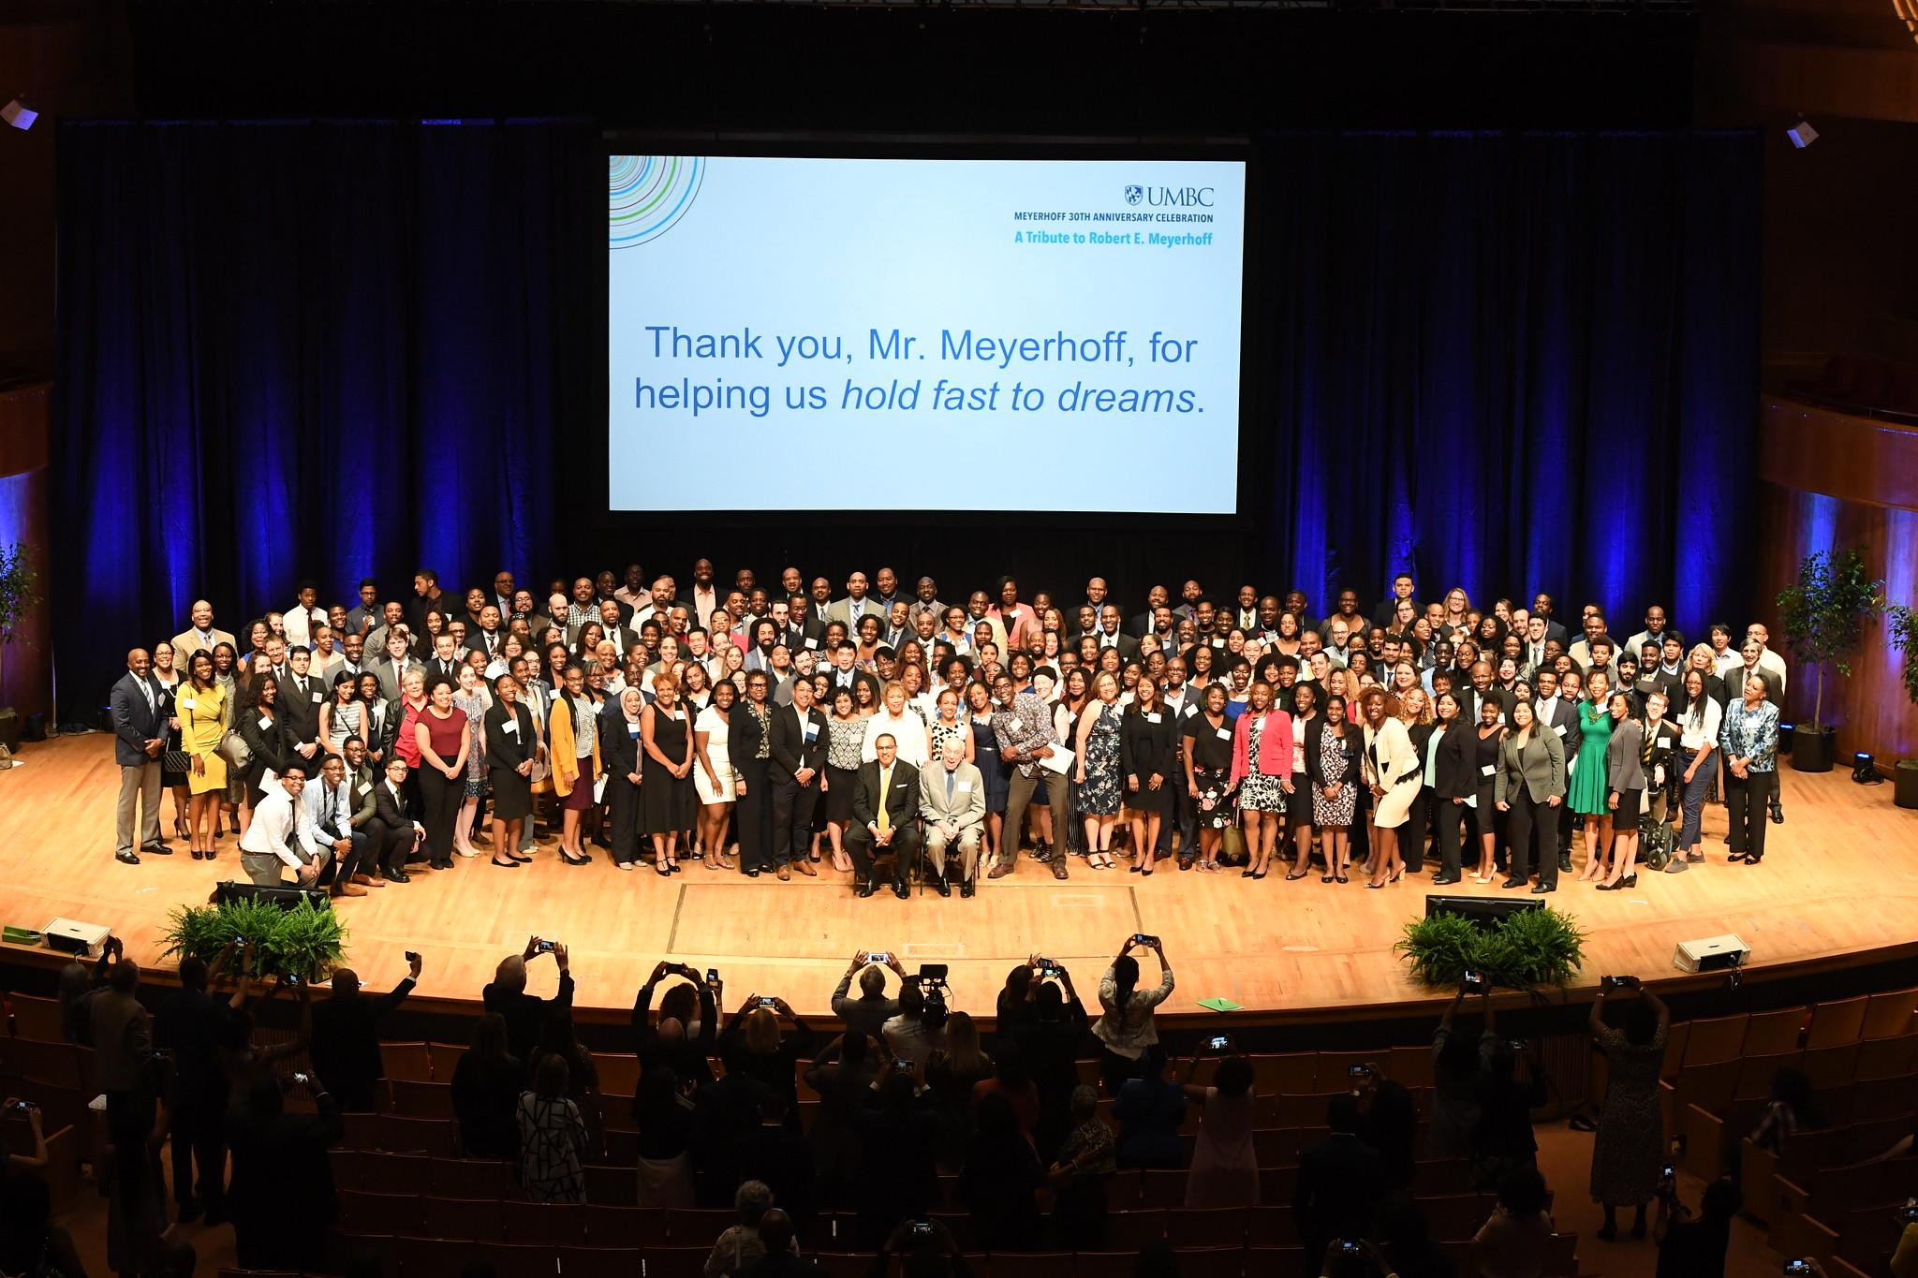
UMBC Quick Facts
Midsize public: 53% white, 47% minority
Representative of state demographics
Meyerhoff Scholars Program
Notes:
Jack

Slide 7
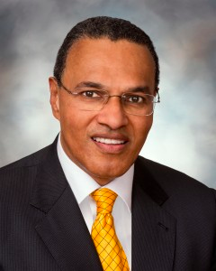
UMBC’s Presidential Challenge
UMBC Division of IT
83 Full-time staff
Approximately 56 staff members worked for us as students
Diversity is low: 20% female, 15% ethnic minority (but increasing)
Dr. Freeman Hrabowski UMBC President
Notes:
Jack

Slide 8
2014 UMBC DoIT - Student Demographics
Unsure exact numbers
We would guess that this was 90% male and 80% Caucasian.
Notes:
Damian

Slide 9
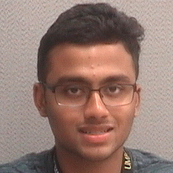
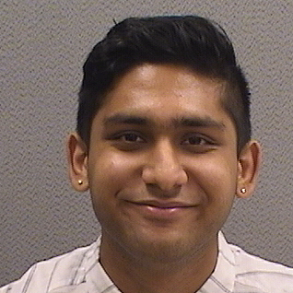
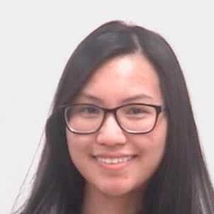
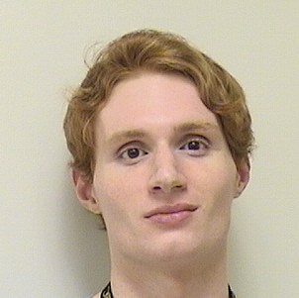
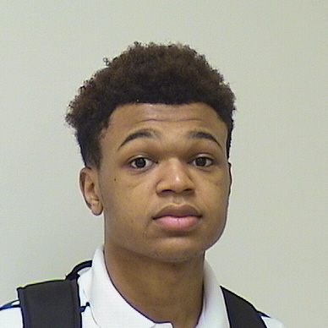
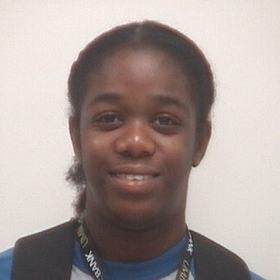
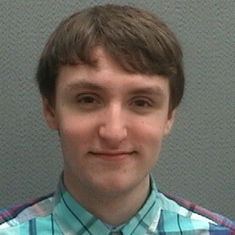
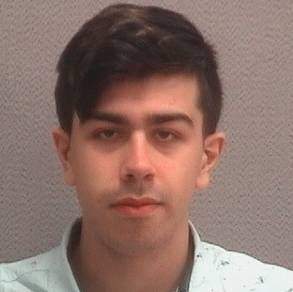
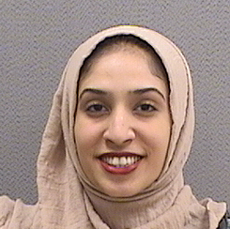
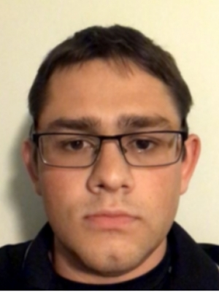
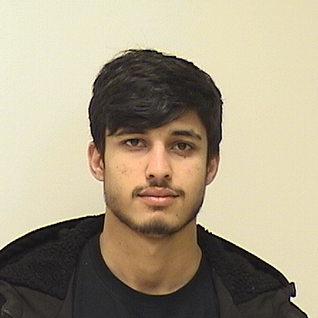
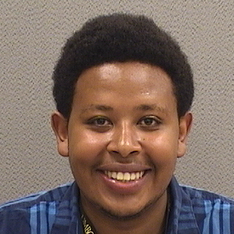
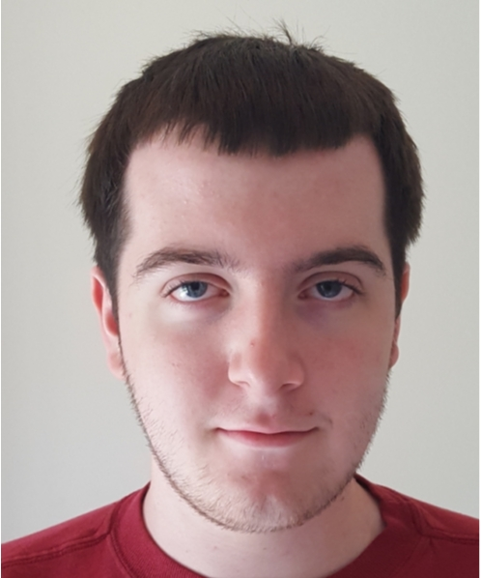
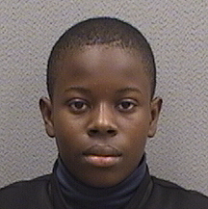
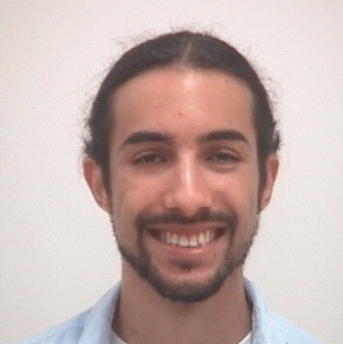
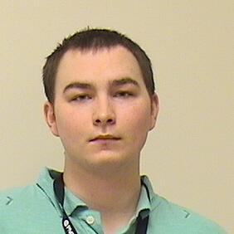
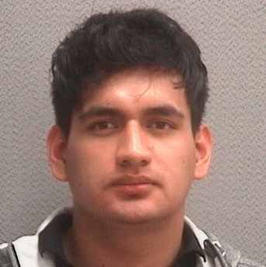
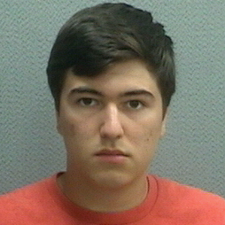
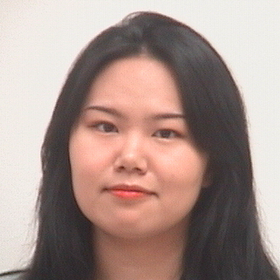
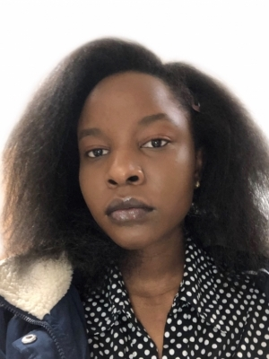
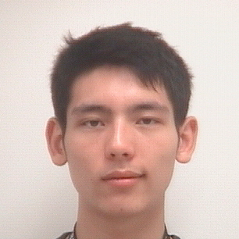
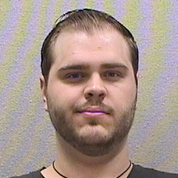
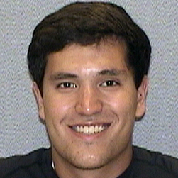
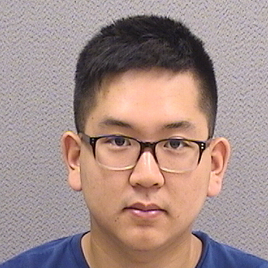
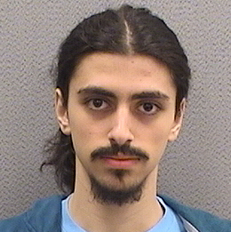
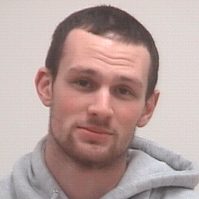
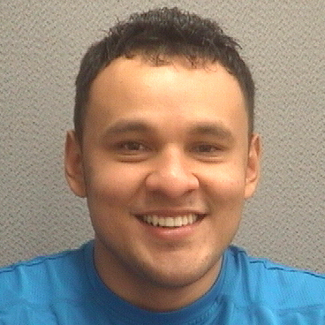
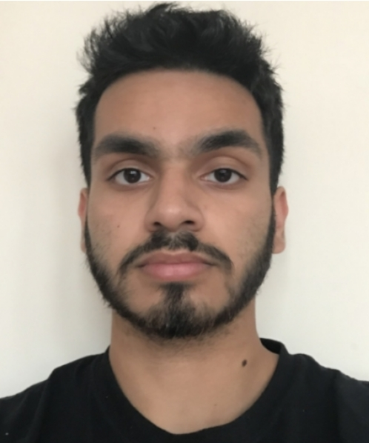
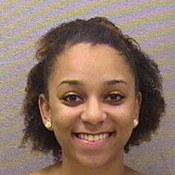
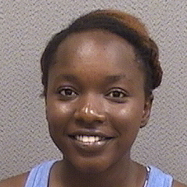
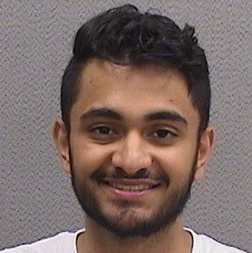
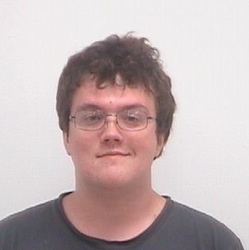
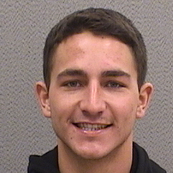
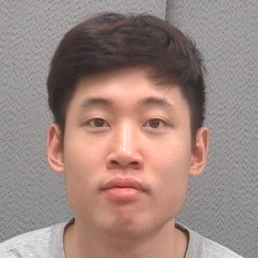
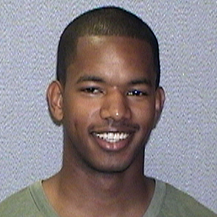
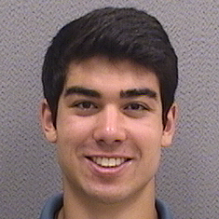
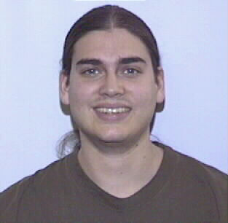
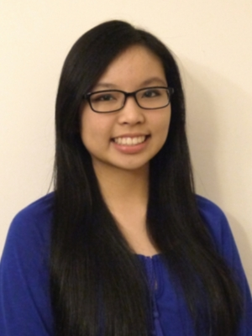
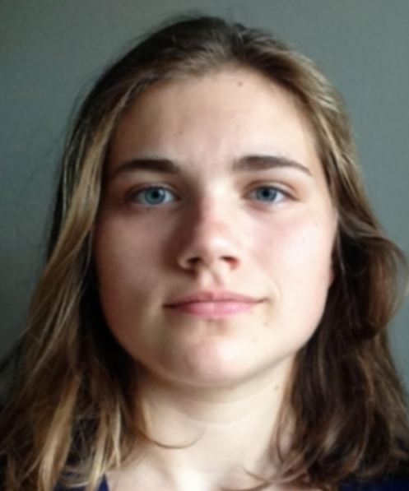
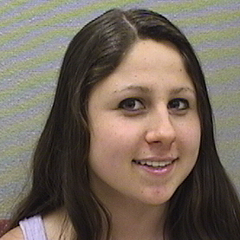
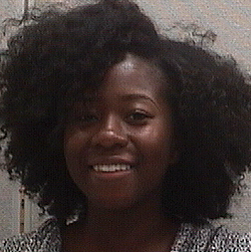
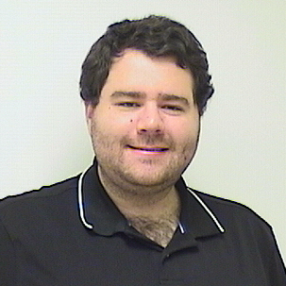
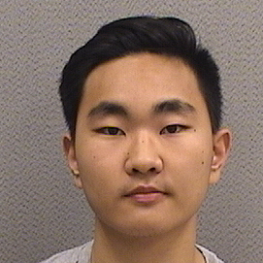
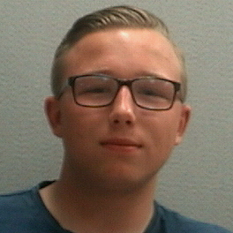
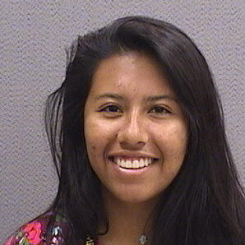
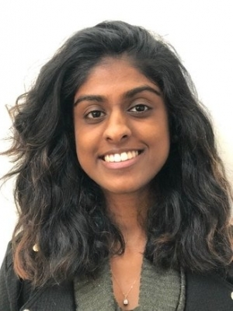
STUDENT EMPLOYEES OF DIVISION OF INFORMATION TECHNOLOGY 2019-2020

Slide 10
Notes:
need to be deliberate, otherwise very hard to get even 25% female

Slide 12
Cyber Security Student Workers
Notes:
Jack

Slide 13
Desktop Support Student Workers
Notes:
Jack

Slide 14
Former Student Stories
https://drive.google.com/file/d/16okGe91dZtnFnXMGyqgNXXg5vG15UmXi/view?usp=sharing
https://drive.google.com/file/d/1ZcLK-QW8gil8WzdzDwHNCG4n_OkWUnbd/view?usp=sharing

Slide 15
Audience Word Cloud
What benefits do you see from a more diverse organization?
Notes:
Deb

Slide 16
How do you get there?
Practical methods to help transform your organization
Notes:
Jack

Slide 17
Recruitment Practices
Job descriptions & ads
Campus units & academic departments
Retention Practices
Developing Your Student Workforce
Interrupting Bias
Notes:
Deb

Slide 18
Recruitment Practices: Job Descriptions & Ads
Masculine/feminine language?
Criteria--really required?
Extreme modifiers?
Assumptions about who can do the job?
Additional criteria?
“Ability to work on a diverse team”
What would rewritten job descriptions and ads look like in your organization?
Notes:
Deb

Slide 19
Recruitment Practices: Campus Units & Academic Departments
Reach out to scholar groups within your institution
Guest lecture in classes, tell your story
Engage with First Year Experience programs
Partner with academic departments
What groups could you partner with to build a better pipeline?
Notes:
Damian

Slide 20
Retention Practices:
Developing Your Student Workforce
Take a holistic approach
Seek out professional development opportunities:
Career Center
Student Affairs
Centers of Inclusivity
Many others
Instill a love of IT and learning
Notes:
Damian
Technical and non-technical

Slide 21
Retention Practices:
Interrupting Bias
Consider:
Benefits and costs
If it is bias
Timing and roles
Interrupt
Ask a question
Arouse dissonance
Pivot
How can you introduce the practice of interrupting bias to your student employees?
Notes:
Deb

Slide 22
One Action You Will Take
Notes:
Deb

Slide 23
Contact Information
Jack Suess Jack@umbc.edu
Damian Doyle damian@umbc.edu
Deborah Keyek-Franssen deblkf@cu.edu

Slide 24
Session Evaluations There are two ways to access the session and presenter evaluations:
1
2
In the online agenda, click on the “Evaluate Session” link
From the mobile app, click on the session you want from the schedule > then scroll down or click on the associated resources > and the evaluation will pop up in the list

