Slide 1

Convincing Campus to Secure Their Devices
Epic Transformation!
Tom Horton, Cornell University
Barbara Friedman, Cornell University

Slide 2

“Are our faculty devices safe?”

Slide 3
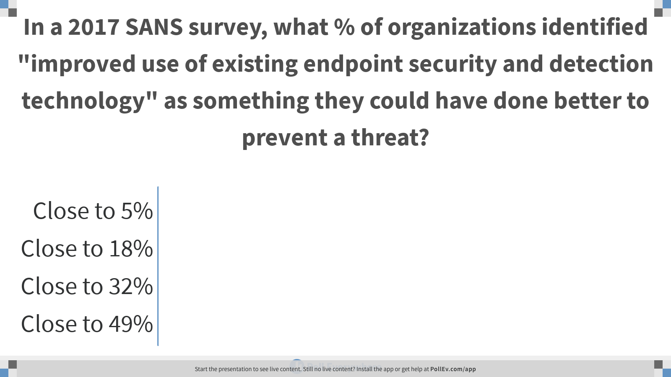
Notes:
Poll Title: In a 2017 SANS survey, what % of organizations identified "improved use of existing endpoint security and detection technology" as something they could have done better to prevent a threat?
Answer: Close to 32
https://www.polleverywhere.com/multiple_choice_polls/kIZ11QRQcaLWlyiJRgUqI

Slide 4

Where we were:
Policy with no teeth
No visibility
Needed new backup solution

Slide 5

Program design iterations:
Faculty Only
Separate pricing for staff and faculty
Package with other security tools

Slide 6

Certified Desktop…
an agreement with campus units
For one low per-desktop price, CIT delivers:
Patches (OS and applications)
Crowdstrike malware protection
Code42 backup
Spirion confidential data scan

Slide 7

In return, campus units agree to have at least 75% of their endpoints in compliance with policy. This includes:
Whole disk encryption
Use of an anti-malware product
Keeping patches up to date
Locking screensaver
System backups

Slide 8
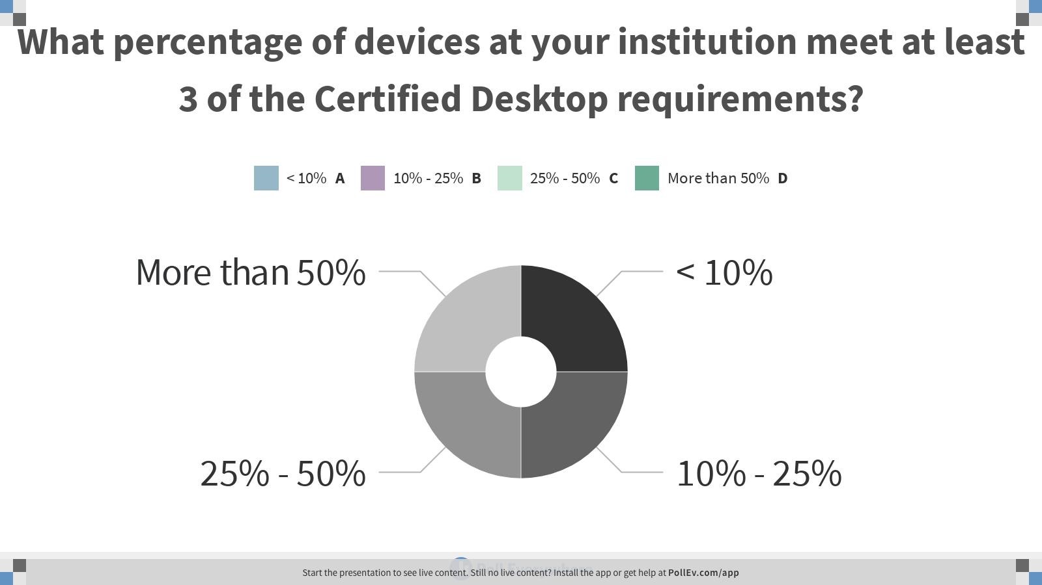
Notes:
Poll Title: What percentage of devices at your institution meet at least 3 of the Certified Desktop requirements? https://www.polleverywhere.com/multiple_choice_polls/aNGvVdhlv1GQgzz7v0Lvh

Slide 9
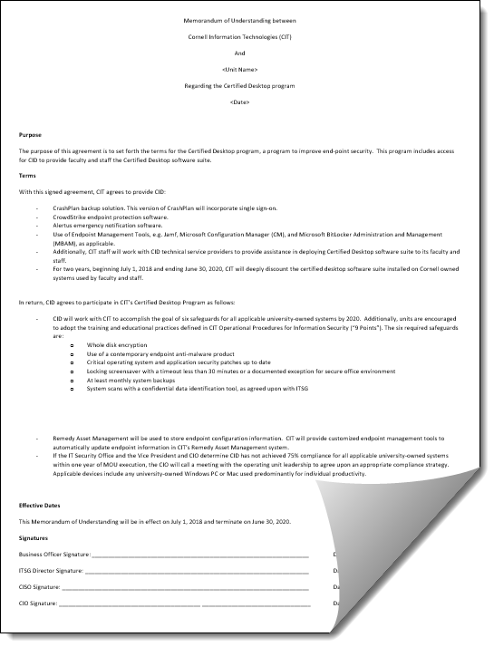
The Certified Desktop Agreement, valid through July 2020, was signed by all 45 colleges and administrative units

Slide 10
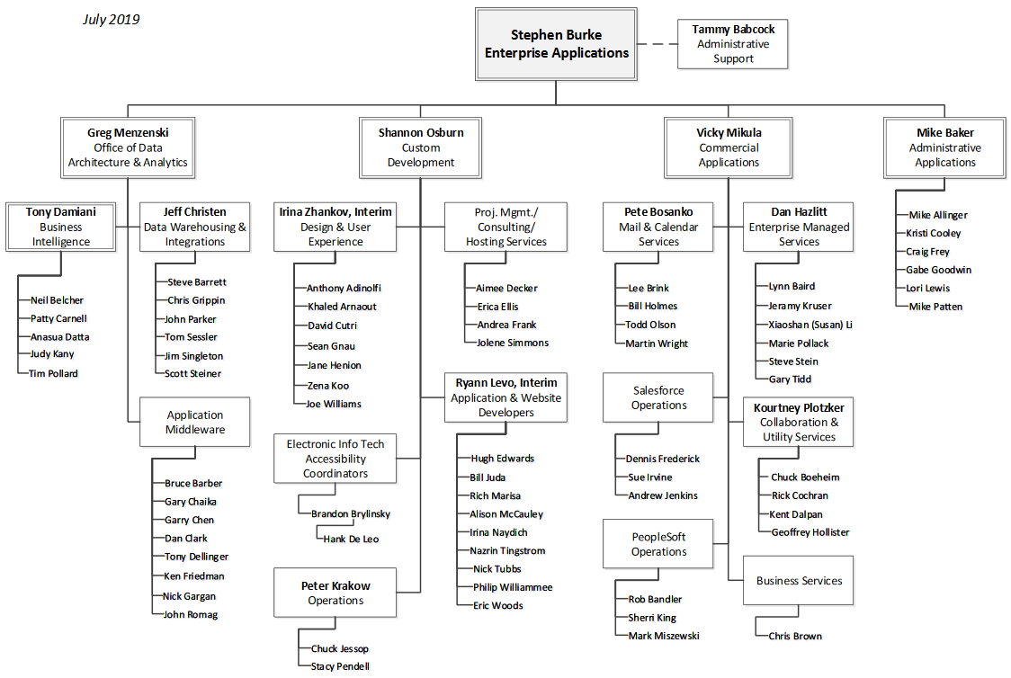
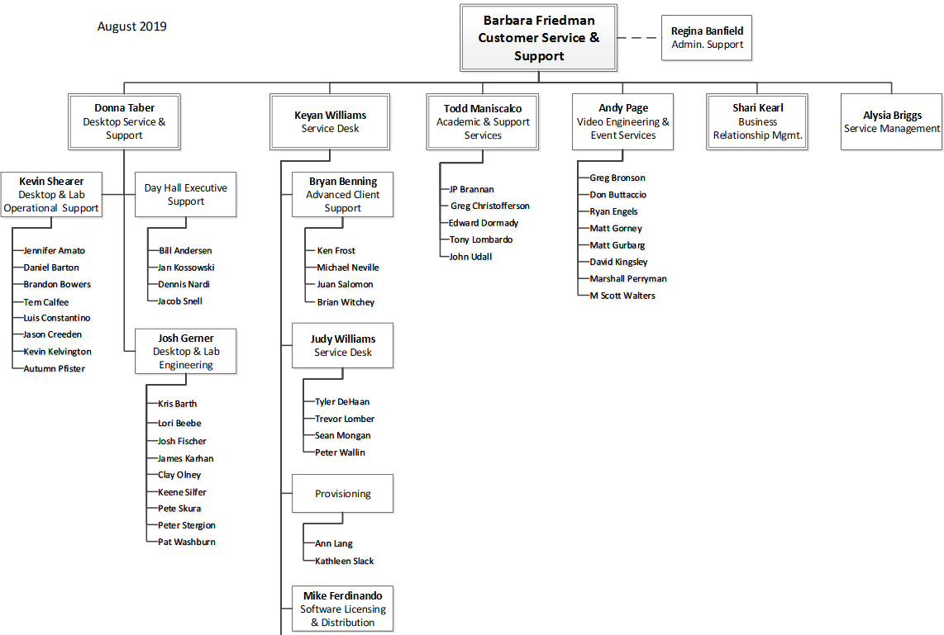
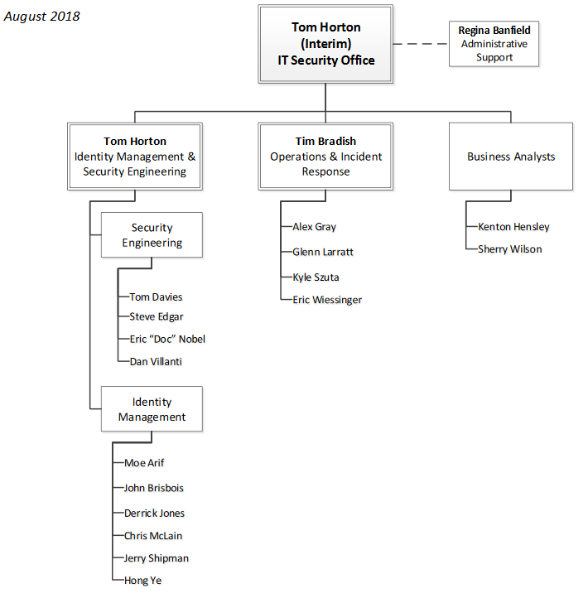
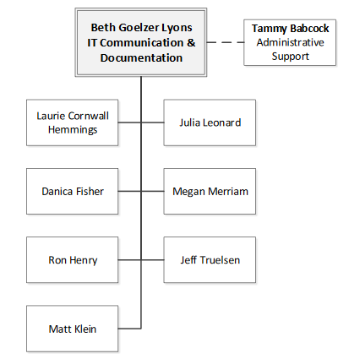
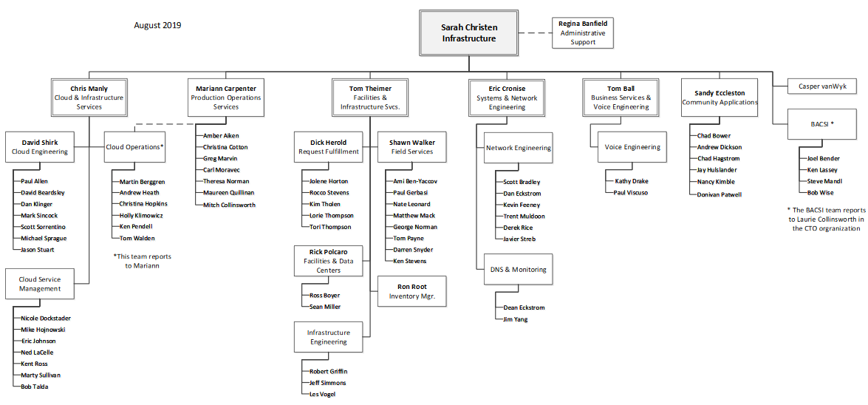
A cross-divisional team

Slide 11

How do we collect and store data from all these systems?
How do we match up device names?
If it’s 95% backed up, is it backed up?
Who has access to the reports?
Who’s responsible for support?
How do we do this on top of our regular work?

Slide 12
Certified Desktop Architecture
JAMF
SCCM
CrowdStrike
Code42
Alertus
Remedy
Asset
Management
Data Aggregator
Spirion
Interactive Reports (Tableau)
CD Data Warehouse

Slide 13
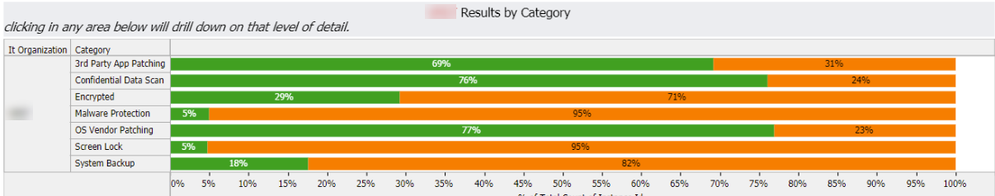
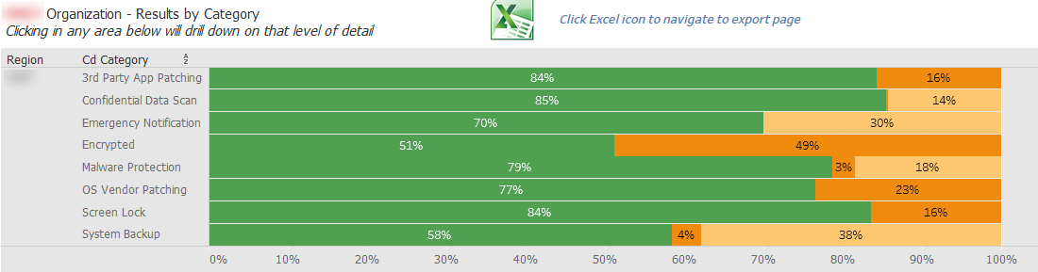
Sample college #1: Desktop security profile, March, 2019
Desktop security profile, October, 2019

Slide 14
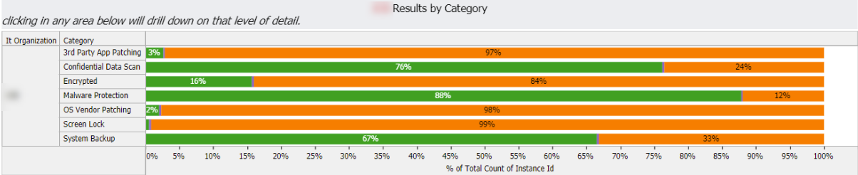
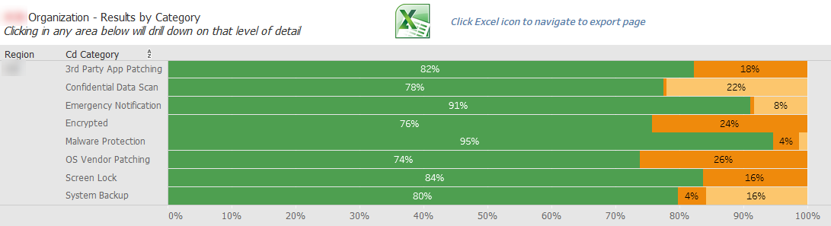
Sample college #2: Desktop security profile, March, 2019
Sample College #2: Desktop security profile, October, 2019

Slide 15
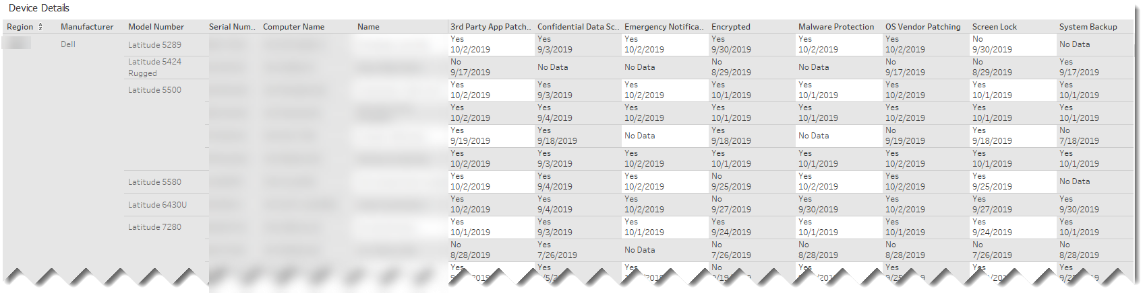
Sample college #2: Detail Data, October, 2019

Slide 16
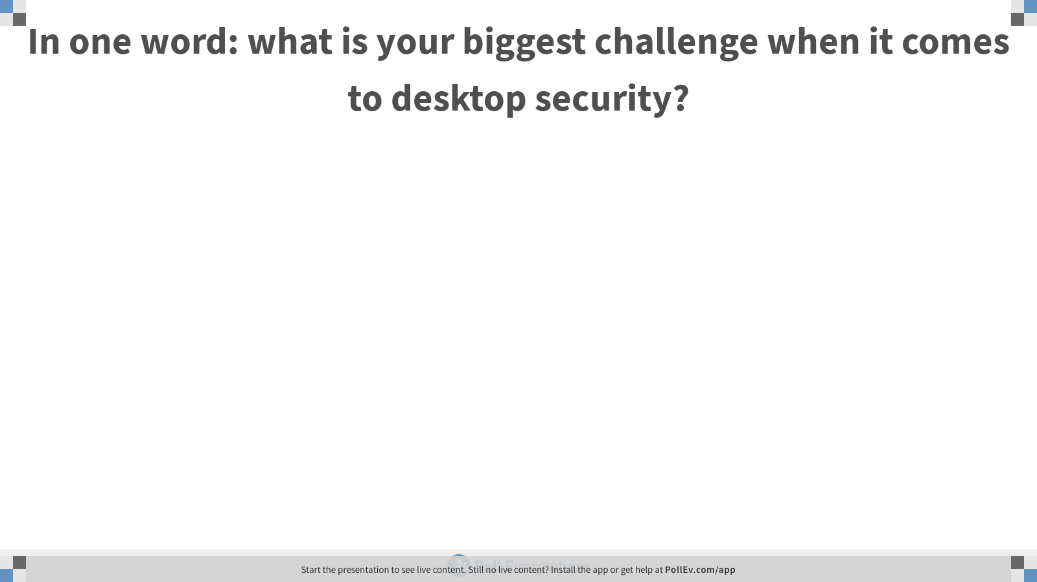
Notes:
Poll Title: In one word: what is your biggest challenge when it comes to desktop security? https://www.polleverywhere.com/free_text_polls/KM7u87pWqsdw0W3PJFVAY

Slide 17
Our Challenges:
Faculty adoption
User experience
Unit-based needs
Resource constraints

Slide 18


Slide 19
Questions?
Contact Information: Tom Horton: horton@cornell.edu Barbara Friedman: btf5@cornell.edu

Slide 20
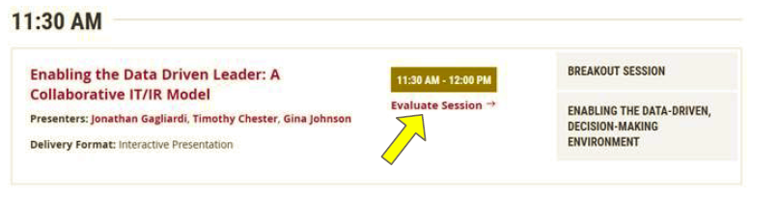
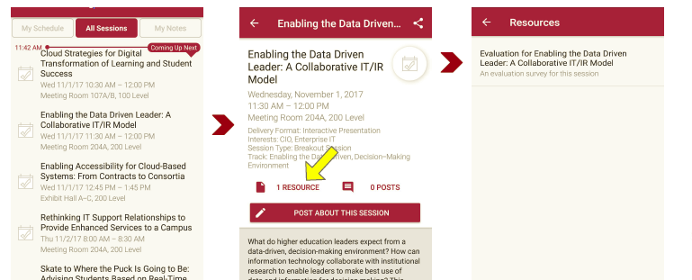
Session Evaluations There are two ways to access the session and presenter evaluations:
1
2
In the online agenda, click on the “Evaluate Session” link
From the mobile app, click on the session you want from the schedule > then scroll down or click on the associated resources > and the evaluation will pop up in the list

Slide 21
"File:Filament Led (140071415).jpeg" by Chicocvenancio is licensed under CC BY 3.0
"Package & Logo Design - Coco Maca" by Kyounghee Lauren Lee is licensed under CC BY-NC 4.0
"Computer Security - Padlock" by perspec_photo88 is licensed under CC BY-SA 2.0
"Pale Pieces" by madth3 is licensed under CC BY-NC-SA 2.0
"File:Cubo mischiato.jpg" by Elbloggers is licensed under CC BY 2.0

