Slide 1
Punching Above Our Weight
Small-College Enterprise IT Stories
Davidson College

Slide 2
challenges - opportunities
Infrastructure
Integrations
Time to deliver new servers - slow
Introduced risk ~ no effective standardization
Differing skillsets and approaches among the team
Technical debt
Multiple devs coding similar if not the same business logic
No shared design patterns
Little if any re-usable code
Multiple error handling solutions
No consistent source control
Technical debt
Notes:
”make this one like that one” method
Differing skillsets
Depth of skill and breadth of experience / system knowledge

Slide 3
not just a technology problem
Our teams were not working as teams; rather, they were strong individual contributors loosely grouped into teams
heroes
problem-solvers
pride in individual work
great customer service
Notes:
These traits are not necessarily bad; however, in our case they all pushed toward working in silos
Some suffered in silence with problems
No effective cross-training, even where we had primary and secondary responsibilities with applications and tasks
No overall approach to how we work – aligned with technical architecture
How do we share work if we all do it differently?
It’s difficult to ensure consistency in manual processes
Heroes don’t scale

Slide 4
the results
Not able to live up to our promises to our stakeholders
People working harder not smarter
Poor work vs. life balance
Everything slows down / can’t keep up with expectations
Our value is not apparent to all of campus
Notes:
Some customers think we are doing great! They have “my person in IT”
Scaling to demand means hiring lots of people

Slide 5
where do we start?
don’t wait for a perfect plan
give your teams the room to tinker and innovate
create opportunities to really work together
small projects create big impact (sometimes)
Notes:
With so much technical debt and “we’ve always done it that way” – where do we start?
You have to start somewhere!
Analysis paralysis
Historically our teams would work very much in the waterfall method
Room to innovate
re-organization (sometimes a shake-up is needed)
Turn hobbies into solutions
Teach each other
Grow our collective skills
Group goals (OKR style)
Opportunities to work together
Peer review / change control
Small projects like supporting the sandbox environment for student dev teams allowed infrastructure to build automated deployments with new tools and tech

Slide 6
developer sandbox project
Need – a lightweight deployment strategy, process, and tools to support our developer community with an insulated development environment
innovation team
student developers
Notes:
What is the solution? - need to validate with John E and JD
Ansible
Github
Moving more toward DevOps
Started as an exercise to support our front-end web developers (Innovation Team)
“sandbox”
Segmented from the rest of the network
Code promotion / release management
Issue their own certs
Create and destroy CentOS servers on the fly
MERN stack deployment – Ansible playbook
Blank CentOS server
Clones repo from GitHub
Installs all dependencies
Sets up a service to run the application
Full on DevOps
Tied to GitHub branch methodology – not completely automated
Reduced dependencies on Infrastructure and Application teams
Mandated code review via branching methodology
Settled on a single deployment workflow and toolset

Slide 7
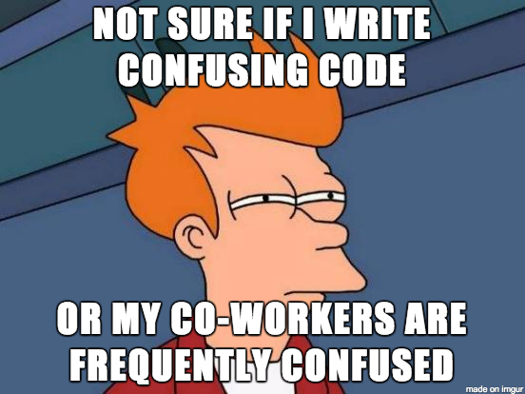
peer code review
Historically – any and all code review was quite informal.
Was not a requirement for release to production.
Resulted in duplication of effort and created challenges in troubleshooting and understanding the work.
Notes:
Implemented as a team goal around the integration project (IPaaS)
Also required developers present their solutions to the team
Peer review is now part of our release management process
Still getting better
Went too far with integration / peer review solution (SnapLogic, GitHub, ZenDesk, etc…)

Slide 8
source control – out of control, that is…
“the code is safe…
right there in the database”
Notes:
Some source control – specifically for .Net web development and SSRS reports.
No consistency – the majority of our custom development was “safe in the database”
Current Solutions
Azure DevOps (formerly visual VSTS, formerly TFS)
GitHub (GitHub for Education)
Our teams didn’t understand the value in release management, source control, etc…

Slide 9
Alex, I’ll take TECHNICAL DEBT for $800 please…
Notes:
Technical Debt
* we’ve built whole processes around work-arounds
Code buried deep in the database – is this Ellucian’s? Is this Ours?
Random tools in a personal toolbox
“I have a script to do that…”
Not always code that needs to be refactored – sometimes processes are implemented which solve a current problem but need to be refactored / re-designed
As soon as you solve the problem – you own the solution
Work processes – PL/SQL developers owning application config and infrastructure

Slide 10
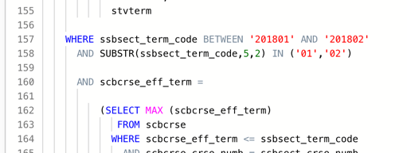
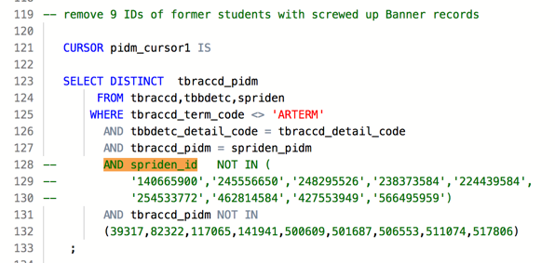
technical debt
Start with simple changes – find technical debt and build scalable solutions vs. constantly maintaining the original debt.
#EDU19
Notes:
Start somewhere
Small changes
Moving ETL to SnapLogic is an opportunity to rework and improve on debt

Slide 11
working together in different ways
Infrastructure as Code
Infrastructure as Code gives infrastructure team opportunities to work with enterprise applications and others around source control, design patterns, and development tools
API
API ecosystems and functionality change the way we work across teams – enterprise applications, business intelligence, integrations, infrastructure, front-end development, etc…
Notes:
API technology
”speaking API” is really the norm for many of our teams now
Tools like SnapLogic are a great catalyst for my PL/SQL developer team in understanding, using, and creating APIs
APIs are discussed during most technical interviews now
APIs are an opportunity for disparate groups of people to work together
Infra as Code
Gets our infrastructure team talking with our applications and digital transformation teams

Slide 12
and now… a live technical demo
Infrastructure as Code
Integration
DevOps

Slide 13
server provisioning and more…
Some numbers to consider:
We have provisioned over 80 servers to date using automation
Windows server provisioning time reduced from ~ 3 hours to 15 minutes
Linux server provisioning time reduced from 30 minutes to 5 minutes
Notes:
Automation can help us scale
Automation helps us produce a consistent OS image (press the button, get a peanut
If it is good enough for Azure – it is good enough for us
Server builds becomes a very simple process, allowing admins and engineers to focus on the most important “stuff”

Slide 14
Ansible & AWX

Slide 15
Server builds are as easy as filling in a few
text boxes and pressing launch.

Slide 16
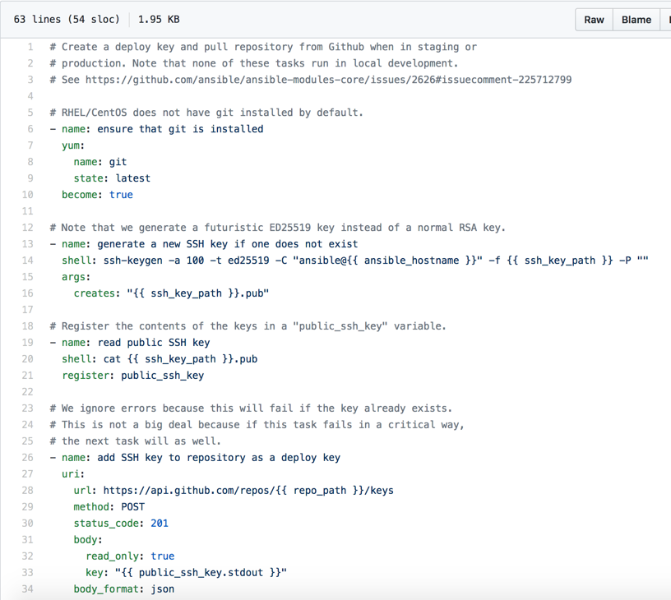
Remember that sandbox project?

Slide 17
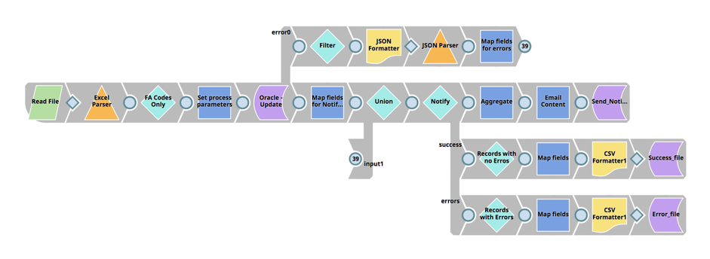
Integration - SnapLogic
Notes:
SnapLogic
IPaaS
Easy onboarding
Accommodates “no-code” and more advanced coding

Slide 18
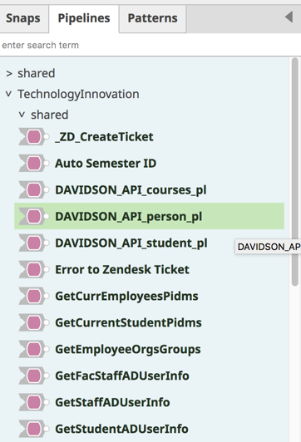
reusable components
one platform ~ multiple teams
better error handling
faster to production
Notes:
Code re-use

Slide 19
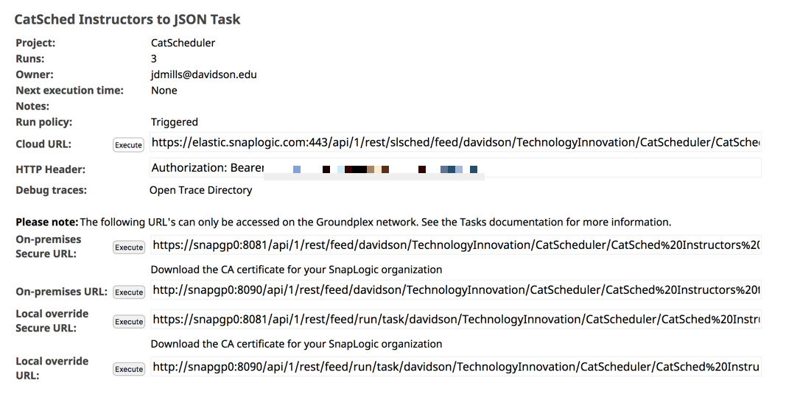
easy API development
Notes:
PL/SQL developer teams developing APIs with each “pipeline”
Pipelines can consume other pipelines via API

Slide 20
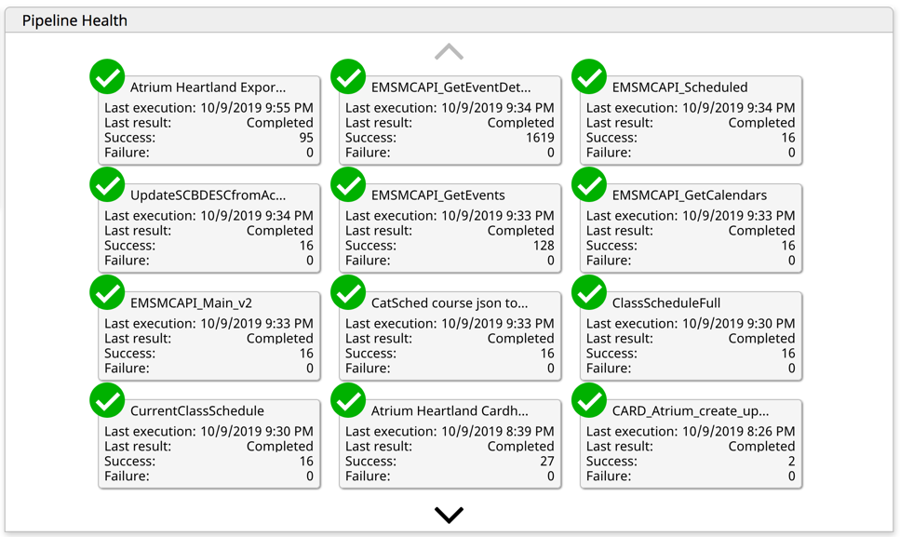
better insights and awareness
Notes:
From cron jobs running shl scripts executing PL/SQL programs to a much better UI / UX

Slide 21
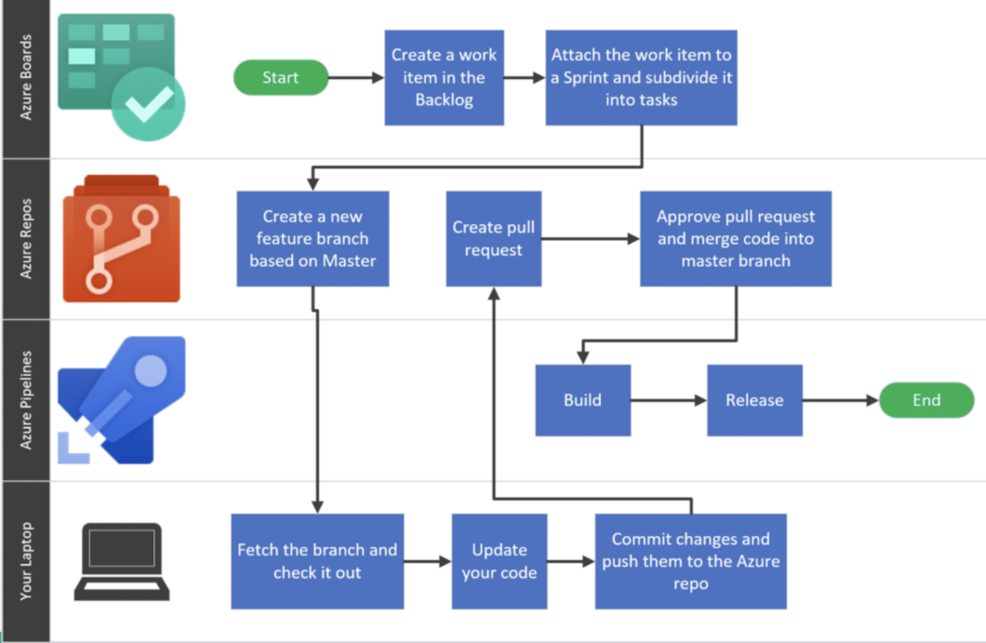
continuous integration / deployment
Azure DevOps
Automated processes and technology
No additional investment
Room to experiment, learn, and innovate
Notes:
BI environment – using AzureDevOps for CI/CD
Tied to branching strategy
Already part of our ecosystem
MSDN licenses for our developers give us the appropriate access here

Slide 22
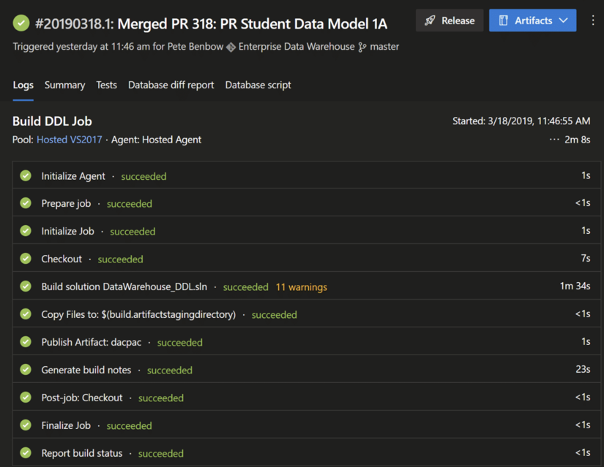
time to deliver solutions
reduced significantly
Notes:
Much improved over manual processes

Slide 23
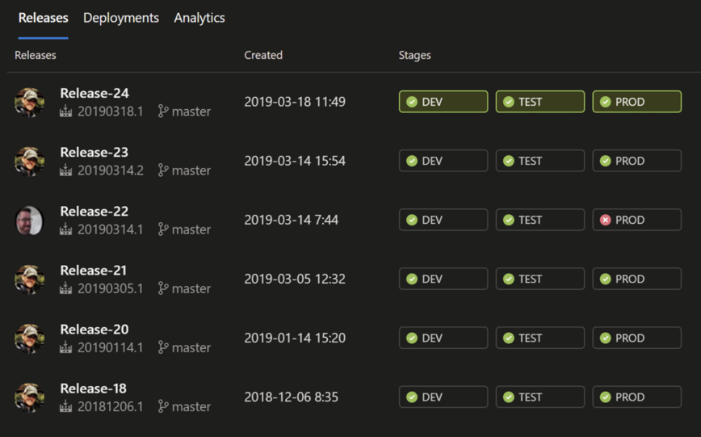
automation reduces risk
Notes:
Note the only failed deployment is mine…

Slide 24
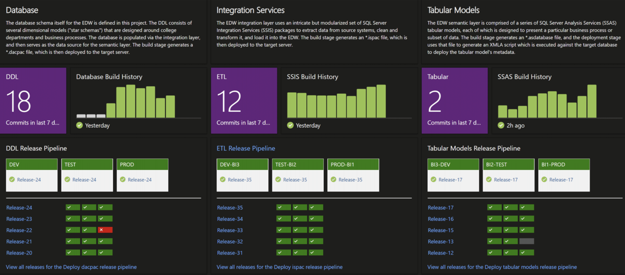
continuous integration / deployment
transparency – no hidden technical debt
Notes:
Transparency
No hidden technical debt!

Slide 25
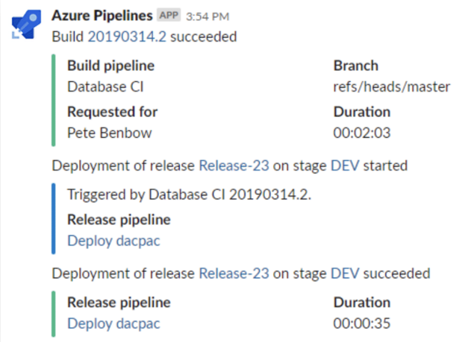
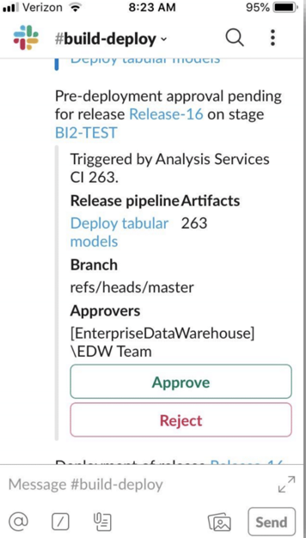
further integration – look at your modern tools
Notes:
Modern tools / API allow for additional automation and innovation
Slack
Note the phone screen

Slide 26
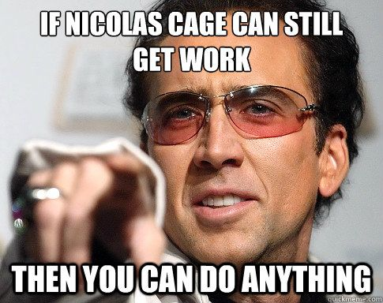
how you can do it
start small
find some technical debt and attack ”why it exists” not just “it”
automate what can be automated
- server builds, account management, look for APIs
innovation vs. rework
- reusability, work together, consolidate methods as well as tools
Notes:
Just buy a new integration platform for thousands of bucks!
https://www.reddit.com/r/sysadmin/comments/cdlar7/psa_still_not_automating_still_at_risk/

Slide 27
where do we go from here?
Hiring for aptitude and adaptability vs. supporting our technical debt.
Remember when I said ”the Davidson API”?
Continue to tighten up release management with continuous integration / delivery
All this and the cloud too?
More granular in our server deployment templates / builds
Don’t stop at the OS – continue to automate environments
Re-invest from the OS to the tools (CentOS vs. RHEL and Ansible Tower vs. AWX)
Containerization of our enterprise apps? DegreeWorks in a container?
Enabling our Campus IT Partners
Promote and support the ”product owner” role across campus

Slide 28
some tools we use
SnapLogic
GitHub
AzureDevOps
PowerShell
Ansible / AWX
Postman
Slack
ZenDesk
Notes:
https://www.reddit.com/r/sysadmin/comments/cdlar7/psa_still_not_automating_still_at_risk/

Slide 29
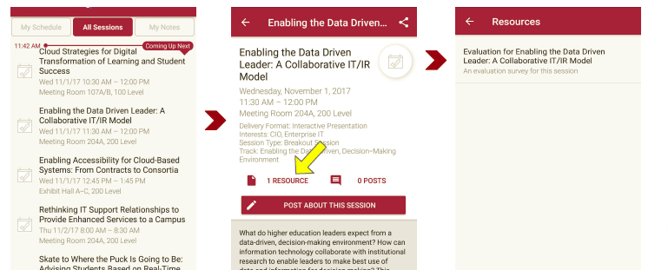
Session Evaluations There are two ways to access the session and presenter evaluations:
1
2
In the online agenda, click on the “Evaluate Session” link
From the mobile app, click on the session you want from the schedule > then scroll down or click on the associated resources > and the evaluation will pop up in the list

Slide 30
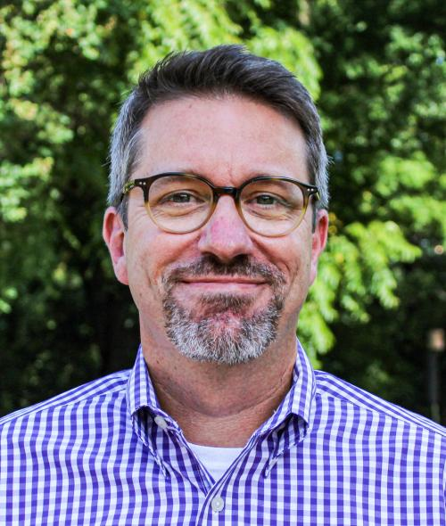
contact information - presenters
Nick Roberts
John Eggleston
niroberts@davidson.edu
704-894-2431
@TweetsOfNick
joeggleston@davidson.edu
704-894-2895
NOTE: This presentation leaves copyright of the content to the presenter. Unless otherwise noted in the materials, uploaded content carries the Creative Commons Attribution 4.0 International (CC BY 4.0), which grants usage to the general public, with appropriate credit to the author.

Slide 31
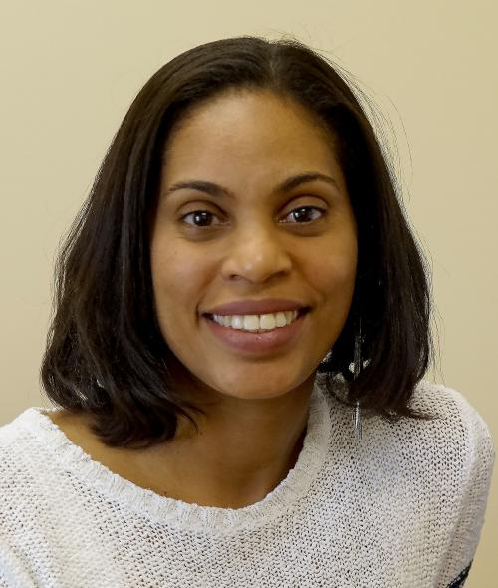
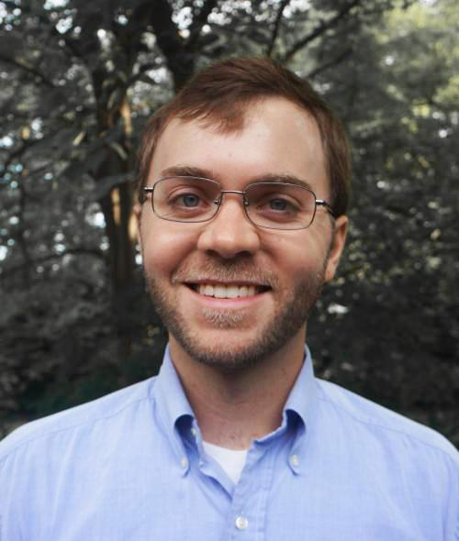
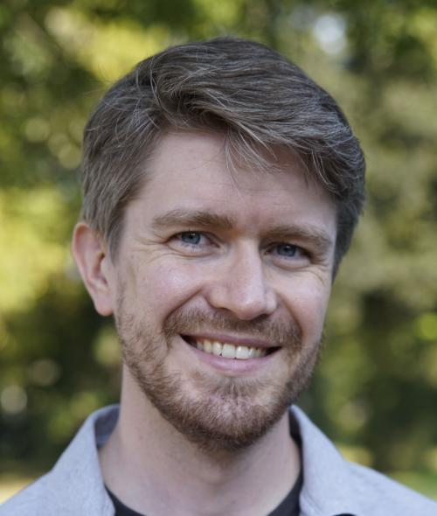
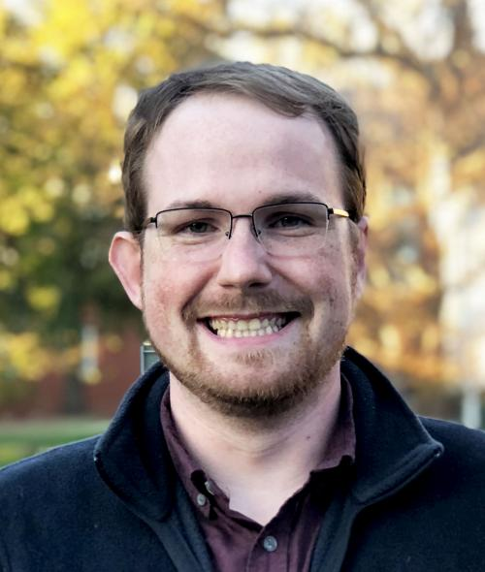
contact information – some innovators
Johanna Ramirez-Sanchez
joramirezsanchez@davidson.edu
Integrations and API development
(SnapLogic)
JD Mills
jdmills@davidson.edu
Sandbox deployment / integrations
(Ansible, AWX, GitHub, SnapLogic)
Pete Benbow
pebenbow@davidson.edu
BI Continuous Integration / Continuous Delivery
(Azure DevOps)
Mike Sapp
misapp@davidson.edu
Infrastructure as Code
(Ansible, AWX)

