Slide 1
You’re legally required to caption videos:
Where do you start?
Lucy Greco
Jen Bellenger

Slide 2
Overview
The challenge behind captioning
Finding out what others are doing
Learning from the results
Ways to start your captioning journey

Slide 3
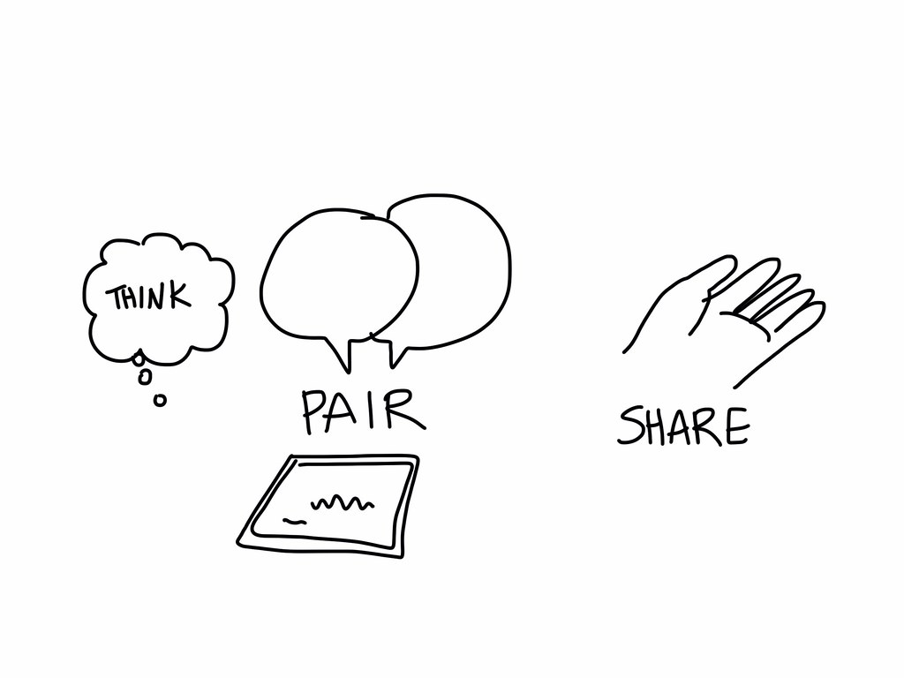
What brings you here?

Slide 4
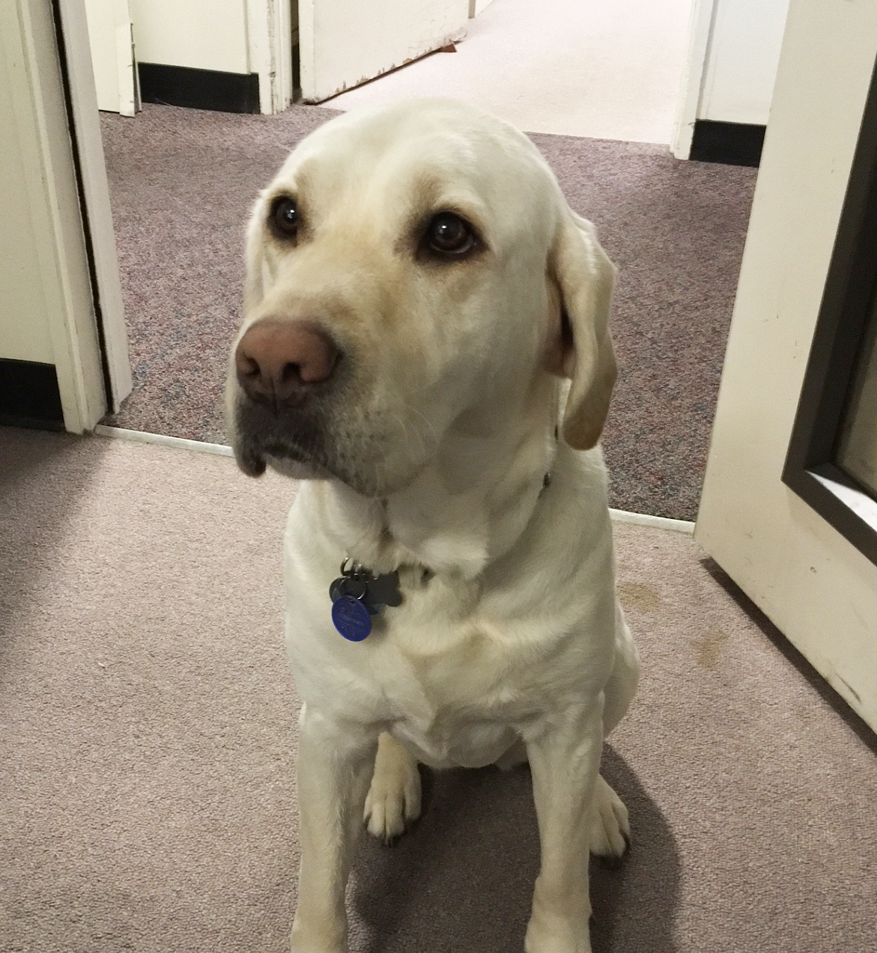
UC Berkeley’s Journey
Confronted with large number of videos being made by everyone and their dog ;-)
Needed a plan to address existing and future videos
Needed to educate everyone about how to address the problem

Slide 5
Getting over the sticker shock
If you approach this sensibly:
You can take your time, and;
It won’t cost as much as it might initially seem

Slide 6


What are you doing at your institution?
Find a partner and ask the following:
  What kind of videos do you caption?
  How are you captioning them?
  How much does it cost you?

Slide 7
What we learned from accessibility leaders
Primary focus on students requiring accommodations
Many non-course-related videos are being captioned
Majority have some means for people to request captions
Descriptive video is less frequent but shows the same trends

Slide 8
Moving forward: Create a priorities checklist
Videos that are conveying emergency status and information
Any video that is made to represent the organization should be captioned
Use a tool to determine what the top 10% of watched videos are
Topics of interest to the community as a whole should be captioned
Topics of interest to people with disabilities should always be captioned
Anything with international impact should be captioned (to allow for various translations)

Slide 9
Why not just give people a way to ask for captions when you’ve missed something?
It's the right thing to do!

Slide 10
Tools you can use to keep down the price
YouTube auto captions are easy to edit, and fix.
CADET captioning, which is free and easy to learn.
Paid-services like 3playmedia
Other free tools to explore: Otter.ai, Amara

Slide 11


Captioning Demo

Slide 12

Questions?
Link to survey: https://webaccess.berkeley.edu/survey
Link to summary of survey responses: https://webaccess.berkeley.edu/survey-responses

Slide 13
Contact Information
Lucy Greco: lgreco@berkeley.edu
Jen Bellenger: jbellenger@berkeley.edu
NOTE: This presentation leaves copyright of the content to the presenter. Unless otherwise noted in the materials, uploaded content carries the Creative Commons Attribution 4.0 International (CC BY 4.0), which grants usage to the general public, with appropriate credit to the author.

