Slide 1
Best Practices in Online Career
Guidance Systems in Career Development
Bryan Dik, Ph.D.
Colorado State University
jobZology and PathwayU
Kurt Kraiger, Ph.D.
University of Memphis
jobZology and PathwayU

Slide 2
AGENDA
What is Evidence-Based Practice?
  Layers of Evidence
Online Career Guidance Systems
  What Are They?
  Pros and cons
Converging EBP and OCGS
  What works in Career Interventions?
  5 Critical Ingredients
Establishing Your Own Evidence Base
  Case Studies (ours and yours)
Q&A
This presentation leaves copyright of the content to the presenter. Unless otherwise noted in the materials, uploaded content carries the Creative Commons Attribution 4.0 International (CC BY 4.0), which grants usage to the general public, with appropriate credit to the author.

Slide 3
Evidence-Based Practice
Really—what is evidence-based practice, exactly?
  Any practice that relies on scientific evidence for guidance and decision-making.
Why does it matter?
  Because we want to do things that work!

Slide 4
Evidence-Based Practice
How do you incorporate evidence-based practice in the career development support you provide for students?
Notes:
What is it?
Any practice that relies on scientific evidence for guidance and decision-making.
How is evidence-base established?
Non-experimental studies
Randomized controlled trials (RCTs) of interventions
Meta-Analyses
Gathering evidence of your own effectiveness

Slide 5
Evidence-Based Practice
Layers of Evidence
  Non-experimental studies
  Randomized controlled trials (RCTs)
  Meta-Analyses
  Gathering your own evidence of effectiveness

Slide 6
Online Career Guidance Systems
What are OCGS?
What are their pros and cons?
Notes:
Online Career Guidance System
Computerized, interactive, individually operated tools designed to promote career exploration and choice
Consists of
computer-administered career assessments
feedback on the career-related characteristics
career exploration

Slide 7
Converging Evidence-Based Practice and OCGS
What works in career interventions?
  Liu, Huang & Wang (2014)
  Whiston, Li, Mitts & Wright (2017)
  Brown & Ryan Krane (2000)
5 Critical Ingredients
W- I – M - S - I

Slide 8
What Works in Career Interventions?
Written Exercises
Individualized Interpretation & Feedback
Modeling of Effective Career Decision-Making
Support-building from Important Others
Information about Work

Slide 9


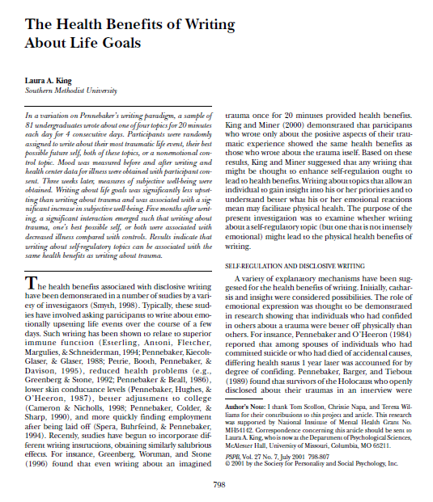
1. Written Exercises
Notes:
Journals, diaries, logs, workbooks e.g.,
Values evaluation exercise encouraging
students to explore fit of their career
and life goals
Encouraging students to search for
and reflect on career information
Reality-check exercises targeting
occupational misperceptions and
stereotypes
Goal-setting exercises

Slide 10
1. Written Exercises
Try it!
Think about your career in the future. Imagine that everything has gone as well as it possibly could. You have worked hard and succeeded at accomplishing all of your career goals. Think of this as the fulfillment of your calling. Now, write about what you have imagined.

Slide 11

2. Individualized Interpretation and Feedback
Frank Parsons (1909)
In Choosing a Vocation
Notes:
“In the wise choice of a vocation there are three broad factors: (1) a clear understanding of yourself, your aptitudes, abilities, interests, ambitions, limitations and their causes; (2) a knowledge of the requirements, conditions of success, advantages and disadvantages, compensation, opportunities, and prospects in different lines of work; (3) true reasoning on the relations of these two groups of facts.”

Slide 12

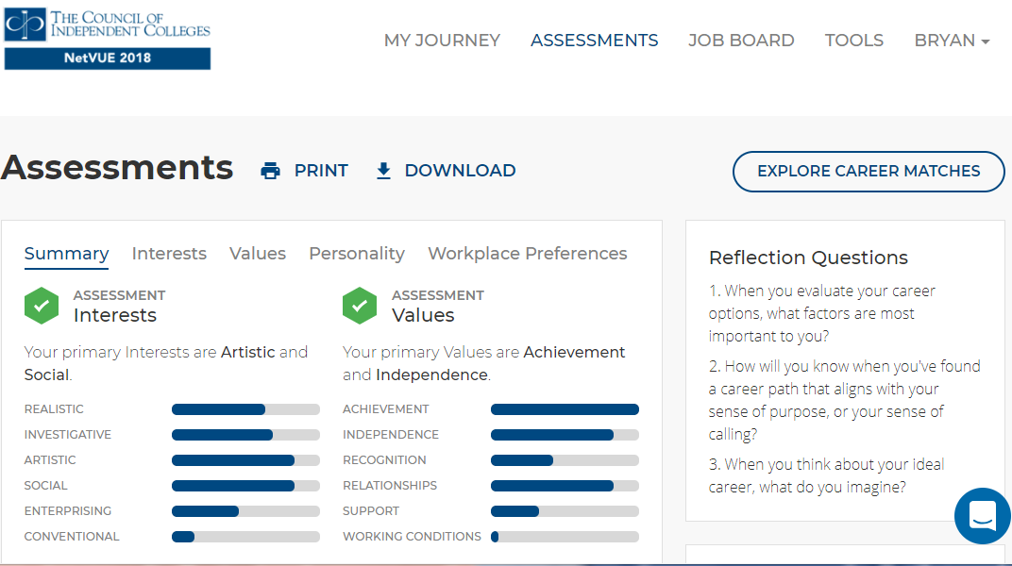
2. Individualized Interpretation and Feedback

Slide 13
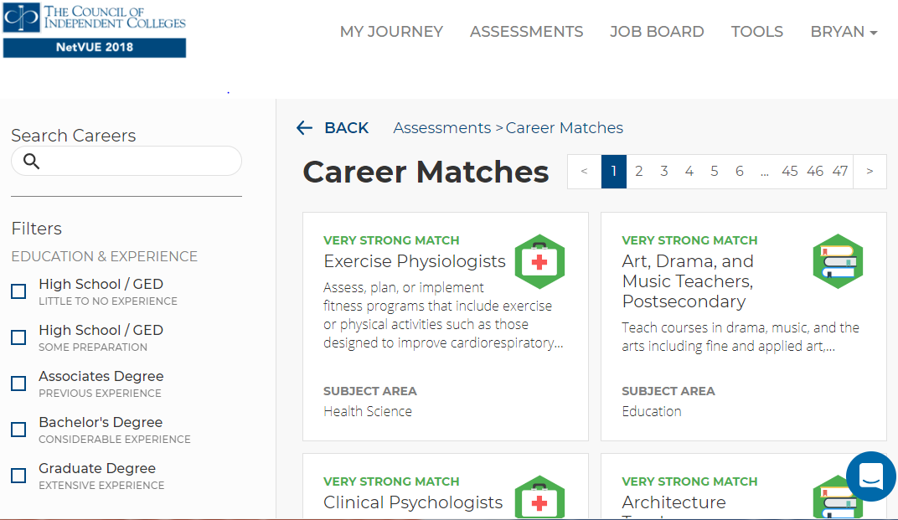
3. (Accurate) Information About Work

Slide 15
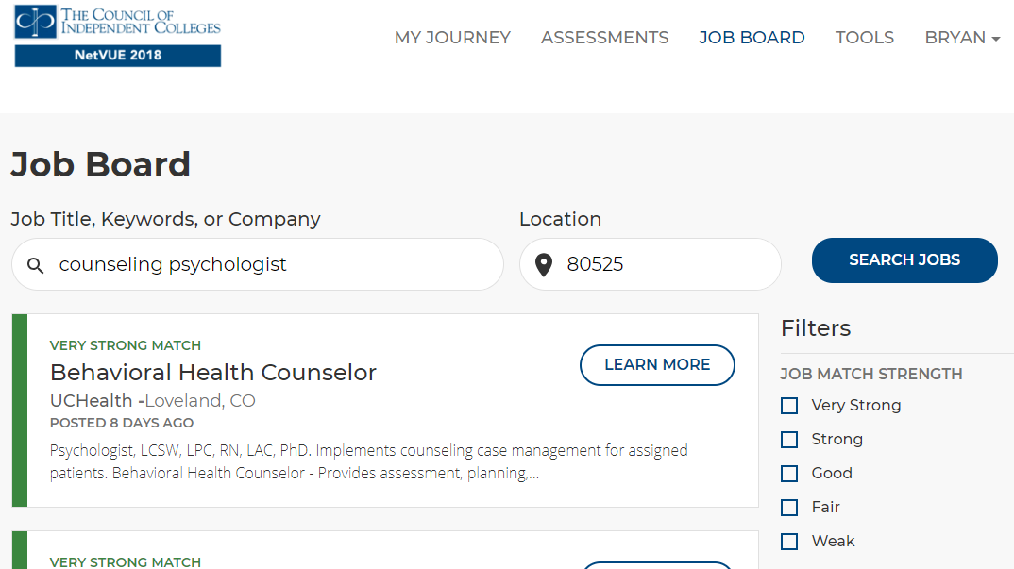


Slide 16

4. Modeling and 5. Support
Personal Board of Directors:
Think of 3-5 people who you know well, who have special wisdom, who are good listeners and candid truth-tellers, and who have your best interests in mind. Write down their names here:
(Assign the students to follow up with one-on-ones, tell their story to these folks, and ask for feedback and advice.)
Notes:
Some options:
Vocation groups (career services, residence life, departments)
Invite parental involvement (parents weekend, parent interview assignment)
Encourage students to create a “personal board of directors”

Slide 17
Establishing Your Own Evidence Base
Measure your students pre-intervention
Measure your students post-intervention and at follow- up intervals
Examine change scores and evaluate outcomes
Things to assess:
Career decision confidence Degree of vocational clarity Seeking, having, living a career-related purpose Satisfaction with the intervention | Retention Graduation Rate GPA Satisfaction in post-graduation employment

Slide 18
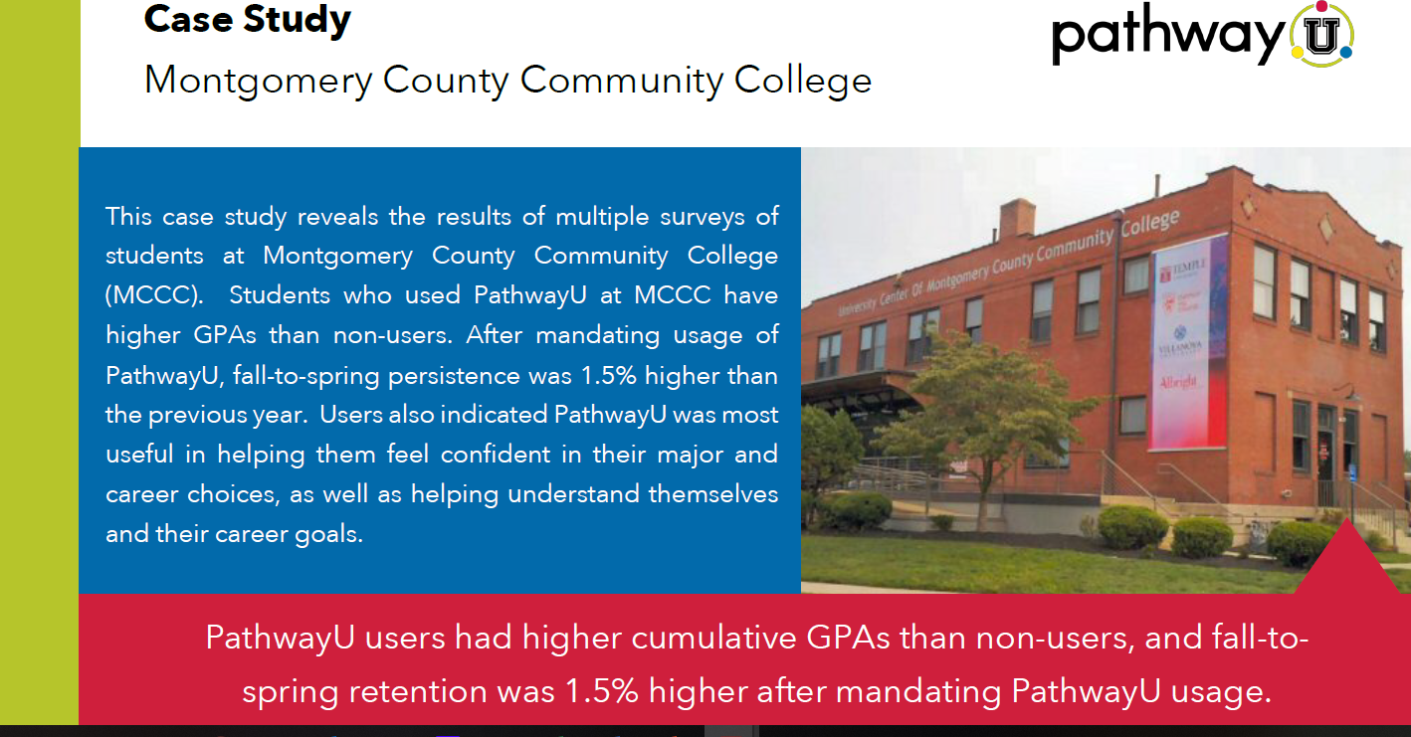
Case Study 1

Slide 19
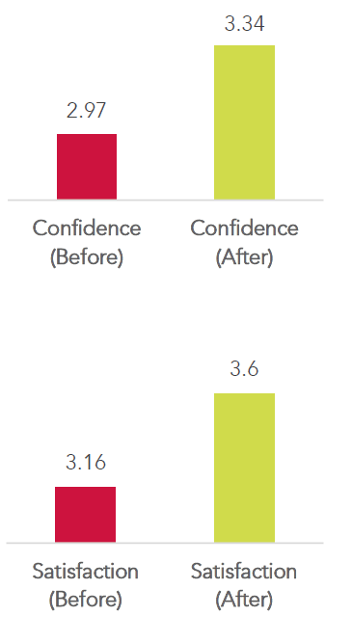
Case Study: Students from 5 different universities
Confidence in navigating the career decision process:
Satisfaction with one’s career direction:

Slide 20
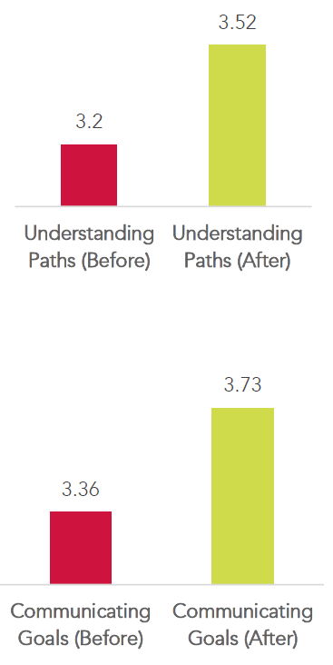
Case Study: Students from 5 different universities:
Knowledge of best-fitting career paths:
Confidence in communicating career goals:

Slide 21
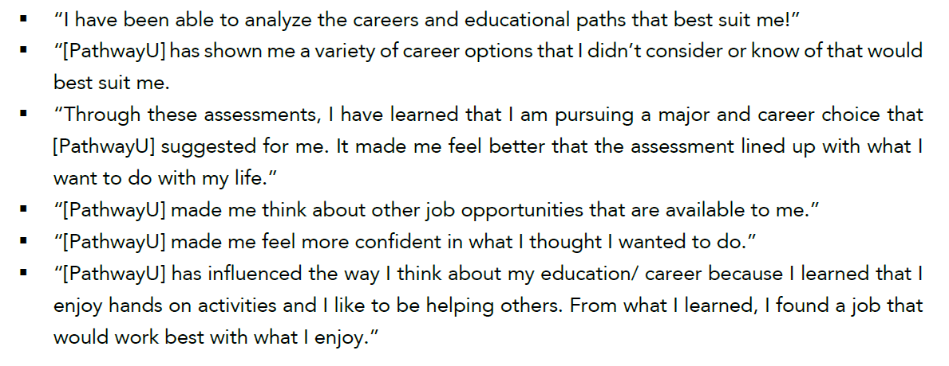
Case Study: Students from 5 different universities:
Qualitative feedback:

Slide 22
Questions?

