Slide 1
Learner-Centered Instructional Development
Welcome!
Please begin the reflection activity on page one of the packet at your table as we wait to begin.

Slide 2
In 2017…
Descriptors: ad hoc, small impact, limited
Aspirations: strategic, accessible and inclusive, evidence-based, learner- and customer-centered, impactful

Slide 3
543
August 2015 – July 2017

Slide 4
543
August 2015 – July 2017
1528
August 2017 – September 2019

Slide 5
Learner-Centered Instructional Development
Diversifying Approaches, Expanding Audiences, and Increasing Impact
Notes:
This presentation leaves copyright of the content to the presenter. Unless otherwise noted in the materials, uploaded content carries the Creative Commons Attribution 4.0 International (CC BY 4.0), which grants usage to the general public, with appropriate credit to the author.

Slide 6
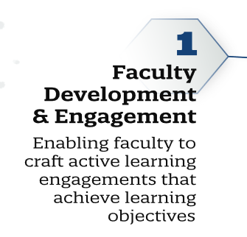
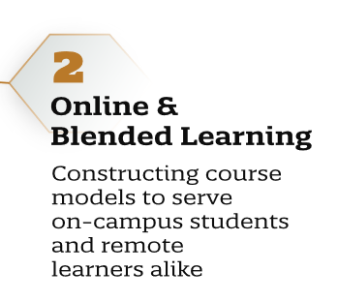
Educause 2019 Key Issues in Teaching and Learning
Notes:
This presentation leaves copyright of the content to the presenter. Unless otherwise noted in the materials, uploaded content carries the Creative Commons Attribution 4.0 International (CC BY 4.0), which grants usage to the general public, with appropriate credit to the author.

Slide 7
Notes:
This presentation leaves copyright of the content to the presenter. Unless otherwise noted in the materials, uploaded content carries the Creative Commons Attribution 4.0 International (CC BY 4.0), which grants usage to the general public, with appropriate credit to the author.

Slide 8
Instructional Development
“… focus on the course, the curriculum and student learning… ”
- POD Network, What is Educational Development?

Slide 9
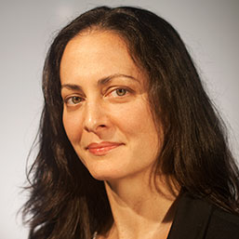
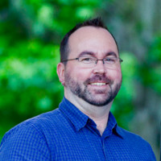
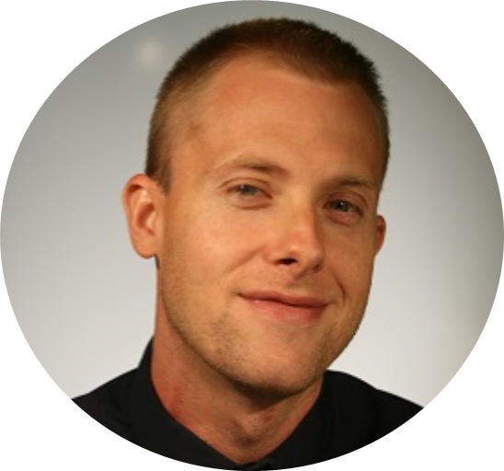
THE PRESENTERS
Shannon Dunn, Ph.D.
Assistant Director, UFIT
@Shannon_M_Dunn
Phillip J. Herr-Klepacki, M.M.
Director for Distance Education, College of the Arts
@pjklepacki
Chris Pinkoson, M.Ed.
Instructional Designer, UFIT
@chrispinkoson

Slide 10
Outcomes
Explore instructional development processes
Begin a plan
Collaborate with colleagues
Access resources

Slide 11
Outline
Introduction
What we did, and how
Faculty perspective
Opportunities for
Reflection, planning, and sharing
Follow up, ongoing discussion

Slide 12
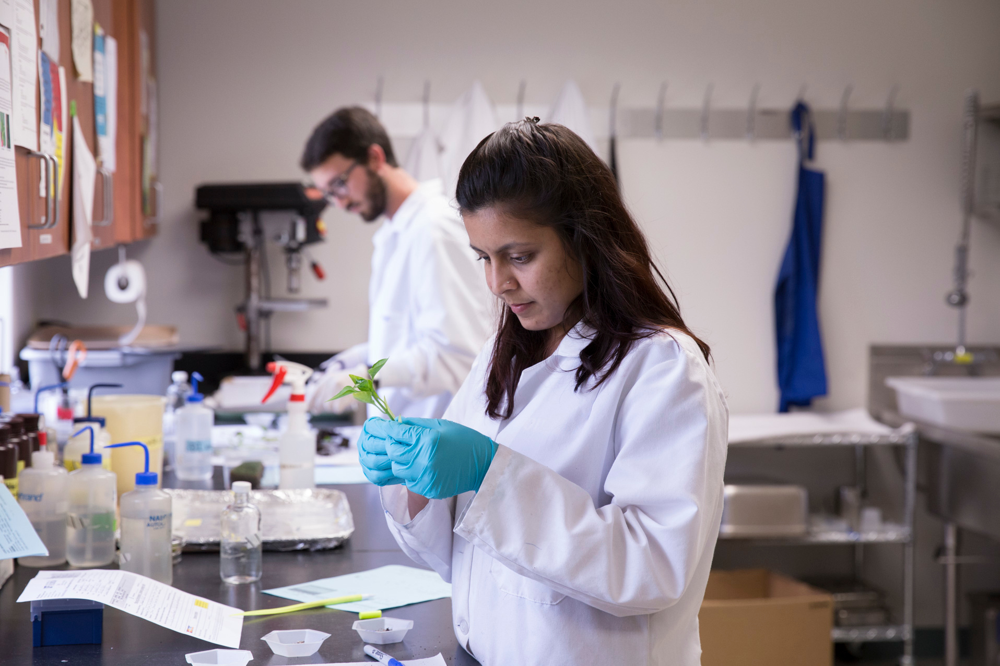
University of Florida
Institutional snapshot
Core instructional support resources
UFIT CITT Instructional Design
Center for Teaching Excellence
Notes:
Photograph citations/source:
https://ufphotography.photoshelter.com/galleries/C0000pm6YaTesuG0/G0000bITQ545dlpc/I00004rQGQkircO0/20160330-PDC-Lab-0827-RFS-jpg
https://ufphotography.photoshelter.com/galleries/C0000pm6YaTesuG0/G0000bITQ545dlpc/I0000BBZf8ckOr3g/EZ-20110914-UF-fish-sampling-0030-jpg

Slide 13
Where we began
Self-paced offerings
Instructional Design Workshop
Accessible Online Environments
Client profiles
Resident, research-focused, tenure-track
Resident, teaching-focused, lecturer
Distance, professional, adjunct
Distance, extension office

Slide 14
Reflect and plan!
Identify: Opportunities, Needs, or Challenges
Four minutes
First page of plan

Slide 15
Initial steps
Opportunity
Need
Challenge

Slide 16
Reflect and plan!
Identify: Resources or Collaborators
Four minutes
Second page of plan – top portion

Slide 17
Initial steps
Resources
Collaborators

Slide 18
What we did, and how

Slide 19
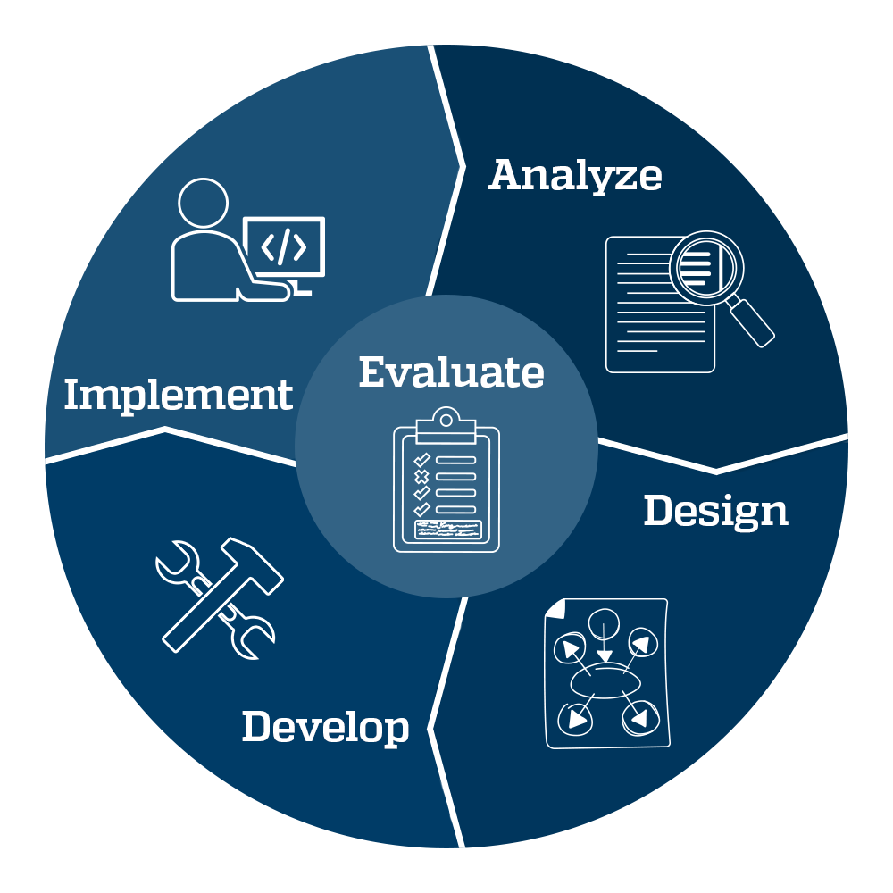
ADDIE

Slide 20
What we did
Identified campus needs
Grouped topics
Badge for workshop
Certificates of completion for series
Modeled best practice and learner-centered design
Collaborated to set development goals and timelines

Slide 21
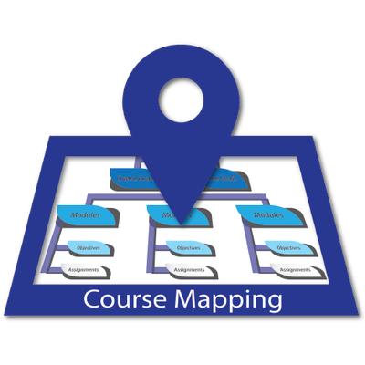
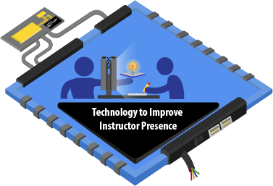
Credentials

Slide 22
Between Summer 2017 and Summer 2019
8
Certificates of completion
61
Individual workshop offerings

Slide 23
Since August 2017
1528 participants
811 completions
53% completion rate
Most popular series is Best Practices for Teaching Online
40% of overall participants

Slide 24
Feedback
“One of the most valuable aspects was the ability to see what my students are seeing when they take a Canvas course.”
“I appreciated how the workshop was provided in pieces, and each built on the one prior.”
“Thanks for putting together another awesome short course with interesting and informative content! I really appreciated your feedback and these materials will be very useful as a reference for course development. I now have lots of great ideas for improving online learning!”

Slide 25
Success
99%
Feedback survey respondents would use parts of the workshop as a model for their own course

Slide 26
In 2019…
Descriptors: learner- and customer-centered, evidence-based, impactful
Aspirations: more strategic, more accessible and inclusive, more impactful

Slide 27
IMPACT

Slide 28
Roles at UF
Director of Distance Education, College of the Arts
Advising and administration for degree and certificate programs
Over 500 majors and almost 100 minors
Adjunct Lecturer, MUL2010 “Experiencing Music”
Online general education class
Current enrollment: 190 students

Slide 29
Relationship with UFIT CITT
2010: develop face-to-face course into an online format
2013: transition from Sakai to Canvas
2015: complete overhaul of the course
Ongoing presentations and workshops on teaching practices and online tools

Slide 30
Instructional development needs
Continual evaluation and improvement of courses, both teaching and advising
Assisting colleagues and faculty

Slide 31
Workshop experience through CITT
Best Practices for Teaching Online:
Accessible Online Environments
Creating Student-Centered Assignments
Engaging Online Learners
Face-to-face workshops:
Course Mapping Camp
Engaging and Meaningful Discussions
Using Quiz Analytics for Stronger Assessments

Slide 32
Application of workshop content
Short-term
Revision of materials for accessibility
Incorporation of technology (VoiceThread; Quizlet)
Long-term
Examine assignments for academic rigor/higher-level thinking
Revising assignments for greater (inter)activity
Assessment of modules as a whole
Clear and measurable learning objectives
Tasks that support and reinforce these objectives

Slide 33
Reflection activity
What would you like to start doing in the next 6-12 months?

Slide 34
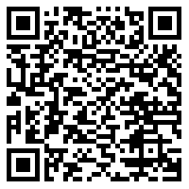
Continue the conversation!
UFIT CITT Educause 2019 Course
Access example content
Optional credential activity
https://bit.ly/2koNzSL

Slide 35
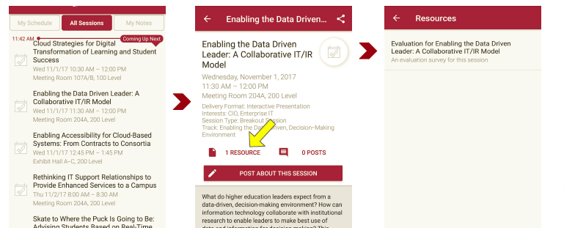
Session Evaluations There are two ways to access the session and presenter evaluations:
1 In the online agenda, click on the “Evaluate Session” link
2 From the mobile app, click on the session you want from the schedule > then scroll down or click on the associated resources > and the evaluation will pop up in the list

