Slide 1
Transforming the Student Experience a Sprint at a Time
Paul Dosal
Alice Wei
Sidney Fernandes

Slide 2
Sprint Zero
Lets start Planning

Slide 3
Sprint 0
Why are we all here?
Team Norm setting – introductions and agreed upon norms
Create the basic skeleton and plumbing for the project so that future sprints can be truly add incremental value in an efficient way. It may involve some research spikes.
Minimal design up front is done in Sprint Zero so that emergent design is possible in future sprints. This includes putting together a flexible enough framework so that refactoring is easy.
Outlines of an MVP should be defined

Slide 4
Introduction to your Development Team
Dr Paul Dosal
Alice Wei
Sidney Fernandes

Slide 5
Notes:
Poll Title: What do you expect to learn from this Session https://www.polleverywhere.com/free_text_polls/GPJXYPqcgXeXjJYAHWsIQ

Slide 6
Notes:
Poll Title: What is important to you - Ranking our Backlog items https://www.polleverywhere.com/ranking_polls/Q5pcFJJWaCfRMG2YUPr4W

Slide 7
Sprint 1
Student Success at USF (Work effort 10 mins)

Slide 8
Introduction to USF
High-impact global research university dedicated to student success
2018-19 System Enrollment: 50,755 (37,333 undergrads)
Ranked 44th best public university in the USA (U.S. News & World Report, 2019)
Ranked #1 among all public universities in the USA for 6-year graduation rate improvement over past 10 years (University of Utah, 2019)

Slide 9
First Year Students Retention Rate

Slide 10
6-Year Graduation Rate

Slide 11
6-Year Graduation Rate: Race & Ethnicity

Slide 12
6-Year Graduation Rate: Pell vs. Non-Pell

Slide 13
4-Year Graduation Rate

Slide 14
Predictive Analytics Allow USF to…
Identify at-risk students in a large population before problems occur
Have a 360° view of students
Refer students to the appropriate expert
Transform passive support services into active outreach
Utilize resources more effectively to expand capacity
Right Support, Right Student, Right Time

Slide 15
#1

Slide 16
USF Usage of Predictive Analytics
Adoption of Miller/Herreid Persistence Model (2012)
Pre-matriculation model identifies top 10% of new students most at risk of not persisting
Student interventions coordinated through first-year course, resident assistants and advisors
Introduction of ‘Big Data’ (2014)
Civitas Learning’s predictive analytics platform purchased
Live data feed from SIS and LMS systems
Data ingestion completed in spring 2016

Slide 17
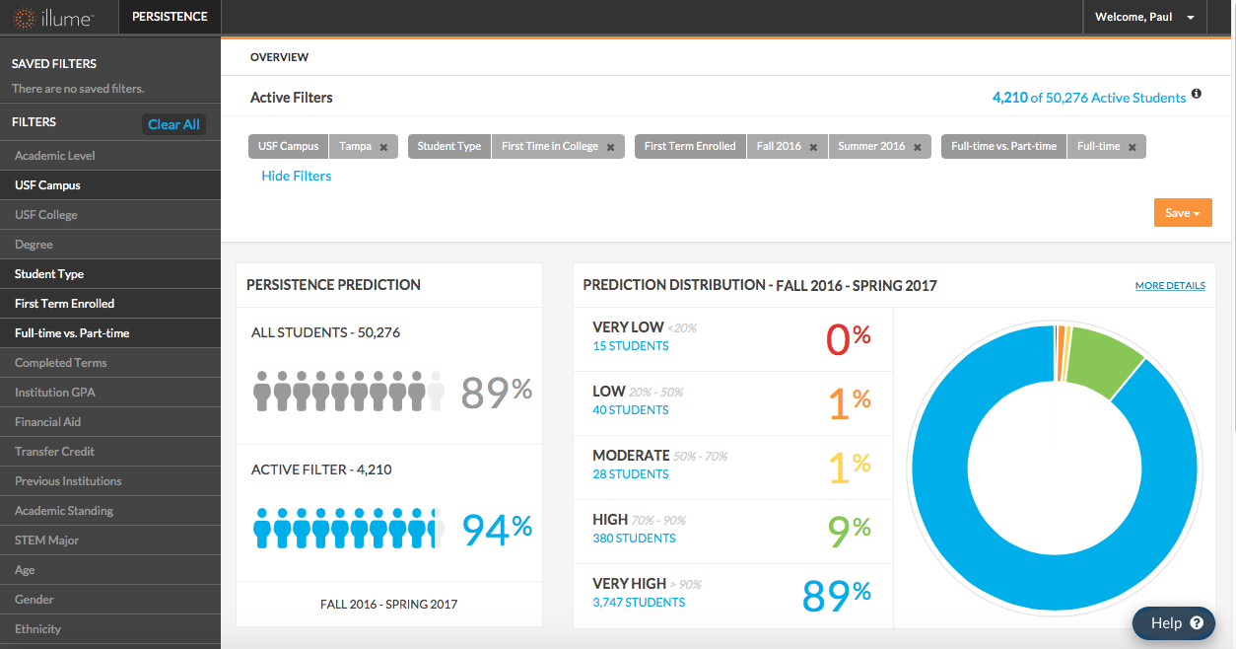
Civitas Learning Predictive Analytics
2-4%
of Students Need Intervention

Slide 18
Persistence Committee
Formed in early 2016; initial focus on 2015 cohort
Cross functional team who identifies and supports all at-risk students through timely and appropriate interventions
Academic Advocates (case managers)  Financial Aid
Housing & Residential Education  Academic Advisors
Academic Foundations Instructors  Cashier’s Office
Orientation Team Leaders  Library
Career Counselors  New Student Connections
Reviews at-risk students bi-weekly and segments according to risk level
Engages appropriate personnel for student contact (Care Team)

Slide 19
Care Management
Civitas Prediction Distribution
Guidance / Action by
Persistence Committee
Deliver Appropriate and
Timely Support
What is the likelihood that a student will persist to the next semester?
Who knows the student and can
determine the issue(s)?
Who can best assist the student?
High-Touch Care
Urgent “cases” requiring immediate assistance
Financial problems dominate
Peer student outreach, if possible
Refer out if a health/wellness issue
Coordinate Care
Advocates manage student cases
Refer students through proprietary technology platform
Care Team captures notes on interventions in platform
Students linked to Care Team members
Very Low
Low
Moderate
High-Tech Guidance
Use electronic tools to nudge and advise
Automate reporting and communication
Enhance Quality of Experience
Promote High Impact Practices
Engage the student
High
Very High

Slide 20
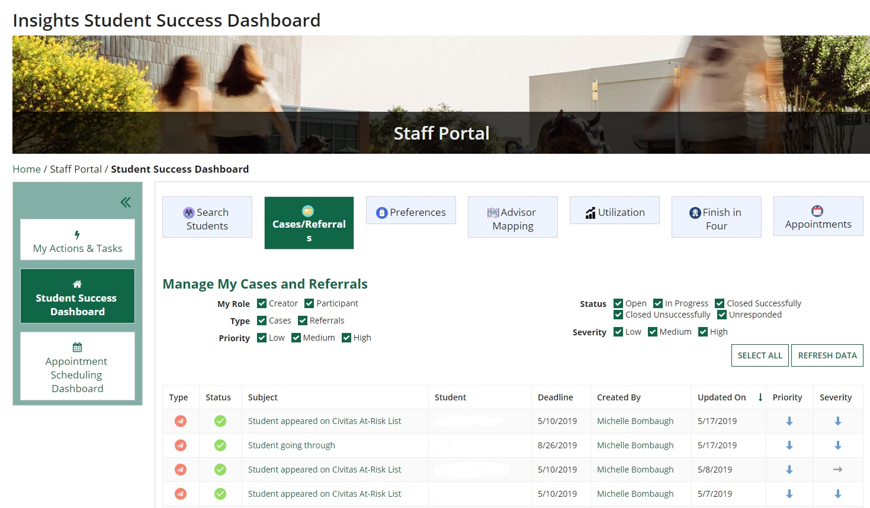
An Integrated Care Management Platform

Slide 22
Sprint 2
Partnerships for Success ( Work effort 5 mins)

Slide 23
A Handshake and the Healthcare connection
Right student Right care Right time
The Student success team functioning as an Accountable Care Organization (ACO)
Democratizing predictive Analytics
Rapid delivery of tool – aka " The 12 week challenge"

Slide 24
A real Sprint 0
What: urgent problem
Why: are we doing this
Who: team members & team norms
When: delivery cadence
Post Zero Planning Artifacts
Business charter defining MVP
Rough solution architectural diagram
Prototype of MVP solution
MVP release plan

Slide 25
We did it and more..
Amazing Teams and leaders
How we did it
What we built

Slide 26
Sprint 3
Scaling success evolving Agile Practices ( Work effort 10 mins)

Slide 27
An urgency that drives change
100+ small & large custom dev projects
Siloed IT departments
Fragmented governance
Over customized ERPs
Significant new ERP implementations costs
Burnt out IT teams
Diminishing ROI
No way to answer to new demands and speed
No view or input into the “IT Black Box”
Clients demanding “faster”, “more agile”

Slide 28
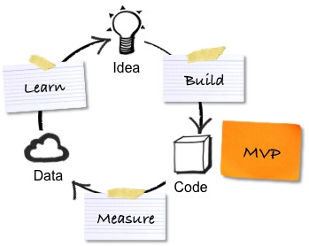
Embracing Agile & Minimally Viable Product
+
=
2007
2019

Slide 29
Embrace new technology
easy + powerful + unified
…to build …to use
…to change
works on all devices
scalable & secure
always current
a single environment across applications
for agile digital business transformation

Slide 30
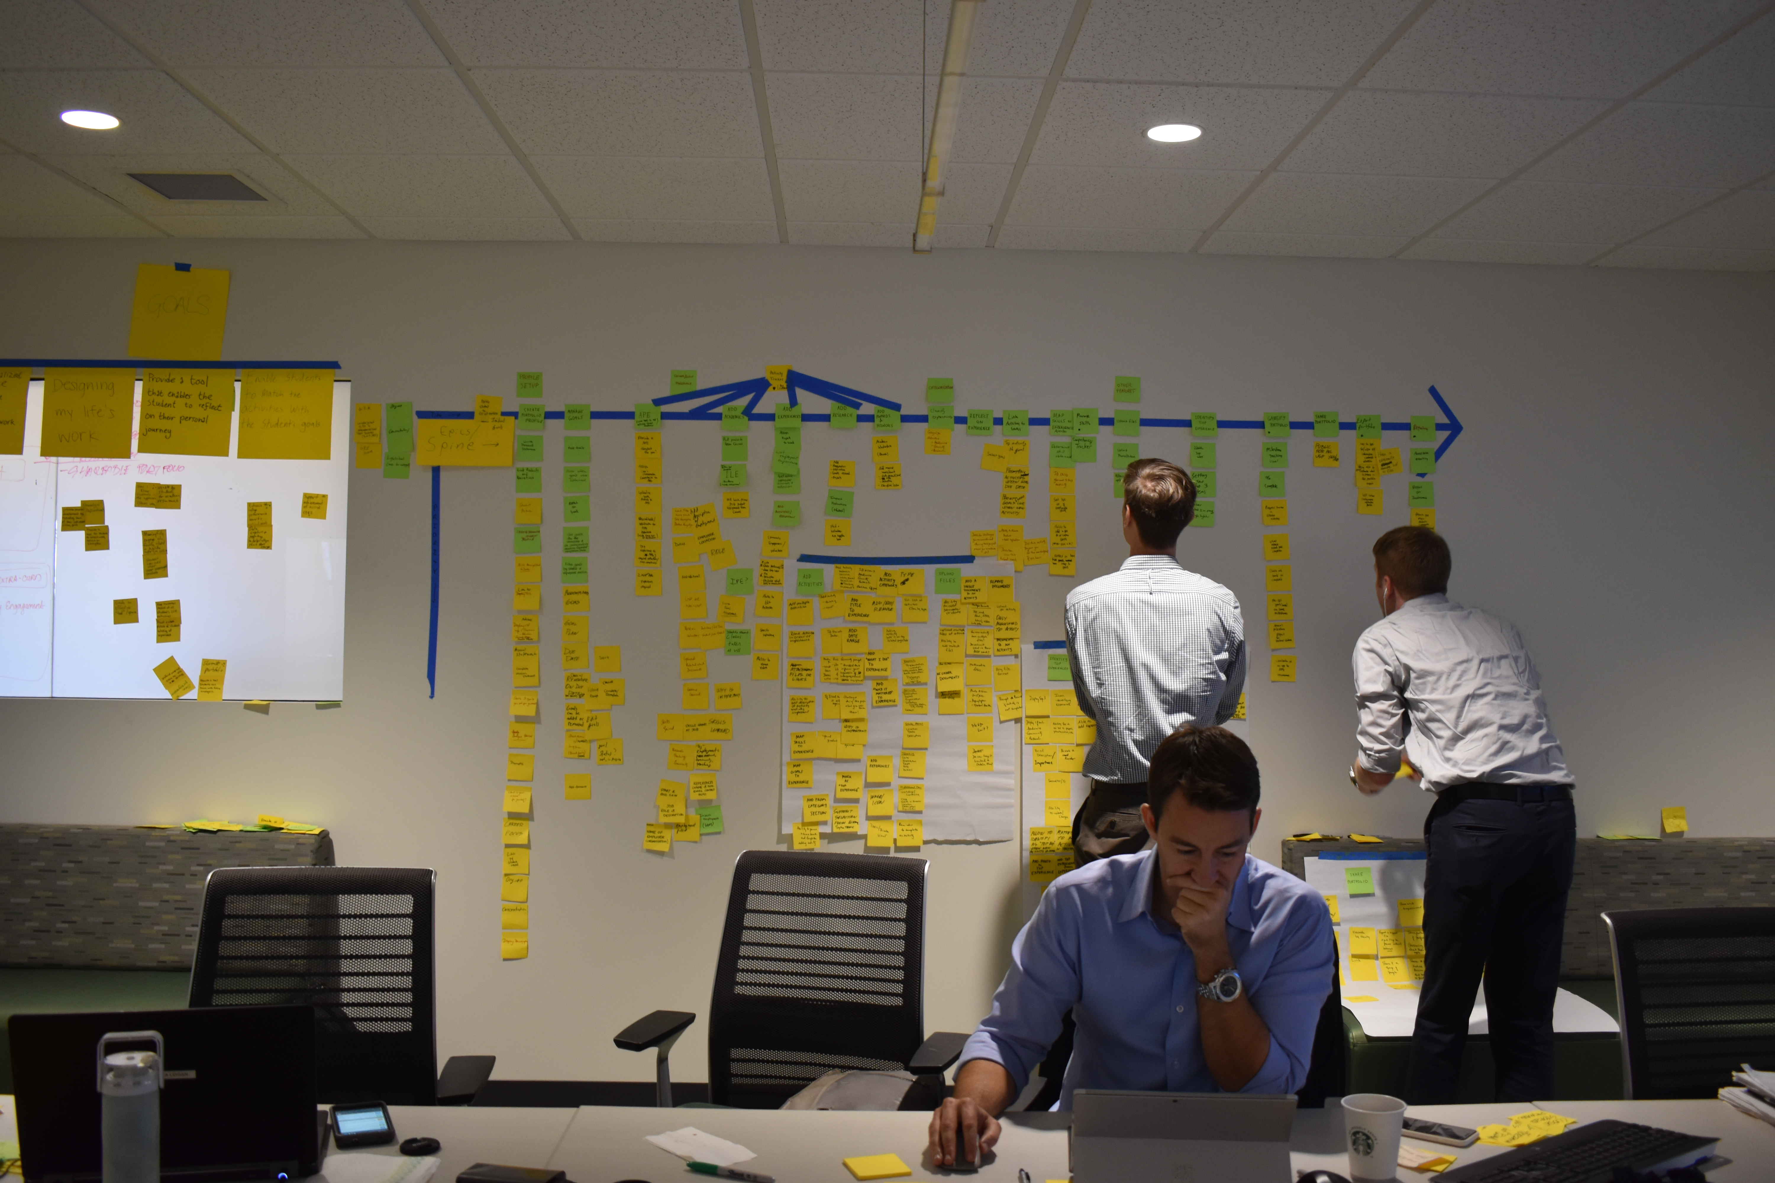
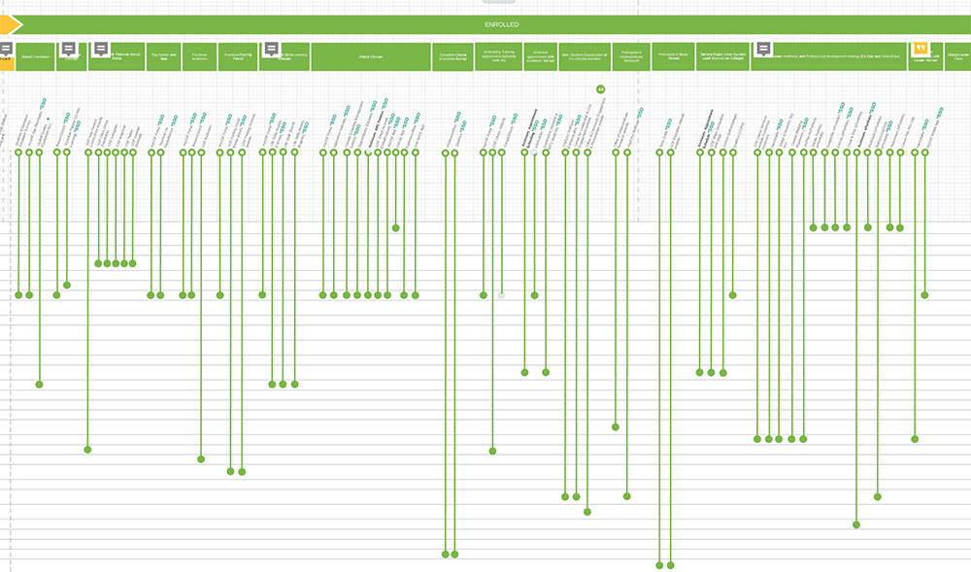
Establishing a common language

Slide 31
Sprint 4
Demonstrating Success, products and Platforms at USF ( Work effort 10 mins)

Slide 32
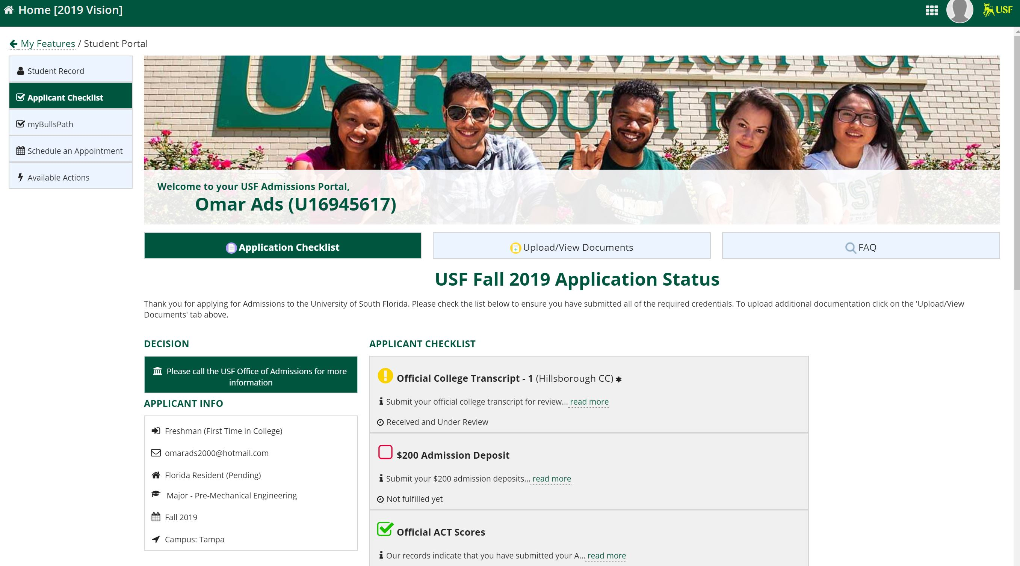
Show me, not tell me

Slide 33
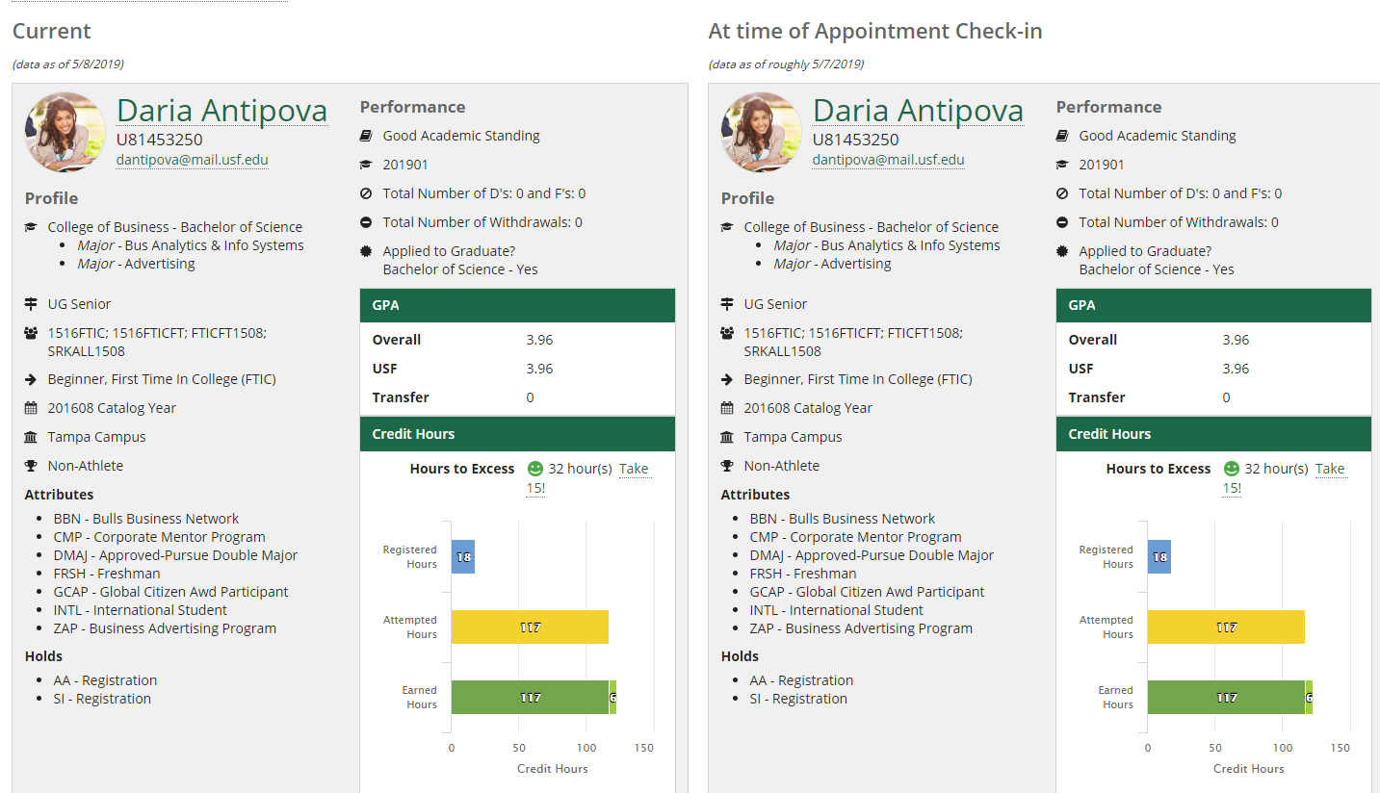
Show me, not tell me

Slide 34
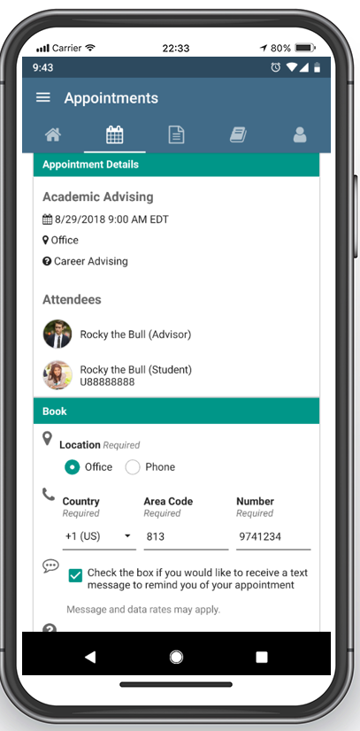
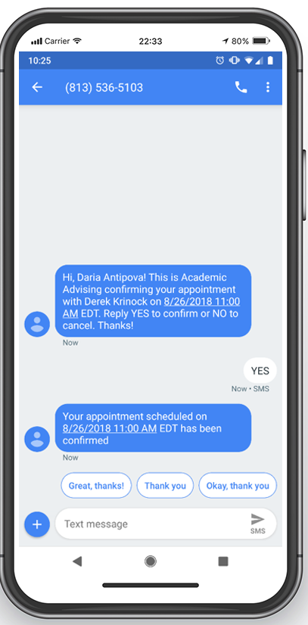
Show me, not tell me

Slide 35
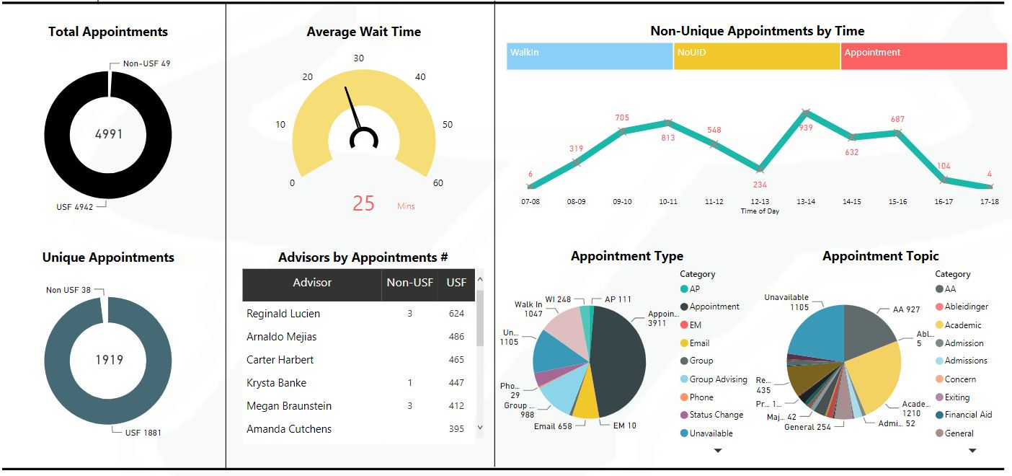
Show me, not tell me

Slide 36
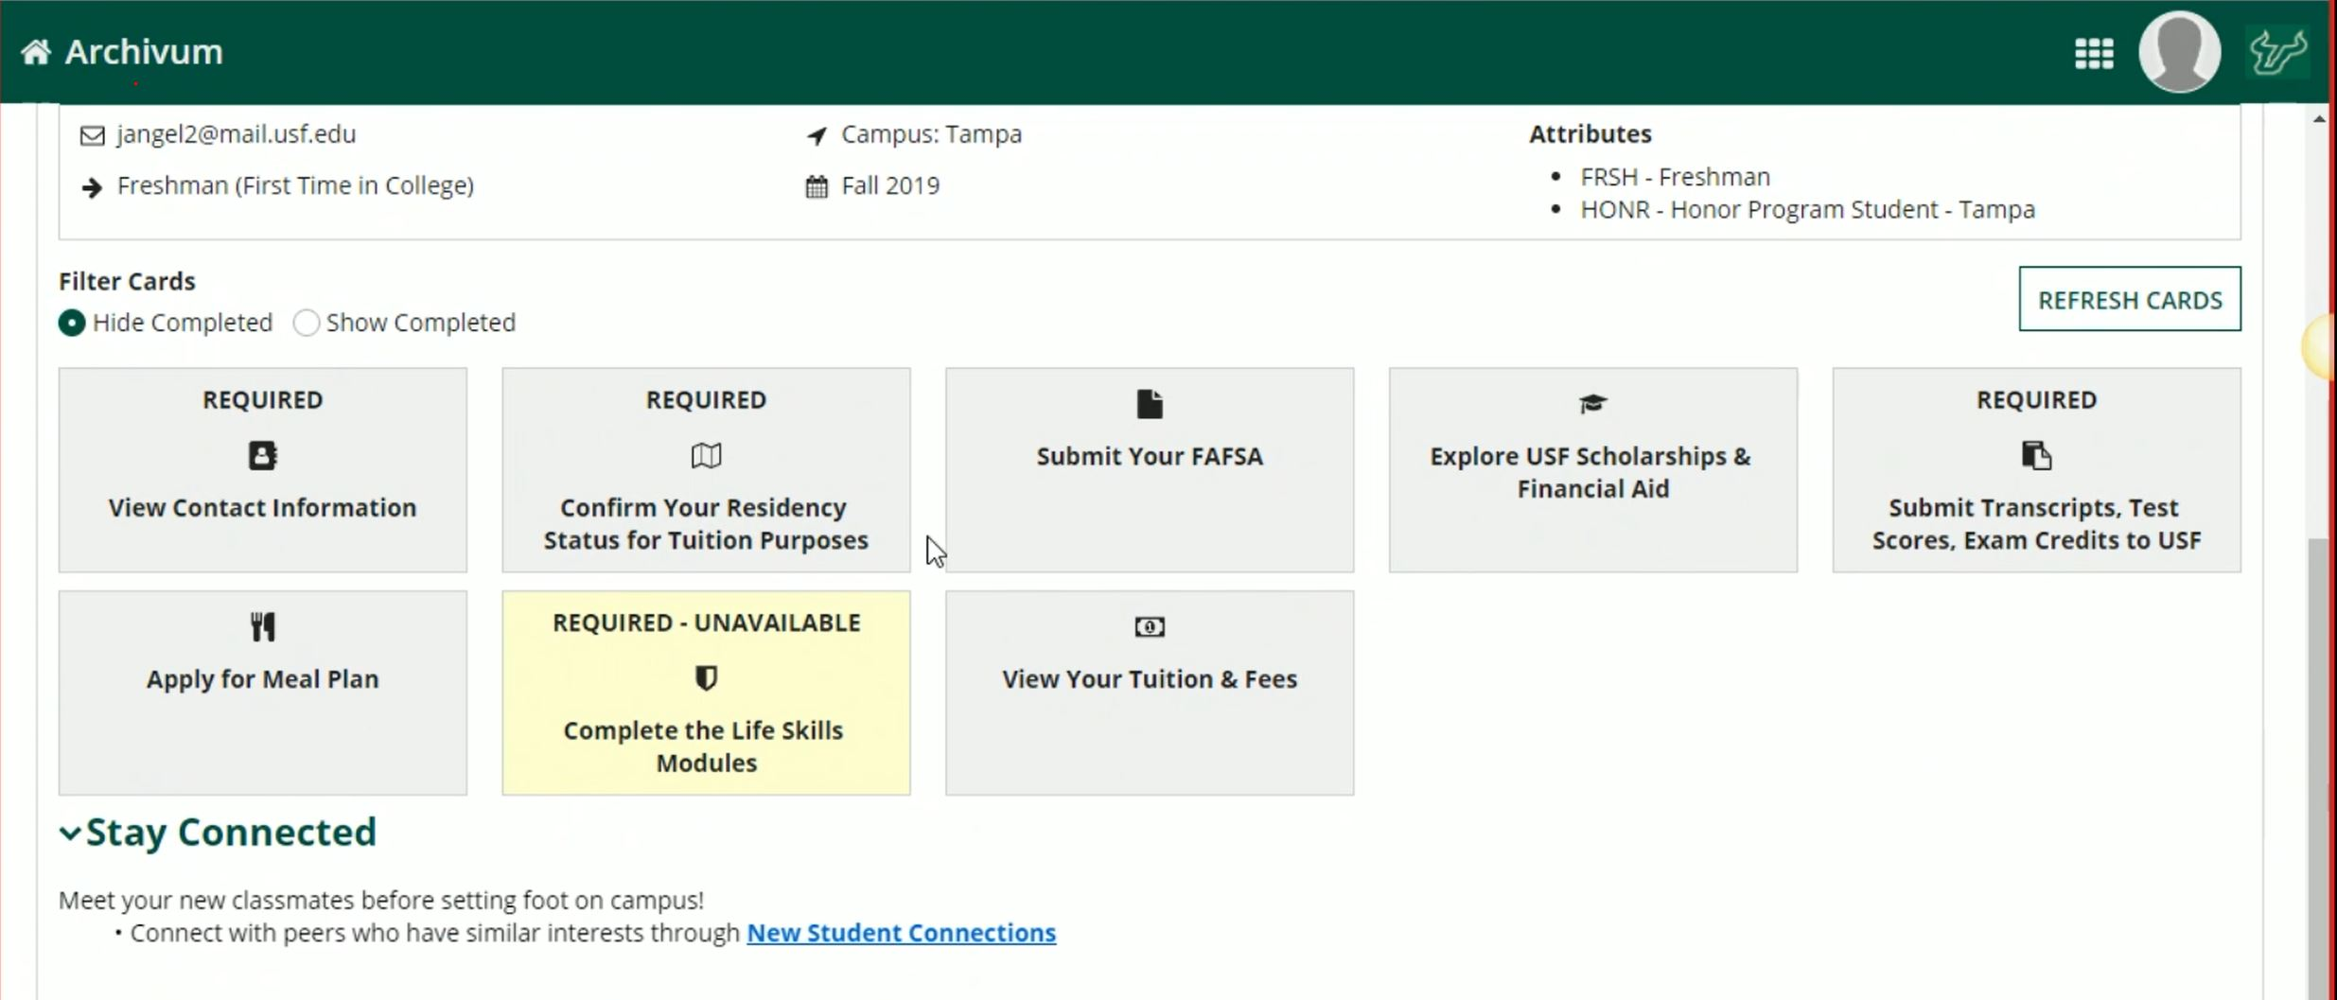
Show me, not tell me

Slide 37
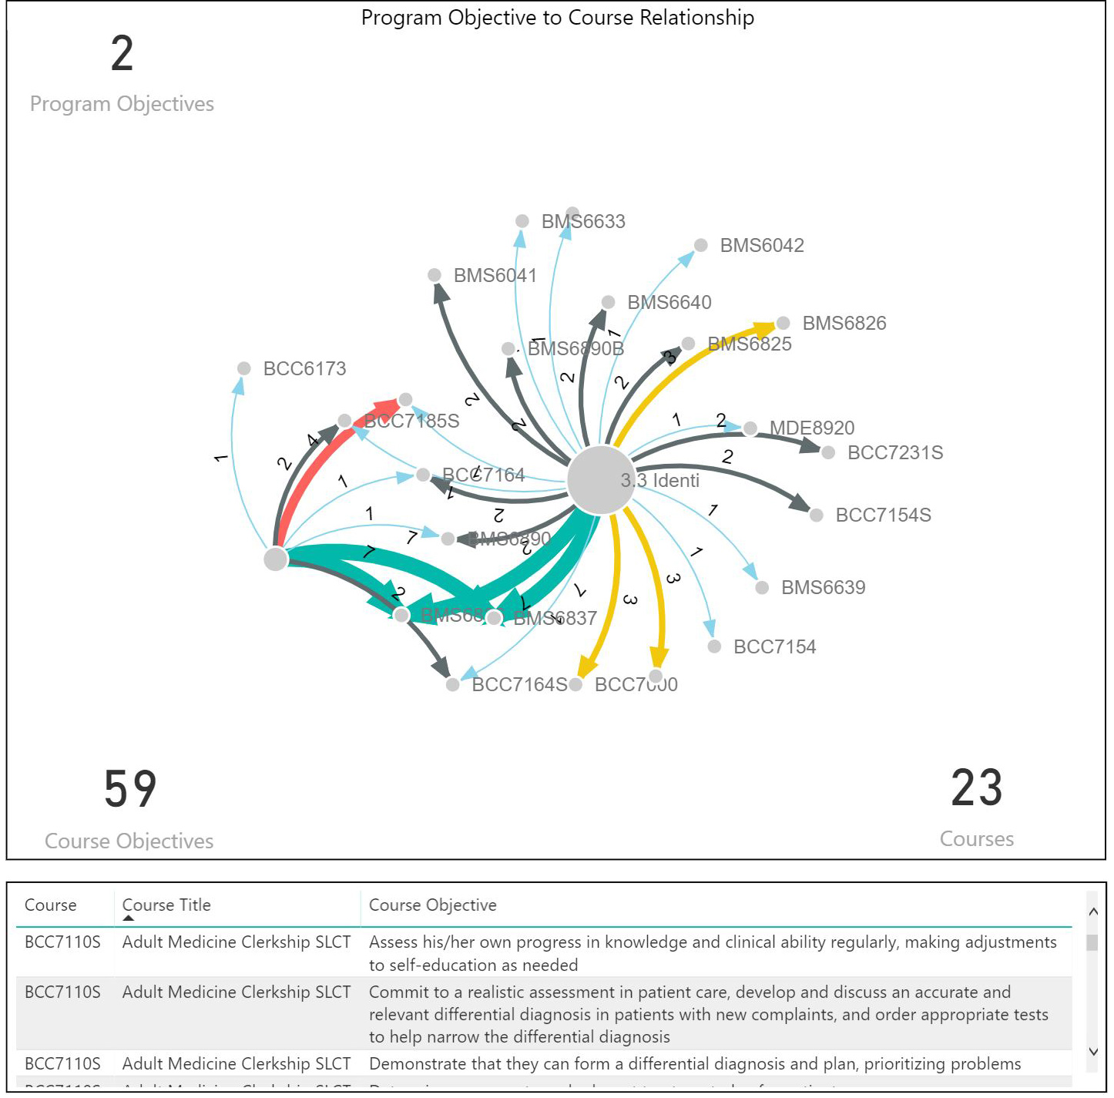
Show me, not tell me

Slide 38
Sprint 5
What we learned and your questions (Work effort 5 mins)

Slide 42
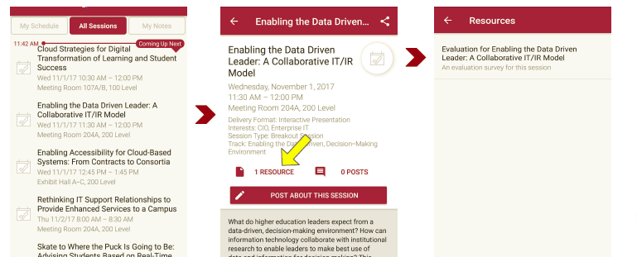
Session Evaluations There are two ways to access the session and presenter evaluations:
1
2
In the online agenda, click on the “Evaluate Session” link
From the mobile app, click on the session you want from the schedule > then scroll down or click on the associated resources > and the evaluation will pop up in the list

Slide 43
Contact Information
NOTE: This presentation leaves copyright of the content to the presenter. Unless otherwise noted in the materials, uploaded content carries the Creative Commons Attribution 4.0 International (CC BY 4.0), which grants usage to the general public, with appropriate credit to the author.

