Slide 1
Legal Update: Data Privacy and Cybersecurity
Elizabeth Lim Brooks, Associate University Counsel,
Virginia Commonwealth University
Christopher Melcher, Vice President for Legal Affairs/General Counsel,
Augusta University
Francisco Pardo, Moderator, Assistant Director of Legal Resources,
National Association of College and University Attorneys (NACUA)

Slide 2
How is data collected?
Applications for Admission
Connection to university wifi
Forms on websites
Social media accounts
Gym, dining hall, and laboratory access (biometrics)
Research projects
Community Outreach
Alumni engagement

Slide 3
Data on Campus
Data Locations
University Finance (Operations)
Registrar (Grades, Discipline, Transcripts)
Auxiliaries (Payment Information)
Financial Aid Office
IT (Email, Website, Apps, Software)
Faculty, Research Labs
Health Clinics
Legal Office (Contracts)
Advancement (Alumni, Donor)
Endowment (Investments)
Typical Data Elements
A/P, A/R, Payroll, Cash Management
Student Records (Grades, Discipline, Transcripts, Address, Medical, Finance)
Applicant Data (Student, Employee)
Health Data (Clinics, AMC, Health Colleges)
Research Data (NIH, Classified, Sponsor)
Intellectual Property
HR Data (SSN, DOB, Benefits, Cell, Discipline)
Financial Aid Data
Alumni Data
Contracts

Slide 4
Legal Landscape

Slide 5
Data Privacy for Higher Education: State, Federal, & International Regulations
FERPA -- The Family Educational Rights and Privacy Act of 1974: Protects students and their families by ensuring the privacy of student educational records. Educational records are agency or institution-maintained records containing personally identifiable student and educational data.
HIPAA -- The Health Insurance Portability and Accountability Act of 1996: Requires covered entities (typically medical and health insurance providers and their associates) to protect the security and privacy of health records. This law is often implicated in conversations about student data when institutions have a campus medical center and student medical records are integrated with student educational records (which are protected under FERPA).
The Gramm Leach Bliley Act (GLBA): Applies to financial institutions and contains privacy and information security provisions that are designed to protect consumer financial data. This law also applies to how institutions collect, store, and use financial records (e.g., records regarding student tuition payments and/or financial aid) containing personally identifiable information. FTC and DOE have made clear they regard higher educational institutions subject to GLBA.
“Red Flags Rule” -- The Fair and Accurate Credit Transaction Act of 2003 (FACTA): Requires entities engaged in certain kinds of consumer financial transactions to be aware of the warning signs of identity theft and to take steps to respond to suspected incidents of identity theft. Like GLBA, this law applies to how institutions collect, store, and use student financial records.

Slide 6
Data Privacy for Higher Education: State, Federal, & International Regulations (cont.)
GDPR – The European Union General Data Protection Regulation of 2018: Replaces the Data Protection Directive 95/46/EC and was designed to harmonize data privacy laws across Europe, to protect and empower all EU citizens data privacy and to reshape the way organizations across the region approach data privacy. Applicable to US businesses and organizations that
CCPA – The California Consumer Privacy Act of 2018 (effective 2020): Leading state statute for an express private right of action for data breaches resulting from a failure to implement reasonable data security measures, provides statutory damages, does not regulate non-profits.
State Laws on PII, PHI, Consumer Data – All 50 States have separate and different data privacy protection laws, complex and contradictory “patchwork” of regulatory guidelines.
COPPA -- The Children’s Online Privacy Protection Act: Governs the online collection of personal information from children under the age of 13, parental consent is required. This law may apply to higher educational institutions that offer summer programming for students under age 13.

Slide 7
I have a feeling we’re not in Kansas anymore…
State laws differ with respect to:
Deadline for notifying (14, 30, 45 days; reasonable time)
Notification to Attorney General
Notification to other State Agencies
Substitute notice (email, website, media)
Specific facts of incident and type of PI compromised
Maintaining records of incident (for 3-5 years)
Countries also differ with notice requirements
GDPR (72 hours)

Slide 8
I have a feeling we’re not in Kansas anymore…
Some states have specific laws addressing student privacy, such as:
Kansas Student Data Privacy Act (2014)
Tennessee Student Online Personal Protection Act (2016)
Texas Education Code (amended in 2015), extends definition of student record to include applicant information
Virginia (2018), requires consent to disclose address, telephone number, or email address of a student
What does this mean for the people search function?

Slide 9
I have a feeling we’re not in Kansas anymore…
California Consumer Privacy Act (CCPA)
Broad definition of personal information, including biometric data, geolocation, household purchase data, sleep habits
Consumers may request the specific information collected (centralized/organized data collection)
Consumers may request to delete personal information
Consumers may opt out of the sale of their personal information

Slide 10
New Applications and Technology

Slide 11
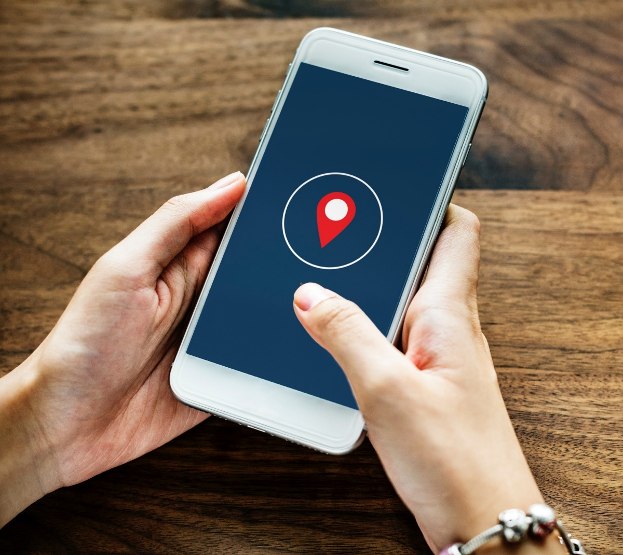
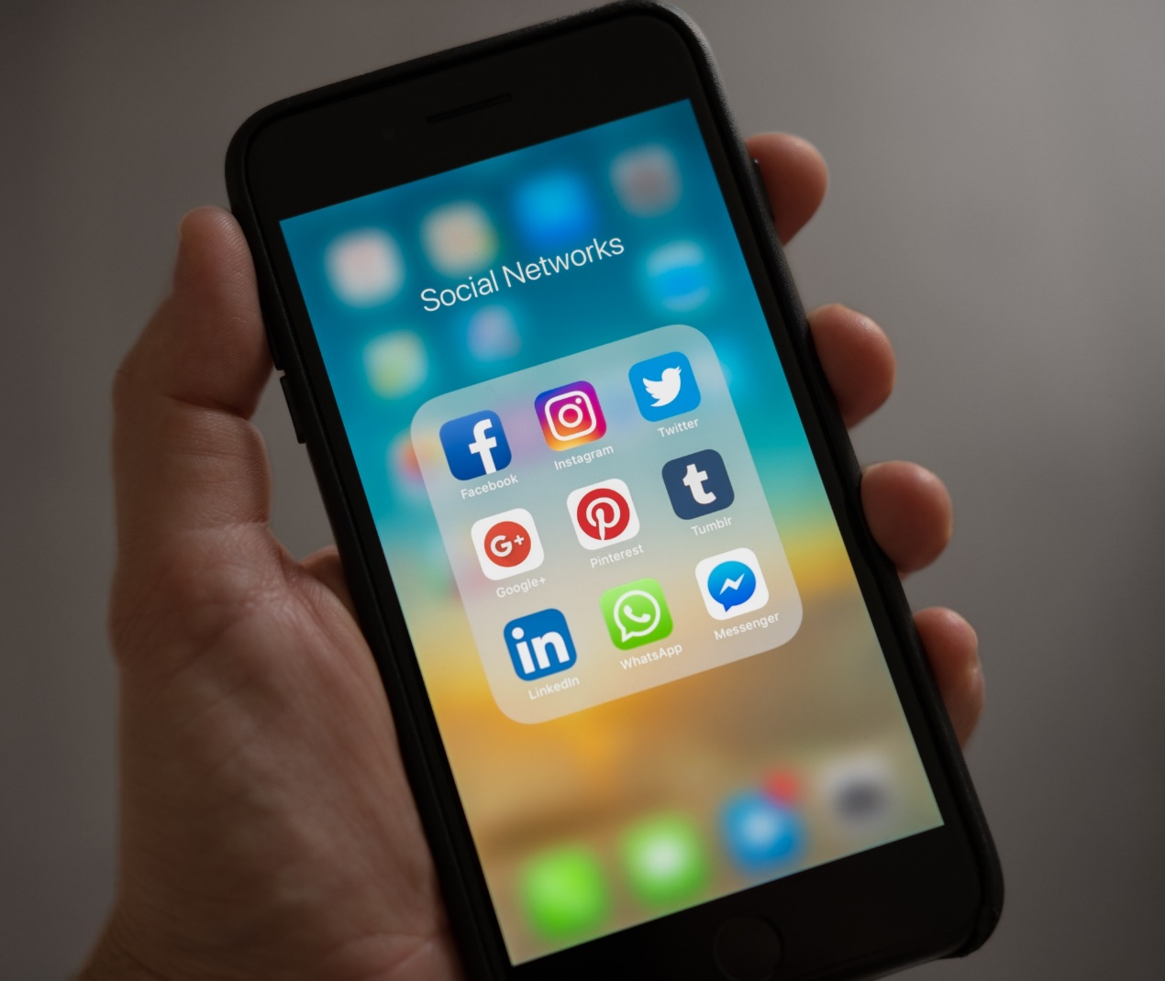
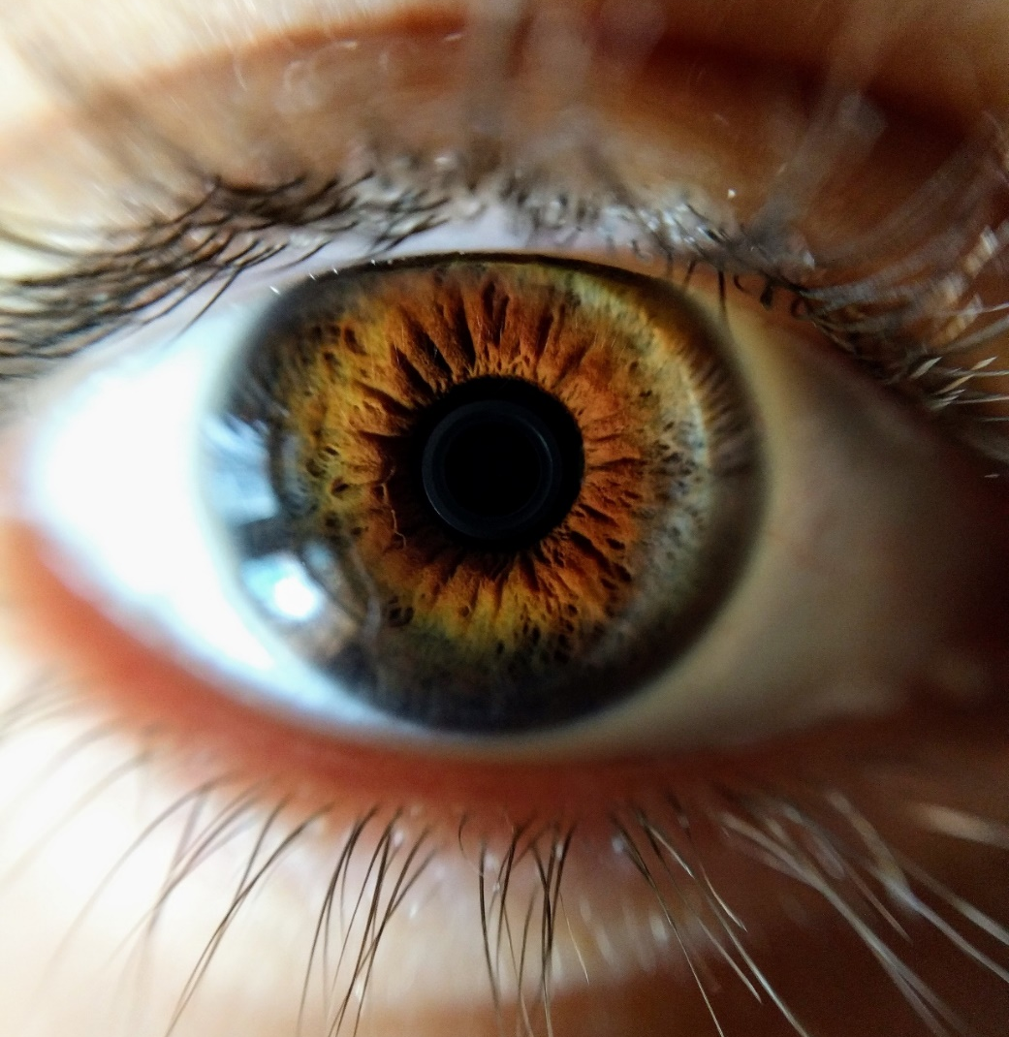
How do we apply privacy laws to new sources/types of data?

Slide 13
The tension between privacy, security, and access
Access/Use of Technology
Location data for student
success
Biometrics for access to university locations
Need to ensure managerial oversight
Privacy/security
Ethical use of location data, privacy expectations
Potentially triggers more compliance
More access means potential for less security

Slide 14
Considerations for Sponsored Research
Unpublished Data
Controlled Unclassified Information
Classified Research
Protected Health Information (HIPAA)
Can the data be deidentified?
Highly sensitive personal information tied to biospecimens
Grant terms may require specific security or privacy provisions
Grant terms may require certain data to be made available to other researchers
What type of consent did the participant provide?

Slide 15
Consent: not always the remedy
Right to revoke consent
Right to be forgotten
If consent is refused, some laws will not allow a waiver of consent (e.g., human subjects research)
Decentralized repositories

Slide 16
Best Practices: Data Privacy Protection
Conduct Data Inventory (Identify What and Where Data is Held)
Create Data Privacy Framework (Assess Type and Nature of Data)
Understand Legal and Regulatory Responsibilities for Each Data Type
Assign Appropriate Level of Security and Protection for Each Data Type
Establish Data Privacy Governance (IT, Legal, Compliance, Finance, Provost)
Some combination of CIO, CPO, CCO, CISO, DPO, Data Steward
Draft and Adopt Data Privacy Policies (multiple foci)
Implement Ongoing Training -- KEY – People are Your “Weak Link”
Test Safeguards, Practice “Desk Top” Events and Recovery, Understand Notifications
Data Privacy Should Be Discussed and Monitored at the Cabinet Level

Slide 17
Contracts – more privacy and security requirements
Business Associate Agreements (HIPAA)
Entities in Europe (GDPR)
Entities in states with specific requirements
Community engagement activities of health profession schools (health records, may not trigger HIPAA)
Development office alumni engagement (student records)
Industry-sponsored student projects (look out for trade secrets!)

Slide 18
Cybersecurity: May the Force Be With You

Slide 19
Cybersecurity No. 1 Challenge for Organizations
Global Cost of Cyber Crime will be $2 Trillion in 2020; Global Spending on Cyber Security $80 Billion in 2018
A 2015 study found the average cost of a cyber breach to be about $225 per compromised record, with a total average cost of $6.5 million. “Higher Education’s Vulnerability to Cyber Attacks”, UNIV. BUS. MAG. (Sept. 6, 2016)
85% of companies report experiencing a breach in the past three years, but only 39% had implemented a cyber defense strategy.
“We are engaged in a long-term strategic competition with China and Russia. … The United States seeks to use all instruments of national power to deter adversaries from conducting malicious cyberspace activity that would threaten U.S. national interests, our allies, or our partners.” DOD 2018

Slide 20
Why Are Universities Targeted?
Colleges and universities store sensitive records (financial records, PHI) and valuable intellectual property from research.
Much of the work relies on collaboration and the free flow of information.
Higher learning institutions are “gold mines” for hackers.
Viewed as “favored targets because they hold many of the same records as banks but are much easier to access.” Identity Force, J. Leary, Dec. 2016
“Why do you rob banks?” “That’s where the money is.” Willie Sutton 1951

Slide 21
Universities Are Being Targeted by Cyber Threat Actors at an Increasing Rate
July 2019 – Monroe College’s computer system was disabled by hackers using ransomware, demanded $2 million in bitcoin
2018 – Augusta U./AU Health System disclosed a phishing breach from 2017 involving 417,000 patients, faculty and employee.
2017 – Phishing theft of over $1 million from Costal Carolina University, person convinced university employees via email to change bank account info
2017 – Penn State’s College of Engineering’s systems were infiltrated by Chinese hackers over a 2 year period, gaining usernames and passwords
2015 – Rutgers University’s computer network was knocked offline four times during 2014-2015 school year by a hacker paid $500/hr in Bitcoin
2013 – Maricopa County Community College breach of over 2.4 million current and former students and staff, data included SSN, Dr. Lic. No., bank account information, FERPA information. Expense to MCCCD over $16.6M.

Slide 22
Top Cyber Security Threats in 2019
Phishing, Spear Phishing, Whale Phishing Schemes Become More Sophisticated
Nearly all successful cyber-attacks begin with a phishing scheme. Business email compromise (BEC), a highly targeted spear phishing technique, is responsible for over $12 billion in losses globally.
Cryptojacking
Cryptojacking allows hackers to hijack mobile devices, single computers, and enterprise computer equipment for “mining” cryptocurrencies, now more common than ransomware
Ransomware/Malware
Healthcare, government, education particularly at risk
Ransom usually in Bitcoin, traditionally smaller amounts ($5000 - $50,000), more recent events indicate increasing ransoms ($100,000 - $2,000,000)

Slide 23
Preventative Measures to Reduce Cyber Risk
Systems and Users
MFA (Duo) Authentication
Auto Archive Email (6 mo limit Inbox)
Eliminate “orphan”, invalid email accounts
Eliminate Servers Off-Network
Mandate New Passwords on a Regular Basis
Ensure Compliance with HIPAA, FERPA, PCI DSS, NIST 800-171,
Eliminate Shadow IT Systems
Schedule Regular Updates for all Patches, Upgrades to Software and API’s
People, Policies and Training
Mandatory Annual Compliance Training
Regular PEN Testing
Frequent “Phishing” Tests
Establish CPO, CISO, CCO
Employee Discipline Standards
Cyber Insurance
Draft, Implement Key Policies
Data Management, Email, Privacy
Implement Cyber Response Policy
Conduct “Table Top” Cyber Attack, Breach

Slide 24
NIST Standard for Cybersecurity
National Institute of Standards and Technology (NIST) released the “Cybersecurity Framework” (CF) Version 1.0 in 2014 (Version 1.1 released April 2018). The CF provides an overview of an effective cybersecurity program and set of action items. Originally designed for federal IT systems and those private systems that must comply with federal standards, now has become the “gold standard”. NIST identified the following five core functions necessary in any cybersecurity plan:
“Identify”: be aware of all of “systems, assets, data and capabilities.”
“Protect”: develop and implement safeguards to limit or contain the cybersecurity incident.
“Detect”: implement procedures/technologies for identification of a cybersecurity incident.
“Respond”: have a plan to adequately respond to a cybersecurity incident.
“Recover”: have restoration plans including evaluations of the response efforts.

Slide 25
Cyber Response Protocol: Timeline and Key Actions
Clock Starts Notice of “Incident” -- Every Incident is a Possible Breach (OCR, DOE, FTC)
0-4 Hours: CISO and IT Conduct Immediate Assessment (Incident, Event, or Breach?), if determined Not Event or Breach, Close Investigation, Report to CIO
4-12 Hours: If “Event” (Data Lost, Intruder had Access), IT Begins Immediate Containment (Secure “Perimeter”), Assess Threat/Exposure, Activate Cyber Response Team
12-24 Hours: If “Possible Breach” Investigation Accelerates, CRT Meets (CIO, Provost, CFO, Legal, Compliance, Communications); President, Board, Insurance Notified
24-48 Hours: “Possible Breach” Investigation Continues, CPO/Compliance Engaged, Outside Counsel Assigned, Law Enforcement Notified If Appropriate
1-2 Weeks: Investigation Continues, Possible Engagement of Forensic Audit Firm
2-6 Weeks: “Breach” Determination Reached, Notice to Regulators (OCR, DOE), Prepare Call Center/Individual Notices/Credit Services, Media Release/Internal Communication
Post Event: Post-Event Analysis, Remediation, IT Upgrades (?), Continued Training

Slide 26
One Approach to University Data Management
Tier 1: Due by December 31, 2019
12.3.1 Data System Documentation
12.4 Cybersecurity (Safeguards, Classification, Access Procedures, Segregation and Separation of Duties)
12.5.1 Regulatory Compliance
Tier 2: Due by June 30, 2020
12.2 Governance Structure
12.3.4 Data Availability
12.5.2 Training
12.5.4 Audit
Tier 3: Due by December 31, 2020
12.3.2 Data Elements and Data Definition Documentation
12.3.3 Data Quality Control
12.3.5 Data Life Cycle
12.5.3 Monitor

Slide 27
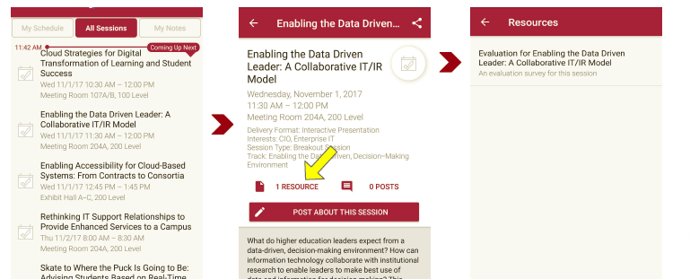
Session Evaluations There are two ways to access the session and presenter evaluations:
1
2
In the online agenda, click on the “Evaluate Session” link
From the mobile app, click on the session you want from the schedule > then scroll down or click on the associated resources > and the evaluation will pop up in the list

Slide 28
Contact Information
Elizabeth Lim Brooks, Associate University Counsel,
Virginia Commonwealth University | Richmond, VA
elbrooks@vcu.edu
Christopher Melcher, Vice President for Legal Affairs/General Counsel,
Augusta University | Augusta, GA
cmelcher@augusta.edu
Francisco Pardo, Moderator, Assistant Director of Legal Resources,
National Association of College and University Attorneys (NACUA) | Washington, D.C.
fpardo@nacua.org
NOTE: This presentation leaves copyright of the content to the presenter. Unless otherwise noted in the materials, uploaded content carries the Creative Commons Attribution 4.0 International (CC BY 4.0), which grants usage to the general public, with appropriate credit to the author.

