Slide 1
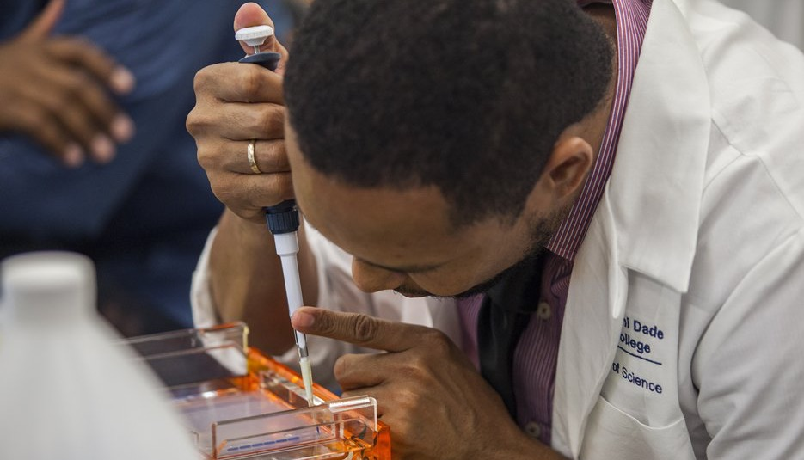
TRANSFORMATION AT SCALE:
The Gates Foundation’s Approach to Institutional Partnerships

Slide 2
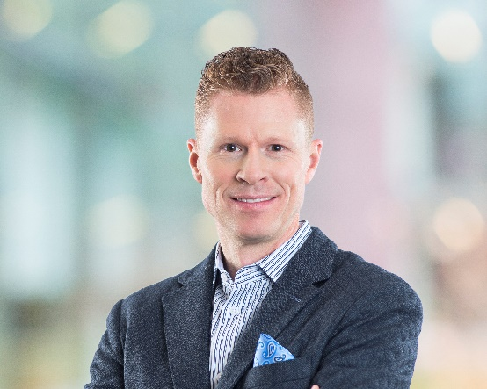
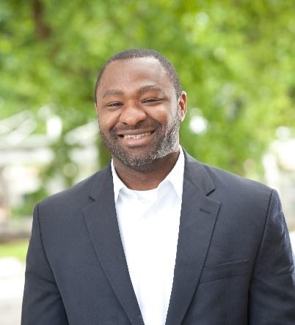
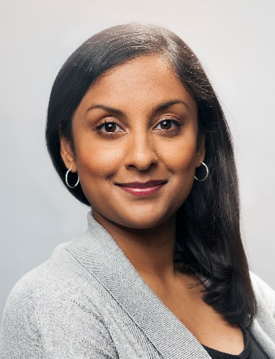
Introductions
Travis Reindl
Senior Communications Officer
Alexander Nicholas
Program Officer
Nazeema Alli
Program Officer
Francesca Mazzola
Program Officer

Slide 3
Objectives
Provide an overview of the Postsecondary Success strategy
Describe how innovation fits into the strategy’s focus on institutional transformation
Identify opportunities for learning and answer questions

Slide 4
We believe that every person deserves the chance to lead a healthy, productive life.
In the U.S., this means expanding life-changing opportunities, including –and especially– education.
Notes:
The PS strategy is connected to all of the program strategies in the foundation by the belief we shared earlier…that every person deserves the chance to live a healthy, productive life.
And the PS strategy is connected to the other strategies in the U.S. Program by a shared commitment to expanding life-changing opportunities. We know from research and experience that education is one of the most powerful of these opportunities.

Slide 5
We work with partners to expand opportunity by:
Increasing the number of students achieving certificates and degrees.
Closing gaps in student success by race and income.
Notes:
Our strategy is driven by two interconnected goals:
Ensuring that many more students achieve a certificate or degree. The demand for educated workers and citizens has never been greater, and it will only continue to grow. To meet that demand, student success will have to grow as well.
That can only happen if we close significant and persistent gaps in student success by race and income. Achieving equity in higher education is both a moral and economic imperative.
For us, completion of a certificate or degree is a critical measure of student success, but it is not the only measure. That is why we support the use of a metrics framework that includes progress and outcome measures, and we will soon be launching an effort to identify an approach for assessing the value of a post-high school education.

Slide 6
Our strategy: increasing opportunity and mobility
WHERE WE ARE
WHERE WE INVEST
WHERE WE WANT TO BE
Student Success Rates +
Innovation
Digital Learning
Technology-Enabled Advising
Redesigned Remedial Courses
Student Success Rates
+
Gaps in Success by Race & Income
=
Less Mobility & Competitiveness
Gaps in Success by Race & Income
=
More Mobility & Competitiveness
Transformation
Institutional Partnerships and Networks
Policy Advocacy
Data and Information
Finance/Financial Aid
Notes:
Now we get to the “strategy” part of the strategy…where we focus our energy and investments to move from where we are to where we want to be when it comes to education after high school.
Our work is anchored in three priorities, and we will walk through each in more detail in a moment.
Innovation promotes development and use of tools and practices that help more students – especially low-income and first-generation students, students of color, and working adults – achieve their educational goals. Our efforts here are driven by research on the most significant “loss points” for today’s college students and evidence on what is most effective to help students steer over/around those points.
Transformation integrates those tools and practices and builds the capacity of colleges and universities to do that work. It is grounded in a network approach, connecting colleges and universities to resources, expertise, and each other to help accelerate learning and avoid “reinventing the wheel.”
Policy Advocacy creates an environment of positive pressure for institutions to make the changes needed to increase student success and close success gaps. In our strategy, the primary policy levers are how resources are allocated and how colleges and universities measure and are held accountable for student progress and outcomes.
We are mindful of the fact that there are other strategies that are also important for advancing institutional change to increase student success. Based on research and experience, we believe that these priorities offer the greatest potential for reach and impact. It’s also important to note that we partner with other funders (such as Lumina, Strada, Kresge, Ascendium, etc.) because of their complementary strategies.

Slide 7
INNOVATION
We work to create pathways that provide students a clear route to a certificate or degree through:
High-quality digital learning
Improved student advising
Redesigned remedial education
Notes:
Today’s students – especially low-income and first-generation students, students of color, and working adults – need strong and clear pathways to a certificate or degree. Too many of them do not have that.
We support innovative, evidence-based solutions that are designed to help today’s students get on a pathway to a certificate or degree, stay on that pathway, and ensure they are learning along the way.
The solutions we support target some of the biggest barriers to students’ progress and success:
Improving advising by deploying people, technology, and data to provide better and more timely information to students.
Redesigning remedial education so that students get the help they need while staying on track to complete their program.
Implementing digital learning courses and programs that provide flexible, high-quality instruction and allow students to move further, faster.

Slide 8
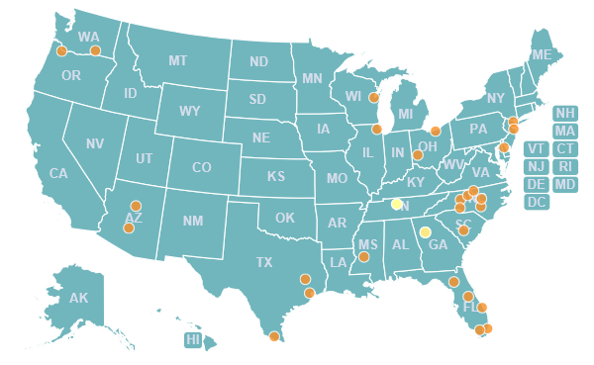
TRANSFORMATION
We support colleges and universities working to transform themselves to increase student success and close success gaps by:
Having a student-centered mission.
Setting goals and being held accountable for them.
Using data to make decisions.
Creating a collaborative environment.
Making a commitment to continuous improvement.
We do this by:
Forming institutional partnerships like the Frontier Set.
Investing in innovation, tools, and resources to help guide colleges and universities through the transformation process.
Building and sustaining networks that connect institutions with peers and resources.
Notes:
Innovative solutions are critical for helping more of today’s students succeed, but colleges and universities also need capacity to implement and sustain that innovation. This includes things like leadership, information technology, data and research, and supportive policy. Solutions and capacity are essential ingredients of transformation.
Through our work with 29 colleges and universities and two state systems in the Frontier Set, we have learned that colleges and universities engaged in transformation have a student-centered mission, set goals and hold themselves accountable to them, use data to make decisions, create a collaborative environment, and commit to continuous improvement.
Transformation is like remodeling a house. Just as people remodel their homes to better fit their lives, colleges and universities need to remodel themselves to better fit the needs and experiences of today’s students to help them achieve their goals. Many of today’s students are ready for college, but colleges are not ready for them.
Pressure is growing for colleges and universities to transform – increasing demand for an educated workforce, coupled with intensifying financial challenges and wavering public confidence – and more institutions are responding to that pressure.
Colleges and universities involved in transformation seek networks that can provide expertise and lessons learned, as well as guidance and support for implementing and sustaining changes in policy and practice.
We are creating and supporting networks to help more colleges and universities. These include partners that focus on specific areas (like advising or digital learning) and partners that play a coordinating role, connecting campuses with experts and with each other and helping to guide the change process.

Slide 9
POLICY ADVOCACY
We promote policy change at the state and federal levels to ensure access and success for today’s students, specifically:
Financial aid that helps more students get to and through college.
Data and information that empowers better decision-making and improves accountability.
Notes:
Federal and state policies affect who colleges and universities serve and how they serve them. For example, up to two million low-income students don’t apply for federal aid every year because the process for applying is too complicated. Many state aid programs leave out part-time and adult students. And federal and state data leave out students whose outcomes matter.
Our policy focus is on finance and data/accountability (money and measures) – how public funds are spent to help today’s college students (low-income and first-generation students, students, of color, and working adults), and how colleges and universities are measuring and being held accountable for their progress and success.

Slide 10
INSTITUTIONAL TRANSFORMATION AT SCALE
Innovation Networks
Transformation Supports
Intermediaries for Scale
Transformation Networks
Impact
Colleges and universities help millions more students obtain certificates or degrees while closing gaps in student success by race and income.
Advising
Transformational Frameworks and Tools
—
Tested with Institutions
—
Developed for Access and Use
Remedial Education
Digital Learning
Feedback
Connectivity
Data, Measurement & Learning
Political Context
Economic Pressure
Notes:
Here’s where we try to put all of the pieces together – our theory of working with partners to help hundreds more colleges and universities provide millions more students with high-value certificates or degrees and eliminate success gaps by race and income.
As we mentioned earlier – but it bears repeating – for us, the institution is the unit of change and the student is the focus of change. This is consistent with the approach of other strategies in the foundation’s U.S. Program. We believe that focusing on service providers – in this case, colleges and universities – provides the greatest opportunity for impact.
Let’s start on the left, with Innovation Networks. These networks are designed to promote the dissemination, implementation, and improvement of solutions associated with increased student success.
Moving to the right, we come to Transformation Supports. These are resources that draw on the insights from the Innovation Networks and combine them with knowledge and lessons learned through implementation and integration of multiple solutions to help colleges and universities map out their transformation process.
Moving on to the right, we come to Intermediaries for Scale and Transformation Networks. Let’s start with Transformation Networks. The change needed is big enough and urgent enough that focusing on transformation one institution at a time isn’t practical or sustainable. As such, we want to build an environment in which diverse colleges and universities can work together to learn and apply/adapt that learning faster. That requires a lot of support, which brings us to Intermediaries for Scale (the reason we’re all here). We will go into much more detail on this over the next couple of days, but at their core, the intermediaries are about making the Transformation Networks work…connecting colleges and universities with resources and each other and providing guidance and support through the transformation process.
Finally, let’s talk about Enablers (the red bar at the bottom). This work will not be done in a vacuum, so we have to account for other factors that can help enable progress.
Connectivity is about linking intermediaries that work in different areas of the strategy.
Data, Measurement & Learning is about ensuring that colleges and universities have and use the information they need to transform, which includes having key metrics on all students in all institutions.
Political Context (aka Policy Advocacy) is about focusing state and federal policymaking on today’s college students and the institutions serving them.
Economic Pressure is about understanding the demographic and financial trends and issues that will help accelerate – or frustrate – transformation.

Slide 11
OUR LEARNING HYPOTHESIS

Slide 12
Questions and Discussion

Slide 13
Learn More:
Visit https://postsecondary.gatesfoundation.org/ and sign up for our monthly e-newsletter
Follow us on Twitter (@GatesUS)

