Slide 1
Risky Relationship? How Audit and Information Security Can Work Together
Tina Thorstenson - Deputy CIO, Arizona State University
Mark Ruppert – Chief Audit Executive, Northern Arizona University
Michael Zimmer - CISO, Northern Arizona University
Lanita Collette – CISO, University of Arizona
Sean Hagan – CISO, Yavapai College
Notes:
Educause Presentation Proposal Details:
Risky Relationship? How Audit and Information Security Can Work Together
As an R1, R2, community college, or other type of institution you have to manage risks. See how four different institutions have approached this and how establishing a relationship between audit and IT can help. Need to build or grow your risk management program? Join us! Outcomes: Identify several approaches to risk assessment and management * Understand how establishing a relationship between audit and IT benefits the institution * Identify possible next steps to build or grow your risk management program

Slide 2
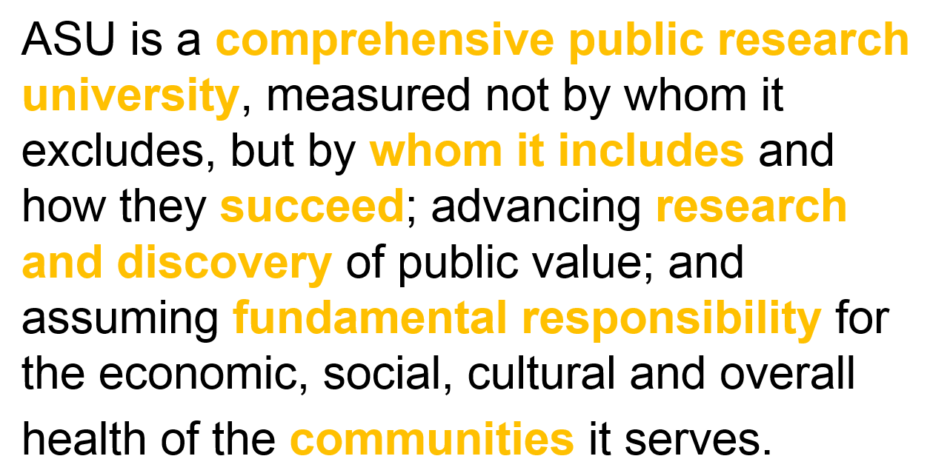
ONE UNIVERSITY / MANY PLACES
Metropolitan Phoenix AZ (5 Campuses), Washington, D.C., Havasu City, AZ, Santa Monica, CA, & Global Locations
“NEW AMERICAN UNIVERSITY” CHARTER
RECENT RECOGNITION
“Top 1% of world’s prestigious universities” - Times Higher Education
“#5 in graduation employability” -Wall Street Journal
“#1 chosen by international students” –Institute of International Education
BY THE NUMBERS
COLLABORATIONS
ABOUT ME
119K Students – ~86% 1st Year Retention!
15K Employees (3,600 Faculty)
$604M Annual Research Expenditures
Starbucks (2014)
Mayo Clinic Alliance (2016)
Adidas/ASU Global Sports Alliance (2017)
Uber (2018)
TINA THORSTENSON
Deputy CIO & CISO
Joined ASU in 2006
Joined Higher Education in 1995
Industries: Transportation & Higher Education
Notes:
Tina

Slide 3
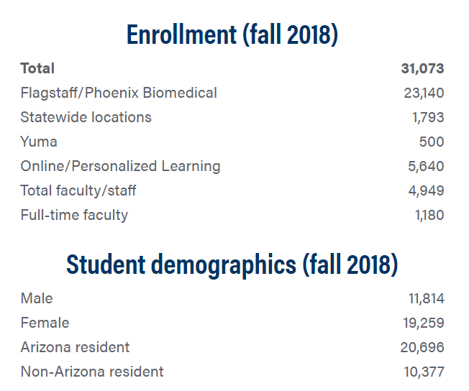
Michael Zimmer: Director, Information Security; 23yrs Higher Ed IT
InfoSec: 7 full time, 1-2 students, plus me; SOC, IAM, Compliance
Mark P. Ruppert: Chief Auditor; CPA, CIA, CISA
Internal Audit: 3 full time
Notes:
Michael, Mark

Slide 4
45,217 Students
16,000+ Employees
$622M Research Expenditure
Land-grant university
Two medical schools
300+ Majors
Lanita Collette, CISO
19 years higher ed tech leadership,
7 years CISO experience
Joined UA in 2017
Notes:
Lanita

Slide 5
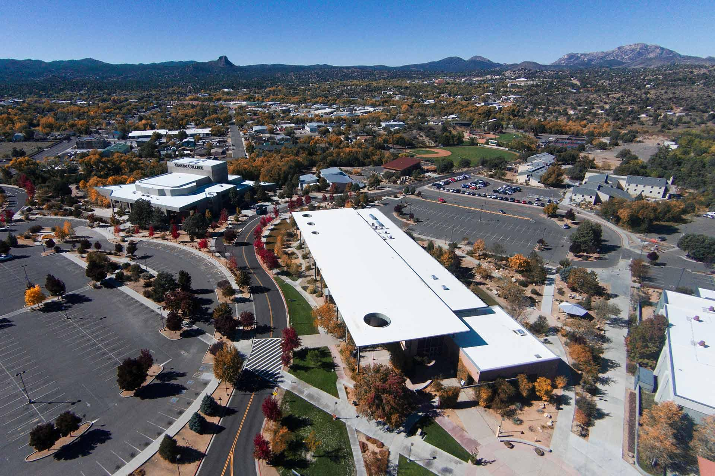
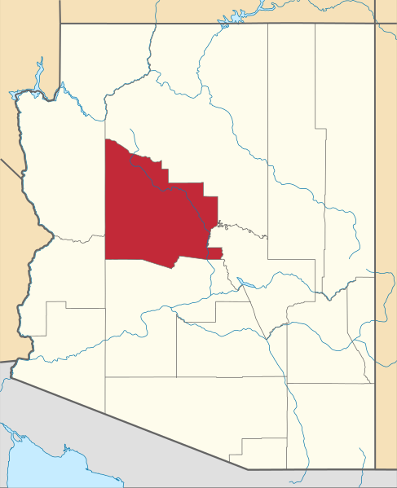
Yavapai College
7,400 Students
Residential CC
6 Campuses
No Parking Fees!
Bigger than MA
2 IS FTE, 0 IA FTE
Notes:
Sean

Slide 6
Does your institution have formal internal audit FTE staff or contract staff to focus on IT-related audits?
www.slido.com – event code #2806
Notes:
Sean can transition from his intro to the Slido description, setup, and getting audience involved right away.
Does your institution have formal internal audit FTE staff or contract staff to focus on IT-related audits?
No
Yes, 1 or less FTE
Yes, more than 1 FTE

Slide 7
If you have internal audit, does your enterprise technology department or security team work together to plan the IT audit focus areas, or just respond when audits hit?
www.slido.com – event code #2806
Notes:
If you have internal audit, does your enterprise technology department or security team work together to plan the IT audit focus areas, or just respond when audits hit?
Work Together to Plan IT Audits
Only Respond to Audits
No Internal Audit Function

Slide 8
Comparing Resources
 | YC | NAU | UofA | ASU
InfoSec FTE | 2 | 8 | 14 | 25
Security Operations | Yes | Yes | Yes | Yes
Identity/Access Management | Yes | Yes | No | Yes
ISO Program - Training | Yes | Yes | Yes | Yes
Compliance/Risk Assessment | Yes | Yes | Yes | Yes
Internal Audit FTE | 0 | 3 | 5 | 5
IT Department FTE | 29 | 192 | 324 | 550
Student Headcount | 7314 | 31,051 | 45,217 | 103,203
Notes:
Sean can round out the slido and resource comparisons stuff with this as quick reference.
Tina to ask audience for institution size, then we’ll move on.

Slide 9
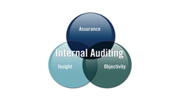
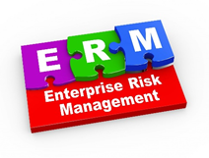
Differences & Similarities
Audited by the Arizona Office of the Auditor General
Information Security program size and maturity
Internal Audit team size and maturity
We all face, and need to manage, similar threats, risks, regulations
Notes:
Tina; Lanita provide input; Michael as needed.
NOTE: Be sure to talk about the similar Financials, annual audit, but a differentiator might be to mention performance audits are for the Three ABOR schools - the nature of each audit may differ.

Slide 10
Risk Management 101 – What is a Risk?
Where is the real risk?
Shark attack? Mode of travel / strength of the rope? Ability of the traveler? Value at the other side?
Decision to walk across?
COSO defines “risk” as:
“The possibility that events will occur and affect the achievement of strategy and business objectives.”
NIST defines “risk” as:
“A function of the likelihood of a given threat-source exercising a particular potential vulnerability, and the resulting impact of that adverse event on the organization.”
Thus, “risk” can be positive or negative. And, many events occur regardless of decisions we make.
Notes:
Mark; some audience participation “shout-out” style as it starts, and before slide-filling.

Slide 11
Assessing & Managing Risks
Many paths to assessing and managing risk - some institutions have Internal Audit, some do not, and some who do lack an established relationship between IA and IT.
Managing risk requires coordination across the university that starts from the top.
Tone from the top:
Set expectations
Align culture and risk tolerance
Implementation Teams:
Mobilize to coordinate across business functions or between business/research/education
Notes:
Tina, with input from others as wanted… then Tina transitions into the ASU slides next.

Slide 12
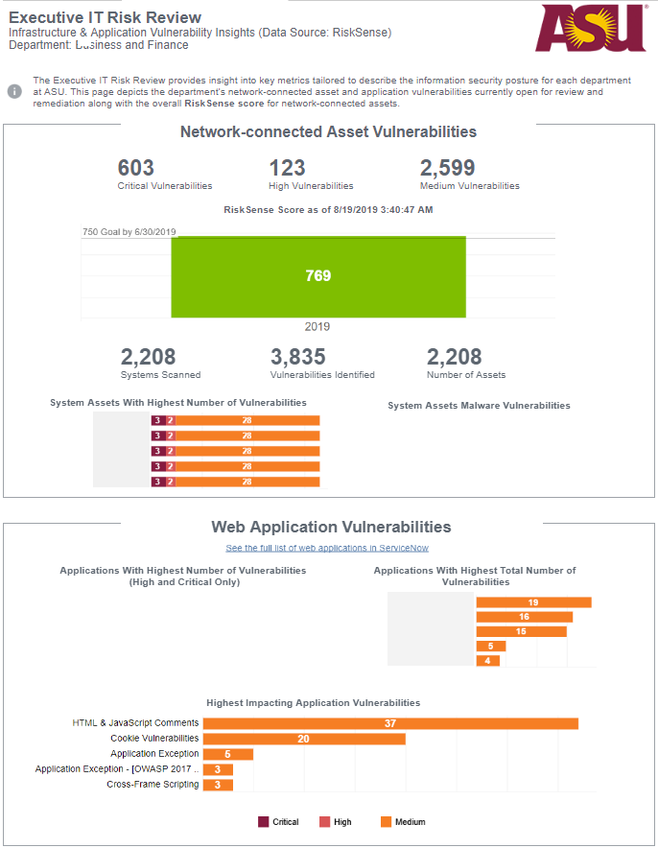
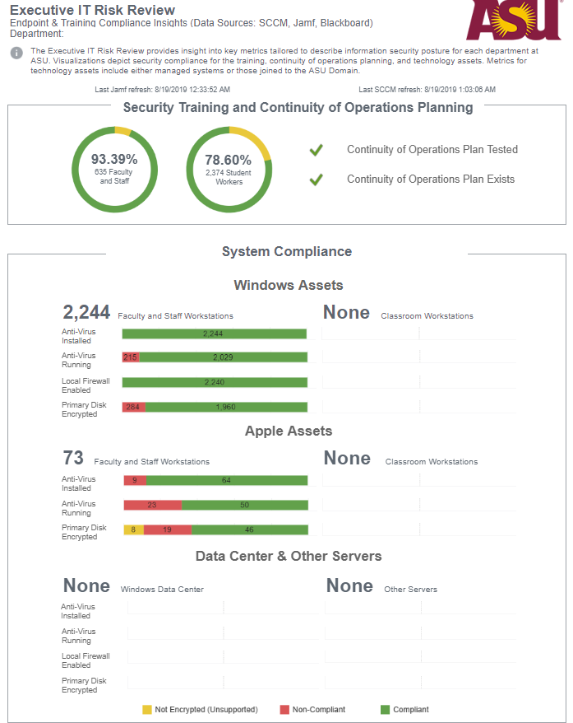
ASU IT Risk Assessment Process
University-wide
Approximately 34 departments
Coordinated with external firm & internal audit
3-year Continuous Improvement Cycle
Data driven, with self assessment component
Address top items of concern across ASU
1:1 CISO & Dean/Department Head discussion
Rinse & Repeat
Stable, repeatable, action-oriented
Notes:
Tina

Slide 13
ASU Risk Assessment Department Goals
Leverage Technologies
Security Awareness
GOAL: 100% Faculty, Staff & Student Workers trained
GOAL: RiskSense score above 750 by June 2019
End User Devices
Continuity of Operations
GOAL: 100% of devices managed compliant across identified security controls
GOAL: Test continuity of operations plans at least annually
Notes:
Tina
Example goals - these were our goals for FY19.

Slide 14
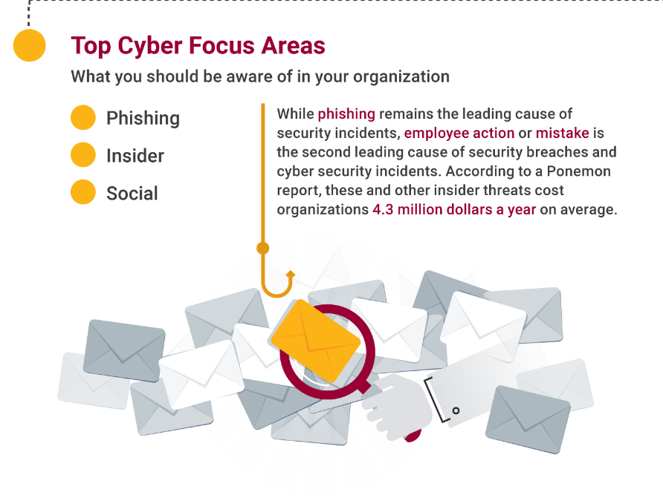
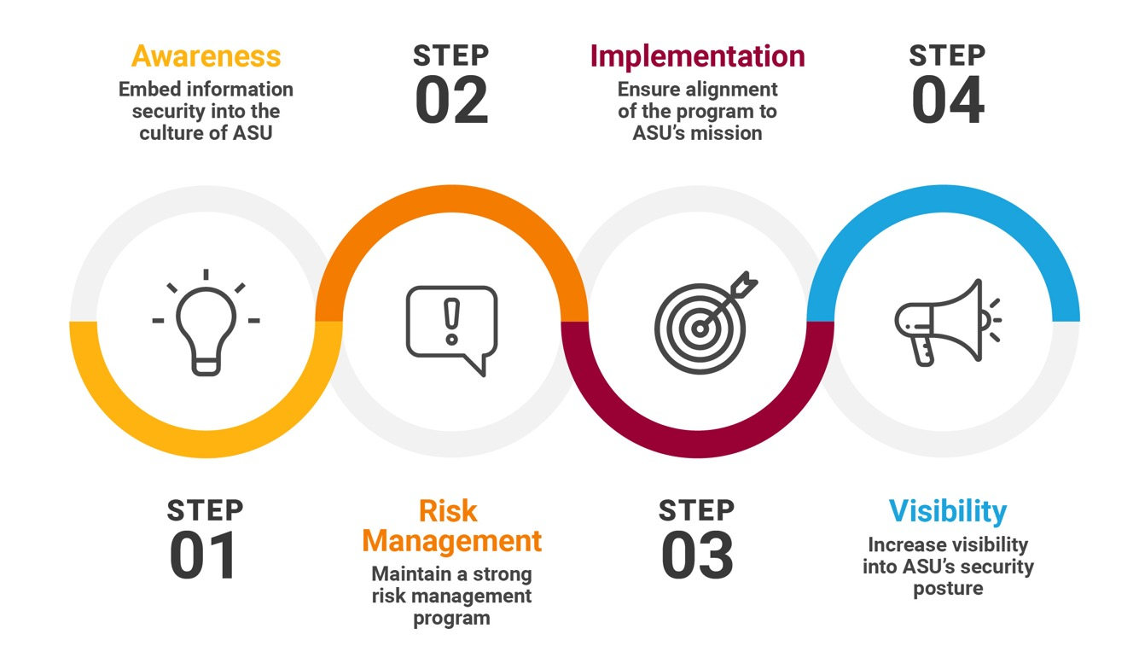
ASU Information Security Lifecycle
Notes:
Tina

Slide 15
Does your institution have an Enterprise Risk Management program in place?
www.slido.com – event code #2806
Notes:
Tina transition to Mark/Michael with this slido question, which will then lead to Mark for NAU ERM...
Does your institution have an Enterprise Risk Management program in place?
Yes
No
Working On It

Slide 16
NAU: IA & IT ERM Risk Assessment Process
1. Establish Context
2. Risk Identification
3. Risk Analysis
4. Risk Evaluation
5. Response / Action Plans
What are your NAU Objectives?
How do they support NAU Strategy?
What are the key internal and external influences on these objectives?
What are the latest emerging issues?
What major events or changes might impact ability to meet objectives?
What might be pursued to improve ability to meet or exceed objectives?
For each “event” identify source(s), cause(s) and consequence(s)/ impact.
How likely is the event or change to occur (short term 6 to 18 months and longer term)?
How will the risk impact the ability to meet objectives?
Apply a risk score using NAU scoring templates.
Does risk significance make sense when reviewing all risks relative to each other?
Which risks should be prioritized?
Which risks must or will we simply accept?
Who owns or should own the risk?
How are the challenges being addressed already; how will they be addressed going forward?
How are the opportunities already being pursued; will or how will they be pursued going forward?
What resources are necessary to support these action plans?
6. Monitor, Review, Reassess & Report
Periodically check status of risk relative to internal and external changes, effect of actions plans, etc. then reassess the risk.
Report updated risk information to ERMOC.
Notes:
Mark

Slide 17
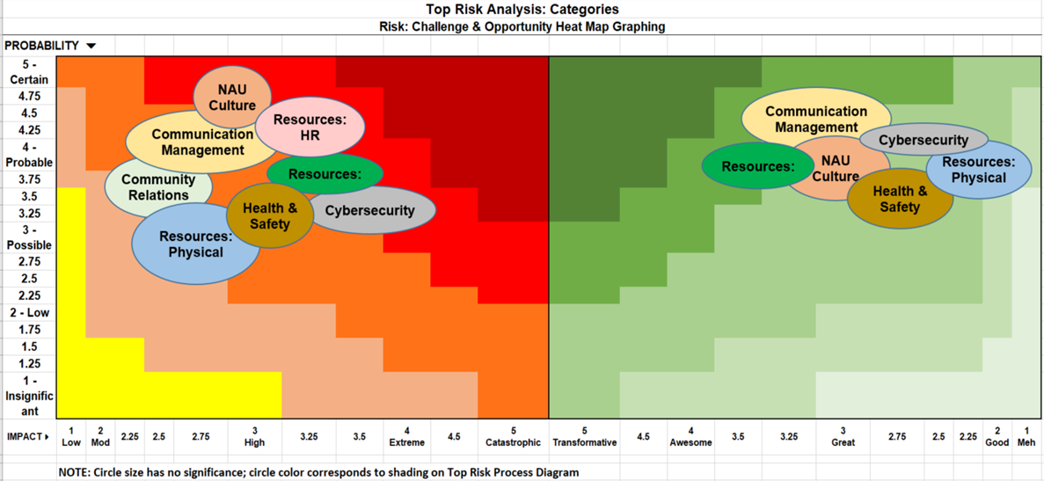
NAU ERM: Challenge & Opportunity Focus
Notes:
Mark
This could just be a quick reference on our ‘outcome’ and how we’ve gone about a heatmap with the two sides. Reference quickly as it’s available in the deck later for those really interested.

Slide 18
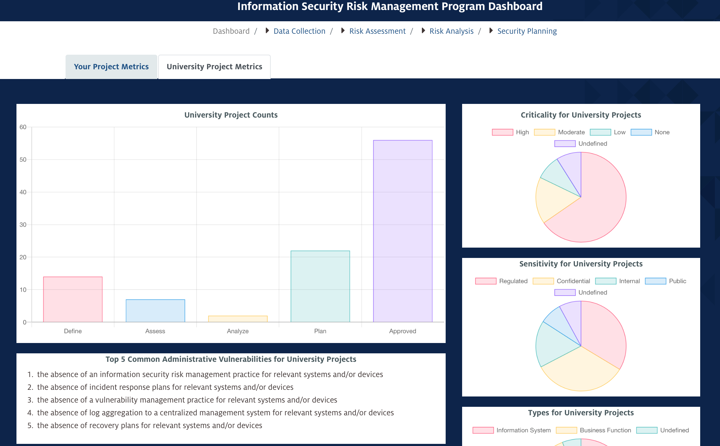
UA Information Security Risk Assessment Process
Notes:
Lanita

Slide 19
UA Shared Responsibility Model - What’s Your Role?
Senior Campus Leaders
Information/Risk Owners
Risk Managers
Security Managers
System and Process Owners
Notes:
Lanita

Slide 20
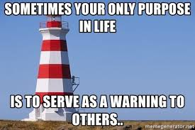
Notes:
Sean

Slide 21
Lower Resourced, Not Lesser Engaged
Smaller schools or those with fewer resources don’t have to put off formal risk assessment, internal audit, and related efforts.
What We Don’t Have | What We Do Have
Internal Audit | A “robust” relationship with state auditors, open communication with peers, maturing “internal” internal audit efforts.
Risk Manager | Routine risk assessment efforts, table top exercises, participation in real-world incident response (mutual aid)
Legal Counsel | Someone who stayed at a Holiday Inn Express last night
Compliance | Challenges...
Large InfoSec Team | Broad, strong relationships with other State/Local Government; ISAC Memberships; An educated and engaged employee community
Notes:
Sean

Slide 22
Evolution of Risk Assessment for YC
Our formal and informal risk assessment efforts guide many of our tactical and strategic initiatives; they form the basis for our still-developing internal audit efforts.
2015
2016
2017
2018
2019
DR/BC
Security Awareness
DR/BC
Security Awareness
Int/Ext Vuln Scans
Phishing Tests
Positive Enrollment
DR/BC
Security Awareness
Int/Ext Vuln Scans
Phishing Tests
Positive Enrollment
Data Inventories
DR/BC
Security Awareness
Int/Ext Vuln Scans
Phishing Tests
Positive Enrollment
Data Inventories
“GLBA Routine RA”
DR/BC
Security Awareness
Int/Ext Vuln Scans
Phishing Tests
Positive Enrollment
Data Inventories
“GLBA Routine RA”
Business Impact Analysis
Table Top Exercises (TTX)
Real-World IR
Notes:
Sean

Slide 23
(R)Evolution in Data Collection & Use
With small teams, flat budgets, and increasing demands, good isn’t good enough. Process refinement, improvement and other efficiency gains become critical to staying afloat in a sea of change.
2017
2018
2019
2020
Data Collected: | SDI | SDI | SDI, BIA | SDI, BIA, VMD, VMP?
Automation: | None | Some (Reporting Only) | More... | Most...
Burden: | High (3+ Hours Per) | Moderate (2+ Hours Per) | Lower (1-2 Hours Per) | TBD (Low?)
Data Value: | Very High | Low | Moderate | TBD (High?)
Notes:
Sean

Slide 24
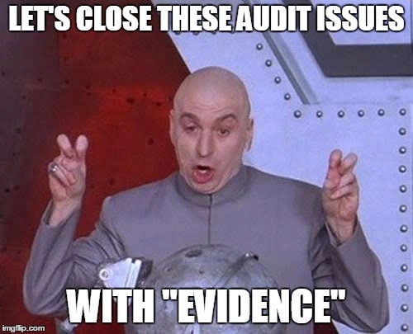
Defining “Audit” @ YC
Evaluating a system or process against a documented standard, framework, or industry best practice.
Or... Are we really doing what we think (or tell others) we’re doing?
Notes:
Sean

Slide 25
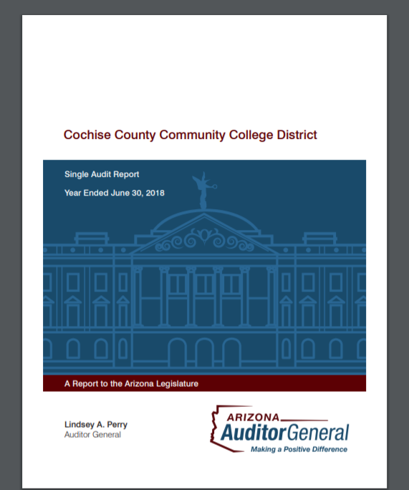
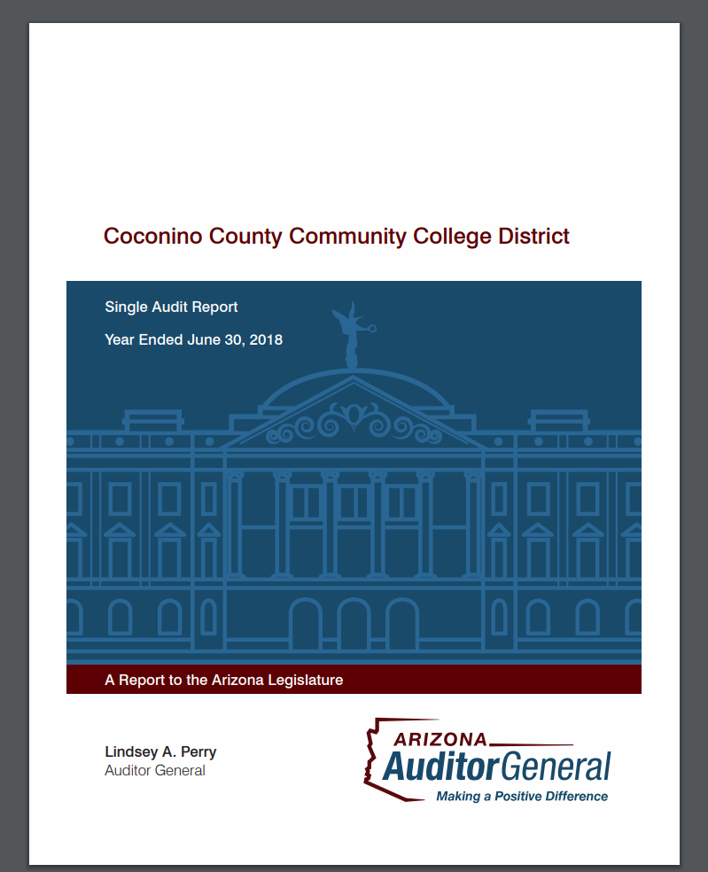
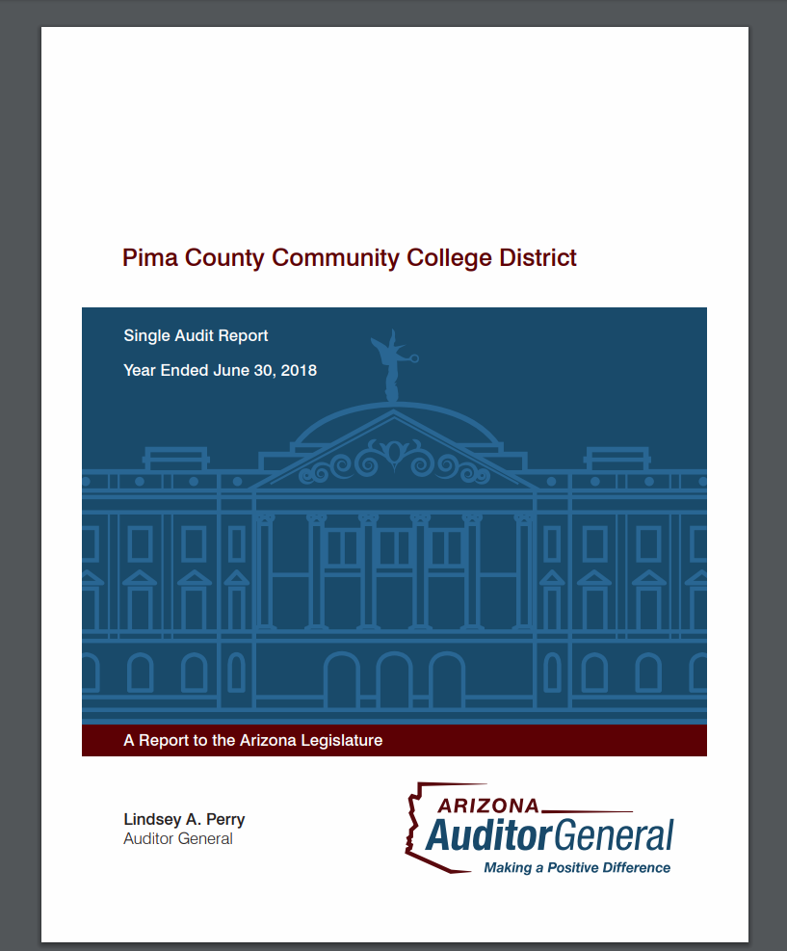
Auditing Without Auditors
Challenges:
Eliminating implicit bias/assumptions
Do the thing or audit the thing?
Possible adversarial perceptions from colleagues
Increasing Importance (HLC Accreditation)
Examples of “Internal” Auditing at YC:
Administrative Privilege (local workstation admin access)
Shared Secret (employee separation/secret rotation)
DNS Audit (external DNS only)
Data Inv. (how truthful accurate are the SDI responses?)
NIST CSF Framework Gap Analysis
Notes:
Sean

Slide 26
Challenges & How to Overcome Them
Differences in Approach, Duties, Obligations
Different Maturity Levels, Knowledge, Skills
Different Technologies
Disagreements
Notes:
(Sean) transition to Lanita with eye on AUDIENCE ENGAGEMENT! -- Questions, how about you…?
Cultural differences is a major aspect that needs to be addressed.
Mark and Michael can certainly help with the times we don’t see 100% eye to eye.

Slide 27
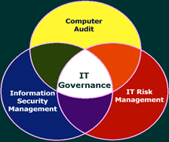
InfoSec-Audit Collaboration Successes
Audits
Improved IT Governance, Risk, Compliance
Key Performance Indicators and Metrics
Strategic Planning and Roadmaps
Policies, Standards, Procedures, Guidelines
Improved focus on strong yet balanced IT security controls
Coordinated representation of IT Security Risks, Solutions, Progress and Context to Executive & Board Leadership
Notes:
Mark and Michael transition from previous slide; and Tina input

Slide 28
What’s on the horizon and how can Audit or Assessment practices help?
Notes:
(time-check) Mark
Some possible ideas, audience-questions if time allows…
How is each institution dealing with Privacy issues: combined with security? Privacy or Compliance Officer interactions?
What’s new in IT Governance for each of our institutions?
Changing roles for CISOs? → Tina
Other ideas?

Slide 29
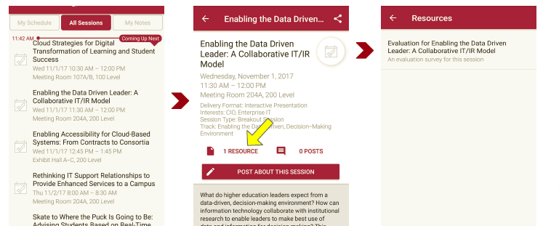
Session Evaluations There are two ways to access the session and presenter evaluations:
1
2
In the online agenda, click on the “Evaluate Session” link
From the mobile app, click on the session you want from the schedule > then scroll down or click on the associated resources > and the evaluation will pop up in the list
Notes:
Michael
Quick Reference

Slide 30
Questions?
Contact Information
Tina Thorstenson: Tina.Thorstenson@asu.edu
Mark Ruppert: Mark.Ruppert@nau.edu
Michael Zimmer: Michael.Zimmer@nau.edu
Lanita Collette: lcollette@arizona.edu
Sean Hagan: sean.hagan@yc.edu
NOTE: This presentation leaves copyright of the content to the presenter. Unless otherwise noted in the materials, uploaded content carries the Creative Commons Attribution 4.0 International (CC BY 4.0), which grants usage to the general public, with appropriate credit to the author.
Notes:
Michael

