Slide 1
Balancing Art and Science in IT Service Delivery
Matt Carmichael, Monash University
Martina Holubcova, Manchester Metropolitan University
Kurt Weideling, Manchester Metropolitan University
http://responseapp.ombea.com Session ID -

Slide 2
In University IT departments
in a galaxy not too far away,
a battle rages for
the soul of Service Delivery.
A desire for corporate efficiency
and metric-based assessment
of effectiveness clashing
with the desire for a more
responsive, creative approach
that aligns with academic
culture and practices.
Meanwhile on the sidelines,
the accountants look on,
constantly demanding
we deliver more with less...

Slide 3
Setting the scene
In University IT departments, a battle rages for the soul of Service Delivery. A desire for corporate efficiency and metric-based assessment of effectiveness clashing with the desire for a more responsive, creative approach that aligns with academic culture and practices.
Meanwhile on the sidelines, the accountants look on, constantly demanding we deliver more with less...

Slide 4
Content
Introductions and background
Art and science in organisation and skills
Art and science in customer satisfaction and continual improvement
Key take-aways

Slide 5
About us
Matt Carmichael
Martina Holubcova
Head of IT Service Management, Manchester Metropolitan University, UK
Kurt Weideling
CIO, Manchester Metropolitan University, UK
Current doctoral student at Warwick Business School, researching the area of innovation in traditional organisations
Director, Support Services and Engagement, Monash University, Australia
Australia's largest University with 70,000 students and 7,500 staff
37,000 students and 5,000 staff

Slide 6
About us
Experience working at:
5 Universities: Monash, Manchester Metropolitan, University of Manchester, Swinburne University, La Trobe University
6 countries: Australia, UK, USA, Canada, Czech Republic, Belgium
10+ corporations
Consumers of our own educational services!
Martina at Manchester Met, Kurt at Monash

Slide 7
Target outcomes
Increase your understanding of how competing demands for corporate style efficiency and academic creativity and responsiveness are influencing University IT departments.
Share ideas about potential organisational approaches to balance these competing demands
Consider what this means for measuring customer satisfaction and service improvement

Slide 8
First interactive quiz
http://responseapp.ombea.com Session ID -

Slide 9
Art and Science in Process and Organisation
Matt Carmichael

Slide 10
Second interactive quiz
http://responseapp.ombea.com Session ID -

Slide 11
Art versus Science
What if you were able to build an IT organization,
that recognized staff strengths,
and then used those strengths to everyone’s advantage?
Scientific
High Volume, Low Variation
Literal
Artistic
Low Volume, High Variation
Lateral
Notes:
What if you were able to build an IT organization that recognized staff strengths and then used those strengths to everyone’s advantage?
Scientific = High Volume, Low Variation work types. A repeatable exercise that follows a recipe (a bit like science). A literal application of a learned skill
Artistic = Low Volume, High Variation work types. Requires lateral application of a learned skill. Requires someone to be artistic in their thinking and adaptation of a solution for a result

Slide 12
Organisational culture
A mix of artistic operators and scientific operators
An artistic operator in a scientific role is bored, frustrated, not producing the results otherwise capable of achieving
A scientific operator in an artistic role is stressed, out of their depth and potentially making promises that can’t be kept
Disaster for an IT organization – culture, reputation and results
Notes:
Our organisations had a mix of artistic operators and scientific operators.
Both were needed and both are important…BUT…
An artistic operator in a scientific role is bored, frustrated…a cost that is not producing the results and outcomes otherwise capable of achieving
A scientific operator in an artistic role is stressed, out of their depth and potentially making promises that can’t be kept
Both situations spell disaster for an IT organization – the culture, reputation and results

Slide 13
Organisational culture
Align people to their desired work type and/or their current skill set
Right person right role
Improves trust, productivity, outcomes, happiness, reputation, behaviors
Positive impact on culture, and then internal and external views of your organization
Notes:
Instead imagine having people aligned to their desired work type and/or their current skill set…you may have heard the term RIGHT PERSON RIGHT ROLE
Trust goes up, productivity goes up, outcomes go up, happiness goes up, reputation goes up, behavior’s improve…CULTURE becomes great and when this happens the (internal and external) views of your organization change for the better

Slide 14
What we actually did
Recognised our Scientific Operators from our Artistic Operators
Scientific Operators asked to focus on scientific duties
Artistic Operators asked to focus on artistic duties
Made it clear that the line is never clean cut
There would always be a little bit of science in the artistic world and a little bit of art in the scientific world
Notes:
So….
at our institutions we went on a path of recognising our Scientific Operators from our Artistic Operators.
Scientific Operators were recognised and asked to focus on scientific duties
Artistic Operators were identified and asked to focus on artistic duties
And…
We openly called this activity out while making it clear that the line is never clean cut and there would always be a little bit of science in the artistic world and a little bit of art in the scientific world.

Slide 15
The impact
Staff satisfaction went up
The scientific operators loved knowing what their day would involve
The artistic operators loved having their day filled with a bit of the unknown, their skills tested and new ideas encouraged
Clearer roles with more defined career growth
New skills emerged
Efficiency:
Scientific tasks were prime candidates for automation
Artistic tasks were prime candidates for turning into a scientific task
Created space for new work from our academic colleagues which showed them how valuable and critical their IT organisation is to their business
Notes:
Staff satisfaction went up
Role clarity was much clearer with more defined career growth
New skills emerged, people started to stand out and want to be seen for their value.
The scientific operators loved the fact that they knew what their day would involve. They knew their duties and fulfilled them day in day out
The artistic operators loved the fact their day was filled with a bit of the unknown, that their skills would be tested and new ideas encouraged
And surprisingly
We were able to continue the idea of efficiency because Scientific tasks were prime candidates for automation and artistic tasks became prime candidates for turning into a scientific task.
We created head room for new work from our academic colleagues which showed them how valuable and critical their IT organisation is to their business.

Slide 16
Relationship with other key concepts
And even better for everyone…
Works regardless of your framework
ITIL, Agile, DevOps, Lean, Waterfall, transactional based is irrelevant because you have RIGHT PERSON RIGHT ROLE and productivity is maximised under any framework

Slide 17
Art and Science in Customer Satisfaction
Martina Holubcova

Slide 18
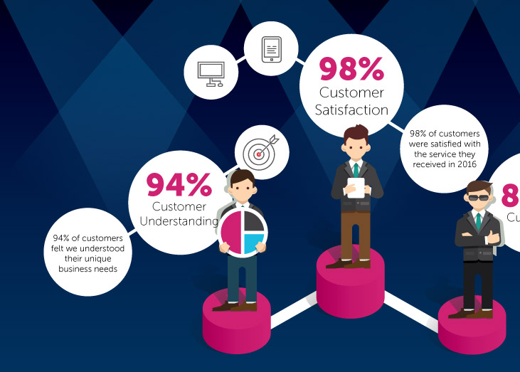
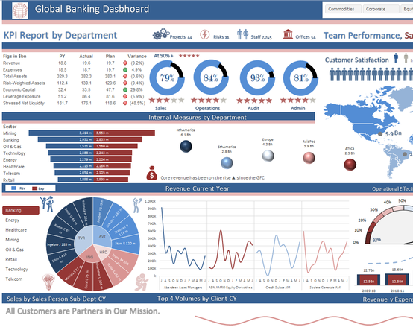
Measuring customer satisfaction
Seems scientific on the outside
Organisations publicise various satisfaction scores
Everyone seems to be using the Net Promoter Score
Even Accident & Emergency units in British Hospitals
But what is the science behind that?
No standardised way of measuring
Data not easily comparable
Often focused on customer loyalty and profit
MSc
Notes:
Service Desk Manager – publicising satisfaction results…not comparable
Net Promoter Score – at conferences
A&E in Manchester – patient experience questionnaire “How likely are you to recommend our service to your friends and family if they needed similar care or treatment?”
Results all over the walls of the waiting room…emergency health care, 2 criteria (nearest & open) + quality
Lacking best practice guidance on these issues (ITIL, SDI)
MSc

Slide 19
Third interactive quiz
http://responseapp.ombea.com Session ID -
Notes:
600 hours, interviews with a number of UK universities -> the most obvious conclusion
But first, more research

Slide 20
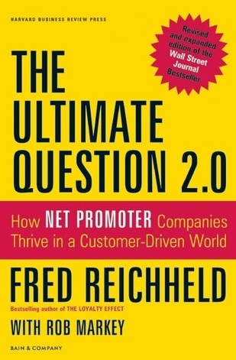
Net Promoter Score
How it works
“How likely is it that you would recommend us to a friend or colleague?”
Net Promoter Score = % Promoters – % Detractors
Benefits
Simple to run and analyse
Scale starts with 0 – an internationally understood negative
Watch out for
Impossible to classify human beings into three categories
Cannot be used for improvement without further qualitative questions
Recommend to whom?
0
1
2
3
4
5
6
7
8
9
10
Detractors
Passives
Promoters
Notes:
First let’s talk about the science
Based on one question
Respondents divided into 3 groups
Actively detracting others from using your service / those who don’t care too much either way / deliriously happy ones go around positively promoting to others
Score calculated as % promoters - % detractors
Irresistible simplicity (question & analysis)
Scale starts at 0 (internationally recognised negative)
Popularity itself
Simplicity – weakness, impossible to classify human beings into 3 piles based on a 2 second choice of a number
Question itself – Apple / Uber - recommend to whom? What will happen?
Not for each ticket or project, but annual survey – long term opinion, accompanied by qualitative questions (why)
More in Fred Reichheld’s book

Slide 21
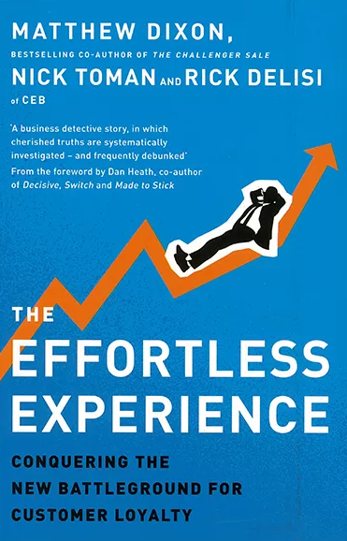
Customer Effort Score
How it works
“To what extent do you agree with the following statement: [Company] made it easy for me to handle my issue”.
Customer Effort Score = Average of all scores
Strongly Disagree
Disagree
Somewhat Disagree
Neutral
Somewhat Agree
Agree
Strongly Agree
1
2
3
4
5
6
7
Benefits
Focusing on making service delivery easier, reducing cost and increasing productivity for the whole organisation
Simple number that can be monitored for trends
Watch-out for
Still need follow-up qualitative questions to be useful for driving improvement
Notes:
Another simple method
Aimed at finding out how much effort the customer had to invest
7 point scale – score is an average of all scores
Driving customer productivity – reduce complexity, duplication of effort, switching channels, speaking to multiple people, repeating information, chasing
Efficiency & lowering cost
Rather than WOW factor (don’t need to exceed expectations, just meet them)
Suitable for internal service providers – drives the right behaviours
Most suitable for ticket-based rather than long term (compared to NPS)
Still based on loyalty, not complex
Accompany by other questions to understand why
More information in a book called The Effortless Experience

Slide 22
TechQual+
Enables benchmarking of customer satisfaction
Shared measure for service quality in University IT Departments around the world
Based on SERVQUAL
13 identical questions and a few individual questions
Measures the difference between:
Minimum service expectations
Desired service expectations
Actual service received
www.techqual.org
Sadly to be decommissioned at the end of 2019
Notes:
Most IT leaders I have interviewed interested in benchmarking (NPS)
Specifically developed for measuring & comparing quality and satisfaction with services of IT departments in Universities around the world = TechQual
The gaps between the 3 levels can be analysed in detail, results compared against other Universities
Messages with Timothy Chester – decommissioning at the end of 2019 – still available in some form, shows what’s possible

Slide 23
But science isn’t everything
Customer Satisfaction is an important KPI to track progress
But measuring customer satisfaction isn’t the goal...
It’s the start of a continual improvement journey
Particularly important for internal service providers
We can improve productivity and efficiency of the whole organisation
We have long term relationships with our customers
Qualitative feedback is essential
Notes:
Other methods – CSAT (how important is something to you & how satisfied are you with it, focus on improving areas that are important)
My research led me towards the art element of customer satisfaction
More important than the measuring itself – what we do with the data
Monitor trends but not the goal – act on feedback, improving & communicating back
As internal providers - sometimes even a small improvement can have a tremendously positive impact on the productivity of thousands of people across the institution
Qualitative feedback – closing the gap between expectations and perceptions

Slide 24
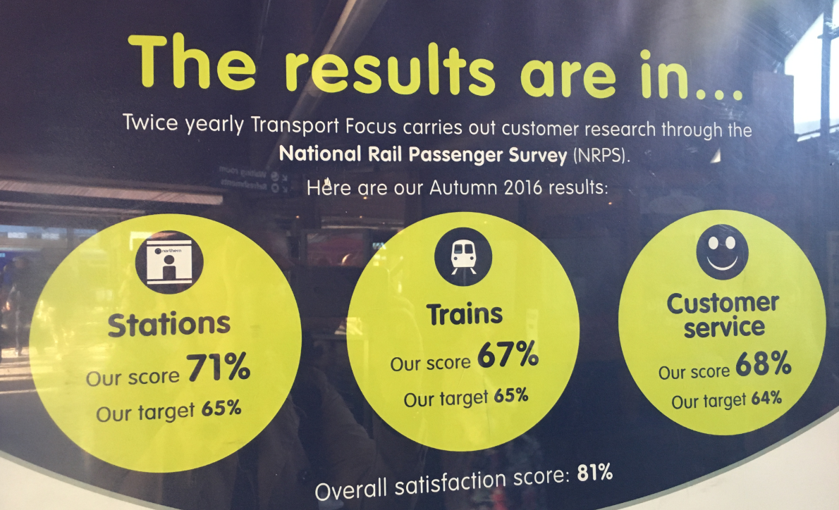
The science without art
Obsession with numbers is damaging
Like hospitals asking patients with serious trauma if they would recommend the hospital to their friends and family
Or this UK train company hitting their very low targets
Notes:
Commitment but not obsession
Focusing too much on the numbers drives wrong behaviours – context (art)
Trauma
Northern Rail smashing their unacceptably low targets

Slide 25
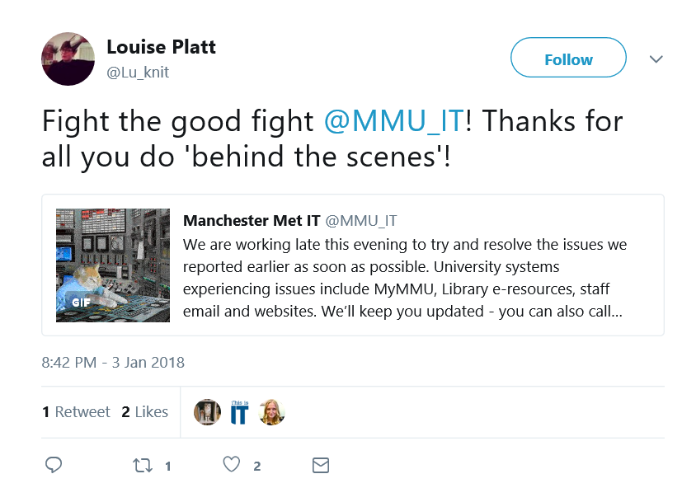
The art in customer satisfaction
Customer satisfaction cannot be reduced to a single number
…It’s a complex, psychological, subjective, human measure
Techniques that have helped:
Customer journey mapping with new employees
Focus groups
Inviting customers who complained to improvement workshops
Listening to frontline staff
Some feedback will never be found in a survey form
For example, during a 6 hour outage on all our core systems…
Notes:
Measuring and monitoring customer satisfaction is really important – science
Humans – thoughts & emotions can’t be simplified into one number or one word – no silver bullet
Have to balance with more “artistic” view / context
A few things that were successful:
What bothers customers will bother new employees too…free consultancy
Balance surveys with more personal face to face workshops / focus groups
Really important how we handle complaints (long term relationships) – improvement workshops, follow-up emails – trust & satisfaction
Service Desks in constant contact
Some feedback can’t be captured in a form – social media
Last year (only option to communicate via social media)

Slide 26
Conclusion and key take-aways
Kurt Weideling

Slide 27
Key take-aways
The art v science paradigm is another way for you to think about the challenge of balancing institutional expectations for responsiveness and efficiency.
We also hope it will help you think about the challenges of organisation design, employee engagement and measuring customer satisfaction.
There is a way to meet institution expectations, please colleagues and customers and keep staff happy…
…just not all at the same time!
We hope this has given you a new perspective to think about these challenges

Slide 28
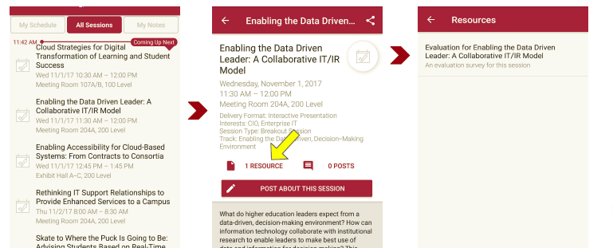
Session evaluations There are two ways to access the session and presenter evaluations:
1
2
In the online agenda, click on the “Evaluate Session” link
From the mobile app, click on the session you want from the schedule > then scroll down or click on the associated resources > and the evaluation will pop up in the list

Slide 29
Any questions?
Matt
Matt.Carmichael@monash.edu
@MatCarmichael74
Martina
M.Holubcova@mmu.ac.uk
@Holubcovka
Kurt
K.Weideling@mmu.ac.uk
@KWeideling
NOTE: This presentation leaves copyright of the content to the presenter. Unless otherwise noted in the materials, uploaded content carries the Creative Commons Attribution 4.0 International (CC BY 4.0), which grants usage to the general public, with appropriate credit to the author.

