Slide 1
Advising Office of the Future

Slide 2
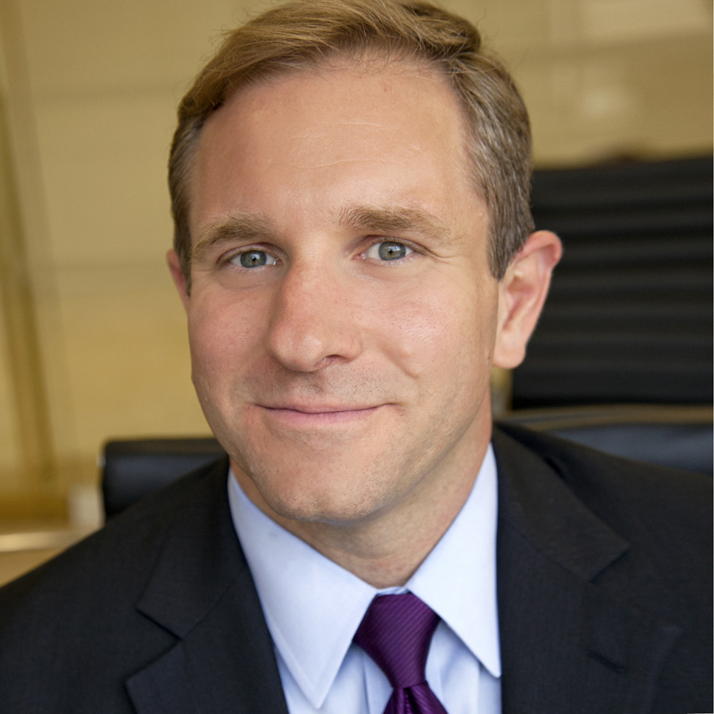
Presenters
Ed Venit, PhD
Managing Director Strategic Research
EAB
Jammie Wilbanks, PhD
Associate Vice President for Academic Success
Wiregrass Georgia Technical College

Slide 3
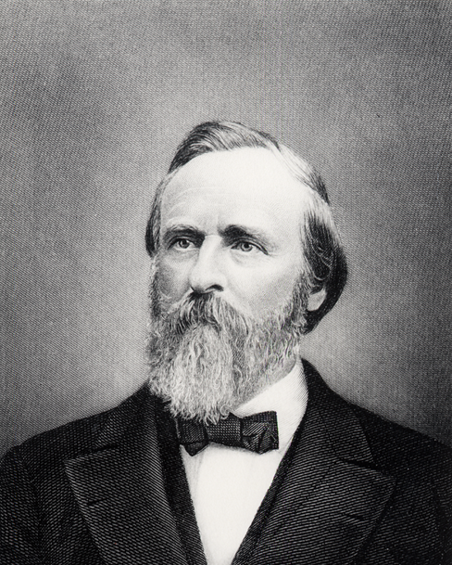
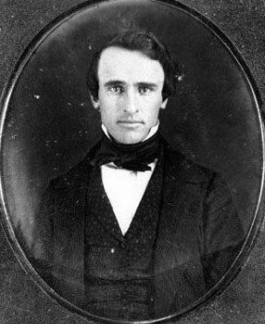
Where It All Started
“A new rule has been established that each student shall choose from among the faculty some one who is to be his advisor and friend in all matters in which assistance is desired and is to be the medium of communication between the student and faculty. This I like very much…”
Rutherford B. Hayes, as a student at Kenyon College, in a letter home to his mother in 1840
Source: Himes and Schulenberg, “The Evolution of Academic Advising as a Practice and as a Profession,” Beyond Foundations, NACADA, 2016, 5.

Slide 4
Meet the Class of 2027
Next Decade of Students Will Demand More From Advising
Generation Z
Recent high school graduates, born between 1996-2011 and entering college after 2015
Post-traditional
Adult, part-time, and online students increasing as # of high school grads declines nationally
How Are They Different from Millennials?
38%
58%
1
More independent
Of undergrads are over the age of 25
Of students work while in college
2
More financially savvy
1 in 4
40%
3
Have never known a world without wifi
Undergrads are raising children
Of students attend school part-time
What They Expect of Advising
Tailored and transparent advice
Help getting a return on education
A seamless technology experience
What They Expect of Advising
A “safety net” monitoring their progress (especially SAP)
Flexibility in scheduling, communication, and advising approach
Source: Lumina, “Today’s Reality,” 2017, https://www.luminafoundation.org/todays-student-statistics; The New York Times, “Move Over, Millennials, Here Comes Generation Z,” 2015, https://www.nytimes.com/2015/09/20/fashion/move-over-millennials-here-comes-generation-z.html?mcubz=0; Fast Company, “Your Guide to Generation Z,” 2016, https://www.fastcompany.com/3062475/your-guide-to-generation-z-the-frugal-brand-wary-determined-anti-millen; EAB interviews and analysis.

Slide 5
The Shifting Role of the Advisor
Moving Beyond Transactional Responsibilities to More Holistic Care
Traditional Advisors
Success Advisors
Student Success
Early alert response
Case management
Registration
Financial Well-Being
Registration
Course planning
Major guidance
Student Success
Specializations
First-year seminars
Personal counseling
Financial advising
Career advising
Career Preparation
Academic Performance
Source: EAB interviews and analysis.

Slide 6
What Is the Advising Office of the Future?
The Advising Office of the Future
A centrally managed group of Success Advisors committed to driving measurable student outcomes
Managed by an Advising Director or AVP of Student Success
Source: EAB interviews and analysis.

Slide 7
The Emergence of Caseload Management
Three Factors in Advising Pave the Way for New Approach
Proactive Caseload Management
1
2
3
Proactive Advising Approach
An Assigned Caseload
Access to Data and Technology (SSMS)
“Proactive Advising involves…intensive advising designed to increase the probability of student success, working to educate students on all options, and approaching students before situations develop.”
Jan Varney
NACADA, 2012
Source: Varney, Jennifer. “Proactive (Intrusive) Advising.” NACADA: Academic Advising Today (2012), http://www.nacada.ksu.edu/Resources/Academic-Advising-Today/View-Articles/Proactive-Intrusive-Advising.aspx; EAB interviews and analysis.

Slide 8
Why Assign Advisor Caseloads?
Prerequisite for a proactive approach and quantitative evaluation
Helps advisors take more ownership of students’ success or failure
Creates a better, more consistent experience for students

Slide 9
What Does It Look Like?
Comprehensive and Continuous Approach to Student Support
Wiregrass Case Management Process
1
2
3
z
z
z
Advisors monitor evolving needs of students in their caseloads
May have multiple visits with same students and no visits with others
Advisors given trust and latitude to “manage their lists” using all available tools
This reflects Wiregrass’s process. Note there will be a walk-in advisor while the case managers can take the time to the outreach they need to do. They’ll have a walk-in side and an appointment side. Triage issues and then schedule with permanent advisor
Advisor identifies key risk factors and student groups within their caseloads, e.g.:
Low high school GPA
First-generation
Financial risk
Low midterm grades in key courses
Identifies critical times for outreach (e.g., registration, midterms, drop/add)
Executes outreach, tracks responses, and follows up as needed
5
z
4
z
Closes the loop and monitors whether targeted students have improved
Advises students in person and refers to other offices as needed
Source: EAB interviews and analysis.

Slide 10
Future Vision: The Coordinated Care Network
Success Advisors Contribute to and Benefit from a Campuswide CCN
Advisor
Student
Admin
Refer
Provide Update
Resolve Case
Track Outcomes
Fin Aid Office
1
Advisor engages with student in advising sessions
2
Connects with support unit when something comes up
3
Collaborates to create and deliver a care plan & close the loop
4
Intervention outcomes tracked & used to inform advisor’s future work
Source: EAB interviews and analysis.

Slide 11
Overview
Background and Challenges
With staff spread over four campuses, Wiregrass struggled with a lack of communication between departments.
Due to lack of coordination, students were making repeat and unnecessary office visits.
Wiregrass also wanted enhance the student experience and better support students through coordination across multiple departments in order to retain students and boost enrollment.
Total Enrollment: 5,900
Campuses: 4
Part-Time: 76%
Dual-Enrollment: 41%
Pell Recipients: 63% of Regular Enrollments
Member Since: June 2016
Millstone Guidance, Academic Planning and Registration Module Launched: April 2017
Strategic Care and Appointment Scheduling Launched: July 2017
Solutions
Used Navigate Reports to enhance student experience
Used Navigate Cases to process their dual-major and change-of-program Requests

Slide 12
Journey to Coordinated Care
2014
Faculty Advising
Decentralized faculty advising model
2015
The ARC
Centralized, professional advising model
2017
The ARC + Navigate
Advisors leverage Navigate to improve student experience
2019
Navigate + Coordinated Care
Staff across the campus use Navigate for workflow and student support
1 in 3 students struggles with planning and registration
Students do not necessarily meet with their advisor before first-term registration
ARC responsible for new students, stop-outs & select academic programs
Students assigned a faculty advisor at 50-60% program completion
9 full-time advisors
1 part-time advisor
100% of ARC advisors use Navigate in advisement sessions
37% by appointment and 63% via walk-in
3,448 appointments since launching Campus module in July 2017
100% Admissions and Financial Aid staff use Navigate
155 SAP appeals have been processed using Navigate cases
Over 80,479 appointments since launching Campus module in July 2017

Slide 13
Let’s Discuss
Is technology necessary to advise today’s students?

Slide 14
Change-of-Major and Dual-Major Request
Old Process Required Students to Make Many Office Visits
Pre-Navigate Process
Process completed on a paper form
Process takes up to 2 weeks to complete
Advising
→
Financial Aid
→
Admissions
→
Advising
Student visits Advising to make the change, but finds they need to visit several other offices to gain approval
VA Office
If the change is approved by all offices, the student must take the form to Admissions
Finally, the student must return to Advising to discuss a new academic plan
Registrars
Student must then visit two to three additional offices to have the request reviewed and signed by appropriate staff

Slide 15
Streamlining the Process for Students
Navigate Cases Eliminates the Need for Multiple Office Visits
Post-Navigate Process
Process completed via Navigate Cases
Process takes up to 3 days to complete
Advising
Student visits Advising to make the change
Advisor opens case in Navigate and assigns it to Financial Aid
Advisor works with student to pick classes in the anticipation of approval
Financial Aid
VA Office
5,904
Registrars
Admissions
Office visits eliminated since January 2018
After each office processes the electronic request, the case is assigned to the next office for review

Slide 16
Inefficient SAP Appeal Process Corrected
Former Appeals Process Could Take Days to Months to Complete
1
2
3
4
5
6
Student submits appeal
1 of 3 Campus committees
Decisions made 1x per term
Approvals receive academic plan
Advisor signs off on plan with little context
Student is permitted to reenroll
New Appeals Process Takes Days with Less Student Hustle
1
2
3
4
Student submits appeal
Staff scans in appeal and creates case
Appeal sent electronically to committee members
Approvals scheduled to discuss academic plan with advisor

Slide 17
Let’s Discuss
How does advising cross over to other departments (i.e., admissions, testing, VA, etc.) and how can technology break down existing silos?

Slide 18
Total Enrollment
2017 to 2018 by Semester
+2%
+7%
+15%
3,910
2,061
4,546
3,823
1,922
3,937
Spring 2017
Summer 2017
Fall 2017
to Spring 2018
to Summer 2018
to Fall 2018

Slide 19
Fall-to-Fall Retention
61%
67%
72%
AY16
AY17
AY18
+10%
Retention in 2-Year Period

Slide 20
Our Next Priority
Working Toward Fully Coordinated Care Using Navigate
Fill in with content from notes and then create the fin aid sap slides
Workforce Innovation and Opportunities Act Office
Advisors can now schedule students with any services to provide case management and more holistic support.
This side is about getting these offices into Navigate to provide that coordinated care, serving the student holistically, so there is documented support of what is going on with the student. Allowing for true case management. Case manager can also then schedule the appointment directly with special offices.
Uses kiosk data for federal reporting
Admissions
VA Office
Staff makes appointments for students and adds pertinent notes to advising reports
Runs Navigate reports to look at withdrawals, change of majors, enrollment progress at midterms
At-Risk Student Outreach
Uses Cases to manage SAP appeals and runs campaigns for students who are at risk of defaulting on their loans
Student Experience
Special Populations
Ensure every interaction students have with staff serves as an learning opportunity.
Uses tags within Navigate to track different student populations and run appointment campaigns

Slide 21
Sustaining Momentum
Lessons Learned
Every Interaction Should Improve the Student Experience
Flagging Isn’t Enough
Reduce the Number of Steps in Student Processes

Slide 22
Then and Now
It’s Still About the Student
1840
Today
“A new rule has been established that each student shall choose from among the faculty some one who is to be his advisor and friend in all matters in which assistance is desired and is to be the medium of communication between the student and faculty. This I like very much…”
Rutherford B. Hayes, as a student at Kenyon College, in a letter home to his mother (1840)
“That's what contributed to my success as a student. Just having an advisor that's constantly in contact; she communicates with you whenever you have a question as far as verifying information for financial aid or advising…She’s got my back.”
Student in Holistic Advising Program (2016)
Mid-Atlantic Community College
Source: Himes and Schulenberg, “The Evolution of Academic Advising as a Practice and as a Profession,” Beyond Foundations, NACADA, 2016, 5; Mercy College, “Our PACT With You,” https://www.youtube.com/watch?time_continue=12&v=47pe6LJdje4; EAB interviews and analysis.

Slide 23
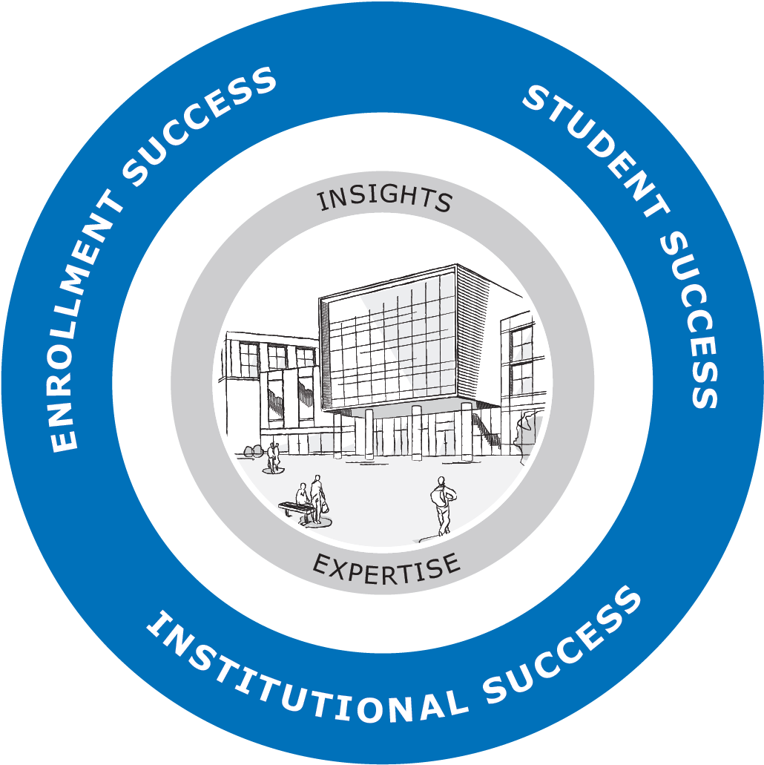
K-12 | Community Colleges | Four-Year Colleges and Universities | Graduate and Adult Learning
Find and enroll your right-fit students
Support and graduate more students
We help schools support students from enrollment to graduation and beyond
ROOTED IN RESEARCH
7,500⁺
Peer-tested best practices
500⁺
Enrollment innovations tested annually
ADVANTAGE OF SCALE
1,500⁺
Institutions served
3.7 M⁺
Students supported by our SSMS
WE DELIVER RESULTS
95%
Of our partners continue with us year after year, reflecting the goals we achieve together
Prepare your institution for the future

