Slide 1
SPRINT!
Applying Agile Methodologies Across the Changing University Environment
Dr. Michael Cottam, Associate Provost, APUS
(Former Dean & AVP at Webster University)
Dr. Michelle Loyet, Associate Vice President

Slide 2
Session Objectives
Explore an agile project management framework adapted to higher education.
Brainstorm and select sample projects to prototype discuss.
Create a comprehensive basic project plan to solve sample projects.

Slide 3
Session Outline
Identify pros and cons of group projects.
Describe our VUCA environment.
Illustrate agile methodologies.
Brainstorm sample projects.
Create basic project plan.

Slide 4
What words (positive or negative) come to mind
when you think about
Group Projects?

Slide 5
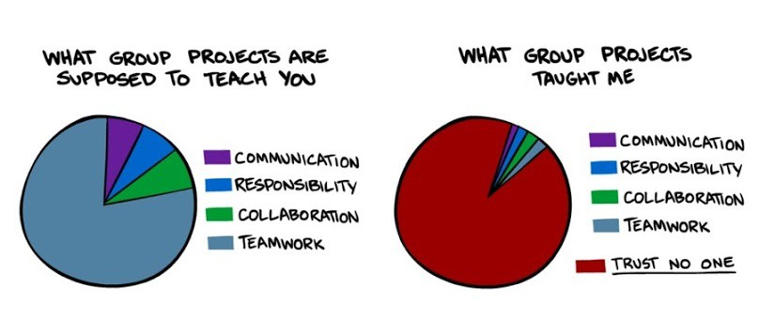

Slide 6
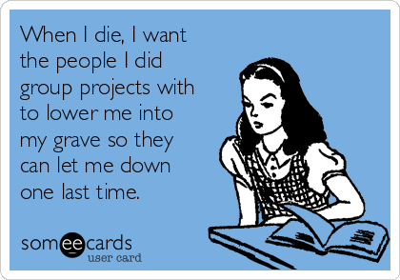

Slide 7
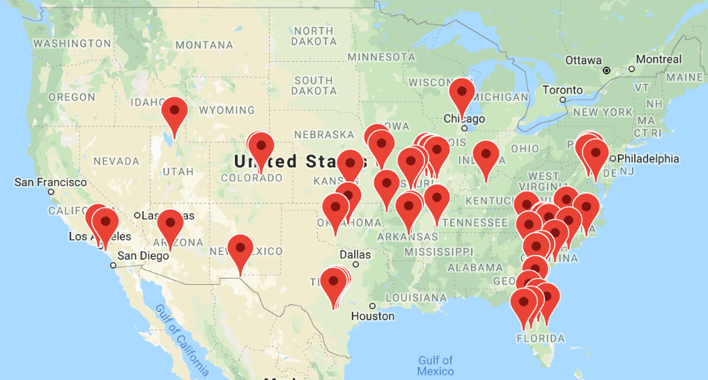
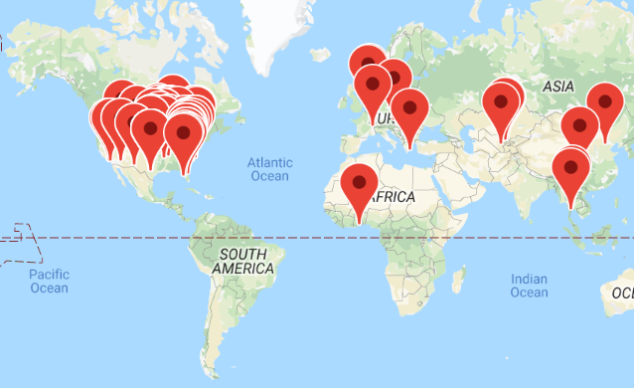
GLOBAL | ONLINE

Slide 8
VUCA Environment
Complex Interrelated decision factors
Volatile High rate of change
Ambiguity Causal relationships are unclear
Uncertain Unclear about affecting change
How well can you predict outcomes?
How much do you know about the situation?

Slide 9
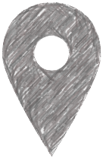
You are here!
We wish the target would remain the same over time!
Wishful
Thinking
Path of
We wish we could know every step along the way!

Slide 10
From Design Thinking to Agile Sprints
We do not THINK our way to a solution from the beginning.
We BUILD to a solution
by creating, testing, and improving PROTOTYPES.

Slide 11
You are here!
Prototype
Prototype
Prototype
Prototype
Prototype
Prototype
Prototype
AGILE
Thinking
Path of

Slide 12
20+ Sprint Cycles… And Counting…
HLC Quality Score Card
Dropout Detective
Success Coach Model
Faculty Training
One Webster Course
WebNet+ video course delivery
Military Support
MA Degree Maps
Admissions Communications Plan
“Build the Model” for Campuses
Centralized Scheduling
Faculty “Commit to Engage” training
Non-Credit course delivery
Student Orientation
Course Accessibility
Online Tutoring
Updated UI for LMS
Video Production & Promotion
Course and Faculty Tracker
Online Student Commons
Centralized Academic Advising
Admissions—lead generation, StoryBrand
Office 365 Rollout
Cybersecurity training
What? No software development?

Slide 13
Adapting Agile Sprints to US
Cross-functional, Cross-departmental
Small, self-managing, diverse teams
Stand up daily, Take responsibility
Track progress, Show your work
Prototype, Test… Prototype, Test… Prototype, Test… Prototype, Test…
Reflect and Adjust
Every Sprint Cycle
The process serves US.
WE do not serve the process.

Slide 14
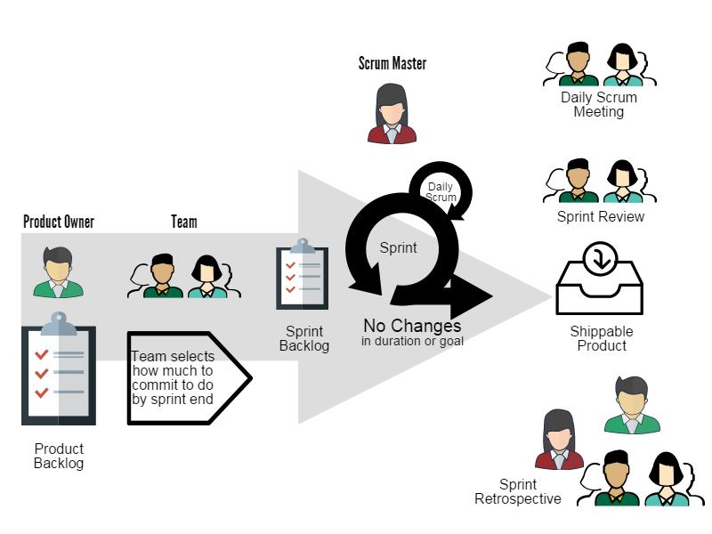

Slide 16
20+ Sprint Cycles… And Counting…
HLC Quality Score Card
Dropout Detective
Success Coach Model
Faculty Training
One Webster Course
WebNet+ video course delivery
Military Support
MA Degree Maps
Admissions Communications Plan
“Build the Model” for Campuses
Centralized Scheduling
Faculty “Commit to Engage” training
Non-Credit course delivery
Student Orientation
Course Accessibility
Online Tutoring
Updated UI for LMS
Video Production & Promotion
Course and Faculty Tracker
Online Student Commons
Centralized Academic Advising
Admissions—lead generation, StoryBrand
Office 365 Rollout
Cybersecurity training
What Complex Project might you plan today?

Slide 17
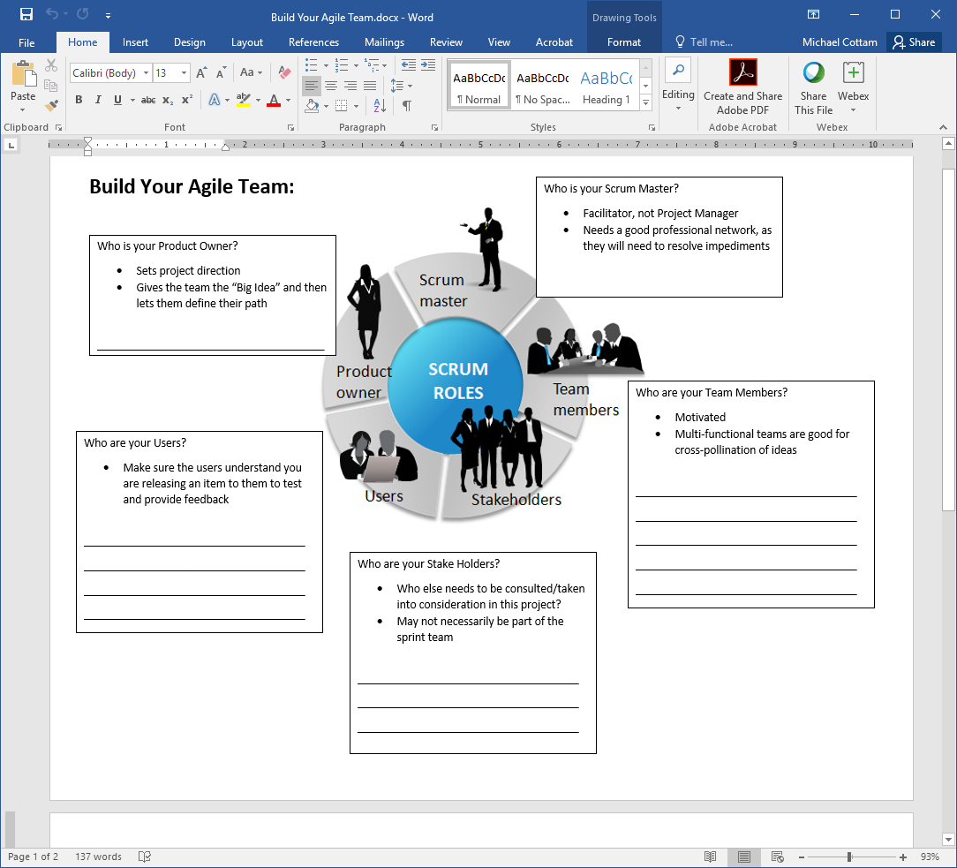

Slide 22
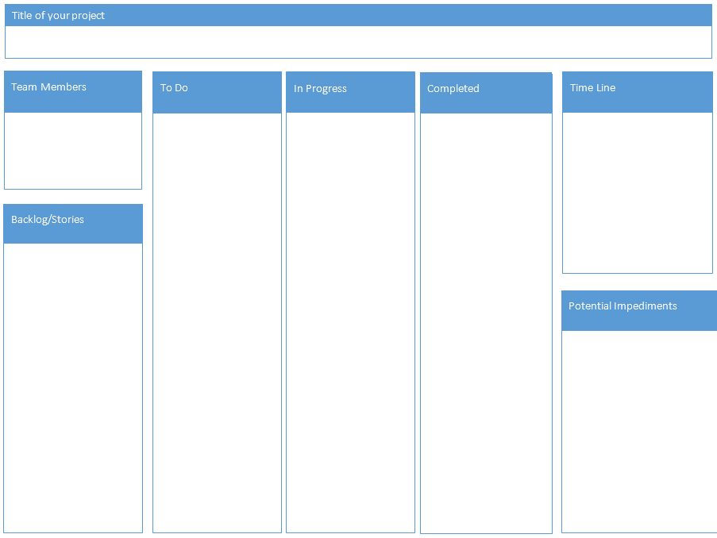

Slide 23
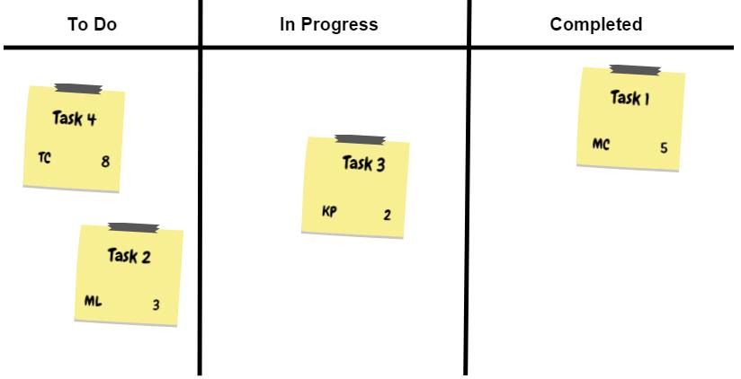
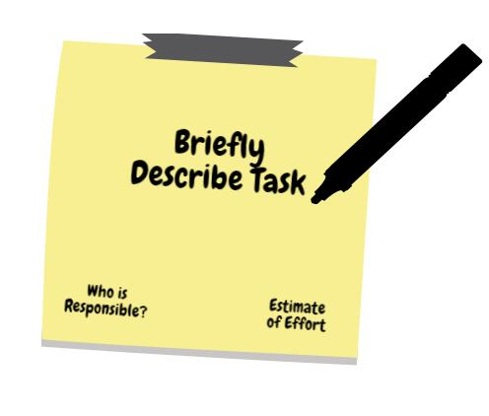
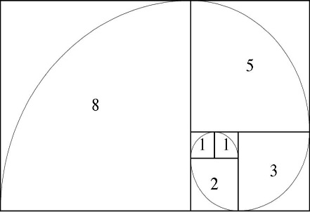

Slide 24
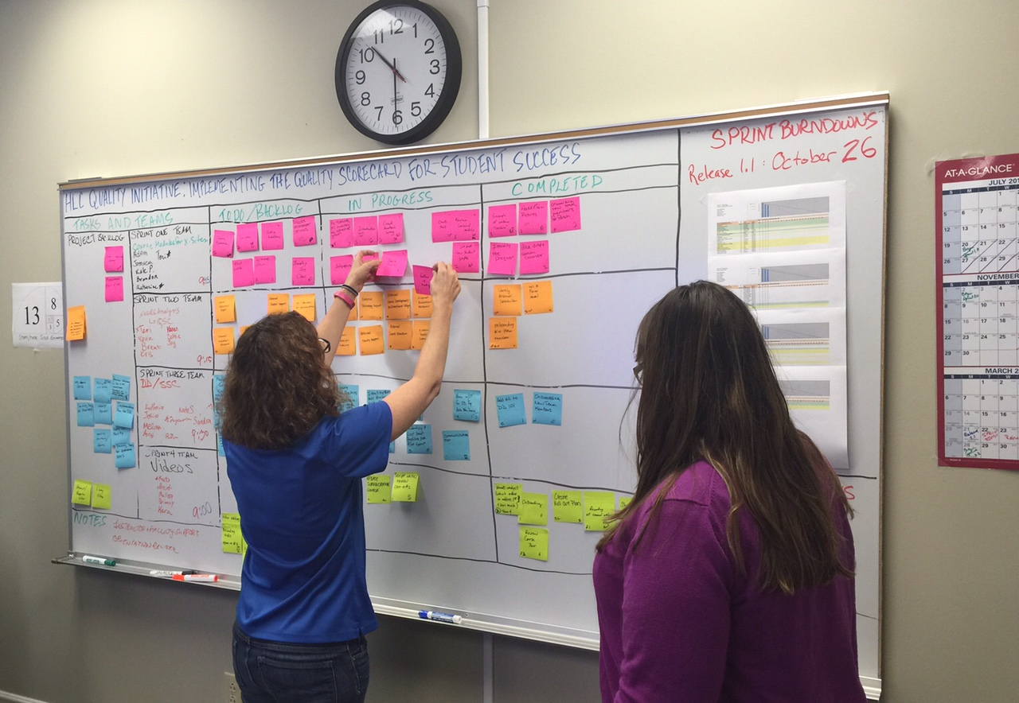
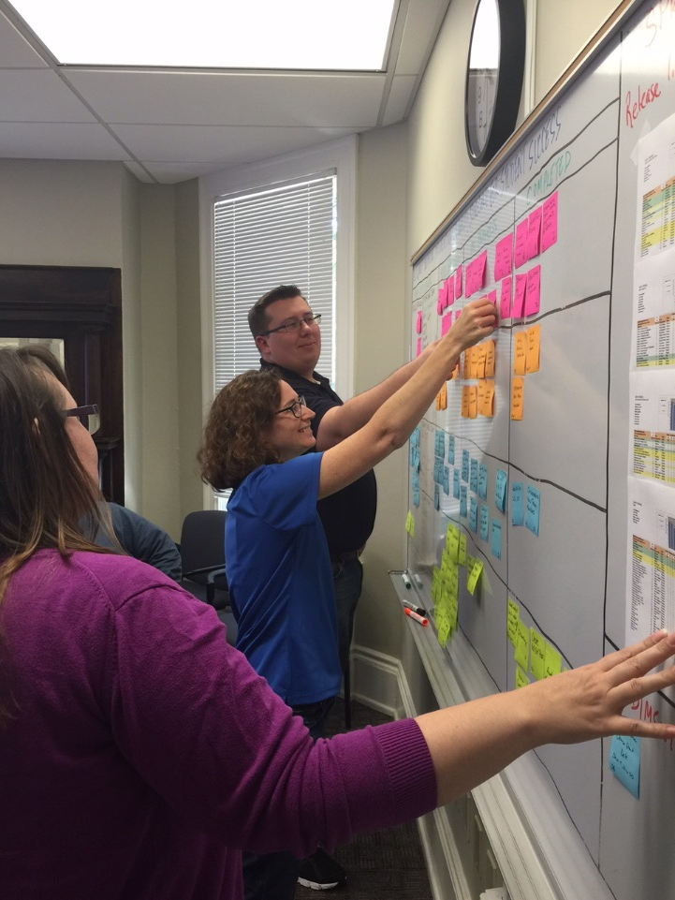
Original OLC Scrum Board

Slide 25
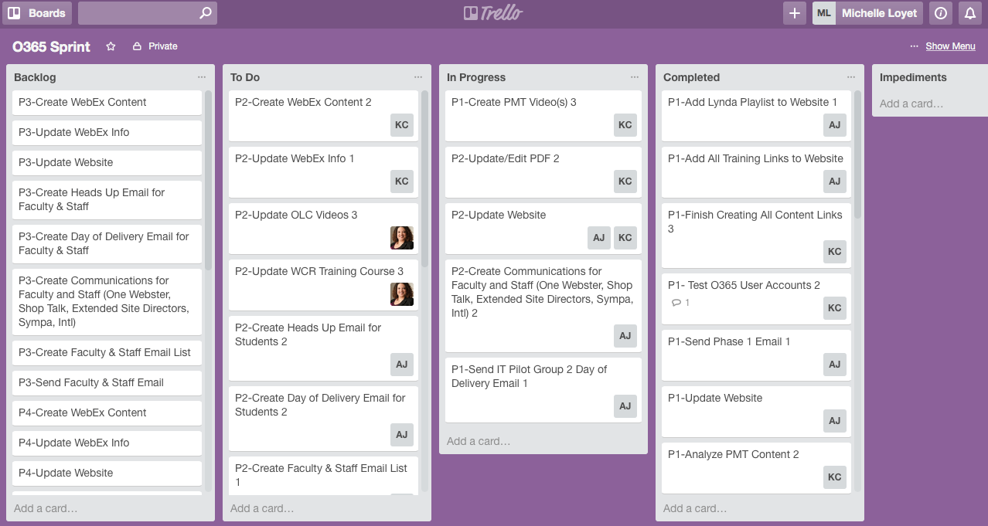
Trello: Electronic Scrum Board

Slide 26
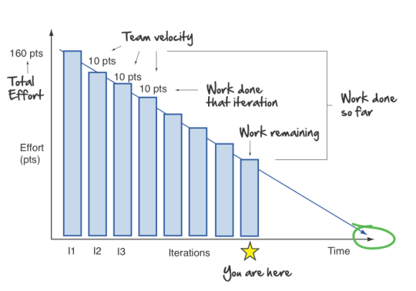
Burndown Chart

Slide 27
Adapting Agile Sprints to US
Cross Functional, Cross Departmental
Small, self-managing, diverse teams
Stand up daily, Take responsibility
Track progress, Show your work
Prototype, Test… Prototype, Test… Prototype, Test… Prototype, Test…
Reflect and Adjust
Every Sprint Cycle
The process serves US.
WE do not serve the process.

Slide 28
SPRINT!
Applying Agile Methodologies Across the Changing University Environment
Dr. Michael Cottam, Associate Provost, APUS
(Former Dean & AVP at Webster University)
Dr. Michelle Loyet, Associate Vice President

