Slide 1
Redefining Advising
Through Performance Based Funding

Slide 2
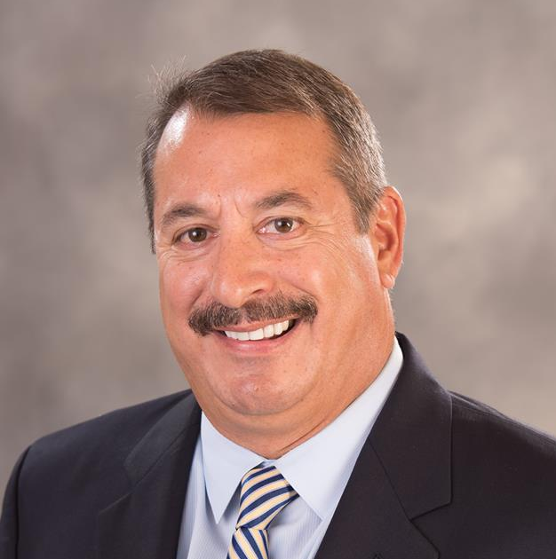
Tony Casciotta
Adam DeRosa
Vice President, Information Technology
Associate Dean, Student Services
Broward College
Large Florida State College

Slide 3
Overview
Background and Challenges
BC has more than 75 advisors spread across four campuses and two regional centers.
Despite transitioning to a centralized advising model and assigning advisors to specific pathways, BC was still experiencing challenges with its advising process.
Inefficient case management and manual data tracking absorbed a great deal of advisors’ time, and students continued to make appointments with non-assigned advisors.
BC was particularity concerned about its First Time In College (FTIC) students, as this population is tied to critical state funding.
# of Students: 68,000
# of Campuses/Centers: 6
% Part-Time: 76%
% First Generation: 48%
% Pell Recipients: 68%
EAB Member Since: July 2016
Onboarding Module Launched: March 2017
Strategic Care Launched: September 2017
Appointment Scheduling Launched: April 2018
Early Alerts Launched: January 2019
Academic Planning Launched:
March 2019
Solutions
Comprehensive Advisor Training and Advising Scorecard
Targeted Appointment Campaigns for FTIC Students

Slide 4
Florida Was an Early Adopter
Performance Based Funding (PFB)
Model Evaluates:
Retention rates
Completion rates
On-time graduation rates
Continuing education rates
2014
The headline writes itself: performance funding works.”
Tom Kuntz, Vice Chairman UCF Board of Governors
$560 M
First year of PBF in the state of Florida
Allocated for PBF in FL in 2019-2020
https://floridapolitics.com/archives/296092-lawmakers-overhaul-performance-funding

Slide 5
Broward College System Deployment

Slide 6
Navigate Rollout: Strategy and Lessons Learned
Phased Approach Ensures 75+ Advisors Can Adopt Navigate Successfully
Spring 2017
Summer 2017
Fall 2017
Spring 2018
Staff Trained
Leadership and Super Users
Orientation Staff and Select Pathway Advisors
Then We Pumped the Brakes!
All Pathway and CTE Advisors
All Advisors + Special Program Advisors
Stopped to reflect on operational and staff preparedness after the pilot group training
Realized that additional human resources would be needed to support the full launch
Shifted an existing staff to focus on training and expectation setting for advisors
Decided to use the fall semester to create a campaign strategy and ensure proper auto-assignments for appointment scheduling
Training Formats
Train the Trainer
Pilot Group Training
Campus-Wide Retreat
Campus-Wide Retreat
Campus Trainings
1-on-1 Trainings
User Audits
Navigate Launches
Onboarding Module Launched
Student Promotion
Pilot Campaigns Launched (Business Pathway Students)
Appointment Scheduling Launched Campus-Wide Campaigns Launched
(Fall 2015 and Spring 2018 FTIC Cohorts)
Key Factors for Successful Technology Implementation
Phased Rollout by Semester
Varied and Ongoing Trainings
Input from Advising Council

Slide 7
College-Wide Training Drives Culture Change
Agendas Are Designed to Be Interactive and Engaging
Peer-to-Peer Learning
Advising SMEs give short presentations to share their lessons learned and best practices
Kudos for Top Performers
Advisors across the college are recognized in front of their peers for outstanding performance
Scenario-Based Learning
Created scenarios that helped advisors practice integrating Navigate into student conversations
Key Topics Covered
All-day training provides dedicated time away from day to day responsibilities, allowing advisors to learn new concepts and engage in hands-on practice
Navigate Functionality
Navigate Integration
Appreciative Advising
Caseload Management
Data Integrity

Slide 8
Phased Deployment of Navigate @ BC
July ‘16
Summer ‘17
Jan. ‘18
Summer ‘18
Jan. ‘19
Fall ‘19
Joined EAB
Business Pathway Pilot
College-wide Advising Strategic Care Launched Internally
5% Increase in FTIC Completion Rates due to Campaigns
College-wide
Early Alert Launched
Analytics, Success Markers, Additional Care Units
Onboarding Module
Navigate Introduced at NSO and FYE
Advising Appointments, Advisor Assignments, Mobile App Launched
Early Alert Pilot
Academic Planner and Kiosk Check-In Launched
Mar. ‘17
Fall ‘17
Apr. ‘18
Sep. ‘18
Apr. ‘19

Slide 9
Student Promotion Leads to Widespread Adoption
Adoption Climbs Even Faster After Appointment Scheduling Is Introduced
Key Promotion Activities
72K
New-Student Welcome Email
Number of students who logged in to Navigate from April 2018 to October 2019
New-Student Orientation
Navigate is a one stop shop where I am able to view information of the different resources that Broward College offers: from scheduling an advising appointment, to joining a group of study buddies, viewing my courses, along with data about my major like salaries or hiring demand. It also has a tips section where I learned about a security application.
– Broward College Student
First-Year Experience Seminars
Major and Career Exploration
Appointment Scheduling

Slide 10
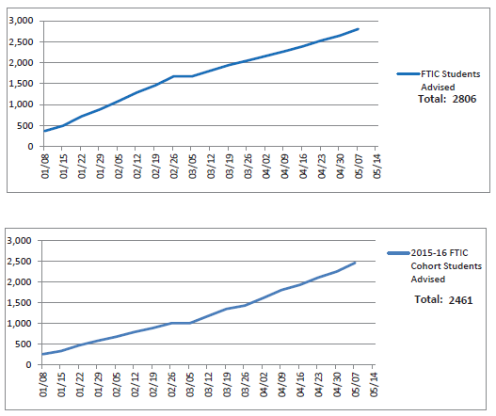
Advising Scorecard Drives Accountability
Data Is Aggregated and Progress Is Reviewed Weekly by Leadership
Weekly Advising Scorecard
Weekly Leadership Dashboard
Examples from Fall 2019 Scorecard
Examples from Dashboard
Populations Tracked
Succeed Goal: Increase from 64% to 68%, FTIC Cohort who meet with an advisor to support their career exploration and entry into a pathway
Soar Goal: Increase from 15% to 17% of FTIC full-time cohort who graduate by May 2018
FTIC Cohorts
75% Completers
DFW Students
Metrics Used
# Appointments
# Walk-ins
# No-shows
# Rescheduled
Data Viewed By
Advisor
Campus
Collegewide
Utilizing a weekly scorecard increases advisor accountability and serves as one variable that contributes toward achieving the annual goal

Slide 11
Navigate Transforms the Advising Scorecard
Manual Scorecards Were Effective but Not Efficient
Pre-Navigate Scorecard
Post-Navigate Scorecard
Advisors utilize color-coded calendars to manually calculate appointment data. Associate deans then aggregate data for the weekly scorecard.
Associate deans utilize automated advising reports from Navigate to populate data for the weekly scorecard.
Process
73 staff pulling data for scorecard
5 staff pulling data for scorecard
Staffing
37 staff hours per week to compile scorecard
3 staff hours per week to compile scorecard
Hours

Slide 12
34 Advising Hours Saved Each Week
What Else Could Advisors Be Doing with That Time?
=
34 Hours of Scorecard Creation Saved
68 Additional Advising Appointments/Week

Slide 13
2020 Campaign Calendar
Sample Spring Term Advising Campaigns
Timing
New Student
Continuing Students
January
Before term begins
Advising Campaign
FTIC students who have not scheduled with or met advisor
Enrollment Campaign
Students who have not yet enrolled for upcoming term
Engagement Campaign
Students newly enrolled into pathway
Reengagement Campaign
Students who dropped/failed/ withdrew from all classes
Beginning of the term
Early Alert Campaign
Students who no-showed to their classes
February
25% through term
Kudos Campaigns
Students who may qualify for graduation
March
Graduation deadline
Enrollment Campaign
Students who have not yet enrolled for upcoming term
April
75% through term
Retention Campaign
FTIC full-time fall cohort
Following the posting of grades
Kudos Campaigns
Students who successfully completed all classes

Slide 14
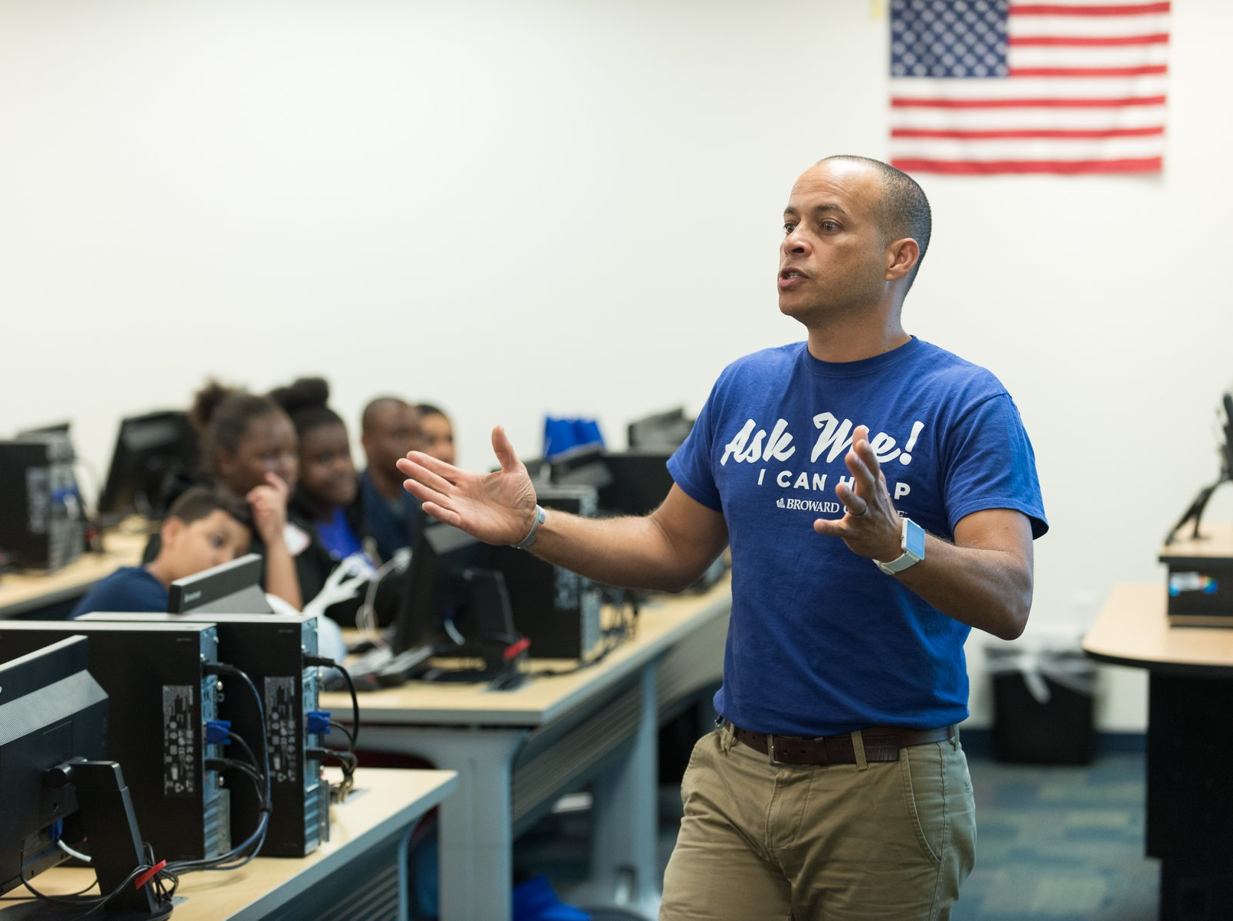
“Navigate has merged traditional academic advising with 21st century technological innovation.”
– Academic Advisor
“With Navigate, caseloads can now be managed to give students the time and attention they need.
Advisors also benefit from Navigate in that there is more equity in caseloads which allows for more time for communications and appointments with students.”
– Advising Associate Dean

Slide 15
Early Alert Launch
Interventions Show Promise
1.79
Ave. term GPA
35% are registered this fall
641
Closed with no intervention
1448
Early Alerts Filed in Spring 2019
2.04
Ave. term GPA
41% are registered this fall
907
Closed with intervention

Slide 16
FTIC Persistence Rates
Comparison of Persistence Based on Use of Advising
+38%
+18%
+7%

Slide 17
Looking to the Future
Strategic Advising Goals Supported by Navigate
Students will be able to identify the correct courses to register for in sequence based on their program map in BC Navigate.
Students will use BC Navigate to create an individualized academic plan based on their identified career goal and program.
Students will use BC Navigate to register for courses according to their program maps, currently an embedded link; soon one-click.
Build out a coordinated care network to connect advising, the career center, academic success centers, faculty librarian, and financial aid.

Slide 18
Thank you for joining!
Please fill out the in-app evaluation
Thank you!

