Slide 1
Building a 21st Century Campus with 21st Century Partnerships

Slide 2
https://www.youtube.com/watch?v=HRnkzEWu5ek

Slide 4
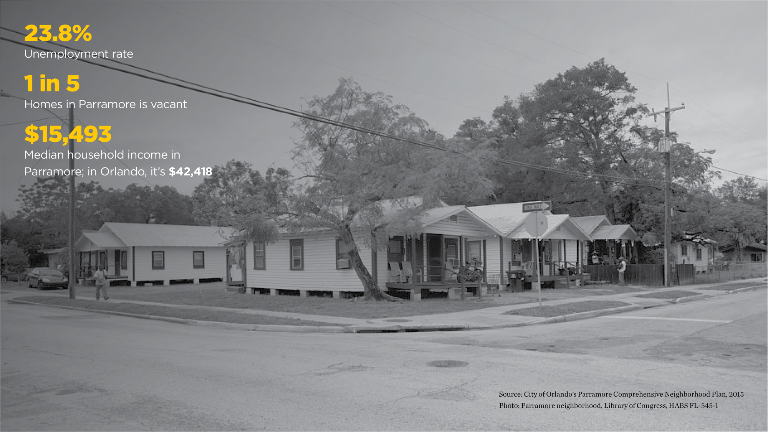

Slide 14
We have the same vision for this campus…
A Student is a Student…
Any student can visit any employee in One Stop – UCF or Valencia – and be served
Students will be together in the dorms
All Gen Ed will be taught by Valencia faculty
Getting credit for their home institution
UCF and Valencia students will be in these classes together

Slide 15
We have the same vision for this campus…
But what are our differences?
Calendars
ERP
Parking Systems
Emergency Notification
Housing
Business Model
Police presence
Student Services Processes
Tuition Rates
Withdrawal Policies
Class Sizes
Bookstores
And the list
Goes On….

Slide 16
Where do we begin?
IT Leadership Meetings and Working Groups
Early discussions included how we might achieve our joint goals
Identified the need to understand the details of the expectations of each functional area

Slide 17
Challenges
Other than our different systems…
How do we get our end-users to understand why we need the details of their expected experiences so far in advance?
Who makes the final decisions?
Separating needs from wants
UCF IT and Valencia IT have different operating models
Software Licensing

Slide 18
Steps to Overcome our Challenges
People
Teams meeting face-to-face
Honest discussion of challenges
Remembering this is to serve our students
Communication

Slide 19
Steps to Overcome our Challenges
Process….
Engage our PMOs
Bring Campus Leadership into the discussions
The creation of OPRs
Lots of communication

Slide 20
Steps to Overcome our Challenges
Technology
Cross-listing courses in Canvas
16 Daily data exchanges
Remote Desktop Services
Partnership with 3rd party vendors
Rave
Barnes and Noble
Star Rez
Lots of communication

Slide 21
Lessons Learned
People
Create empathy between the teams by educating each other on how we do things differently
Socialize the teams
More formally establish roles and responsibilities earlier
Pick up the phone and call if you have a question

Slide 22
Lessons Learned
Process
Engage the PMO sooner
Sit with each functional area earlier and guide them through their process requirements
Establish formal governance, roles, and responsibilities for clear, efficient decision-making
Pick up the phone and call if you have a question

Slide 23
Lessons Learned
Technology
Create a more comprehensive inventory of core IT and functional solutions
Methodically go through the inventory of solutions needed and establish winners and alternatives
Build and test, selecting alternatives as needed

Slide 25
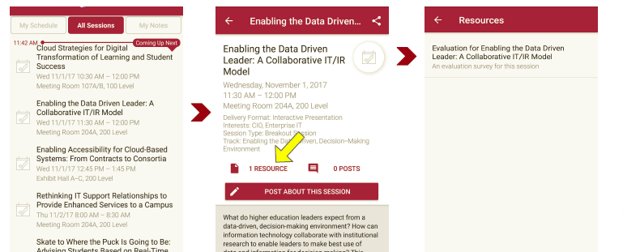
Session Evaluations There are two ways to access the session and presenter evaluations:
1
2
In the online agenda, click on the “Evaluate Session” link
From the mobile app, click on the session you want from the schedule > then scroll down or click on the associated resources > and the evaluation will pop up in the list

Slide 26
Contact Information
Patti Smith
Chief Information Officer
Valencia College
407-582-5411 psmith50@valenciacollege.edu
Michael Sink
Associate VP & COO, UCF IT
University of Central Florida
407-823-4321
michael.sink@ucf.edu
NOTE: This presentation leaves copyright of the content to the presenter. Unless otherwise noted in the materials, uploaded content carries the Creative Commons Attribution 4.0 International (CC BY 4.0), which grants usage to the general public, with appropriate credit to the author.

