Slide 2
3 Critical Strategies for Influencing Students' Success Berenecea Johnson Eanes, Ph.D. California State University, Fullerton Amelia Parnell, Ph.D. NASPA – Student Affairs Administrators in Higher Education Kathe Pelletier, Ed.D. EDUCAUSE

Slide 3
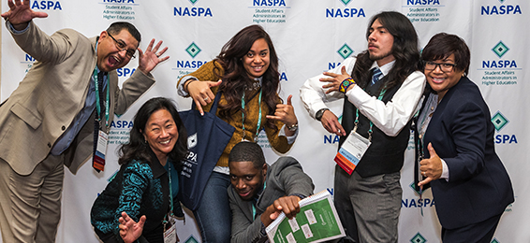
About NASPA
NASPA is the leading association for the advancement, health, and sustainability of the student affairs profession.
NASPA provides high-quality professional development, advocacy, and research for 16,000 members in all 50 states, 25 countries, and 8 U.S. territories.
Notes:
Mention 100th anniversary and breadth of topics and issues covered

Slide 4
Big Issues in Higher Education
Mental health
Alcohol abuse prevention
Drug abuse prevention
Sexual assault and gender-based violence
Suicide
Crisis management
Gun violence

Slide 5
Really Big Issues in Higher Education
Closing the achievement gap
Building a socially just campus community
Increasing dialogues about race, religion, ethnicity, gender identity
Increasing civic and democratic engagement
Bringing personalized learning to scale
Developing and leveraging technology
Delivering high-impact practices
Helping students develop cross-cutting skills in preparation for career and life

Slide 6
Current Responses to The Big Issues
Resources for Students
Institution Strategies
Cost: emergency aid, financial literacy, on-campus employment
Learning: advising, co-curricular engagements
Health and wellness: counseling
Community: clubs and organizations
Proactive use of data and interventions
Increased leveraging of financial aid
Programming and initiatives to support priority populations
Revised and refined campus policies
Increased cross-functional collaboration (ex: institutional research, enrollment management)
Centralized support services
Notes:
Mention 100th anniversary and breadth of topics and issues covered

Slide 8
Our Plan – Long Term
First-Year Experience for Freshmen and Transfers
Targeted Support Services
Free, personalized services for special populations of students, particularly underrepresented students
Success in Low Completion-Rate Courses
i.e., course redesign and Supplemental Instruction
Building Pathways with K–12 and Community Colleges
present clear pathways for students of all backgrounds to aspire and pursue a college degree
improved academic transition programs help support students to succeed once they matriculate.

Slide 9
Our Plan – Long Term
Remediation in Math and English
Encouraging students via high school advisors and policies to fulfill remediation requirements prior to the fall
High-Impact Practices
Financial Assistance
Expanding available resources, awareness, and access
On-campus employment
Policies and Processes
Streamlining bureaucratic processes smooths the path to graduation

Slide 10
Our Plan – Short Term
Targeted Outreach to students on track to graduate in 4.5/2.5 years
Financial incentives for intersession and summer school
Additional Course Offerings
Additional Academic Advisement
Success Coaches
Early Warning System

Slide 11
DISCUSSION
and
QUESTIONS
Notes:
What are some of the leading challenges students, especially first generation students, face in terms of learning, persistence, and degree completion?
Financial capabilities, health and wellness, first generation…(Others)
Connection to the community, which fosters a sense of belonging, is often cited as a key factor in student success and retention. What kind of strategies might strengthen a student’s sense of belonging on campus?
Co-curricular engagement, comprehensive learner record
Learning happens everywhere
Are there any equity issues to consider? How might equity be addressed through technology? What are the risks to equity when planning and implementing technology solutions for student success and how might they be mitigated?
Lower income, digital divide – accessibility issues
Advocacy: what makes it easier for students to navigate/what serves all students
What kind of structures on campus enable technology innovations that contribute to student success? OR: Sometimes when we think about technology innovations, we think of flashy technologies. Are there more foundational approaches to innovation that are critical for advancing student success?
Berenecea: “innovative housekeeping,” innovation, leading to student advocacy and agency – breaking down silos/tools that don’t talk to one another.
How do you best optimize technology in the context of student success?
(This might be a version of the last question?)

Slide 12
Thank You!
Berenecea Johnson Eanes, Ph.D.
Vice President for Student Affairs, California State University, Fullerton
bjeanes@fullerton.edu
Twitter: @vp_BJEanes
Amelia Parnell, Ph.D.
Vice President for Research and Policy, NASPA
aparnell@naspa.org
Twitter: @ameliaparnell
Kathe Pelletier, EdD
Director, Student Success Community Programs, EDUCAUSE
kpelletier@educause.edu

Slide 13
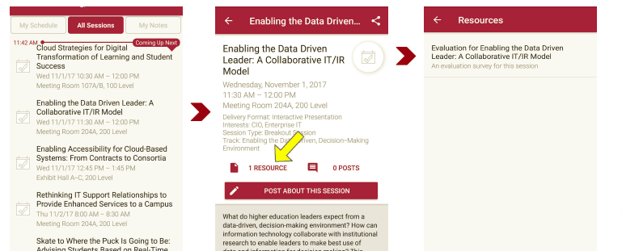
Session Evaluations There are two ways to access the session and presenter evaluations:
1
2
In the online agenda, click on the “Evaluate Session” link
From the mobile app, click on the session you want from the schedule > then click the associated resources > and the evaluation will pop up in the list

