Slide 1
"This presentation leaves copyright of the content to the presenter. Unless otherwise noted in the materials, uploaded content carries the Attribution-NonCommercial-NoDerivs CC BY-NC-ND, which grants usage to the general public, with appropriate credit to the author.”
Copyright 2019 by Victoria Mondelli and Joe Bisz.

Slide 2
The ALLURE of Play a learning game design workshop
Joe Bisz, PhD & Tori Mondelli, PhD
EDUCAUSE Learning Initiative February 19, 2019

Slide 3
ASK where to apply the play
Où ?
Где?
کہاں سے؟
Where?
在哪里？
Dove?
Wapi?
Wo?
أين؟
Strategic placement.

Slide 4
My students reach a learning bottleneck when we work on________________.
My students are bored when we work on______________.

Slide 5
Lesson Topics with Goals
Critical appreciation of an article: Students evaluate the article’s argument or contribution within the context of the field of study and beyond.
Problem-solving in Science or Health: Students create solutions to improve the lives of fellow human beings.
Finding Sources: Students navigate databases and investigate sources for their reliability and appropriateness.
Using Case Studies: Students analyze relevant real world examples or simulations and apply academic concepts learned in the course.
Achieving Effective Collaboration in a professional development setting): Colleagues communicate and cooperate to reach a common goal.

Slide 6
LIST thinking steps
Unpack the SLOs and uncover
more granular cognitive processes.

Slide 7
Make the mental processes explicit for “Students will write a thesis statement.”
a. Student demonstrates an understanding of the purpose of a thesis statement.
b. Student is familiar with various types of thesis statements: analytical, expository, and argumentative.
c. Student completes several different thesis statement templates to practice writing thesis statements.
d. Student drafts and revises a thesis statement, along with a working bibliography to support his/her position.
Notes:
Student moves from understanding to application to creation.

Slide 8
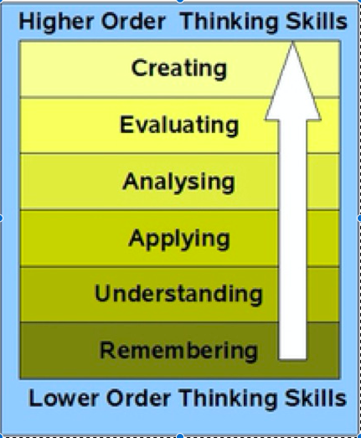
Notes:
Anderson & Krathwohl, 2001.

Slide 9
LIST
First, I would like my students to <insert Bloom verb>
Next, I would like my students to <insert Bloom verb>
Next, I would like my students to <insert Bloom verb>
Next, I would like my students to <insert Bloom verb>

Slide 10
LINK thinking steps to play

Slide 11
UNDERSTAND how design principles operate

Slide 12
REINFORCE play and learning
Consider another complex, simple or micro-mechanic to boost the design.
Facilitation Tips

Slide 13
EVALUATE learner experience
Play-testing
What do your observations and debrief show?

Slide 14
Selected Sources
Slide 5 Image
https://www.knowatom.com/how-to-unpack-the-new-science-standards Access date, June 3, 2017.
Slide 7 Image
http://www.lowcosttechforteachers.com/blooms-taxonomy-and-using-technology.html Access date, June 3, 2017.
Anderson, L. W., & Krathwohl, D. R. (2001). A taxonomy for learning, teaching, and assessing: A revision of Bloom's taxonomy of educational objectives. New York: Longman.
Pace, D. & Middendorf, J. Decoding the Disciplines: Helping Students Learn Disciplinary Ways of Thinking. New Directions in Teaching and Learning. Vol. 98 (Fall 2004).

Slide 15
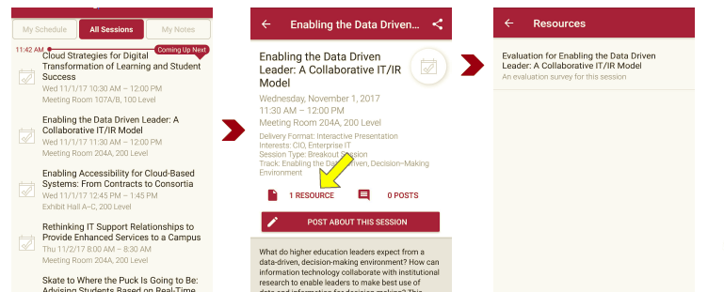
Session Evaluations There are two ways to access the session and presenter evaluations:
1
2
In the online agenda, click on the “Evaluate Session” link
From the mobile app, click on the session you want from the schedule > then click the associated resources > and the evaluation will pop up in the list

