Slide 1
"This presentation leaves copyright of the content to the presenter. Unless otherwise noted in the materials, uploaded content carries the Attribution-NonCommercial-NoDerivs CC BY-NC-ND, which grants usage to the general public, with appropriate credit to the author.”
Copyright 2019 by Victoria Mondelli and Joe Bisz.

Slide 2
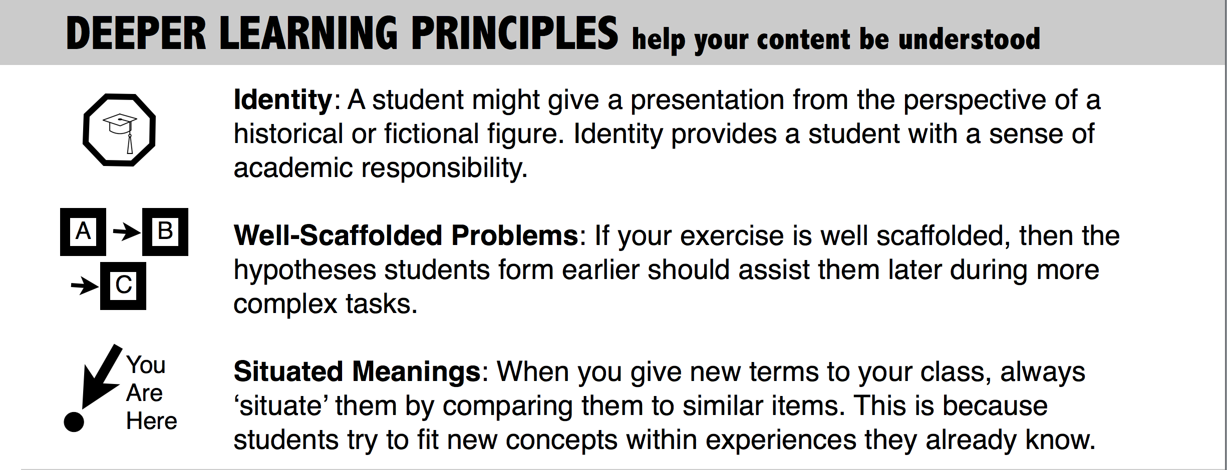

Slide 3
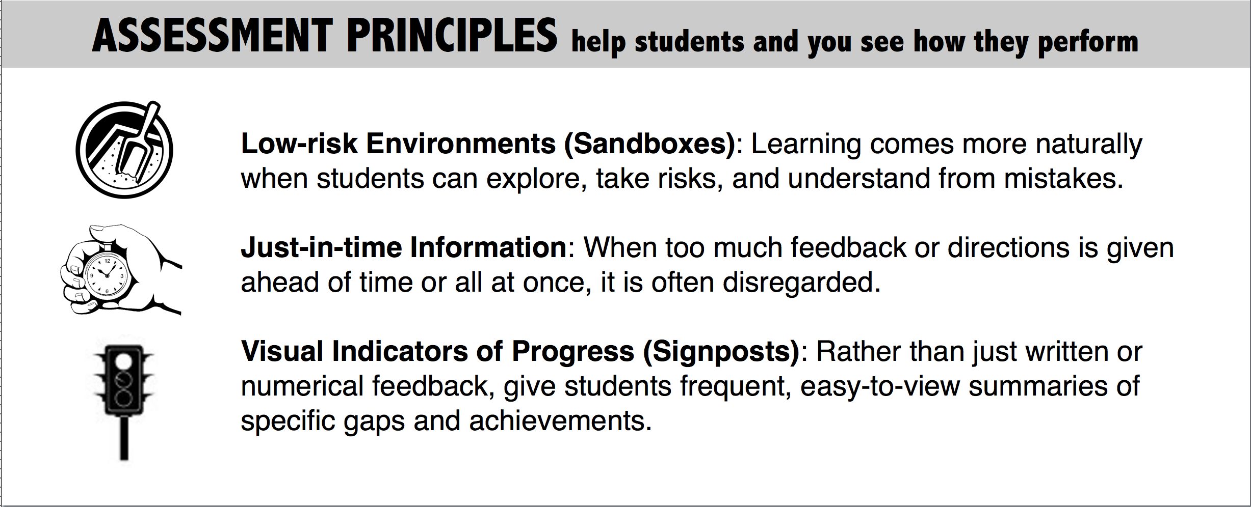

Slide 4
Characteristics of Digital Natives
“Digital Natives are used to receiving information really fast. They like to parallel process and multi-task. They prefer their graphics before their text rather than the opposite. They prefer random access (like hypertext). They function best when networked. They thrive on instant gratification and frequent rewards. They prefer games to “serious” work. (Does any of this sound familiar?)”
--Prensky, Digital Natives Pt 1, Pg 1

Slide 5
Engagement Principles
Networked or Sensory Environment
(graphics, etc.)
Fast, Random, or Simultaneous Access (multitasking, etc.)
Frequent Rewards or Feedback
Additional Engagement Principles:
Challenge
Narrative or Fantasy

Slide 18
1. Move the squares around until the values are equal on both sides of the equal (=) sign.
2. You must use ALL squares, including minus (-) signs.

Slide 20
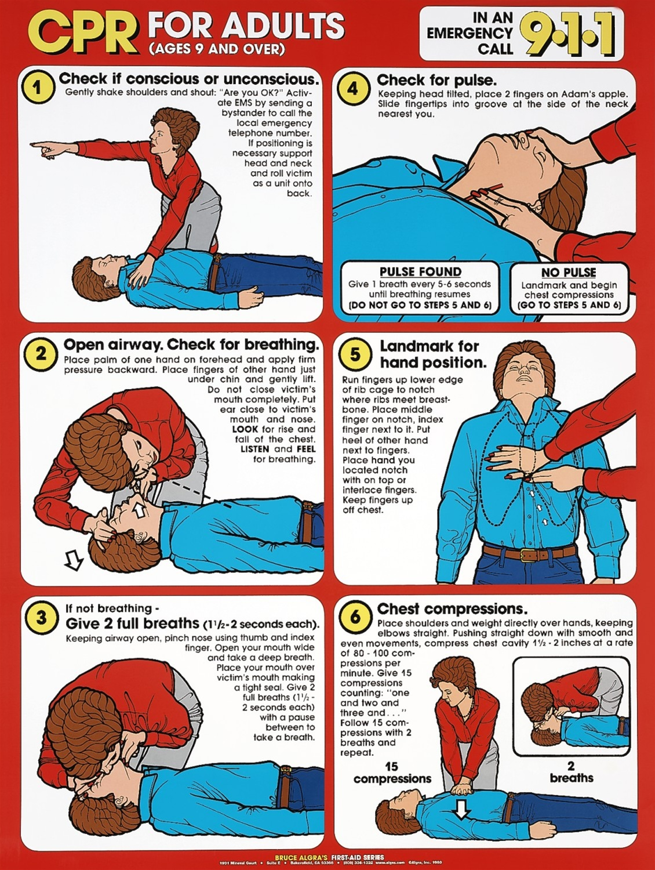

Slide 21
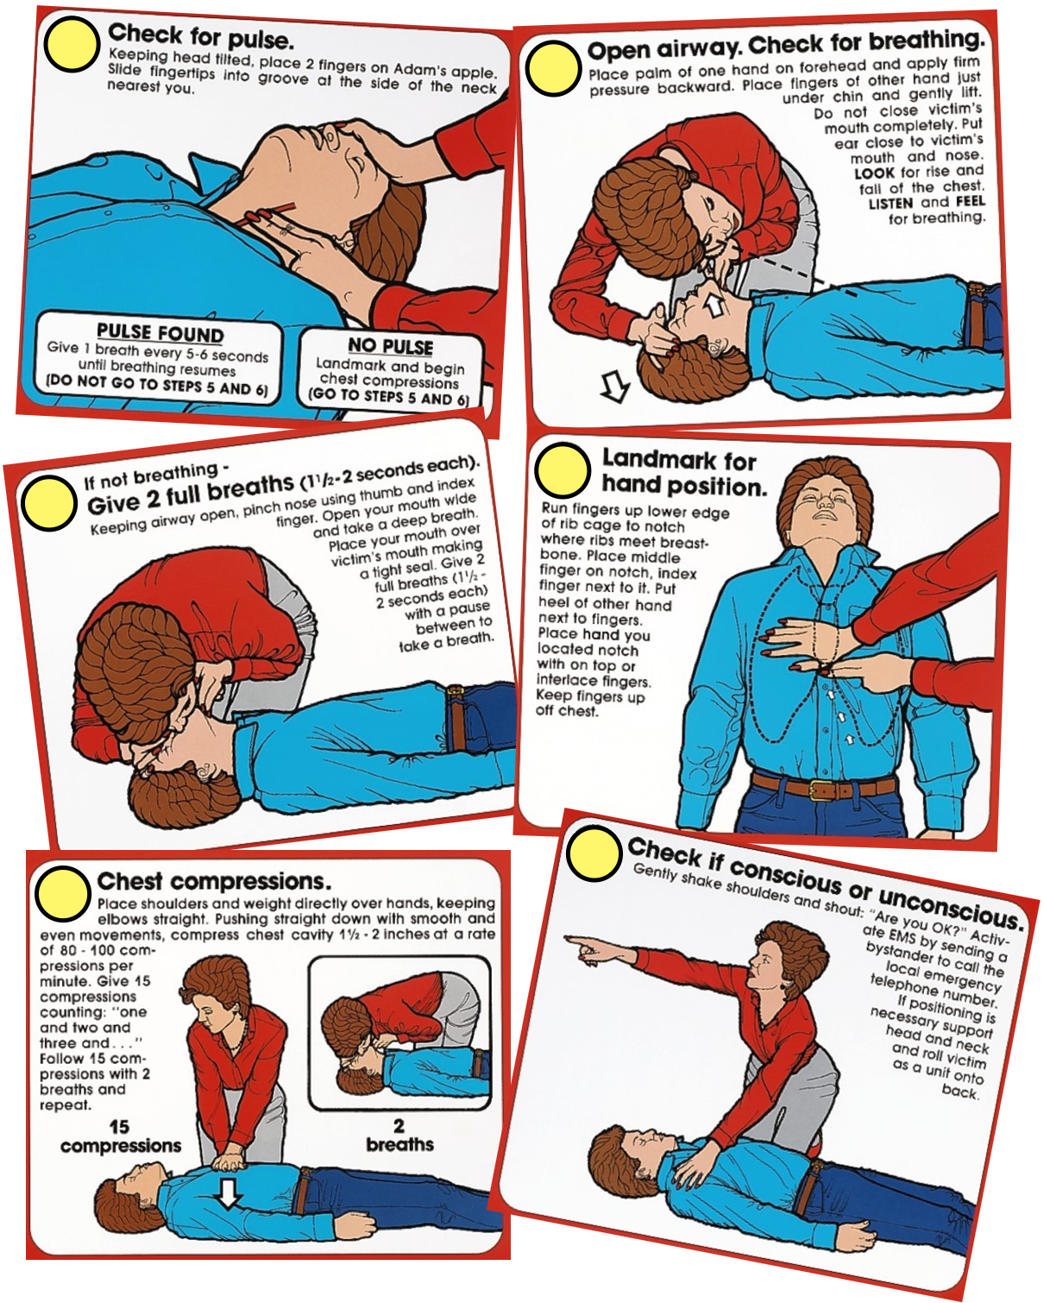

Slide 22
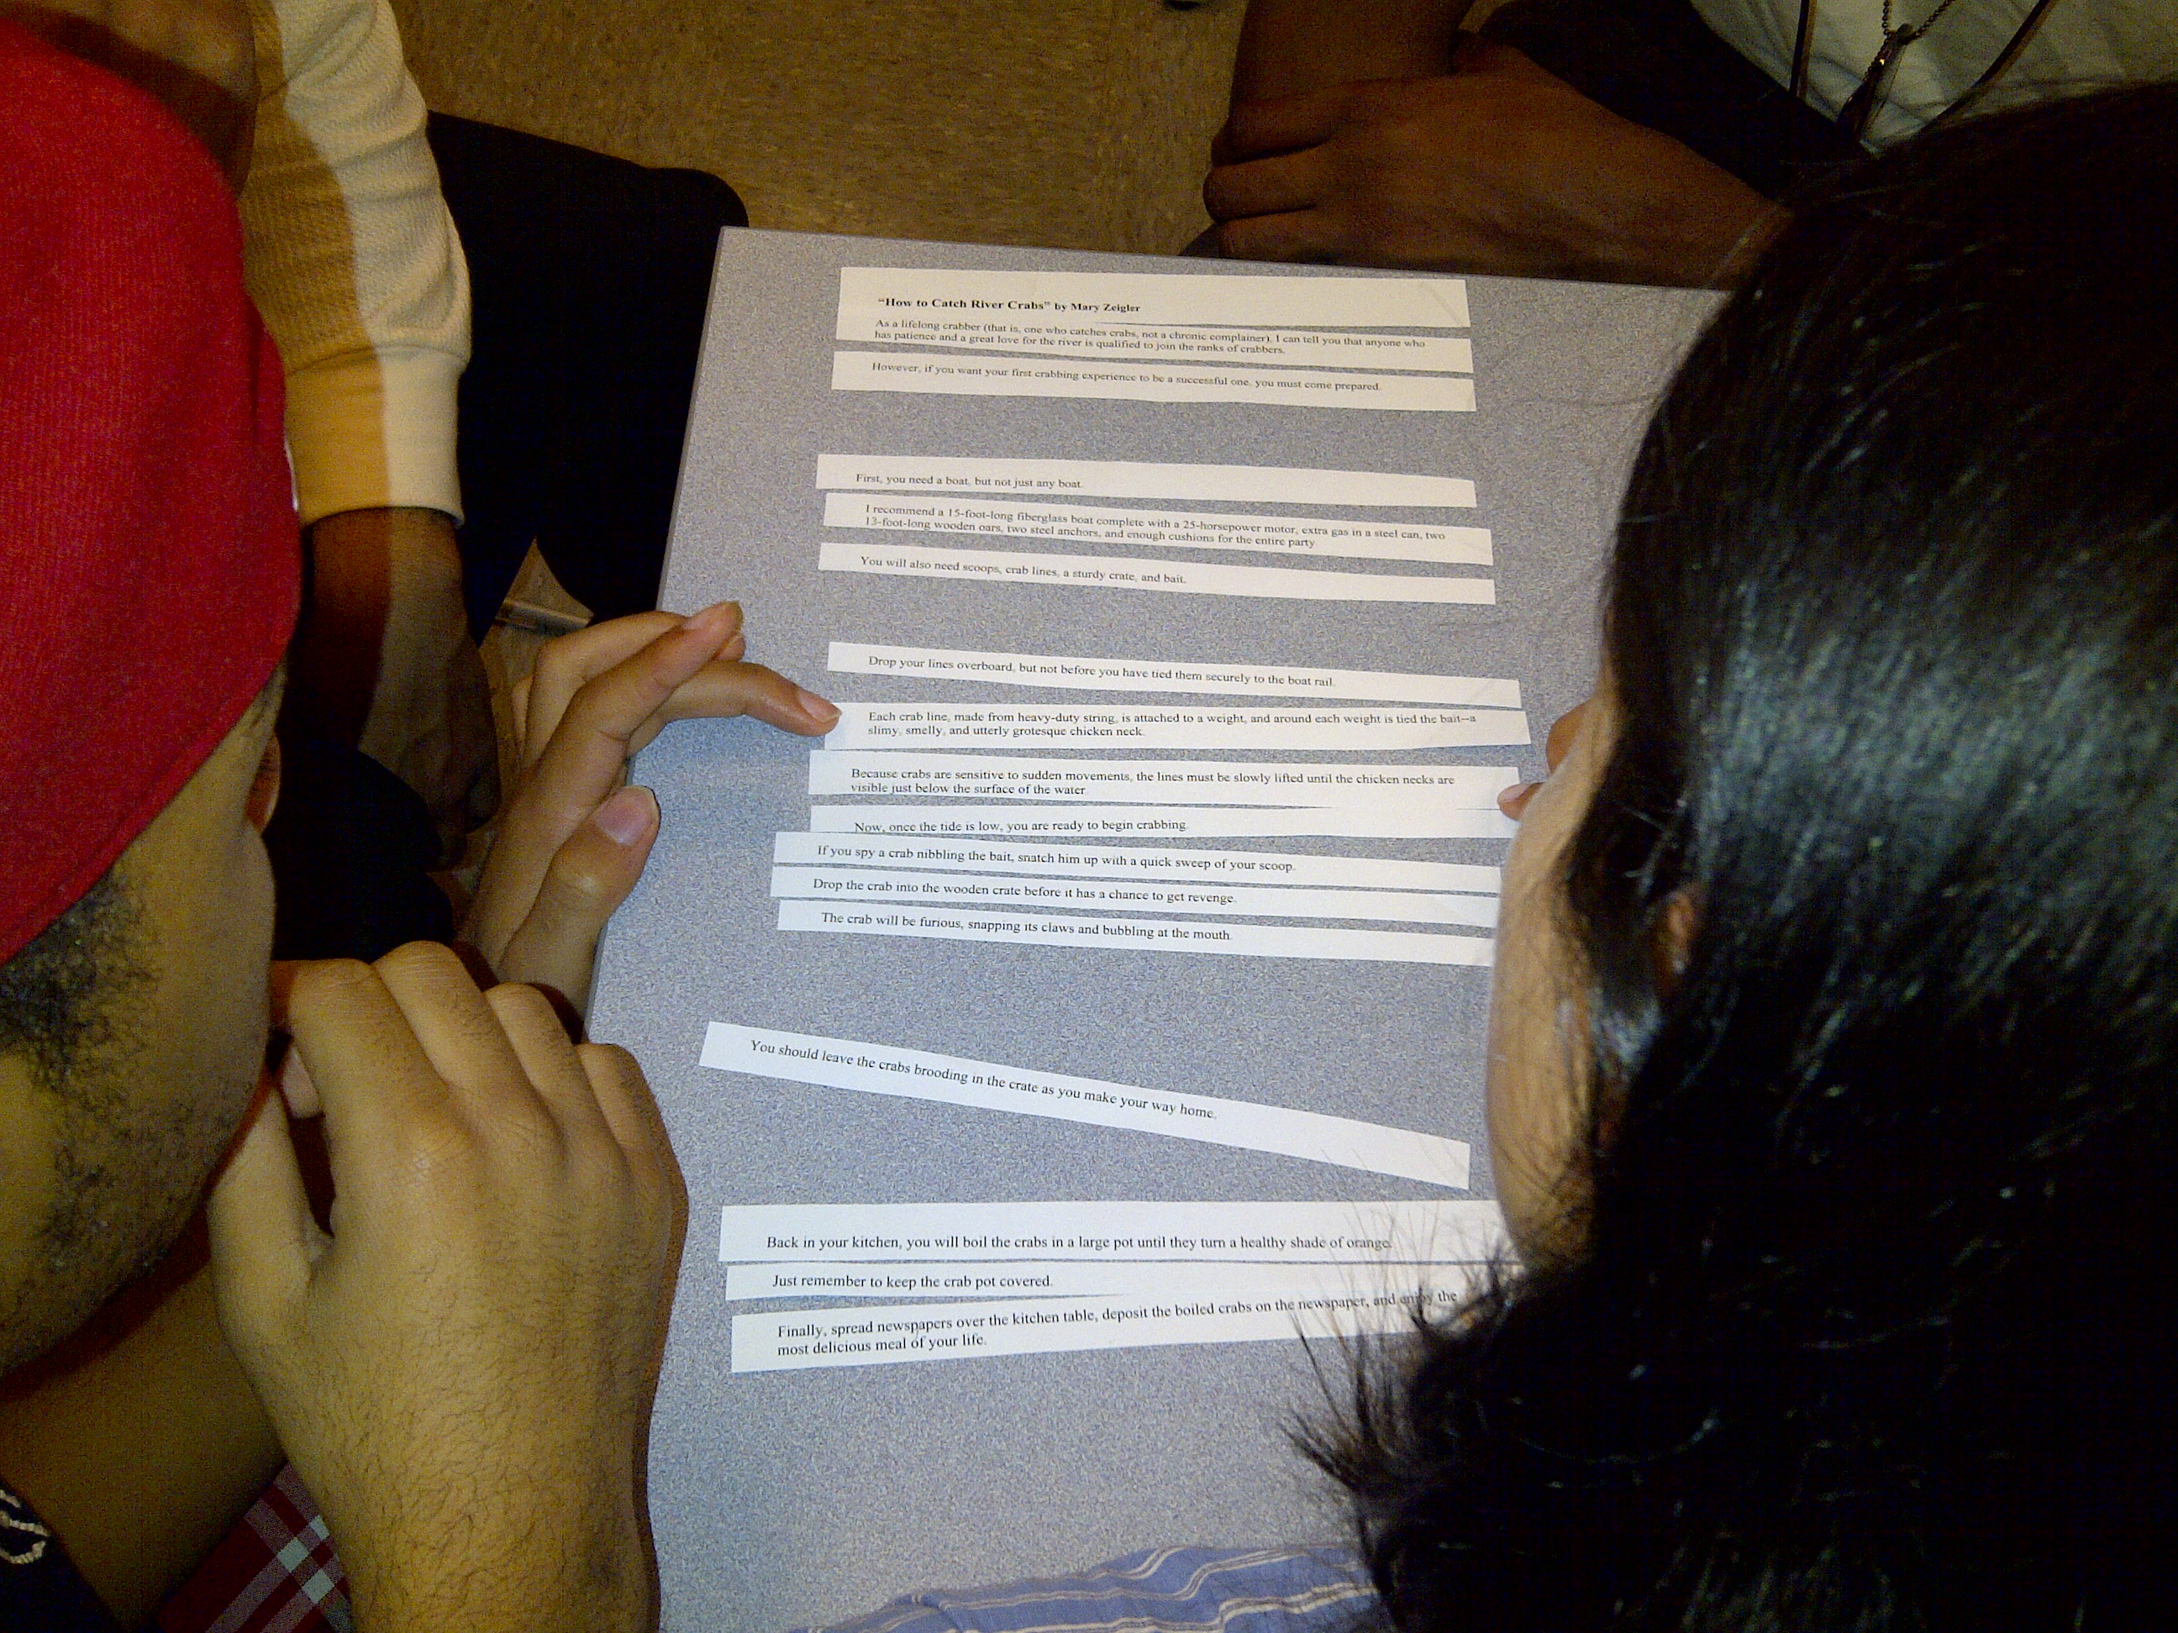

Slide 25
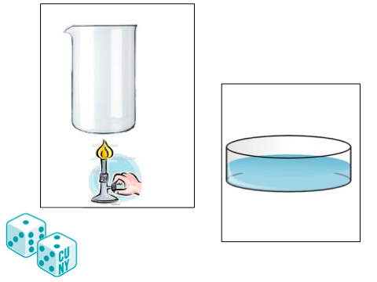

Slide 26
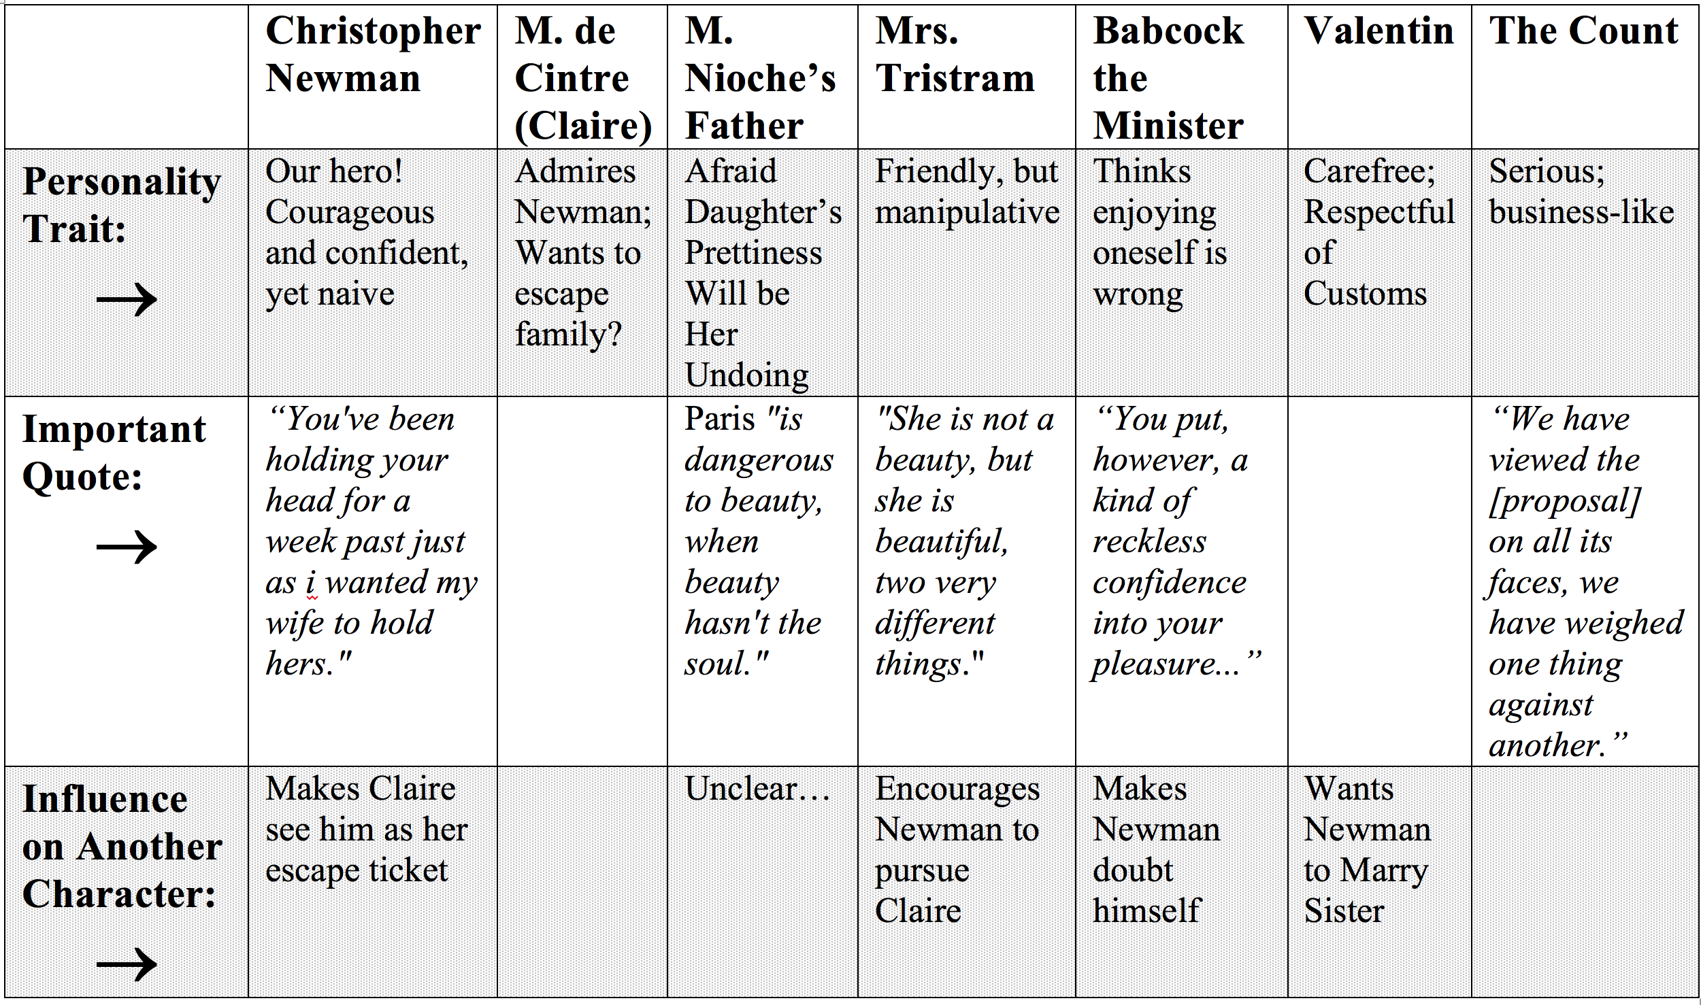

Slide 27
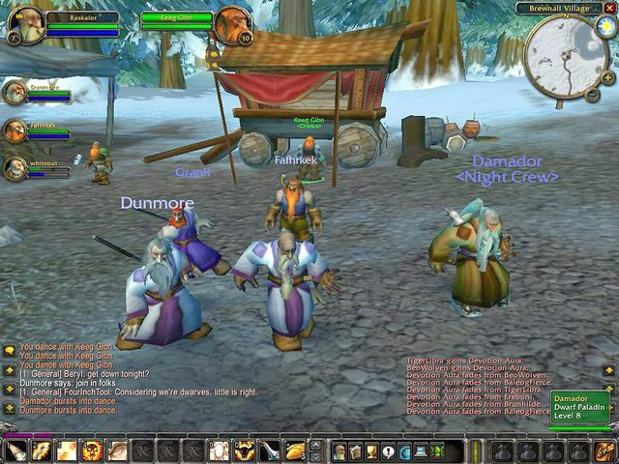

Slide 30
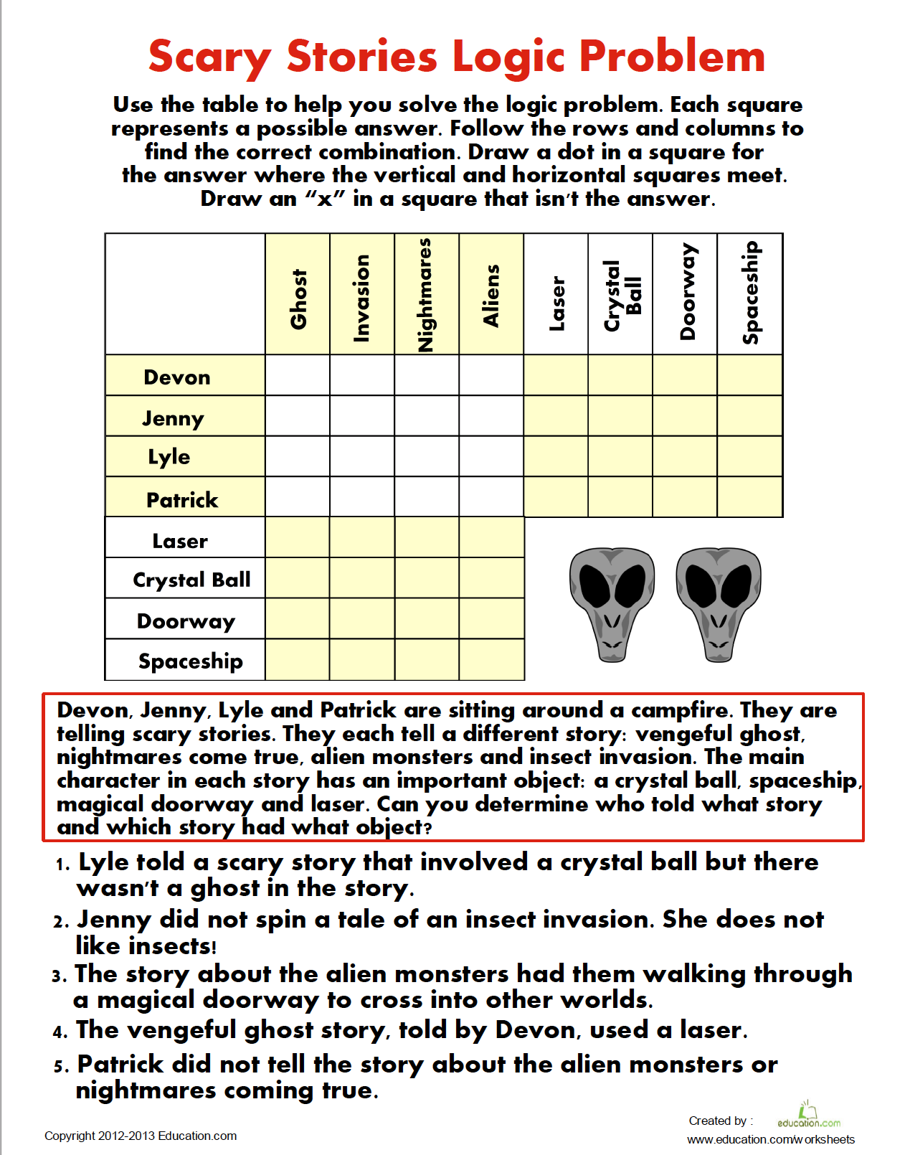

Slide 31
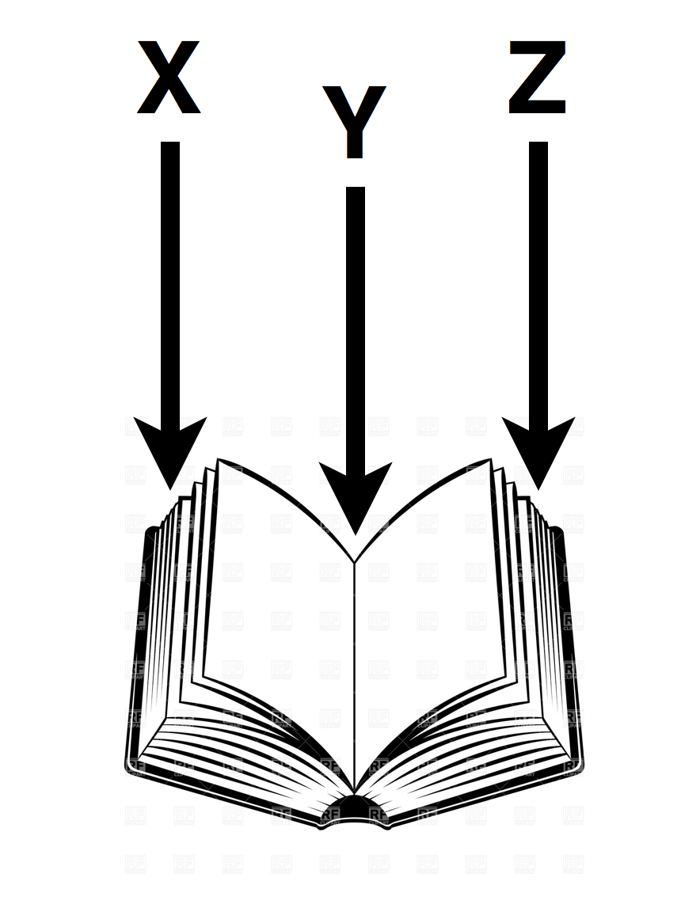

Slide 32
