Slide 1
Fair is fair:
Scoring and distribution in purdue’s “circuit” peer review app
Jason Dufair, Alex Cam Liu, Evan Tragesser
Full Stack Developers, Purdue University
@jkdufair, @alexcamliu, @EvanTragesser

Slide 2
PEEr
REVIew?
EW
Peer Review?
.
Notes:
Paper passing – Mrs. Jones’ 3rd grade class

Slide 3
2.
Crude!
1.
arbitrary!
3.
UNSCIENTIFIC!
Peer
Review
IS:

Slide 4
Peer review pros and cons
Pros
cons
Students
Instructors
Have I mentioned the joy of NOT grading 500 draft essays?
Were you asleep for that last slide or what?
Wake up!
Notes:
Students learn from one another Students get more feedback Students may write/create more
Learn from their peers - exposure
Better assess their own work
Sense of how to structure feedback thx to the rubric model
Grading scales to large class sizes
Consistent feedback via calibration - "can you look at my paper"
"Tribe of TAs" - variable
Forces them to plan out assignment
See student feedback without having to "collect"
Can be done outside the physical classroom
Time savings Can see process - generative - can help with cheating
Corrections will be higher level

Slide 5
The expanding
classroom
Notes:
I can’t grade 500 essays! And I don’t have a legion of TAs with grading superpowers!

Slide 6
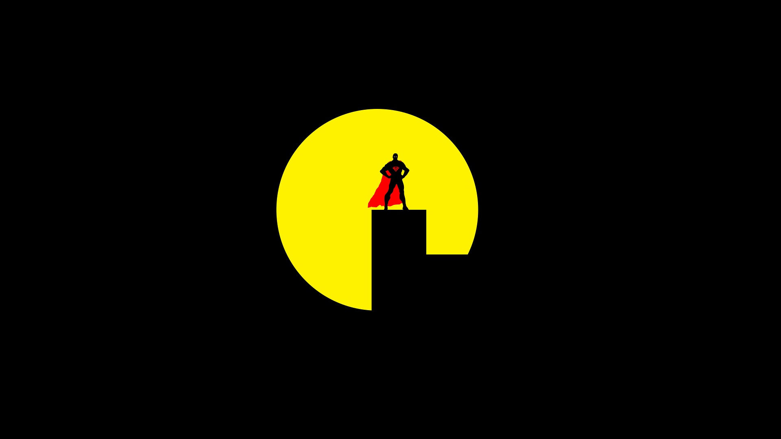
enter...
C
“The calibrator”
a.k.a. the instructor

Slide 7
Instructor: MISSION #1
Good
Medium
Poor
...or WHATEVER
...or Python code snippets
Upload three example essays
...or CAD drawings

Slide 8
Instructor: MISSION #2
Grade
THEM!!
Notes:
And then they evaluate each of them

Slide 9
Instructor:
C
Mission Accomplished

Slide 10
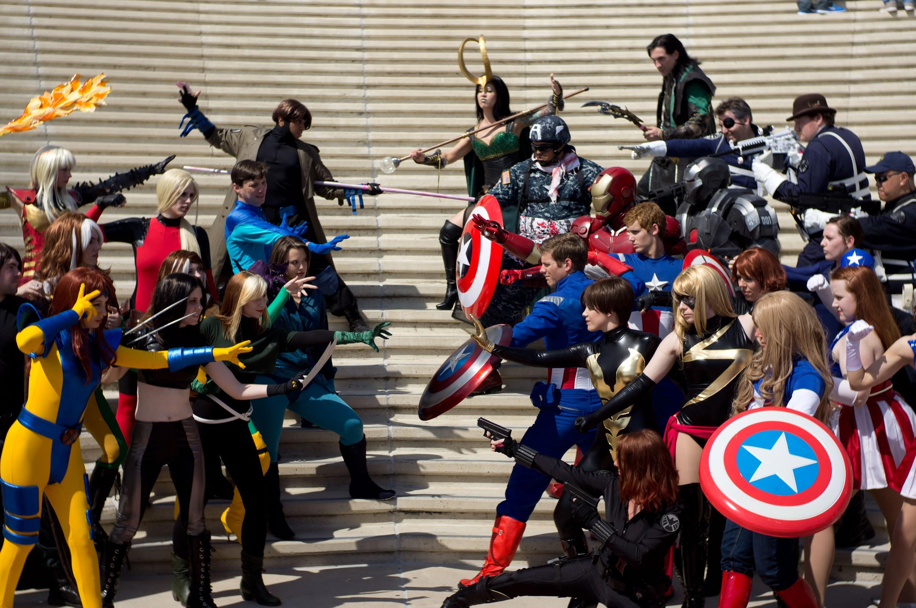
Enter…
Peers”
”THE

Slide 12
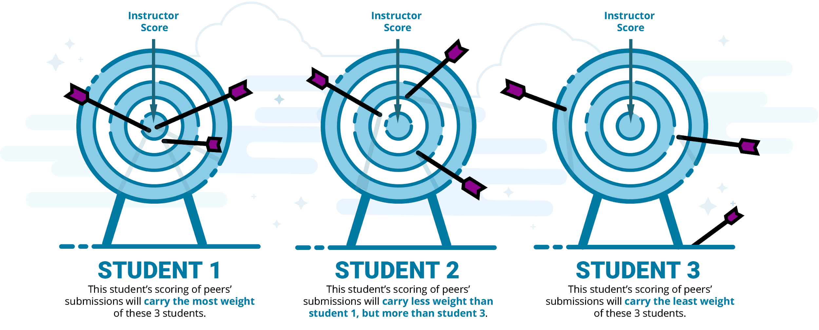
Weighted peer review
For example...
0.95
0.75
0.15

Slide 13
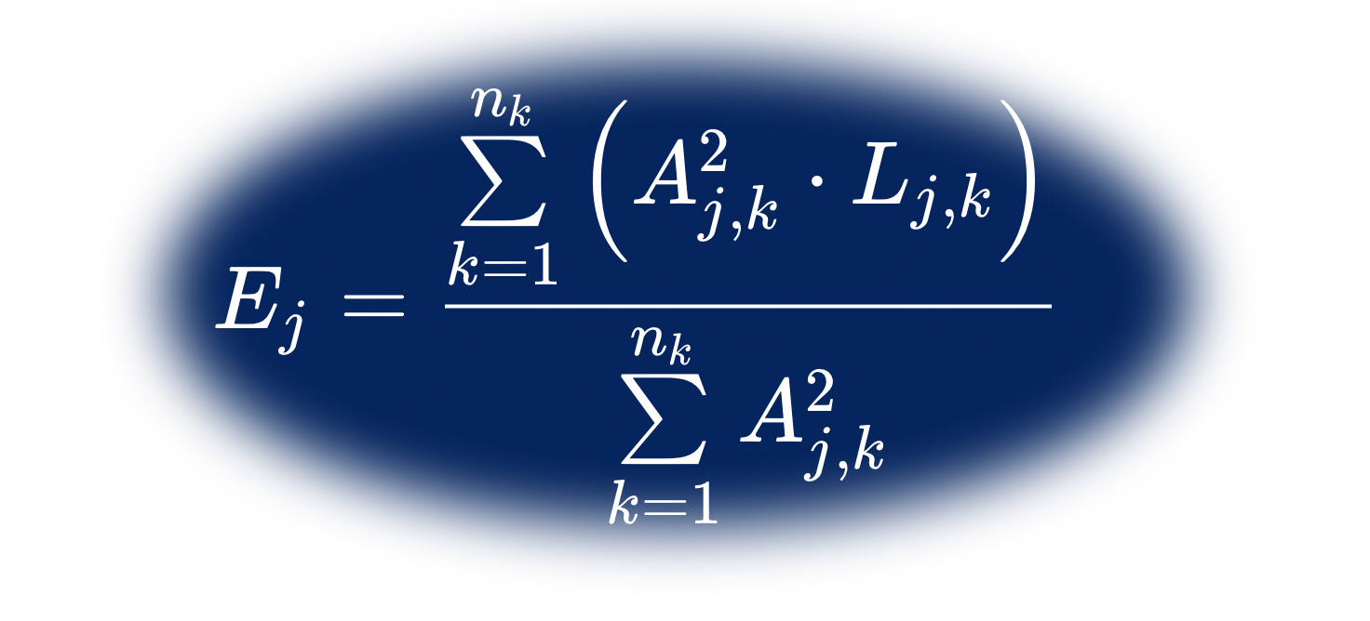
The PEER POWERUP

Slide 14
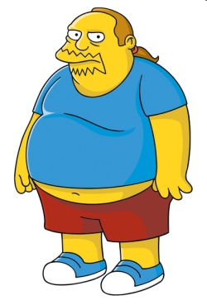
Your class:
Heroes,
Bystanders,
Villains
Worst.
Essay.
Ever.
Calibration Score
0.95
0.75
0.15
Notes:
Villain is a trope.
We don't have real villains in the classroom

Slide 15
What if all of my peers Are like...
The villain?!?

Slide 16
enter...
D
“The distributor”
a.k.a. Circuit

Slide 17
“Why don’t we just randomly assign the students into groups?”

Slide 18
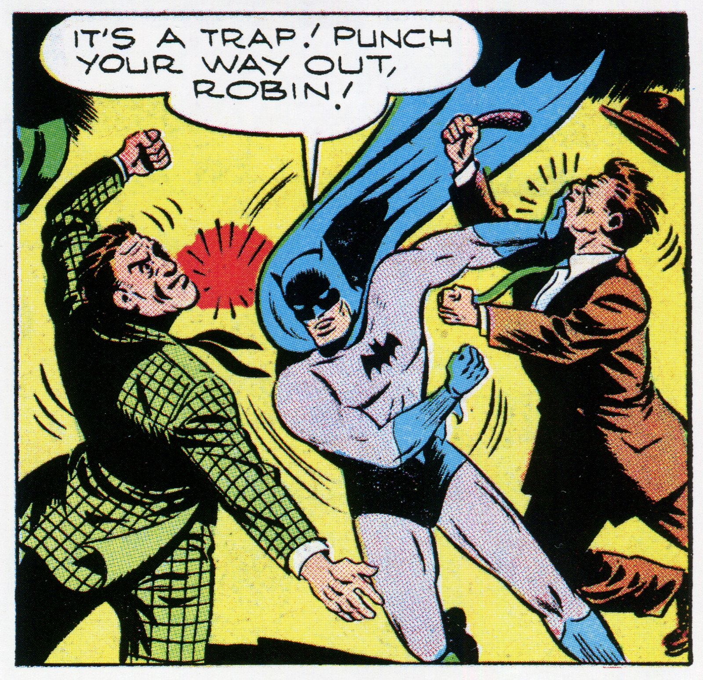

Slide 19
Student In Danger!
Average reviewer rating: 0.25
Notes:
Equivalent to paper passing
Student perception of danger - buy in

Slide 20
Justice Restored!
0.82
0.87
Average reviewer rating: 0.85
0.86
Notes:
Characters are ranges of people

Slide 21
"I absolutely love the ease of viewing the document and inputting the reviews—very well done on that!” Ashley M. Purpura, Assistant Professor of Religious Studies
testimonials
“I sure appreciate you guys. It really is a good tool for what I need.” Jerri Faris, PhD
Brian Lamb School of Communication
“It has given me back two days of class time so far this semester, and instead of only getting one person's feedback, they're getting anonymous feedback from three of their peers” Brett Creech, Educational Technologist

Slide 22
http://peercircuit.org

Slide 23
DEMO TIME!

