Slide 1
GAP ANALYSIS: Smart Strategies for Identifying Courses Impeding Student Success
Karen Swan & Bill Bloemer
University of Illinois Springfield
Notes:
Premises – limited resources, different causes require different solutions
The link between passing courses and persistence
Gap analysis procedure – using de-identified examples from UIS
Some cool tools that my colleague Bill Bloemer has been building
Some initial findings using just quantitative analyses
Future directions -- qualitative

Slide 2
Although more students are seeking college degrees, graduation rates remain disappointing (60% within 6 years at 4-year colleges; much less for community colleges) (NCES).
Progression to degree has been linked to semester to semester retention, and retention has been linked to successfully passing courses, especially courses which stand as gatekeepers to further study and progression (Koch & Pisitilli, 2015; Lewis & Terry, 2016).
Notes:
Although graduation rates have been a major focus for more than a few years, they remain depressingly low.

Slide 3
Persistence Drop: DFW vs no DFW
With DFW
Notes:
The scale, though not revealed, is the same for all charts -- but different patterns for different types of students at different points in their academic journey
The impact of a DFW on retention varies by point in the student life cycle, and by type of student.
The gap for “Later” is accounted for, in part, by the fact that successful students are being removed from the population by graduation, as time moves along.

Slide 4
We know that D/F/W rates affect student persistence and retention.
This has led some educators to identify large enrollment, entry level classes – gateway courses – with high D/F/W rates, and to focus on improving them (Gardner Institute, 2017, Protopsaltis & Baum, 2019).
In this presentation, we will argue that not all gateway courses are the same; that different gateway courses differentially affect persistence and retention; and that understanding such differences can help us improve student success.

Slide 5
We argue that no matter what we do, there will be courses which too many students do not pass simply because of the nature of their content and the preparation of the students who must take them.
Further, not all gateway courses similarly impede progression to degree – some exceed expectations (predictions) for the students enrolled in them, and some meet them.
The courses on which we should focus our attention are those in which outcomes are worse than expected.

Slide 6
MODELING RETENTION & PROGRESSION
instructor behaviors
learner characteristics
FIT; feelings of academic & psycho-social belonging
retention/
progression
course characteristics
FIT; feelings of academic & psycho-social belonging
learner behaviors
other
supports
other
supports
(Vignare, Wagner, & Swan, 2017)

Slide 7
MODELING RETENTION & PROGRESSION
instructor behaviors
instructor behaviors
learner characteristics
course characteristics
FIT; feelings of academic & psycho-social belonging
learner behaviors
retention/
progression
learner characteristics
course characteristics
other
supports
(Vignare, Wagner, & Swan, 2017)

Slide 8
subjects and setting
all undergraduate degree-seeking students enrolled in the past three years
unit of analysis was course -- all undergraduate w/ total registrations of 20+ across the entire 3 year period
549 courses: 270 exclusively on-ground, 119 exclusively online & 160 courses taught in both formats
39 different subject areas, 27% lower division
Notes:
Fall 2014 and Spring 2017

Slide 9
take into account student characteristics when looking at course DFW rates:
student type -- Honors, Native, Transfer, OL Transfer
point in degree path -- First Term, Second Term, Second Year, Later
prior performance indicators -- prior cumulative GPA, fraction of previous courses passed

Slide 10
GAP ANALYSIS
binary logistic regression w/ D, F, or W grade (yes/no) as the dependent variable
predictor variables = student type, point in degree path, prior GPA & previous DFW rate
used to create a model predicting the probability that a particular student would get a D, F, or W in the average course taken
predicted DFW rate calculated for each course based on students in it
then compared to actual DFW rate

Slide 11
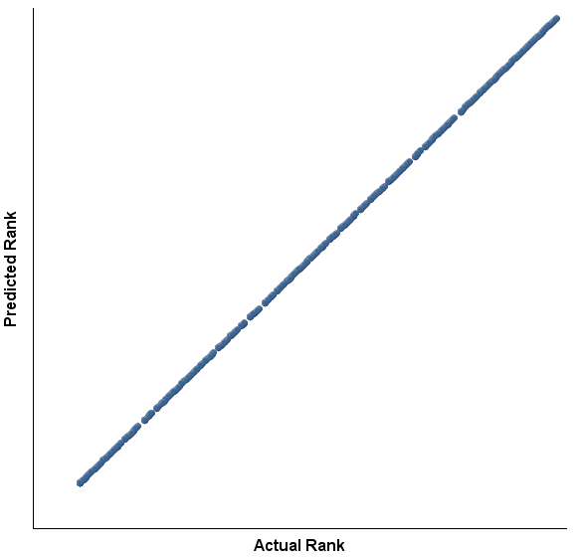
No point in predictions? Everything goes as predicted…….
……. and we could stop there

Slide 12
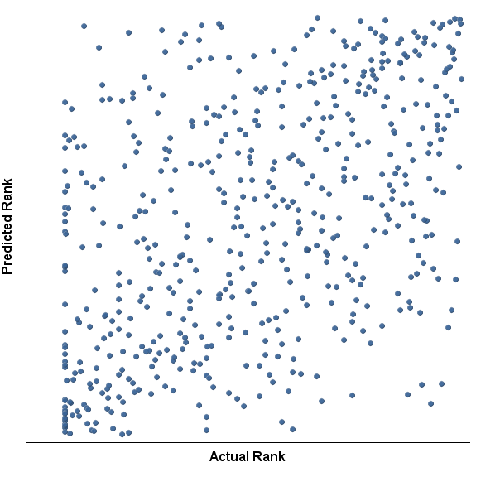
Reality….

Slide 13
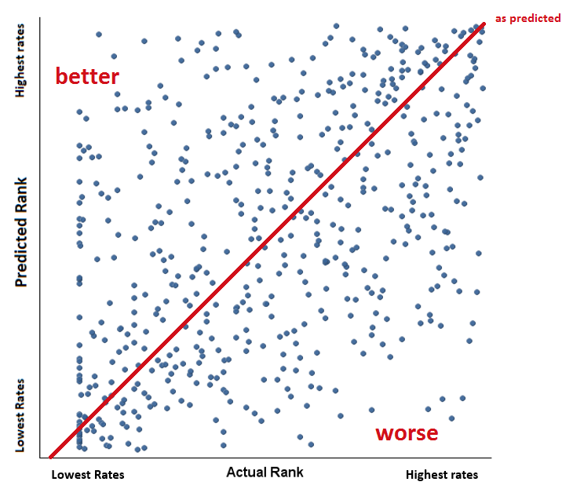

Slide 14
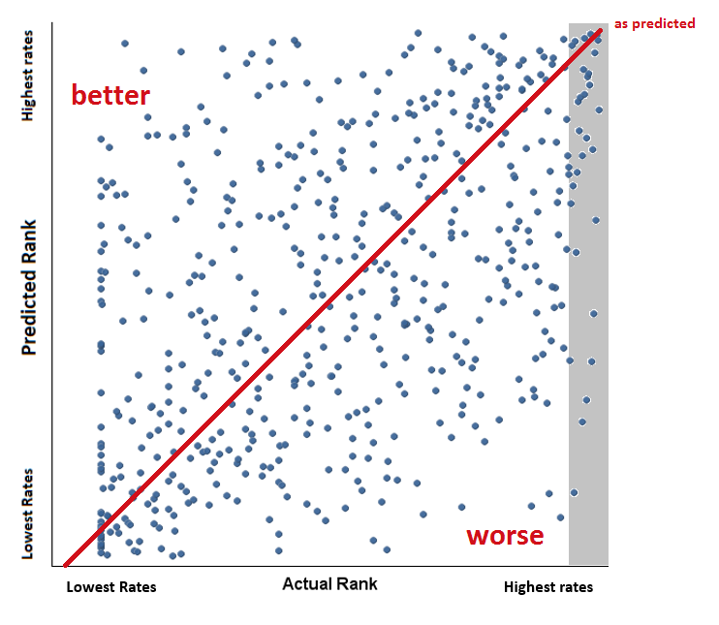
high DFW rate only?

Slide 15
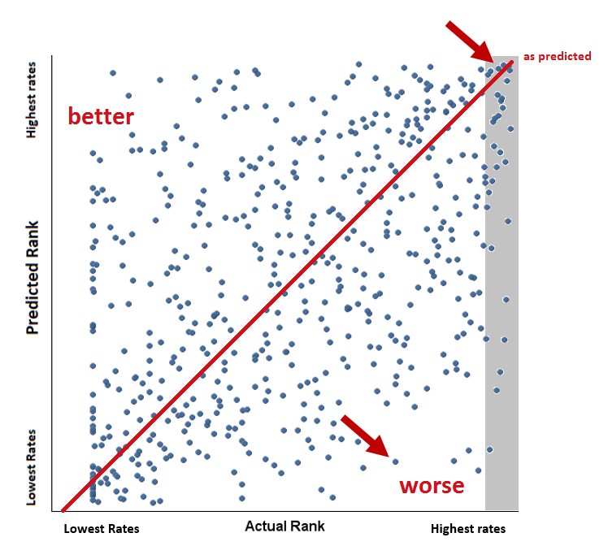
which course is of greater concern?

Slide 16
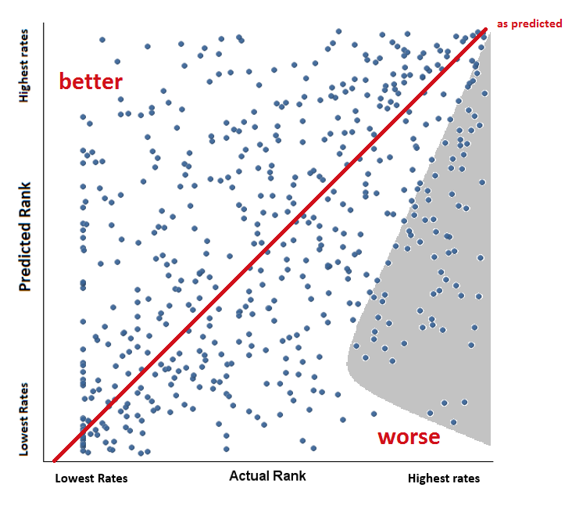
of possible concern?

Slide 17
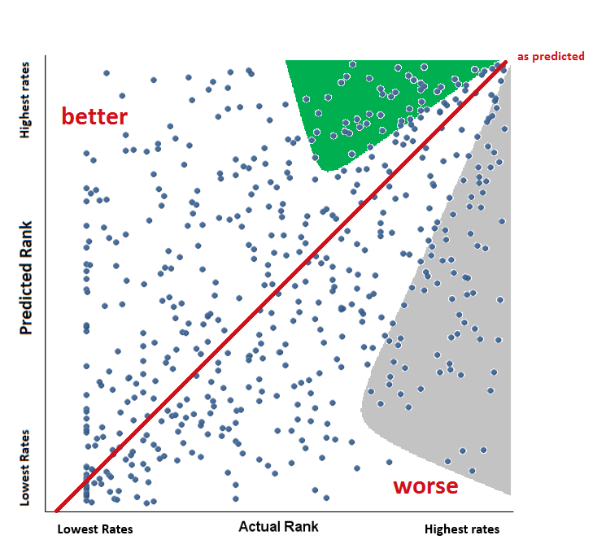
more effective than average?

Slide 18
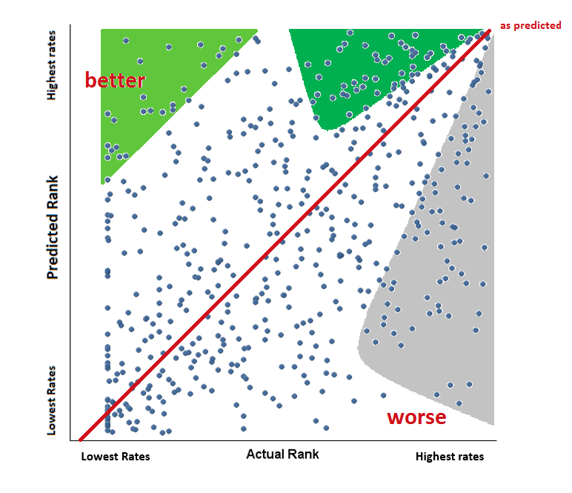
too good to be true?

Slide 19
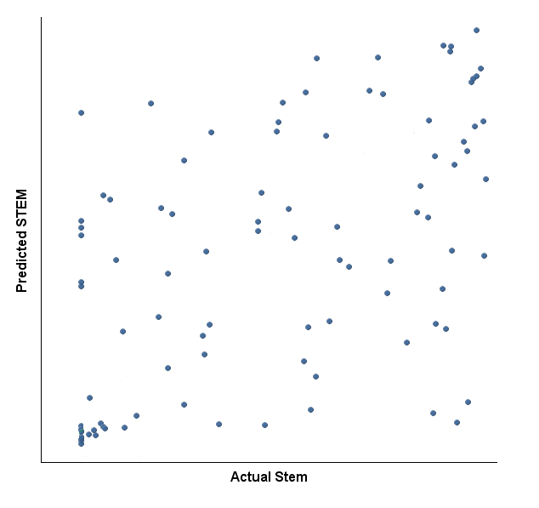
Scatterplots of subsets of courses can show useful information -- STEM
better
worse

Slide 20
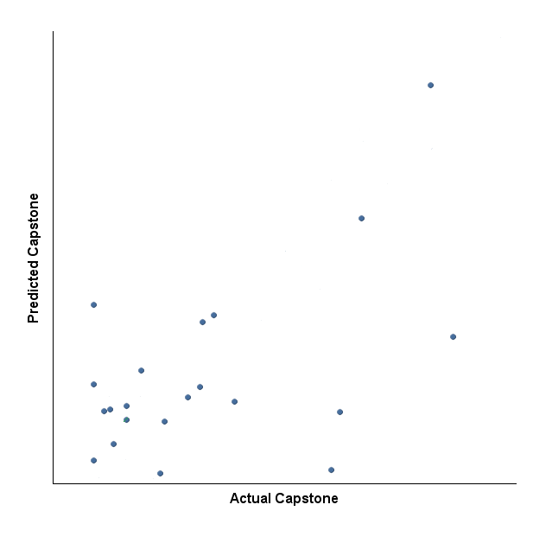
better
Baccalaureate capstone courses
worse

Slide 21
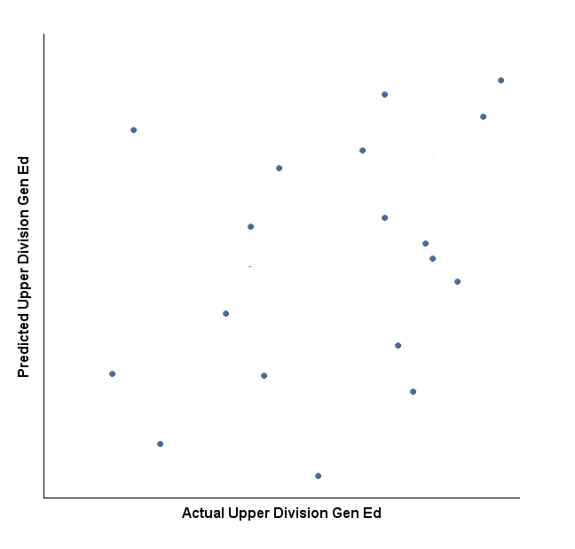
better
upper division general education courses
worse
Lowest Rates Highest rates

Slide 22
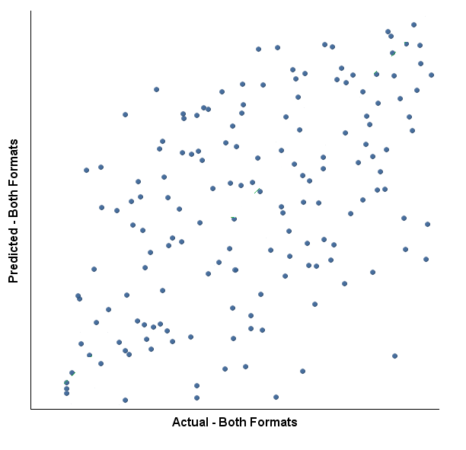
better
online vs. F2F?
-- courses offered in both formats
worse

Slide 23
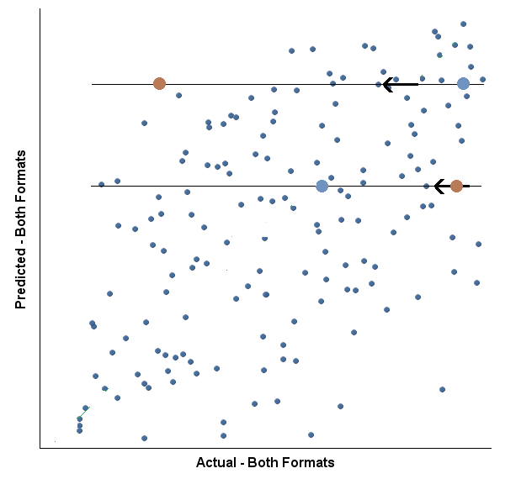
better
F2F
online
online vs. F2F ?
online
F2F
worse
Lowest Rates Highest rates

Slide 24
So once we have used gap analysis to identify courses in which students are performing worse than expected, then what?
VISUALIZATIONS
course by course
Notes:
We use visualizations to break down the findings a little more – to look for possible sources of the gap – Bill has created some neat tools for this purpose

Slide 25
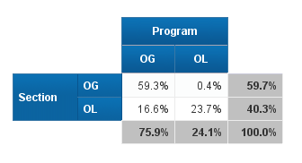
enrollment patterns by section and program format

Slide 26
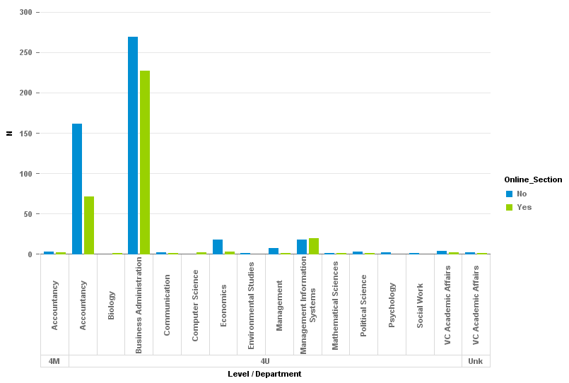
enrollment patterns
by major, level, and course format

Slide 27
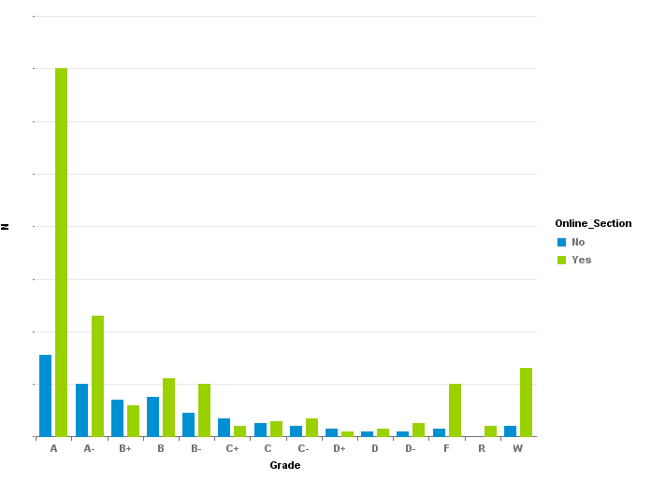
grade distribution
Notes:
Rs are taking again just for credit

Slide 28
summaries
Notes:
8.4% OG; 10.7% OL fail;

Slide 29
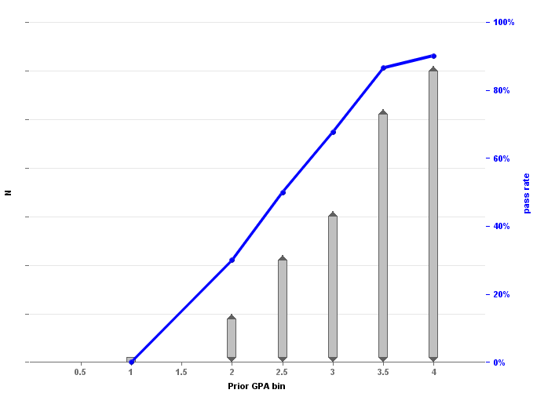
data visualizations
pass rate vs GPA
Notes:
Data visualization – slope and length of lines
Nonlinear cliffs
Can fluctuate wildly for small ns

Slide 30
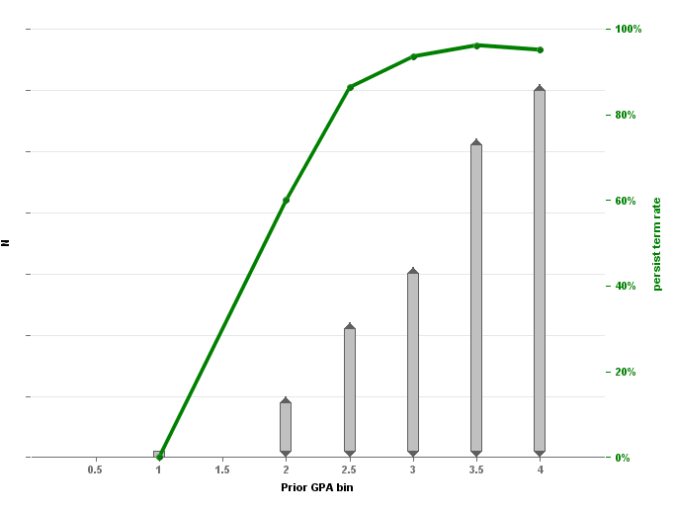
data visualizations
persistence vs GPA

Slide 31
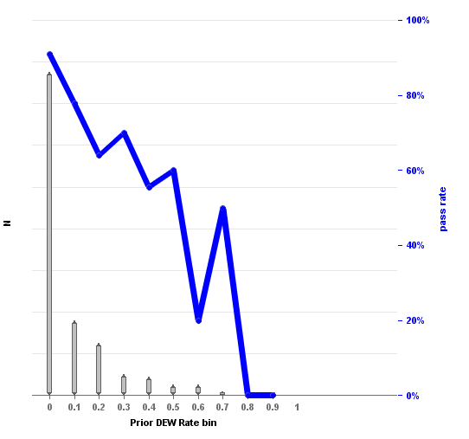
data visualizations
pass rate vs. prior DFW rate
Notes:
Online only GPA and DFW rates occasionally better ACT or other scores can also be used

Slide 32
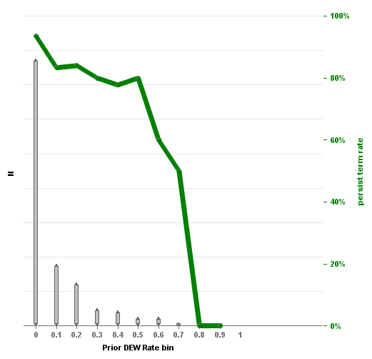
data visualizations
persistence vs DFW
Notes:
Online only GPA and DEW rates occasionally better ACT or other scores can also be used

Slide 33
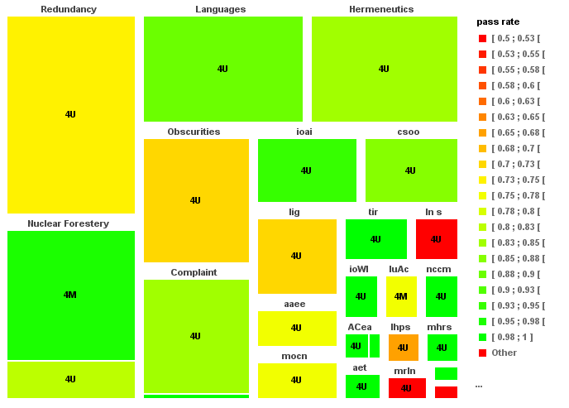
Tree Plots: Passed by Major

Slide 34
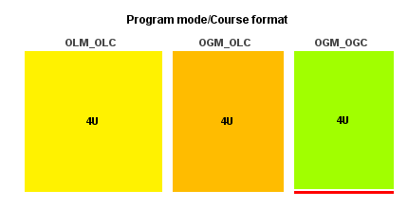
Tree Plots: Passed

Slide 35
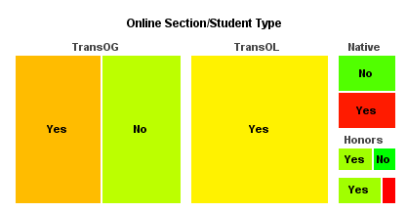
Tree Plots: Passed

Slide 36
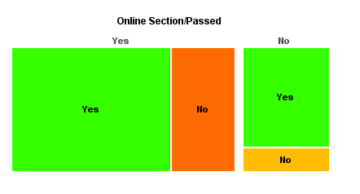
Tree Plots: Persisted
Notes:
Whether Course was passed is now a predictor

Slide 37
Statistical Analyses: Decision Trees -- CHAID
Classifiers – Student Type
Program modality / Course Format
Prior GPA (& OL GPA)
Prior DFW rate/hours (& OL DFW rate/hours)
Prior W rate/hours (& OL W rate/hours)
Passed Hours (& OL Hours)
Outcome: Passed
Withdrew
Persisted Next Term
Persisted Next Year
Passed course – added for Persistence outcomes
Persisted Next Term – added for Persisted Next Year

Slide 38
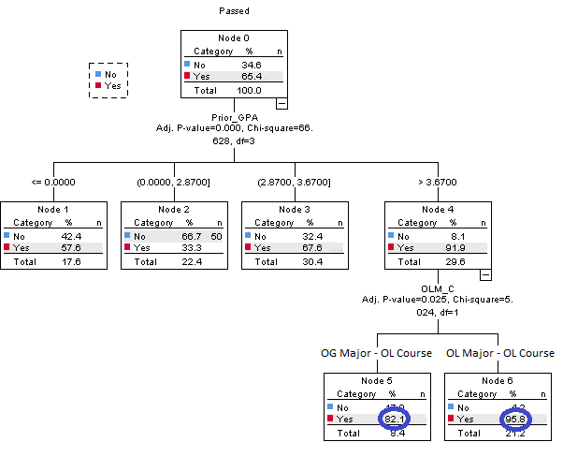

Slide 39
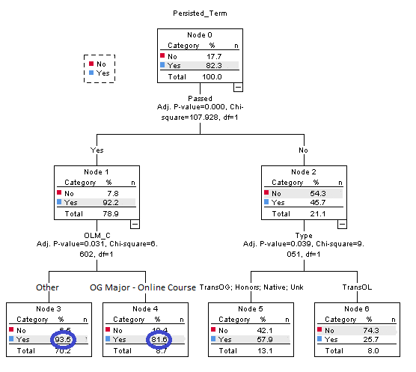

Slide 40
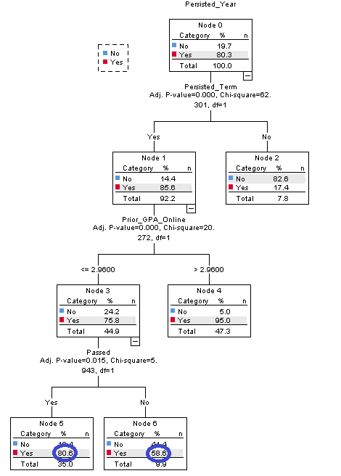

Slide 41
more depth?
parallel analyses – Binary Logistic Regression
course timing
course sequencing
(hidden) prerequisites
poison pairs
section differences
delivery modalities

Slide 42
Gap analysis is just a first step and courses so identified need a closer look.
We suggest a kind of triage.
Some gaps result from anomalies – one time issues that will not occur again and so can be ignored.

Slide 43
There are some courses whose underlying issues can be fixed relatively easily and inexpensively and outside the courses:
scheduling, staffing -- careful scheduling
course sequencing, poison pairs, hidden prerequisites -- advising guides, course prerequisites
mismatched modalities – careful scheduling, enrollment restrictions, student orientations

Slide 44
But some gaps result from more substantive issues.
These courses need serious qualitative investigation to try to get at underlying issues and develop suggestions for possible:
course redesign
faculty development
student support

Slide 45
KEY Takeaways:
Not all courses with high DFW rates are problematic.
Courses at all levels can be gateway courses.
It only makes sense to identify courses that may have issues, to make best use of limited resources.
While gap analyses can suggest courses to examine further, these must be examined individually.
When underlying issues aren’t readily discernable quantitatively, qualitative analysis is called for.

Slide 46
THANK YOU
questions?
bbloe1@uis.edu, kswan4@uis.edu

