Slide 1
Beyond Mentoring
NETWORKS FOR CONNECTEDNESS, LEARNING, AND LEADERSHIP

Slide 2
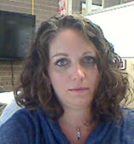
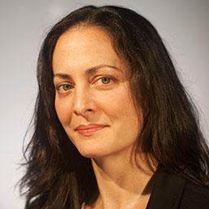
THE PRESENTERS
Diana Voss, M.S.
Director of Academic Technologies
Stony Brook University
Kelly Scholl, M.S.
Mosaic Initiative
Consultant
Indiana University
Shannon Dunn, Ph.D. Instructional Designer
University of Florida
This presentation leaves copyright of the content to the presenter. Unless otherwise noted in the materials, uploaded content carries the Creative Commons Attribution 4.0 International (CC BY 4.0), which grants usage to the general public, with appropriate credit to the author.

Slide 3
What are your networking challenges?
Take the poll!

Slide 4
What are your networking challenges?
Notes:
If problems with QR code, use https://pollev.com/shannondunn662

Slide 5
Notes:
Poll Title: What are your top challenges for developing and maintaining professional networks? https://www.polleverywhere.com/ranking_polls/nnrYyJu6AF1yw3XTyPugU

Slide 6
Notes:
Poll Title: What other challenges do you have? If you selected "Other" in the previous question, what challenge wasn't provided? https://www.polleverywhere.com/free_text_polls/Zh3gjSzgwn4ATfVlIsA6i

Slide 7
Poll Results

Slide 8
Small Group Action
Identify the top challenge most relevant to you
Break into small groups
Begin to complete your network map

Slide 9
Small Group Reflection
For each connection on your map, think about
Age
Gender
Organization/institution/unit
Professional position
Area(s) of expertise/knowledge
Geographic location

Slide 10
Small Group Discussion
What gaps do you notice in your network map?
Is your network diverse? In what way(s)?
In what ways is it not diverse but might benefit from diversity?
How can you get new ideas from your network?
How can people learn about you? Do they understand your strengths?
Think about the people who have helped you become who you are today. How would they introduce you?
Notes:
Re: gaps: most significant gaps may not be the most empty lines, but the places where participants feel they need or want to develop their networks the most

Slide 11
Small Group Challenge
How does your challenge impact your network?
How have you tried to address or resolve that challenge?
How might you address or resolve that challenge in the future?

Slide 12
Large Group Challenge Summaries
What was your group’s challenge?
What potential solutions did you identify?

Slide 13
Networking Next Steps
Exchange business cards with your colleagues
Make a note on the back about something you have in common or would like to ask about in the future
Sign up for the Slack channel
Continue the discussion with your colleagues
Receive networking challenges and prompts from your facilitators

Slide 14
THANK YOU!

Slide 15
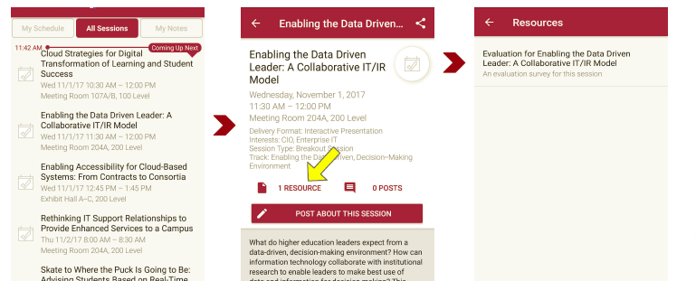
Session Evaluations There are two ways to access the session and presenter evaluations:
1
2
In the online agenda, click on the “Evaluate Session” link
From the mobile app, click on the session you want from the schedule > then click the associated resources > and the evaluation will pop up in the list

