Slide 1
Engaging Faculty in the Creation of Accessible Course Content
Megan Wuebker, Ph.D.
University of Cincinnati
Notes:
Abstract: In Spring 2018, we conducted a pilot of Blackboard Ally as part of a broader commitment to ensure the accessibility of our digital content. There were many positive results, including significant accessibility increases in the pilot courses. Valuable hands-on experience in making documents accessible empowered faculty, resulting in an unexpected but noteworthy benefit. We will discuss how we worked with faculty to address the barriers to creating accessible content: time, skills, and resources. We will also discuss how this pilot is driving course content accessibility and our plan for broader faculty engagement and development moving forward.

Slide 2
Notes:
Where are you in your quest for accessible course content?
https://www.polleverywhere.com/multiple_choice_polls/meMZRhekTYzzDv3WhbMMa

Slide 3
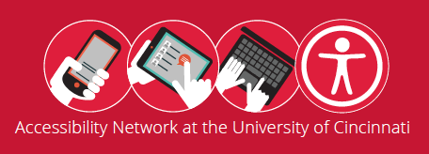
Context
Notes:
In December 2014, the University of Cincinnati entered into a resolution agreement with the Office for Civil Rights (OCR) to make its online resources accessible to all members of the community. The Accessibility Network was created in response to this agreement to ensure that information provided through the university’s websites, eLearning environment, and software is accessible to individuals with disabilities. This university-wide program continues to drive the establishment and sustainability of online accessibility as part of the institution’s core commitment to inclusive excellence.

Slide 4
What is Ally?
Notes:
Ally integrates with Blackboard and other learning management systems.
Ally scans uploaded content in order to provide:
Alternative formats for students to download (tagged PDF, mp3, epub, HTML, electronic braille)
Provides accessibility scores to instructors
Gives instructors step-by-step feedback on how to improve their accessibility scores
https://help.blackboard.com/Ally/Instructor/Quick_Start

Slide 5
Why Ally?
Notes:
Ally emerged as the only option to let us meet our OCR obligation as well as greatly help us improve the delivery of our course content
Ally afforded the opportunity to create a baseline for course content so as to show improvement with continued accessibility initiative

Slide 6
Pilot Overview
Notes:
One Semester (Spring 2018)
26 Faculty
Adjunct, full-time
33 Courses
Online, hybrid, face-to-face
Training
Ally and Accessibility
Data Collection
Email surveys, focus groups, Ally dashboard

Slide 7
Results: Impact on Accessibility
Notes:
8.71% increase in ”With Ally” score from Spring 2017 to Spring 2018 in matched courses; 7.68% increase in all pilot courses from Spring 2017 to Spring 2018
504 additional files in all courses in Spring 2018

Slide 8
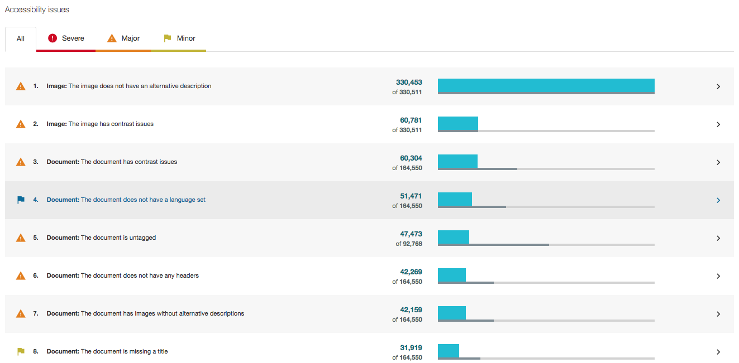
Impact on Accessibility
Notes:
From this report, we can identify issues which may exist across courses. For example, there are 330,453 images in spring semester courses that do not have alternative descriptions for screen readers. Very few images contain descriptions, actually. As with the next summary, we have the ability to drill down into individual courses and look at individual items of content.

Slide 9
Impact on Accessibility
Notes:
This is the same report for Spring Semester ‘18, just listing the severe Accessibility issues. In this instance, there are 14,334 scanned PDFs that have not been run thru Optical Character Recognition (OCR).

Slide 10
Notes:
What are significant challenges you've identified in getting faculty to create accessible course content, whether for accessibility or accommodation?
https://www.polleverywhere.com/multiple_choice_polls/FwOdlbC0fhxW2OuoYpfea

Slide 11
Faculty Barriers to Creating Accessible Content
Time
Skills
Resources

Slide 12
Barrier: Time
Notes:
Remediating existing course content can be incredibly time consuming and feel overwhelming. In the pre-semester training, several faculty mentioned that they already had their courses developed for the term and indicated that they were overwhelmed at the thought of remediating all of their content after the course build was complete.

Slide 13
Resolution: Incremental Change
Notes:
The Accessibility Network at UC has been running a “Start Small” campaign, encouraging content creators to begin with one manageable technique (using headings, etc.) and to grow their skills from there. This approach was echoed in the pre-semester training to pilot faculty, encouraging them to remediate what they could rather than an all-or-nothing approach.

Slide 14
Barrier: Skills
“I have been on feedback panels about accessibility before, and I’ve taken workshops about accessibility and UDL. What was missing, however, was the practical walk-through about how to apply what I had learned in the workshops and panels.”
- Ally Pilot Participant

Slide 15
Resolution: Guided Remediation

Slide 16
Barrier: Resources
Notes:
One of the primary complaints from faculty members throughout the pilot was the lack of access to software, specifically Adobe Acrobat. Due to licensing costs and restrictions, many units do not provide the software to their faculty. As an attempt at a workaround, our Information Technology unit paid for 6 months of the software for the pilot faculty.
An additional resource barrier is the time it takes to make courses fully accessible. Though the ”Start Small” campaign encourages incremental changes, many courses will require a much more intensive remediation process for content to be fully accessible.
Time and skills also fall under the umbrella of resources

Slide 17
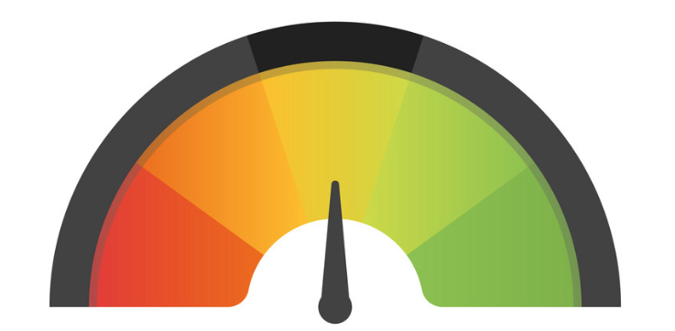
Resolution: In Progress
Notes:
One workaround to the specific PDF issue that we recommended was to encourage faculty members to create original versions of their documents in MS Word instead of relying solely on PDFs. However, we realize that this is not feasible for many of the documents utilized by faculty in their courses.
Course buy-out: Suggestions from pilot participants included course buyout or additional assistance from their units to enact the changes.
Centralized remediation: Another idea that may provide assistance with PDFs is a centralized location where faculty can send their files to be remediated. However, this requires advanced notice/planning for faculty.

Slide 18
Post-Pilot Faculty Reflections
Accessible content
Expectations
Proficiency
Ally as a tool
Notes:
Pilot faculty were willing to take the extra time needed in order to make their course content more accessible. By providing a tool that allows not only for immediate feedback but guided remediation, faculty members were able to not only increase their own proficiency and understanding but also ensure that their course material was more accessible for their students. It also increased faculty awareness of accessibility and reframed their expectations.
Expectations not only of them but also expectations of how they can/will be supported by the university
Of the 26 faculty members who participated, the 17 who participated in the end-of-term focus groups indicated that their own proficiency in creating accessible content was higher than it was at the beginning of the semester, with several stating that creating accessible content was easier than they thought it would be.

Slide 19
What’s Next?
Summer 2018: Soft Launch
Focus on remediating Great Gateways course content
Fall 2018: Campus-wide Launch
Training
Support
Resources

Slide 20
Questions

