Slide 1
Ethics in Predictive Analytics with a Data Governance Twist
Enterprise Summit: Analytics
April 19, 2019 | Long Beach, CA
Denise Nadasen, Association of Public and Land-grant Universities
Julie Alig, University of Massachusetts, Lowell
Notes:
Julie Alig was not able to make it to the summit.
I am Denise Nadasen: APLU, UMCP, UMUC, BOR.
25 years ago, data security was not an issue.
I started in this area about 5 years ago.
It is an evolving topic.

Slide 2
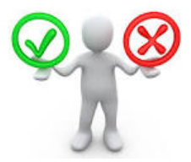
Our purpose today
Clarify the problem
Review examples of potential bias
Foundations of an ethical framework for data and analysis on your campus
Review data governance principles
Notes:
Review scenarios and identify potential problems.
Both intentional and unintentional bias.
Leading researchers: Sharon Slade, George Siemens, Abelardo Pardo, Paul Prinsloo.
GDPR.
Discuss components of an ethical framework and DG strategies.
There will be questions that I will ask you and you should answers.

Slide 3
What is said here stays here.
Think about an ethical issue that has come up at your campus or someone else’s campus.
Notes:
Invoke the cone of silence. It is safe to talk freely about questionable activities.
Please write down an ethical issue that has come up at your campus.
At the end, I will ask a brave soul to share their example for discussion purposes.

Slide 4
How is Analytics Different from IR?
Analytics is IR on steroids.
Imagine that you are collecting structured and unstructured data, analyzing it in real time, cutting it 100 ways, and immediately disseminating it to your constituents
…. Without conversation
With IR, we explain things, help people understand the data and the context. It takes time. It is not sexy.
Analytics is at risk of contributing to confusion
IR is at risk of missing a window of opportunity
Notes:
Create balance between these two opposing approaches.
Both sides have the same goals.
Work together; collaborate.
Be the “Match made in heaven”

Slide 5
How can Predictive Analytics be Used
Admissions decisions
Financial aid disbursement
Predicting course success
Predicting retention or graduation
Predicting revenue or rankings
Notes:
Just a sample.
UMUC – Predicted FTGPA, First year retention, and graduation in 6 years based on academic performance at the community college with a relatively high level of accuracy. Strong predictors. Math.
Mentoring, Engagement activities, improved experience, but not course success.

Slide 6
Scenario 1
You are a Financial Aid director. You are given the charge to make sure that the financial aid that is disbursed helps students succeed. Your IR office evaluates the effectiveness of financial aid on student retention.
They find that students from Montgomery County who received financial aid were more likely to be retained than students from Howard County.
You make a decision to increase aid to Montgomery County students and reduce aid to Howard County students. Retention goes up.
Notes:
What are the concerns?
Inherent bias in the analysis? What is the profile of Howard County students?
Could you be unintentionally biasing students geographically?
What would an appropriate response be to this type of analysis?

Slide 7
Drown the Bunnies
Mount St. Mary’s president, Simon Newman, decided to use predictive analytics to increase retention rates
Action taken: remove 20-25 students from the rosters by census date who would likely drop out anyway
This would boost retention rates 4 – 5 points
Justification: They will be more successful elsewhere
(The Promise & Peril of Predictive Analytics in HE, 2016)

Slide 8
Notes:
Prescriptive analytics is where we want to be.
Make sure the prescription is free of counter indications and
Be transparent about side effects

Slide 9
Predictive Analytics
Uses current and historic data to predict a future event
Student success
Risk scores
Areas of weakness
Intervention
Could limit opportunities for some students
Notes:
Historical data may have baked in bias – men in stem and women in EDUC.
SsSu is is often descriptive or diagnostic.
Risk Scores are predictive.
Different predictive model for AfAm.
Pell Ss performed worse than non-pell.
But they persisted at a higher rate.
Persistence was a stronger predictor then performance.
Intervene with care (UMBC example).

Slide 10
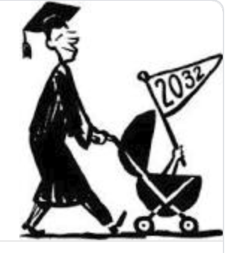
Scenario 2
You are an Admissions Director at a selective university. Your analytics team analyzes historical data and finds that children of alumni don’t perform as well as other incoming students and their performance is trending down. The number of applications has gone up this year.
You know that the parents of these students have donated a lot of money to the institution. Traditionally being a child of an alum has weighed heavily in admissions decisions.
Do you continue the practice to allow these student to take spots that could go to more deserving students?
Notes:
Admissions workshop at Bucknell for parents.
UMCP example.
Neighbor.

Slide 11
Ethical Concerns
Collection and use of personally identifiable Information
Data creep
Data quality
Access and security
Biased insights that may harm students
Black box analytics
Notes:
PII: Any information that permits the identity of an individual to be directly or indirectly
Inferred.
Example: A research firm examines outcomes of various subgroups of students across universities. They need unit record data. Do you share SSN? Birthdate? Race? Grades? Fin Aid info?
Data Creep: Is the data used to help students or to help the university?
Example: Using transfer credit information to improve recruitment efforts.
Quality data: Garbage in garbage out
Access: Data in ERP was secure, but PeopleSoft was not.
Bias: Historic data may have biases baked in. Men in STEM and women in EDUC.
Black box: Married students had a higher graduation rate.

Slide 12
Consumer Privacy Bill of Rights
Provides substantive protection that the Fair Information Practice Principles are followed and have the following notions:
Transparency
Individual control
Focused collection & responsible use
Security
Access & accuracy
Accountability
(center for democracy & technology)
Notes:
Federal policies govern the use of PII to protect individual privacy.
Best practices for collection, storage, and use.
Transparency is acknowledging how data will be used.
Allow students to opt in or opt out.
Use the data for its intended purpose.
Secure data behind a firewall.
Limit access.
Who is responsible for the collection and security of the data?

Slide 13
Ask Questions
Why was the data collected and is it being used for its intended purpose?
Are students aware and willing to share their data for this purposes? Do they have a choice?
Are the data used in a reasonable manner?
Are the data appropriate, authoritative, and complete?
Who owns the data? Who is responsible for the data?
Who has access?
How equitable are the results?
What are the consequences of the analysis?
Can mistakes and unintended consequences be repaired?
(Chessell, 2014)
Notes:
Just because you have it ….
Transparency …
To help students … or to make money?
Do you have all the data you need to draw accurate conclusions?
Data ownership vs. stewardship.
Access.
Examine the potential biases in the historic data and in the algorithms.
What could happen if you take action on a biased conclusion?
What are the stakes?
REMEMBER THAT THESE ARE PEOPLE.

Slide 14
Scenario 3
A for-profit company Campus Success offers a platform called LMS Solutions with a wide range of student progress and success metrics at your institution as well as comparisons against a group of unidentified but similar institutions. In order to deliver this service, the contract indicates that Campus Success will be the owner of the data collected. How would you advise the Provost on handling a
situation like this?
(Courtesy of Julie Carpenter-Hubin, The Ohio State University, 2018)
Notes:
Data creep?
Is this what the data was intended for?
What if the data did not include SSN?

Slide 15
Six Principles
Moral necessity to use data focusing on what is important in the education process for the student
Students provide informed consent
Data has an expiration date
Student outcomes are influenced by various factors
Transparent standards, access, storage, security, & privacy policies
Institutions embrace value of learning analytics and its potential impact on student success
(Slade & Prinsloo, 2013)
Notes:
Student focused morality.
Transparency.
Do we need to keep it forever?
Are we drawing conclusions based on race when there may be other mitigating factors?
Transparency.
Student-centered.

Slide 16
Five Principles for Ethical Use
1. Create a vision and a plan
2. Build a supportive infrastructure and culture
3. Make sure the data is used as intended
4. Evaluate bias in predictive models
5. Intervene with Care
(New America, 2016)

Slide 17
Data Governance
Data Governance refers to the organizational bodies, rules, decision rights, and accountabilities of people and information systems as they perform information-related processes
(The Data Governance Institute)
Notes:
I won’t discuss DG in much depth.
First, it is an entire presentation by itself.
Second, UNT covered this very well in their presentation yesterday.

Slide 18
Governance Structures
Formal governance committee may include:
Legal, IT, IR, Registrar, Faculty affairs, Student Affairs, and representatives for Chairs, Deans, or the Provost
A Master Plan
Data Governance Officer
Notes:
Be organized
Get buy in
Communicate

Slide 19
Governance Content
Policies
Access & security
Data definitions
Identify the data steward
Guidelines for interpreting data
Communication plan

Slide 20
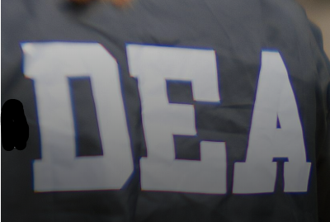
Governance Startup
IT & IR
Value statement
Roadmap
Executive buy-in
Organizational structure
Communication plan
Policies related to data
Document, Evaluate, and Adjust

Slide 21
Example from the audience

Slide 22
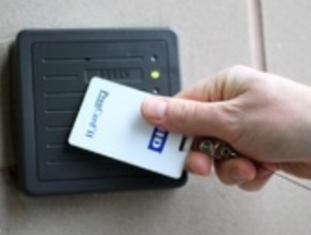
Scenario 4
As a Student Affairs staff member, you want to help students at risk of dropping out. You read somewhere that students who don’t go to the dining hall on a regular basis are more likely to drop out. You know there is data on student activity. You ask Facilities for swipe card data to identify students at risk of dropping out. Facilities shares a secure file with you. You do the analysis, find out which students are at risk, and reach out to these students. You helped some get back on track and re-engaged.
Notes:
Just because you have it doesn’t mean you use it.
You don’t share data without permission … of who?
What policies exist on data sharing?

Slide 23
Thank you!
Denise Nadasen, D.M.
Director of Research and Data Policy
Association of Public and Land-grant Universities
202-478-6081
dnadasen@aplu.org
Julie Alig, Ph.D.
Executive Director, Office of Strategic Analysis & Data Management
University of Massachusetts Lowell
978-934-2506
Julie_Alig@uml.edu
Please Complete Your Session Evaluations :

