Slide 1
Privacy Gaps in Mediated Library Services
Micah Altman
<micah_altman@alumni.brown.edu>
Director of Research Center for Research in Equitable and Open Scholarship
MIT Libraries
Prepared for
NERCOMP 2019
March 2019
Providence , RI
Notes:
Alex

Slide 2
Abstract
In this work in progress, we summarize privacy principles based on ALA, IFLA, and NISO policies. We then organizing and comparing high level privacy protections required by ALA checklist, NISO, and GDPR. This framework of principles and controls is then used to score the privacy policies and practices of major vendors of research library content. We evaluate each element of the vendors privacy policy, and use instrumented browsers to identify the types of tracking mechanisms used by different vendors. We use this set of privacy scores to support analyses of change over time, and of potential gaps between patron expectation and major practices.
The major findings are as follows:
There is misalignment between stated library values and privacy practices
Increasingly patrons accessing content purchased and branded by an institution, may not be protected by institutional privacy policies
Vendor policies that permit compreshensive data collection, broad use, detailed tracking are common
A range of active tracking mechanisms are employed that make individuals reidentifiable even when they are nominally anonymous.
Surprisingly even open-access collections are intensively tracked
Some vendors do better than others -- e.g portals (EBSCO, Proquest) do better than publishers
Many of these privacy risks can be mitigated through awareness, analysis of vendor tracking mechanisms with common tools, and the use of model licensing language

Slide 3
Attribution Statement
Co-Conspirators:
Katie Zimmerman, MIT
Kit Haines, MIT
Margaret Purdy, Foaly & Hoag
Thanks:
Harvard University Privacy Tools Project
Sponsors:
Supported in part by the Sloan Foundation

Slide 4
Disclaimer
These opinions are my own, they are not the opinions of my employers, collaborators, or project funders.
Secondary disclaimer:
“It’s tough to make predictions, especially about the future!”
- Attributed to Woody Allen, Yogi Berra, Niels Bohr, Vint Cerf, Winston Churchill, Confucius, Disreali [sic], Freeman Dyson, Cecil B. Demille, Albert Einstein, Enrico Fermi, Edgar R. Fiedler, Bob Fourer, Sam Goldwyn, Allan Lamport, Groucho Marx, Dan Quayle, George Bernard Shaw, Casey Stengel, Will Rogers, M. Taub, Mark Twain, Kerr L. White, etc.

Slide 5
Related Work
Altman, M., Wood, A., O’Brien, D. R., Vadhan, S., & Gasser, U. (2015). Towards a modern approach to privacy-aware government data releases. Berkeley Technology Law Journal, 30(3), 1967-2072. https://doi.org/10.15779/Z38FG17
Altman, M., Wood, A., O’Brien, D. R.,, & Gasser, U., (2018) Practical approaches to big data privacy over time, International Data Privacy Law, Volume 8, Issue 1,, Pages 29–51, https://doi.org/10.1093/idpl/ipx027
Wood, A., Altman, M., Bembenek, A. , Bun, T., Gaboardi, M.,Honaker, J., Nissim, K.. O’Brien D., Steinke, T. & Vadhan, S.. (2018) Differential Privacy: A Primer for a Non-Technical Audience, 21 Vand. J. Ent. & Tech. 209 http://www.jetlaw.org/journal-archives/volume-21/volume-21-issue-1/

Slide 6
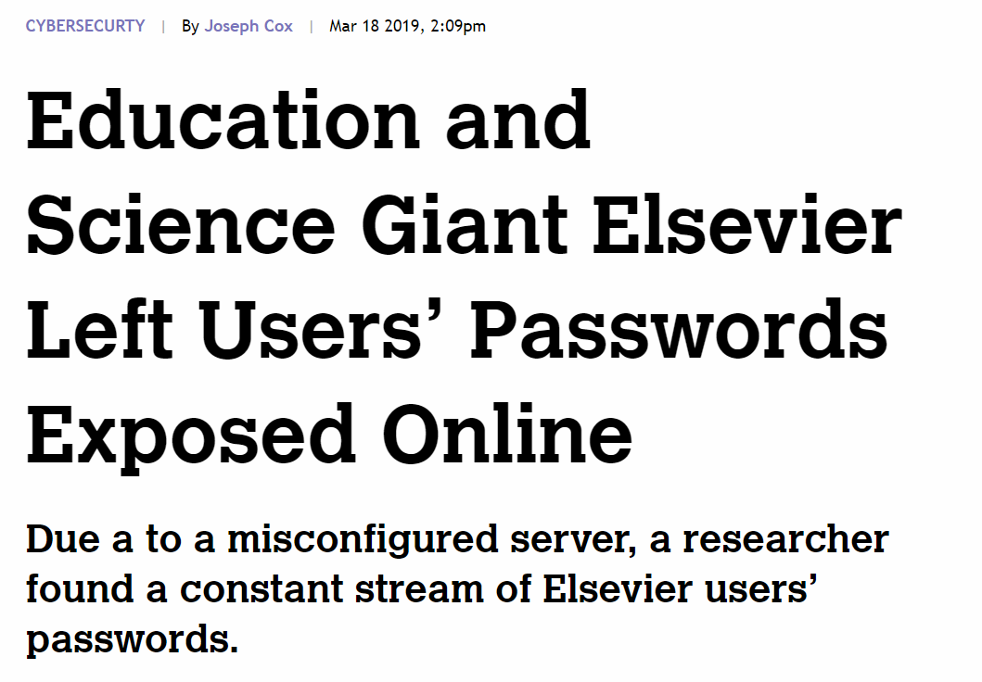
Good Morning All Your Data Are Belong to Us
Notes:
How many people in Libraries, Publishers, Govermnet
CSO, CPO in your organization
Privacy Policy
How many use tools to protect privacy and =- incognito mode, browser, vpn, tor, pl

Slide 7
Background - Libraries and Privacy

Slide 8
Libraries Facilitate Human Right of Privacy
International libraries recognize privacy as part of Universal Declaration of Human Rights
Derives from direct right to privacy
Implied by right to access information and right to free expression
“Freedom of access to information and freedom of expression, as expressed in Article 19 of the Universal Declaration of Human Rights, are essential concepts for the library and information profession. Privacy is integral to ensuring these rights.”

Slide 9
Respect for Privacy is a Core Value of Librarianship
American libraries recognized right to library privacy since 1939
Privacy and confidentiality identified in list of 10 library core values
Based on a professional value of supporting free inquiry
“The Library Bill of Rights affirms the ethical imperative to provide unrestricted access to information and to guard against impediments to open inquiry. Article IV states: “Libraries should cooperate with all persons and groups concerned with resisting abridgement of free expression and free access to ideas.” When users recognize or fear that their privacy or confidentiality is compromised, true freedom of inquiry no longer exists.”

Slide 10
Legal Requirements for Library Vary by Jurisdiction
International Law
Libraries increasingly serve content to a global audience
Many countries law’s, such as GDPR apply to users’ interactions with libraries
US Federal Law
No general protection for library use or patrons, but some protections for certain categories of users (e.g. children under 13) who are library patrons
Patriot Act may require disclosure of information collected in libraries
State laws
State laws vary from specific protection, to implicit inclusion in open records requests

Slide 11
State Laws -- Focus on Circulation Records
Protected from FOI/gov. public records: CA, CO, IA,MD, ND, OR, VT, VA, WA, HI (AG Opinion) ,KY (AG opinion),
Not public: DE, IN (not releasable), MA, MN (private), RI, WY (not open for inspection), TX (Private)
Confidential – except for court order: AK, AZ, DC, FL, LA, ME, MI, MS (except minors), MO, MT, NB, NH (other statutory exceptions), NJ, NM (except minors), NY (specific records), NC, PA, SC, SD (except minors), TN (except for seeking reimbursement), UT (except minors) WV ( except minors), WU
Confidential: AL, AR, CT, GA, IL, KS, NE, OK (shall not disclose)
See: R.E. Smith 2013 for an Overview

Slide 12
Related Contractual Obligations
Industry Standard for Credit Card Information
PCI-DSS
Imposes information-security controls, where libraries directly accept credit card payments
Content-Vendor Contracts
May impose duties on vendors to protect personal information
May impose duties on libraries to protect “proprietary”information -- eg. usage, service, and cost

Slide 13
Library Usage Has Changed -- Implications for Privacy
From circulation of physical content held by library, → to mediating access to electronic content hosted by vendors
From patron access & reference from within library spaces → to patron working from anywhere
From library hosting of software & business records → cloud-based OPAC systems
Discovery of library-mediated content often occurs outside library

Slide 14
Consolidation of Scholarly Communications
In the last 30 years, scholarly publishing has consolidated to an unprecedented degree
Handful of publishers are responsible for vast majority of journal article production
Most content accessed through a small number of portals: Elsevier, Wiley, Springer, ProQuest, Ebsco, ...
Most in-house content managed by a small number of vendor systems

Slide 15
Vulnerabilities in Mediated Services
Tracking

Slide 16
Research Questions
What is privacy protected in library mediated services?
Are there systematic gaps between library values and practice?
Are protections different between library-hosted and vendor-hosted content?
What privacy practices are necessary address gaps?
How do changes in privacy/security landscape create strategic risks/opportunities for research libraries?

Slide 17
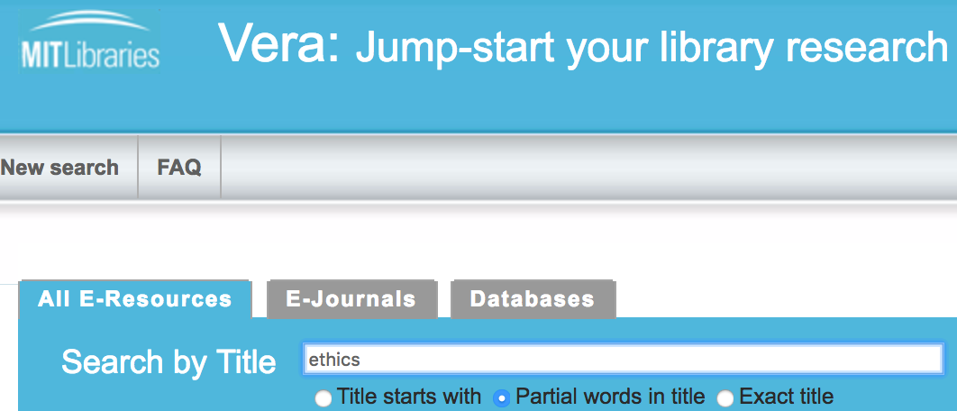
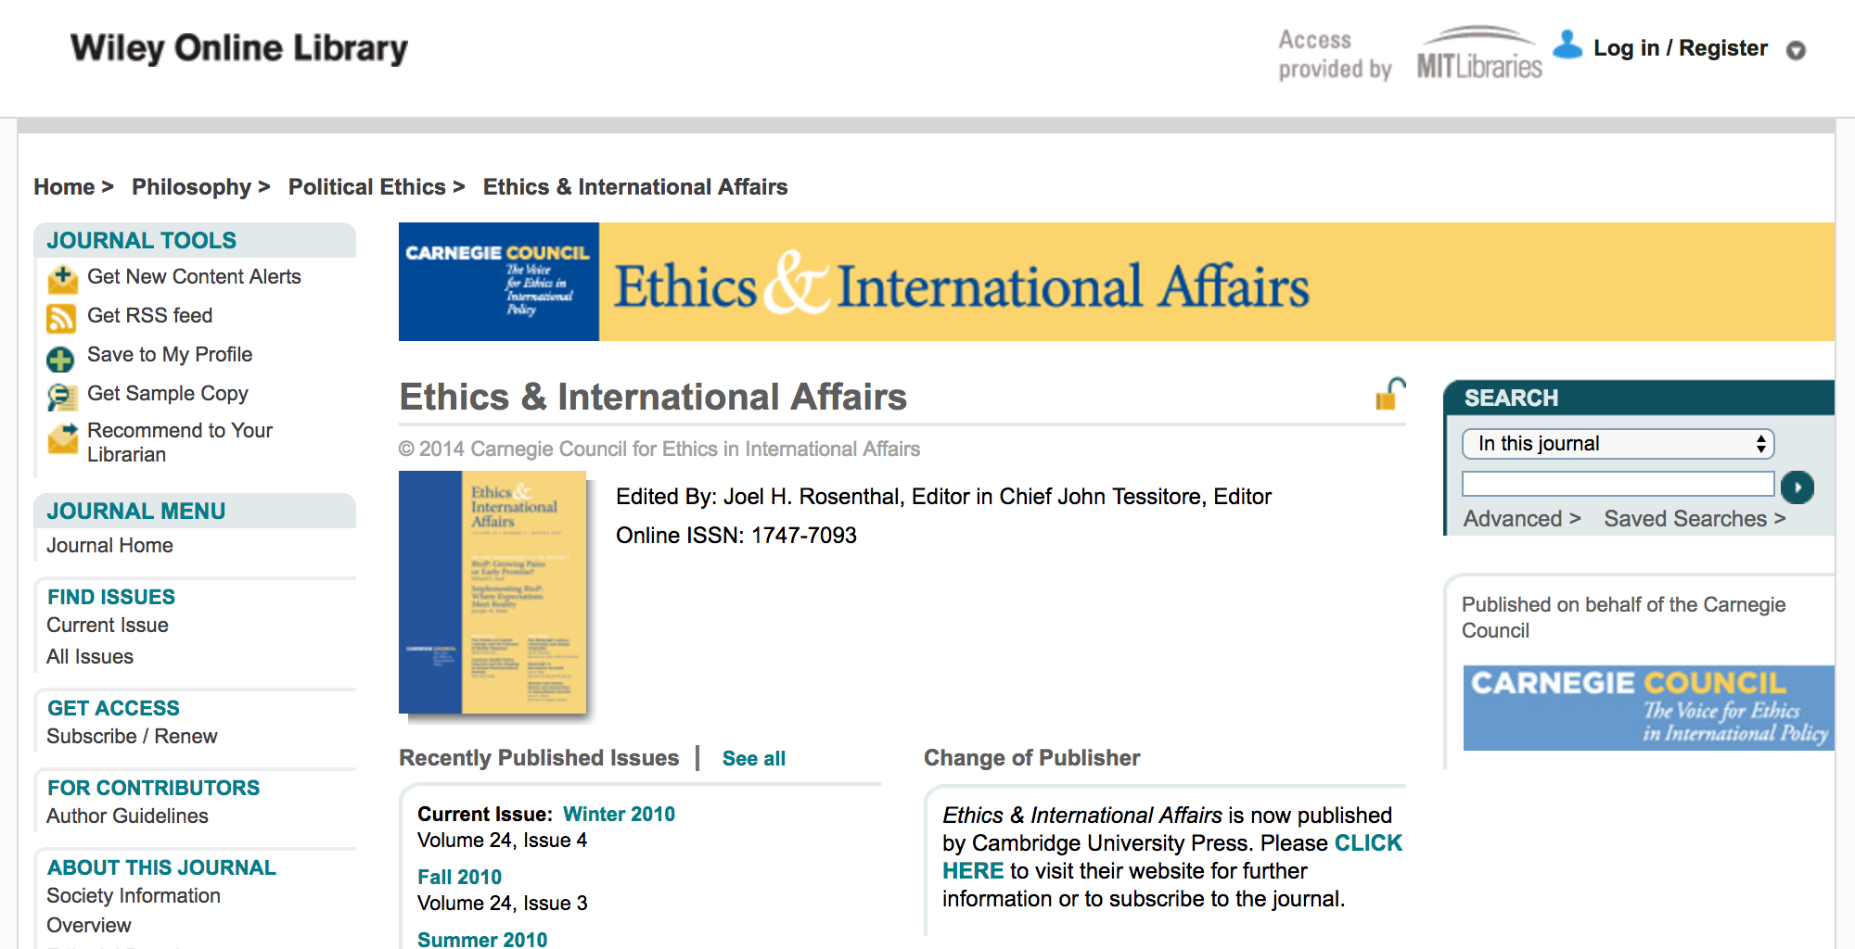
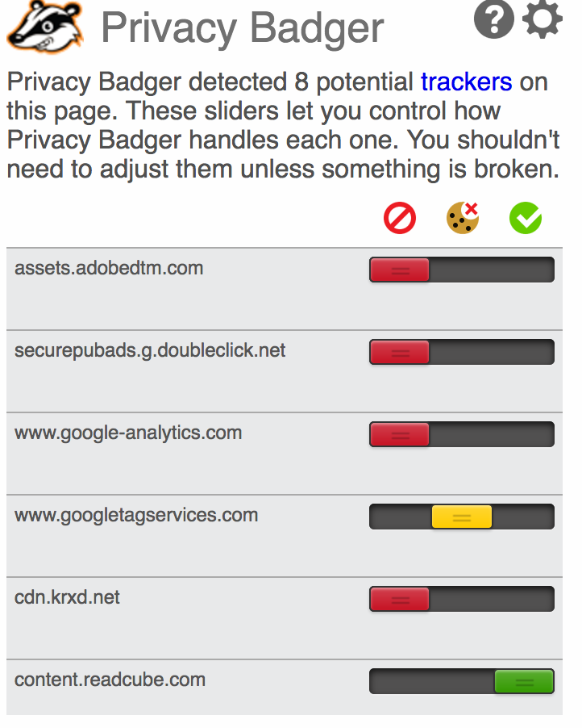
Example Use Scenario
Access
MIT patron uses library system to discover journal to which MIT has licensed access
Patron authenticates through id gateway, accesses journal through MIT Proxy
Content
Content is provided through third party web site, which also brokers further discovery and navigation
Content is presented through proprietary reading app
Potentially vulnerable information
Tracking cookies
IP addresses
Authenticated identity
Browsing history
Reading/sharing history
Example visible potential intrusions
Targeted advertisements
Personalized recommendations
Tracking cookie insertion

Slide 18
Evaluating Vendor Tracking Practices
Tracking Mechanisms
Tools
Category | Exemplar Mechanisms
Encryption | HTTPS everywhere, valid certificates
Ad placement | Internal Ads, Third-Party Ads
External Resource | Fonts, Javascript Packages, Google Analytics
Cookies | Persistent Cookies, Third Party Cookies, Known ad Networks, SuperCookies
Reader Apps | Page and highlight analytics
Active Fingerprinting | Canvas Fingerprinting, WebGL fingerprinting
Visual inspection
Privacy badger
Chrome dev tools
Brave browser

Slide 19
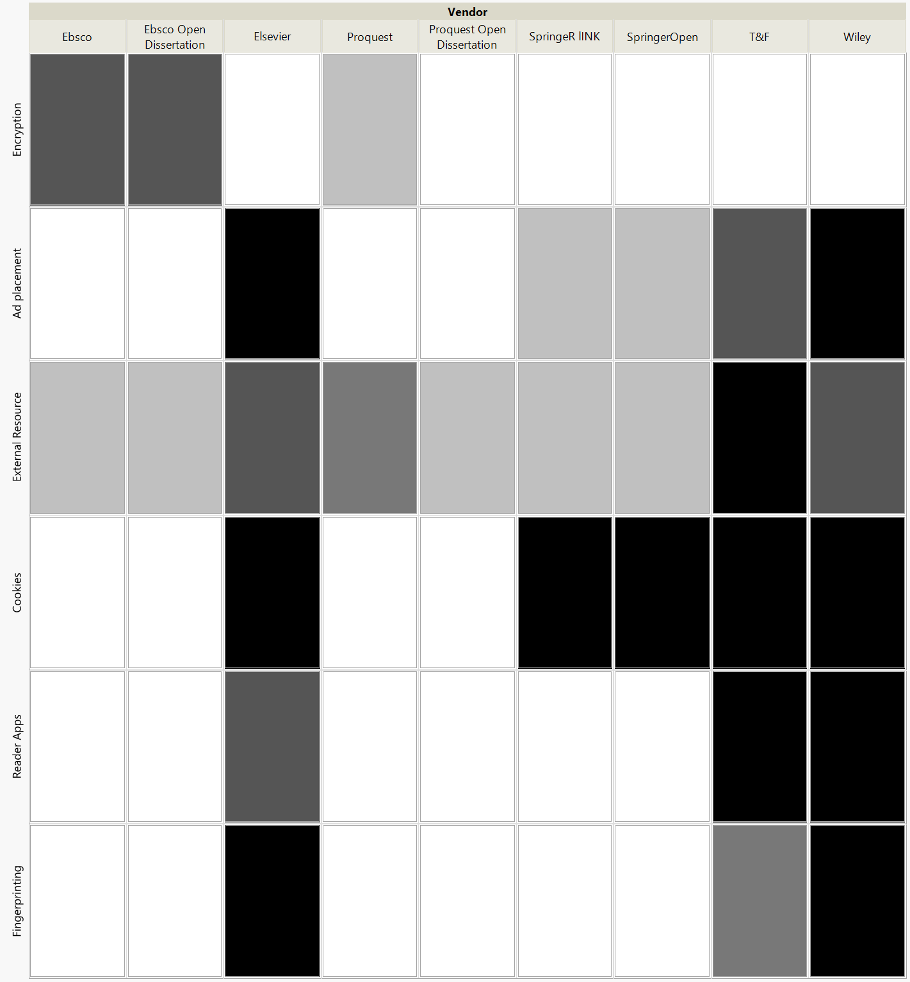
Tracking Comparison

Slide 20
Vulnerabilities in Mediated Services
Legal Protections

Slide 21
Evaluating Current Vendor Policies
Identify Reference Framework
Develop a Taxonomy of Protections
Develop a Measurement Instrument
Repeated Assessments
NISO Principles; ALA Guidelines; GDPR Regulations
Group specific protections with higher level principles; harmonize related protections
Develop coding rule and sale measurement for each protection
Assess over time; Repeated independent measures for reliability
1
2
3
4

Slide 22
Emerging library privacy framework - NISO
National Information Standards Organization Principles
Relatively broad & forward looking
High-level statements
Not operationalized as certification, checklist, etc.
Convened library, publishers, vendors
Developed consensus principles document over 18 months
Published in 2015

Slide 23
NISO Principles Enumerated
Shared Privacy Responsibilities
Transparency and Awareness
Security
Data collection and use limitation
Anonymization
Informed consent and opt-out
Restriction on sharing
Notice
Support for anonymous use of libraries
Access to one’s own use data
Continuous improvement
Accountability

Slide 24
Selected NISO Principle Details
“Libraries, content-, and software-providers should continuously assess and strive to improve user privacy as threats, technology, legal frameworks, business practices and user expectations of privacy evolve.”
Anonymization should be used as part of a broad set of information privacy controls that include: data minimization; statistical disclosure limitation methods, such as controlled aggregation; data-use agreements; and auditing. Anonymization may not completely eliminate the risk of re-identification. Therefore even anonymized raw data should be treated with the precautions detailed in the Security principle (item 3 above), in proportion to the potential risk of re-identification.

Slide 25
NISO Principles as a Framework?
Compare NISO Principles with:
ALA guidelines & checklists for library privacy
GDPR requirements for data protection
Do principles map at a high level?
Areas not covered by NISO?
Areas not covered by GDPR/ALA
Level of details
Most specific practices/requirements in each category?
Gaps?

Slide 26
Example ALA Guidance
Notice
Right to access one’s own data
Collection minimization
Encryption of transmission and backup
Use of strong passwords
Data sharing limitation
Policy on government requests – warrant canaries
Privacy awareness education for staff

Slide 27
Cross-Walk of NISO Principles
NISO Section | Evaluation Name | NISO Wording | GDPR Section | ALA Section
1. Shared Privacy Responsibilities | Training | “Anyone with access to library data and activity… should have training in related standards and best practices.” | Art. 39 // Tasks of the data protection officer (Paragraph 1b: “training of staff involved in processing operations, and the related audits;”) || Art. 47 Binding corporate rules (“the appropriate data protection training to personnel having permanent or regular access to personal data”) | Privacy Awareness
2. Transparency and Facilitating Privacy Awareness | Availability | “Libraries, content-, and software-providers shall make readily available to users specific, non-technical statements that describe each stakeholder’s policies and practices relating to the management of personally identifiable information.” | Art. 12 // Transparent information, communication and modalities for the exercise of the rights of the data subject (Paragraph 1: “Easily Accessible Form”) | Clear privacy policies

Slide 28
Comparing NISO, ALA, GDPR
NISO as a principles framework
ALA
NISO is more comprehensive
NISO is sometimes more detailed
GDPR
NISO principles align with categories of GDPR
NISO sub-principle -> GDPR subarticle level
NISO principles does not address vulnerable populations
Level of Detail
ALA
Guidelines are no more detailed than NISO
Checklists are more detailed
GDPR
Some GDPR articles provide more detailed requirements

Slide 29
Evaluating Process -- Step By Step
Each sub-principle evaluated
Options and Informed Consent: Choices
Niso Text: “When personal data are not required to provide services as described in \”Data Collection and Use\”, libraries and content- and software-providers should offer library users options as to how much personal information is collected from them and how it may be used.”
GDPR Additions:
Right to Object [art 21]
Right to restriction of processing. [art 18]
Notification obligation regarding rectification or erasure of personal data or restriction of processing [art 19]
Converted to statement
The privacy policy promises to fully support the requirement that: “When personal data are not required to provide services ... license should offer library users options as to how much personal information is collected from them and how it may be used including addressing a right to object; right to restriction of processing, notification of obligation regarding rectification or erasure of personal data or restriction of processin . “
Ranked on 1-5 Likert(Agree-Disagree) Scale
Repeated by independent coders

Slide 30
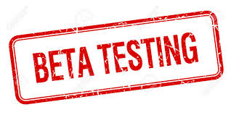
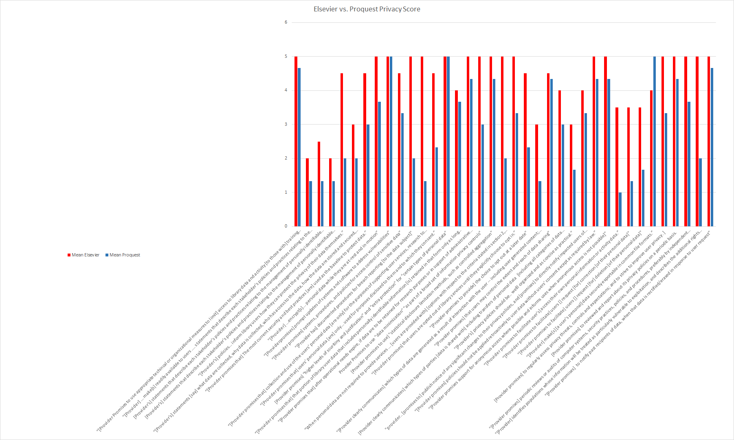
Scoring
Grand Score
Proquest: 3 (“B”)
Elsevier: 4.3 (“D-”)
Score Range:
1 (best) - 5 (worst)

Slide 31
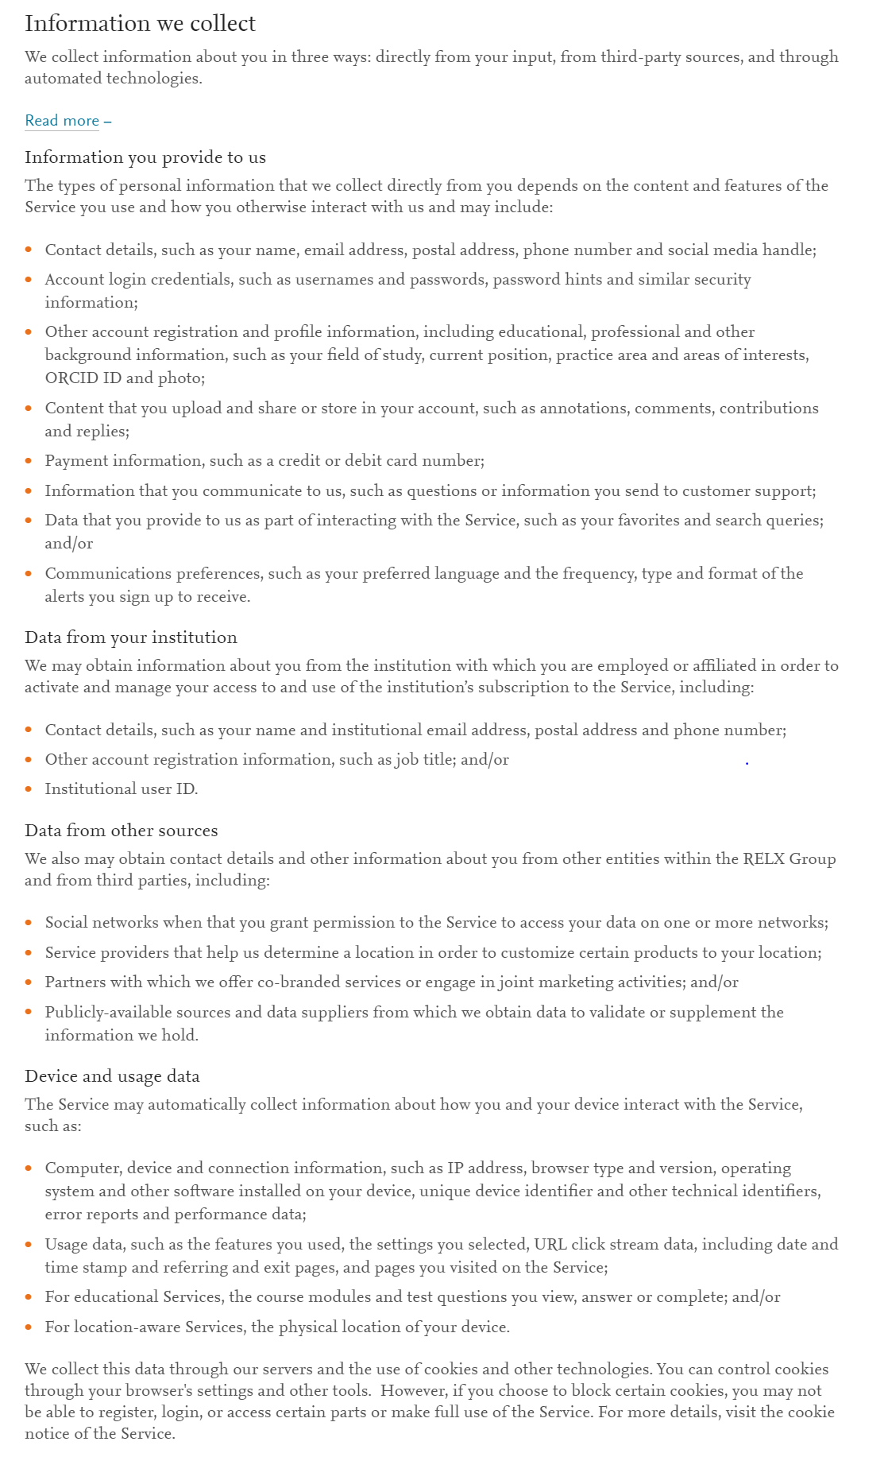
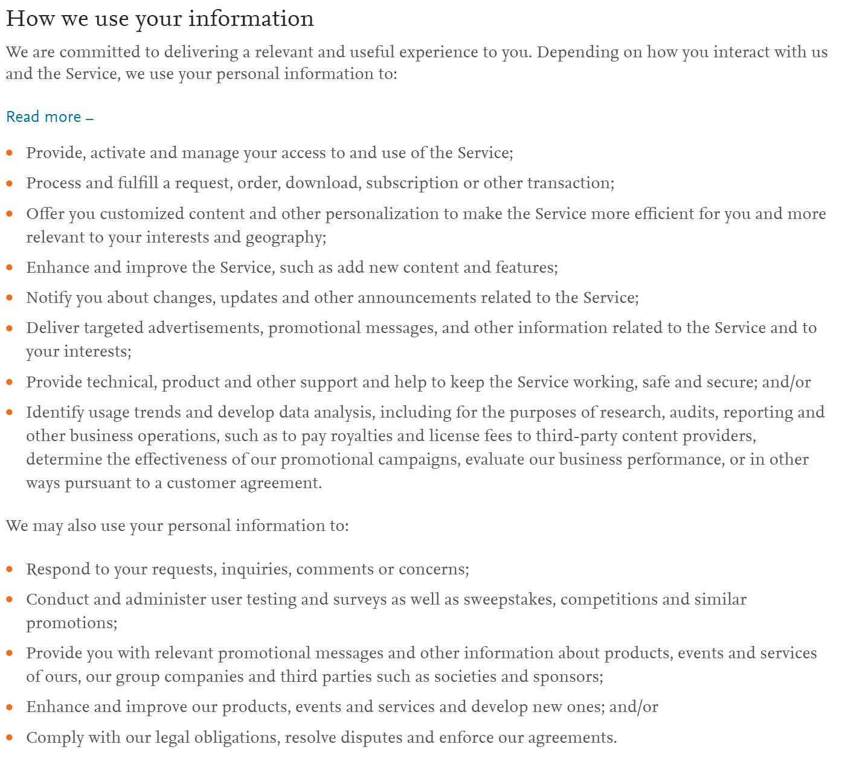
Privacy Policy Examples - Elsevier Collection and Use

Slide 32
Privacy Policy Detail - Elsevier
Use
Collection
Social networks when that you grant permission to the Service to access your data on one or more networks;
Service providers that help us determine a location in order to customize certain products to your location;
Computer, device and connection information, such as IP address, browser type and version, operating system and other software installed on your device, unique device identifier and other technical identifiers...
Deliver targeted advertisements, promotional messages, and other information related to the Service and to your interests;
Conduct and administer user testing and surveys as well as sweepstakes, competitions and similar promotions;
Comply with our legal obligations, resolve disputes and enforce our agreements.

Slide 33
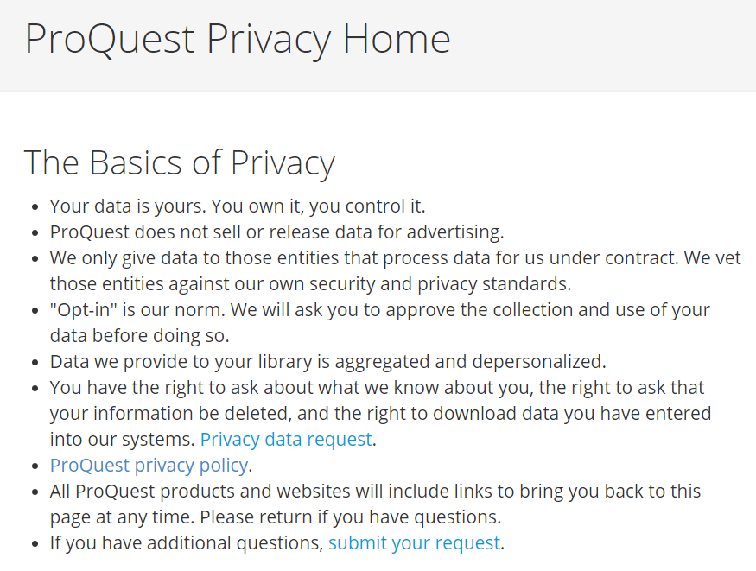
Example -- A Bit of a Better Policy

Slide 34
Laws Change, Compliance Changes, Protection May Not Change for You
Elsevier Post-GDPR Policy
You have the right under European and certain other privacy and data protection laws, as may be applicable, to request free of charge: Access to and correction and deletion of your personal information; Restriction of our processing of your personal information, or to object to our processing; and/or Portability of your personal information. If you wish to exercise any of these rights, please contact us through the contact address provided below. We will respond to your request consistent with applicable laws. To protect your privacy and security, we may require you to verify your identity

Slide 35
Discussion & Recommendations

Slide 36
Summary
Increasing misalignment between stated library values and privacy practices
Data collection, broad use, detailed tracking are common
Information tracking generally extends to vendor-hosted open-access collections
Portals (EBSCO, Proquest) do better than publishers
Elsevier most invasive tracking

Slide 37
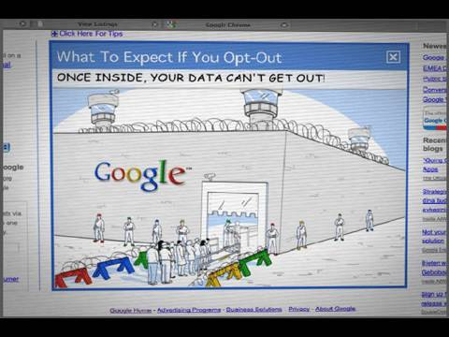
The Perfect Solution?

Slide 38
The Perfect Solution?

Slide 39
Legal Protections and Licenses
Laws provide inconsistent protection
Library values privacy rights
Laws drive compliance
Patchwork privacy and security landscape
Licences provide limited additional protections
Little protection for data collected by third party itself
Not based in library privacy values and principles
Improving Licenses
Current licenses are opaque
Patrons do not know their rights or choices
Libraries are restricted
Current License are inconsistent
Model terms needed to align with principle and requirements
Standard terms need for interoperability
Standard explanations needed for understanding
Current licenses do not support evaluation
Evaluation of license compliance
Evaluation of user needs /use from data being collected

Slide 40
Baseline Comparison: Privacy and Security in ARL Library Systems
ARL Library Implementations
Libraries using https on main site: 13%
Libraries using https for catalog: 14%
Libraries including commercial tracking: 100%
System Vendors
Most support optional encryption of interaction with users
Some support encryption of data in motion
Other privacy and security features not well characterized
See: Breeding 2016

Slide 41
Supporting Privacy by Design -- Using New Mechanisms
Open Access
Access service but not recommendations
Not all content can be made open
Open access can still be trackedd
Local Differential Privacy
For reading apps and other application-mediated access
Usage statistics
Recommendation
Privacy-Protected Machine Learning
Recommendation systems?
Cryptographic ID
Authentication statistics
Cryptographically-Secure Pseudonyms

Slide 42
Awareness, Consent & Control
Does university have a contract with vendor
That protects user data?
Is known to patron?
Is viewable to patron?
Is presented to patron?
Does university policy protect data where ...
contractor is collector/controller?
User has has accepted separate TOS, etc?
Does user agree to vendor policy

Slide 43
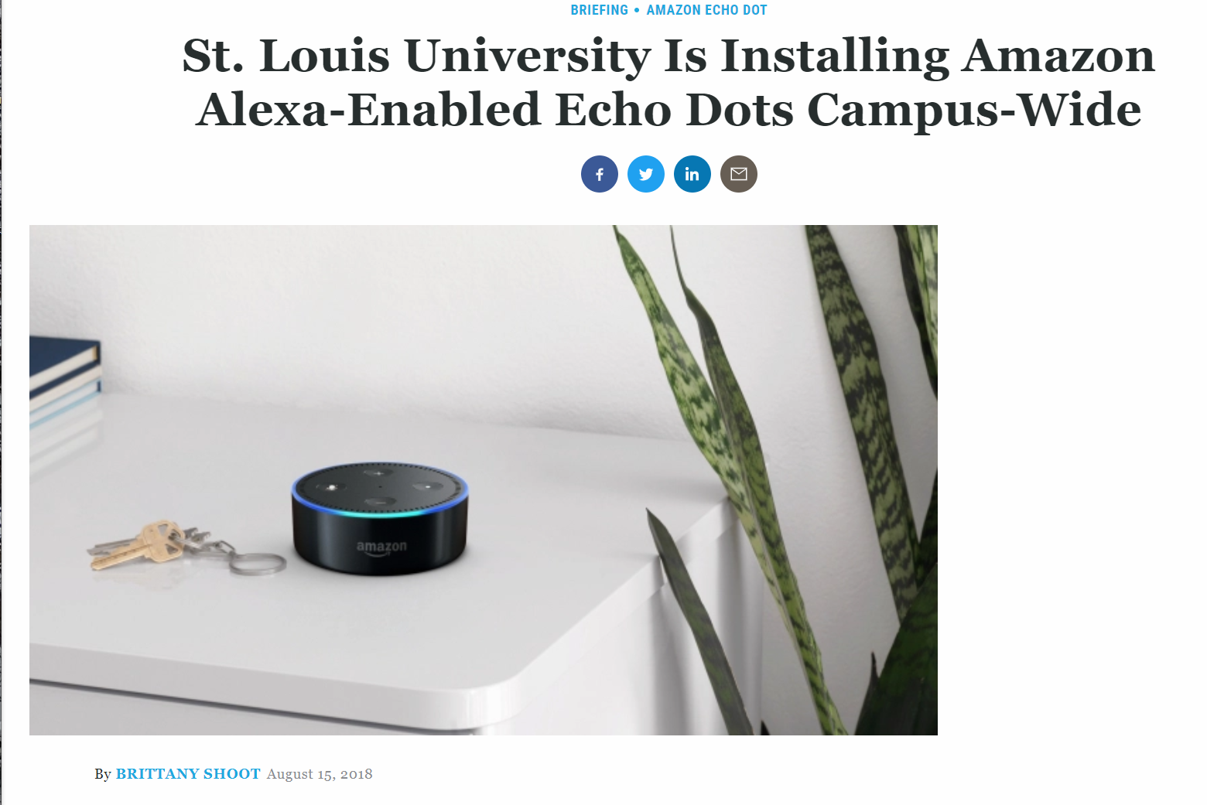
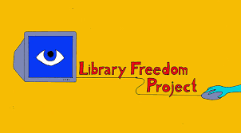
Libraries Can Play a Larger Role
Publishers are Not Biggest Threat to Community Privacy
Libraries Should Advocate & Educate

Slide 44
Discussion
Patrons accessing content purchased and branded by an institution, may not be protected by institutional privacy policy
Support needs to be designed in to enable more patron protection
improved accessibility of services by for human and machine clients
explicit support for anonymity, privacy preserving recommendations, etc.
Need for standardized model community license
Aligned with library principles
Transparent, and verifiable
Consistent and understandable
Need for libraries to promote information privacy, agency, and citizenship

Slide 45
Resources
Smith, R.E. 2013 (supplemented 2015), Compilation of State and Federal Privacy Laws, Privacy Journal.
American Library association Compilation of State Library Laws http://www.ala.org/advocacy/privacyconfidentiality/privacy/stateprivacy
ALA Privacy Resources: http://www.ala.org/advocacy/privacy/toolkit
LITA Patron Privacy Checklists http://www.ala.org/news/member-news/2017/02/lita-offers-patron-privacy-checklists-support-library-bill-rights
NISO, 2015; NISO Consensus Principles on User’s Digital Privacy in Library,Publisher, and Software-Provider Systems. http://www.niso.org/apps/group_public/download.php/16064/NISO%20Privacy%20Principles.pdf
, Marshall, 2016 Privacy and Security for Library Systems, Library Technology Reports 52(4)
Notes:
Micah

Slide 46
Questions? Observations? Arguments?*
Now
(10 minutes)
or
Later
micah_altman@alumni.brown.edu
micahaltman.com
*£1 for a five minute argument, but only £8 for a course of ten.
Notes:
Q&A From Educause Questions:
Questions:
Are there privacy issues are unique libraries? How has the use of vendors created new privacy issues in the digital age?
Libraries have a unique trust relationship with the communities that they serve. These communities rely on libraries to be safe spaces, and place a great deal of trust in librarians to guard their privacy and intellectual agency.
Further, libraries are evolving rapidly in the digital age. Such change is not unique to libraries -- information and communication technology has also sparked profound changes in the news media, arts, and legal professions -- but libraries are unusual in that they have successfully maintained many of the direct relationships with their communities (and concomittant expectations), while increasingly acting as portals and mediators to publishers and other sources of information.
At the same time information ‘publishers’ are changing their technologies and business models. Elsevier no longer describes itself as a publisher, but as an information analystics company.
In academic settings -- approximately half of the content that libraries work to make available to their communities -- electronic journals, ebooks, databases etc -- are hosted by other organizations; primarily publishers.
As a result, the boundaries between what the library does and what an online information-service or publisher does has become increasingly difficult for library users to see. As a result patrons can step out of the virtual library safe space and not know itl.
Are there privacy practices that differ between policy and practice? What are some ways do you think we could close that gap?
There are substantial gaps between library values, model policy, ‘best’ practice, and implementation.
Library values are crystal clear -- privacy and intellectual agency are fundamental. At a high level model policy such as the NISO principles and ALA Library Privacy guidelines reflect these values.
Best practices such as the LITA checklists are very useful for providing concrete implementation guidance the library community. And at the same time the pace of technology makes it a challenge to keep these up-to-date. Moreover, model practices tend to focus primarily on services, and systems maintained by the library.
Ironically, it is not these systems that are the greatest threat to patron privacy. The largest privacy threats to patrons in the context of the library interactions comes when patrons interact directly with 100’s of external publishers and other information sources mediated by the library.
At the level of implementation there are substantial gaps -- as Breeding’s 2016 study on library systems demonstrated (and this finding has been confirmed and updated by an IMLS funded project at UNM and Montana State) … libraries are not employing fairly basic protections -- such as systematic encryption of website connections (e.g. https).
What are some of the privacy controls we can use either with vendors or in self-regulation?
Libraries (like most organizations) tend to focus on a narrow range of controls -- frequently notice, redaction, aggregation. These are useful, but far from sufficient -- and there are a wide variety of privacy controls that libraries and patrons could deploy,..
Individual patrons:
Limited
Browser plugins - Ghostery, Privacy Badger, Privacy
Specialized browsers -- Brave
Specialized tools -- VPN, TOR
At the level of the individual library organization:
Providing clear privacy policies
Conducting a privacy audit
Adopting and applying the LITA checklists as a baseline
At the level of associations and communities
Privacy is a group sport -- your actions leak information on others, and the economics of privacy means vendors have a concentrated interest
Model licenses
Privacy protected recommendation systems and library usage and auth (RA21)
Education on information citizenship
Is there anything else you’d like to add that we haven’t covered?
And the largest privacy threat to patrons in general is the increasingly ubiquitous information surveillance to which people are subjected -- this is not somethng libraries have unique responsibilities for, but libraries can help educate their communities about the consequences of information privacy to their lives, the (limited) actions they can take to protect their own privacy directly, and the opportunities to engage in broader policy conversations.
Library Freedom Project is pioneering in this. EFF and EPIC.
Libraries also should be voices for privacy protection in their institiutions. When STLU installed alex campus-wide this created far more privacy risks than those related to library content. Libraries do not have control of such decisions, but can inform their institutions about the threates to privacy and information agency in the digital age.

