Slide 1

ALIGNING TECHNOLOGY INVESTMENTS TO STRATEGIC PLANS.
Carol Thomas, New England College
Sean Moriarty, SUNY College at Oswego
Deborah Gelch, Curry College

Slide 2





TECH DISRUPTION
$40 billion
$68 billion
Retail has seen the most disruption in 20 years.
$699.53 billion
As of April 2018, Amazon is larger than the top 5 brick and mortar retailers in the world, combined.
$92 billion
$260 billion

Slide 3
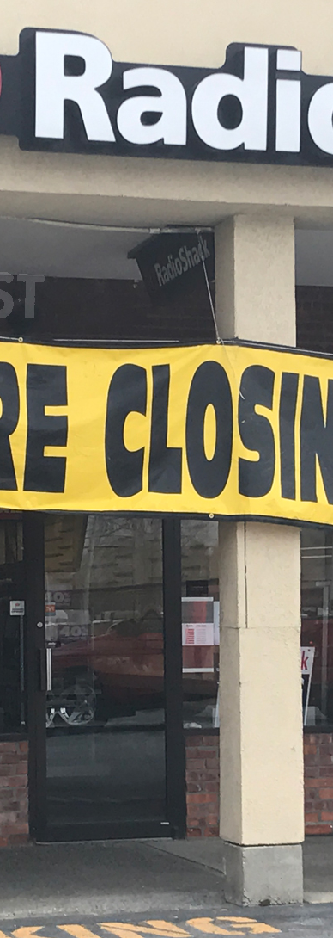
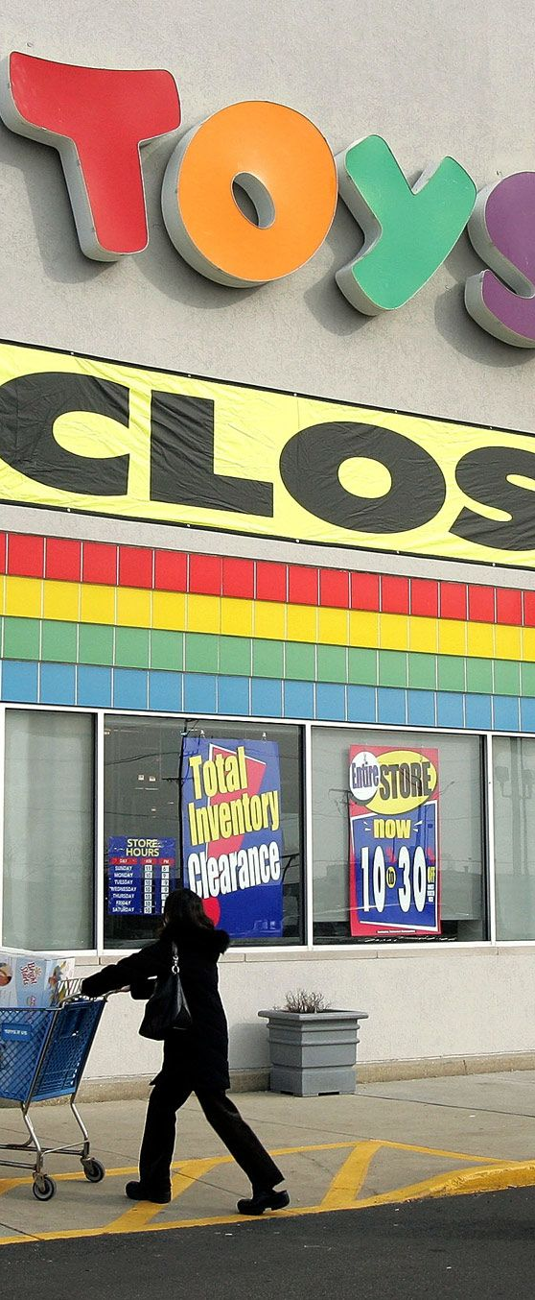
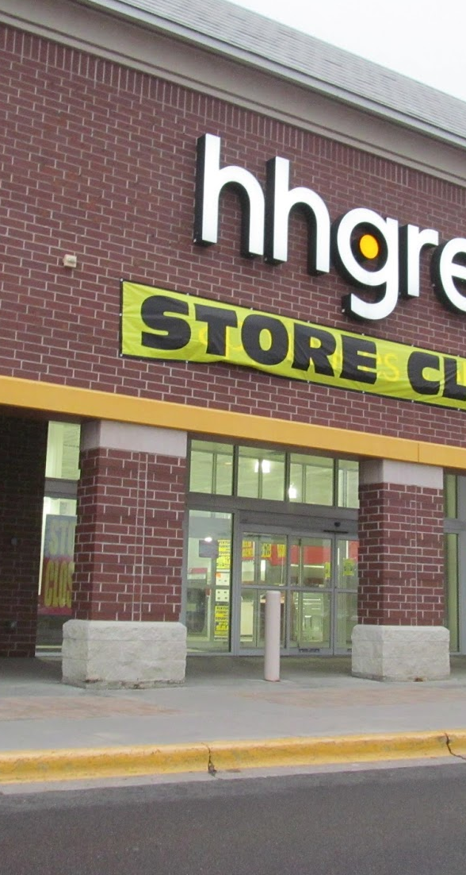
Retail didn’t adapt with changing technology.
Radio Shack declared bankruptcy in March 2018
Toys ‘R’ Us closed all its U.S. stores in June 2018
HH Gregg also declared bankruptcy in March 2018

Slide 4
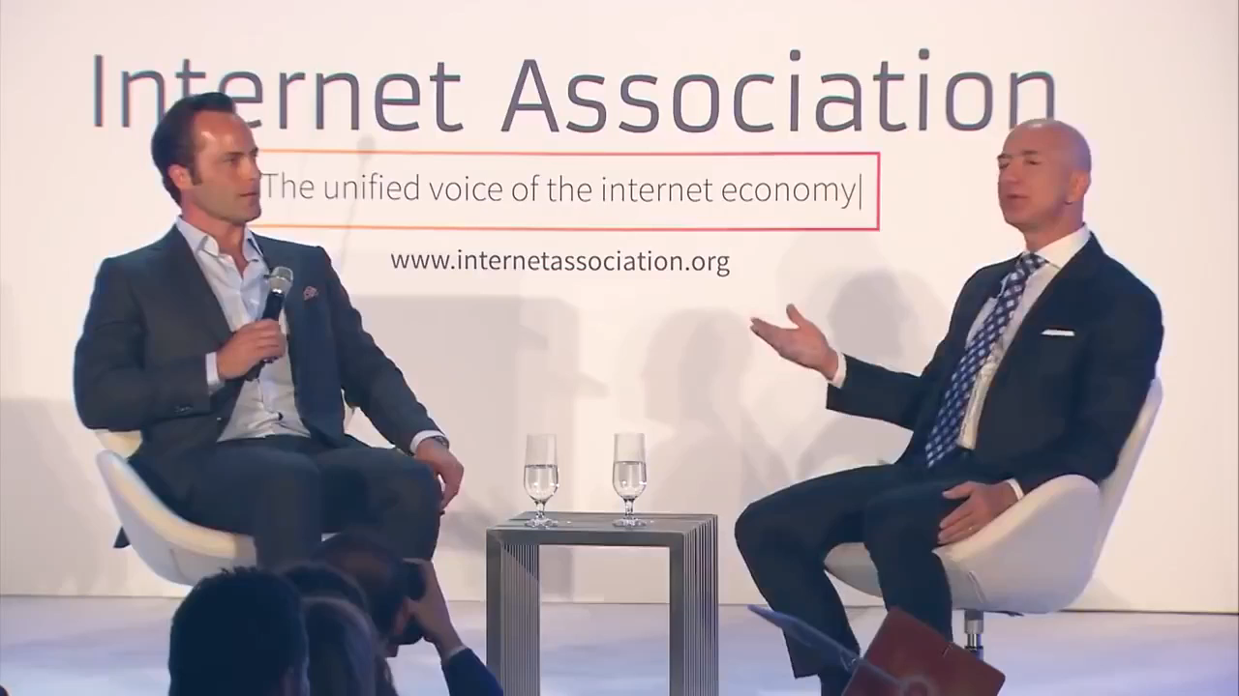

Slide 5



The blended experience has become mainstream.
THE FUTURE
The future of retail will oscillate between online and in-person.
Online
In-Person

Slide 6
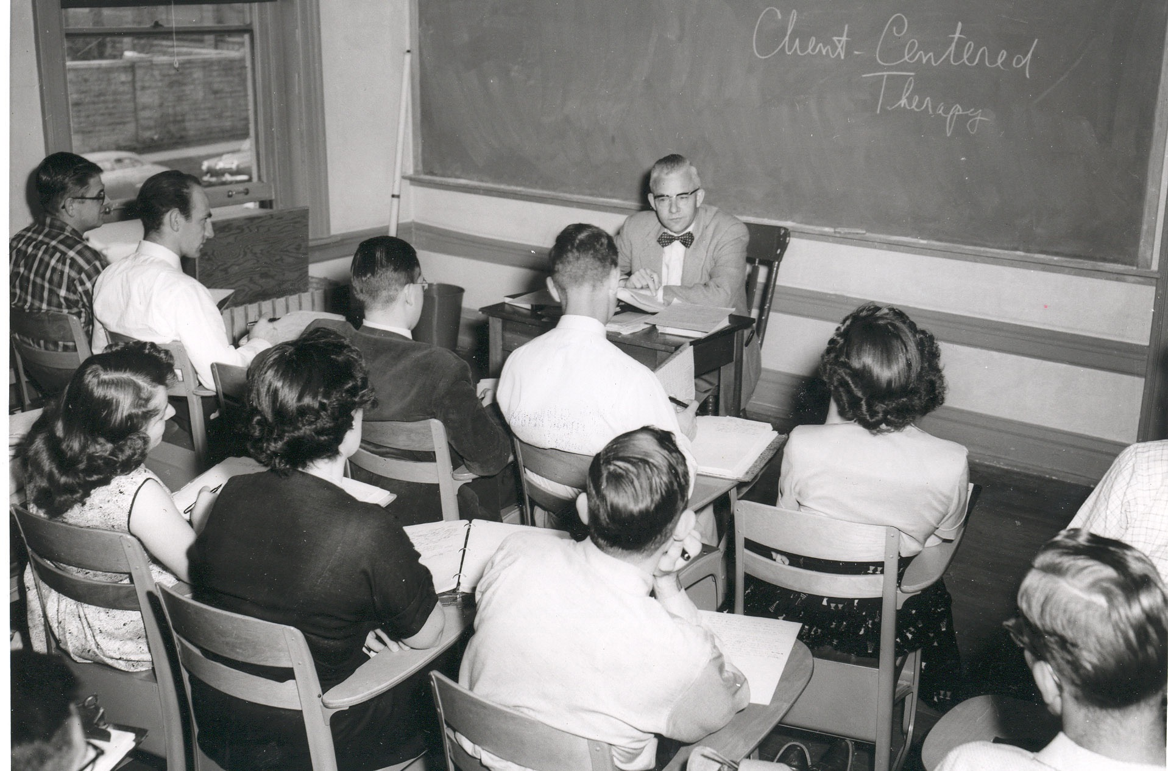

The past and present of Higher Education have some similarities.
While universities have adapted in many ways, the way in which we teach, learn, research and experience hasn’t changed very much.
1950s
Now

Slide 7

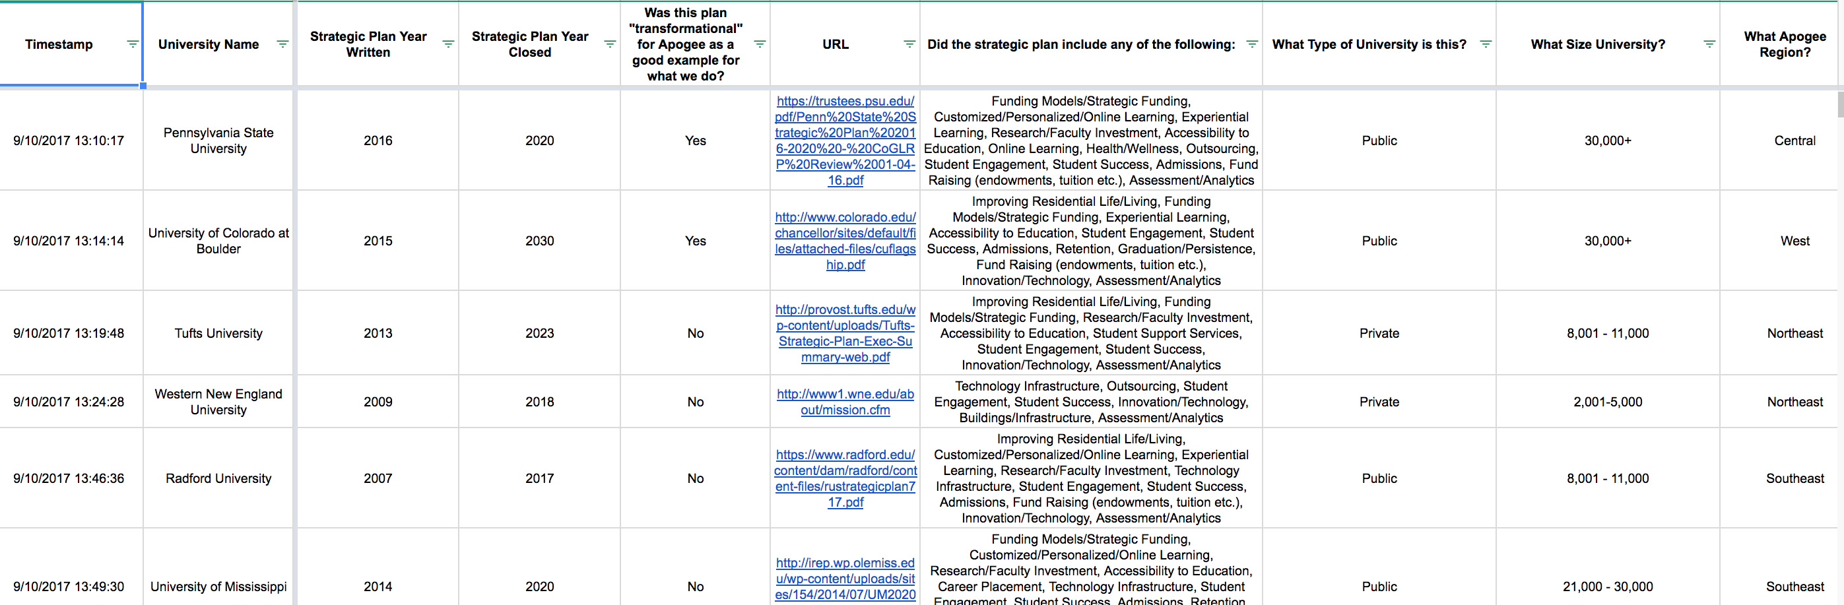
Apogee Strategic Plan Research

Slide 8
Which has resulted in identifying some interesting trends…
88%
90%
86%
76%
83%
73%
20%
TECHNOLOGY
STRATEGIC FUNDING
GRADUATION
RETENTION
ADMISSIONS
STUDENT SUCCESS
STUDENT ENGAGEMENT

Slide 9
Today’s goals:
We will hear from our panelist as to how they have integrated technology to drive their strategic plans.
Technology’s role in strategic plans
Strategy should drive process and technology
Prioritizing investments
Mission-critical objectives versus essential tools to achieve goals
When to outsource or do in-house

Slide 10
Maslow’s Hierarchy of Technology Investment
4
PARADIGM SHIFTS
Strategic initiatives
3
COMPETITIVE DIFFERENTIATION
Inspirational
2
STABILITY, SECURITY,
AND INFORMATION
Essential but not core
1
INFRASTRUCTURE & CONNECTIVITY
Foundational

Slide 11
How To Evaluate Strategic Goals
Software and tools do not solve problems.
Strategic thinking, collaboration and focus do.
Security
Research data centers
Recruitment initiatives
Training initiatives
IoT and innovative tech
Mission Critical Initiatives
Specialty networks
Immersive technology
Robotics
Augmented Reality
Virtual Curriculum
Email
Student Information
CRMs
Help Desk
Mobile
Operationally Essential
HR Systems
ERPs
Networking
LMS
Video & Streaming

Slide 12
References
http://www.pewinternet.org/2015/10/08/social-networking-usage-2005-2015/
https://www.statista.com/statistics/371828/worldwide-mobile-connections/
https://royal.pingdom.com/2009/01/22/internet-2008-in-numbers/
https://www.internetworldstats.com/stats.htm
https://www.gartner.com/newsroom/id/3598917
© 2019 Apogee

