Slide 2
Adventures in Academic Accessibility:
From Curious to Call to Action
Emerson College
Wentworth Institute of Technology
The Carroll Center for the Blind
Notes:
Jenn – Welcome to our session!

Slide 3
Outcomes
Experience a demonstration of how assistive technology navigates digital content
Identify practices and tools used to meet WCAG 2.1 AA standards for website and course content
Consider actions your institution can employ to influence long-term digital accessibility on campus through partnerships and strategies
Notes:
Jenn – Invite presenters to introduce themselves (names, institutions and titles). Also introduce Karina, Adam and Bridget (in audience).
Reminder: All of our contact information added to google doc at end of presentation.
Abstract: Where is your school on the journey toward accessible digital content? Wrestle with the challenges, decisions, policies, partnerships, instruction, and implementation of an array of solutions. Learn how Emerson College and Wentworth Institute of Technology promote accessibility standards and implement them in their LMS tools (Canvas and Bb Learn). Tap into the collective wisdom of colleagues to walk away with new questions, ideas, and practical strategies! We invite technologists, designers, and educators to imagine a future in which remediation is not an overwhelming task but instead an automatic part of content design.

Slide 4
Starting with the End in Mind
Poll! What level of experience do you have with screen readers?
Answer at https://www.sli.do/
Enter event code fluffylion
Notes:
Jenn – Introduce 1st poll question then pass to Bruce
Bruce –10 min: Start with screen reader demo using JAWS primary navigation, brief -- brief difference WCAG AA 2.0 to 2.1 (low vision, mobile) changes – demo PDF with JAWS. First poll question! This is a multiple choice question, and all you have to do to answer it is to go to sli.do, type fluffylion and click Join. There will be other poll questions along the way, and we’ll display the results at the start of the question and answer period.

Slide 5
About Emerson
Small liberal arts college focused on communication and the arts (FTE of ~4500)
Relatively new to online (started in 2011)
Accessibility guidelines for online are stronger than for face-to-face:
all video captioned
all PDFs OCR’d & tagged
LMS content follows best practices for accessibility
www.emerson.edu/policy/itg-online-accessibility
Notes:
Jenn
Pulling back to the macro view, here’s a quick view of our institutions. (Emerson stats)
The policies for face to face classes and online classes are different at Emerson. As a result of being relatively new to online, we had the opportunity to collaborate with the Provost to write the online policies, and we were able to make accessibility in online a priority from the start. The f2f courses do remediation when there is an accommodation request, but our goal for online is UDL to a degree that there will be little remediation necessary (if there is an request).
That means (slide)
That has led to some pushback, as faculty have to provide resources farther ahead of time than they’re used to, but after 250 online classes, it’s now become more accepted as the way things are. We’re working across campus to try and promote a mindset that includes accessibility as a given when things are first considered.
Timed at 1:37

Slide 6
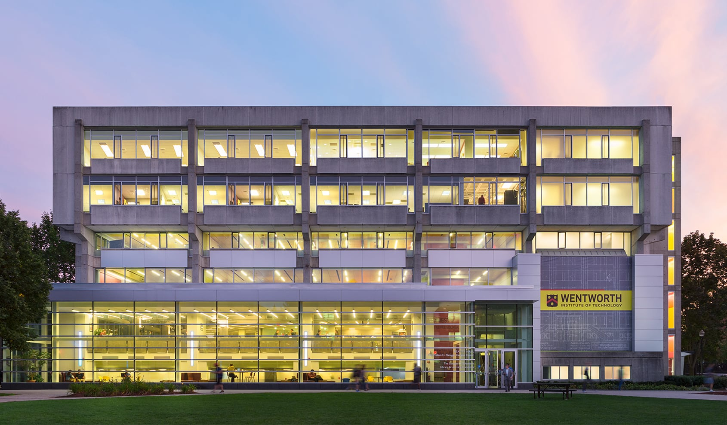
About Wentworth Institute of Technology
Engineering & Computer Science
Architecture, Design, and
Construction Management
Arts & Sciences
Continuing & Professional Education
Private University
~4760 FTE students
Colleges of the Fenway
Experiential Learning
Undergraduate and Graduate
Notes:
Tes
Private University located in Boston with 4765 FTE students (reported in most recent IPEDS).
Members of the Colleges of the Fenway with MassArt, MCPHS, Simmons, and Emmanuel
Experiential learning is a hallmark in Undergraduate, Graduate, and Workplace Learning.
Colleges: Engineering & Computer Science; Architecture, Design, and Construction Management; Arts & Sciences; and Continuing & Professional Education.
Full-time courses delivered primarily face to face, technology enabled with small number of hybrid/online.
CPCE courses primarily delivered hybrid/online (part-time) with small number of face to face courses.

Slide 7
Wentworth’s Journey Toward Accessibility
Governance
Proactive Audit of Digital Accessibility
Policies and Guidelines
SiteImprove and Ally
Education and Awareness
https://wit.edu/accessibility
https://www.flickr.com/photos/poakpong/4681315789
Notes:
Tes (and Bridget)
Governance --Fall 2013 grass roots universal design committee, grew into Accessibility Advocacy Committee with cross-Wentworth representation 2018
importance of proactive - frame as social justice issue + compliance
Proactive Digital Accessibility Audit 2016-2017
students’ digital experience from considering Wentworth through taking courses
improved navigation to courses in LMS so on left; adjusted error messages so “error” part of the text; caption all public facing videos
Policies and Guidelines -- Web Accessibility (2018), Procurement (2018 for 2018/9 budget cycle), Captioning Guidelines (in progress for course content videos), proactive testing for page changes and new systems (in draft); centralizing accessibility budget
SiteImprove - implemented for external facing website 2018-- video editing, link checking, content creator training
Ally - implementing for LMS - Bb Learn -- testing fall 2018 - pilots spring and summer 2019 -- implement across fall 2019/spring 2020
Education & Awareness -- village approach; wit.edu/accessibility launched Fall 2018, open houses start of each term 2018/9, training on how to make documents/PPT/PDFs accessible; lunch and learns; mandatory online ADA training 2019 -- continue offer workshops every term

Slide 8
Poll!
What level of captioning for video content is required by your institution, if any? (ie, auto-generated, human corrected)
Answer at https://www.sli.do/
Enter event code fluffylion
Notes:
Jenn
Poll Question 2:
What level of captioning for video content is required by your institution, if any? (ie, auto-generated, human corrected). To answer this question, go to sli.do, type fluffylion

Slide 9
Emerson at the Course Level
14 Week Development Cycle semester before the course goes live
New online faculty go through a 14 week or 4 week training, includes UDL best practices
Notes:
Jenn
Now we’re going to get a little more granular about how this works in practice.
We have a 14 week online course development cycle. The full time faculty have a required (paid) 14 week online training that they need to complete to develop their first online course. This training also serves as our project management, in that the assignments are things like “create an assignment” or “write a course map”. Initially, only full time faculty could teach online - this was an attempt by the provost to reassure faculty that online classes were high quality. In the last few years we’ve been able to train affiliates as well. The affiliate faculty have only a 4 week training, which means they have a little less structure and handholding than the full timers, but they’re expected to keep same major due dates and quality standards for deliverables.
In both trainings, we cover accessibility expectations, presented alongside fair use questions. We ask for non-original video and PDFs at least 7 weeks out from the course’s start date: this allows us to see if we can find library-owned or otherwise copyright-friendly versions of the content, and also to assess what it will need for remediation. The video that faculty themselves create for their course can be turned in later, as we don’t have to also worry about sorting out intellectual property rights, and captioning is pretty fast.
How does accessibility happen in the course? We carry the weight of it, as long as faculty can get us their content in time. PDFs OCR’d, corrected via Abbyy, tagged and metadata’d in Adobe Acrobat in-house, Video captioned by 3Play / Amara / Panopto.
Faculty expected to follow best practices for web content when building their Canvas course (headers, alt text, etc), ALLY has been helpful in guiding them with adding Alt Text- we fix as needed in the quality review before the course goes live.
1-2 part time grad assistants for PDFs, 2 designers for faculty support building new courses, 3 technologists and 1 developer/technologist that handle the repeat classes.

Slide 10
Emerson at the Course Level Cont’d
Faculty submit PDFs and video to ITG at week 7 and week 14
PDFs remediated in-house using Abbyy FineReader and Acrobat Pro
Videos sent out for captioning to 3Play, Amara, or Panopto
Quality check before course goes live
Run WAVE on all course pages, ALLY turned on in all online courses
Notes:
Jenn
Now we’re going to get a little more granular about how this works in practice.
How does accessibility happen in the course? We carry the weight of it, as long as faculty can get us their content in time. PDFs OCR’d, corrected via Abbyy, tagged and metadata’d in Adobe Acrobat in-house, Video captioned by 3Play / Amara / Panopto.
Faculty expected to follow best practices for web content when building their Canvas course (headers, alt text, etc), ALLY has been helpful in guiding them with adding Alt Text- we fix as needed in the quality review before the course goes live.
1-2 part time grad assistants for PDFs, 2 designers for faculty support building new courses, 3 technologists and 1 developer/technologist that handle the repeat classes.

Slide 11
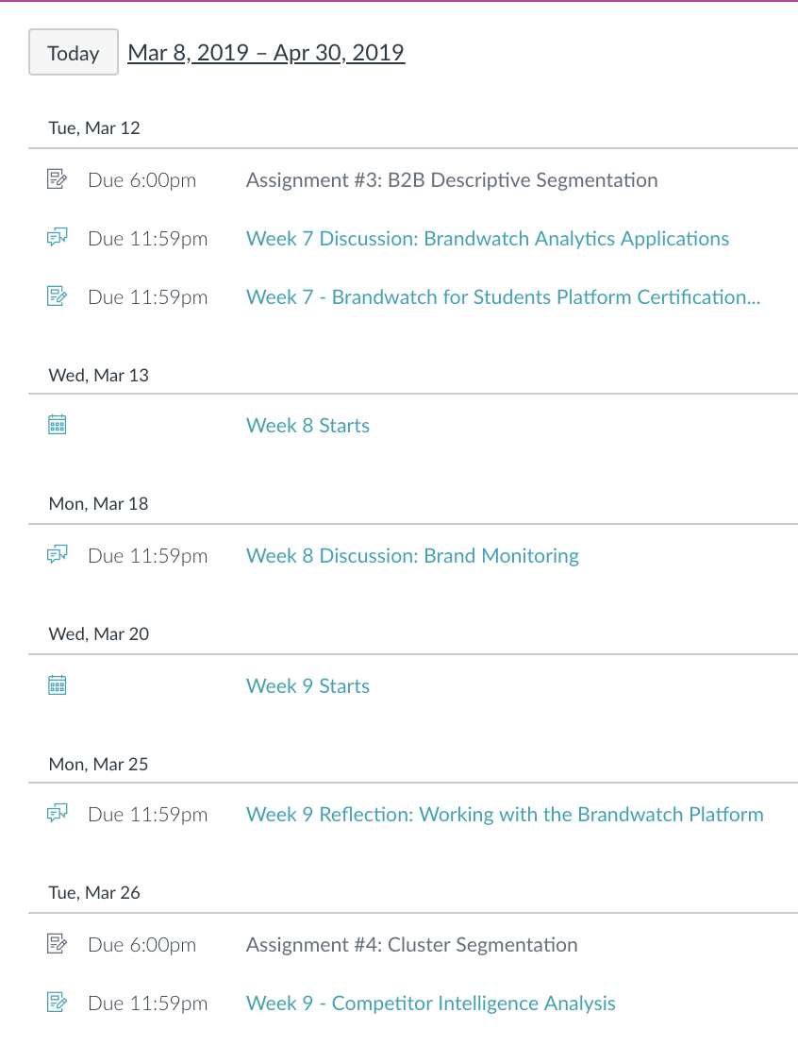
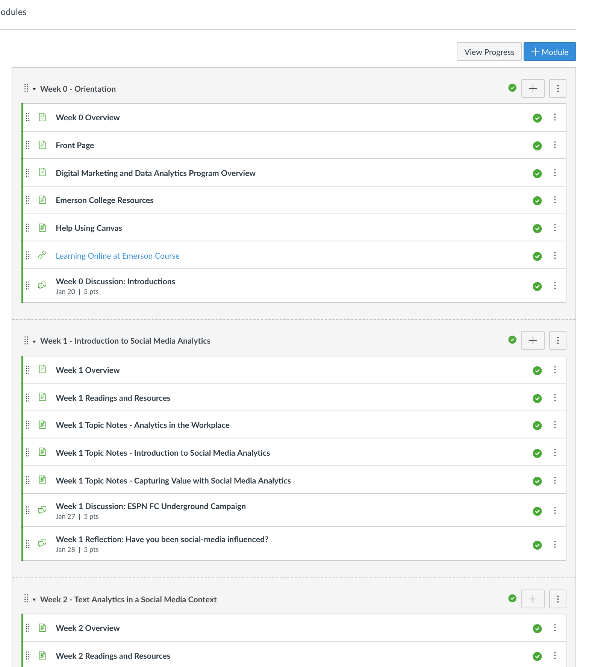
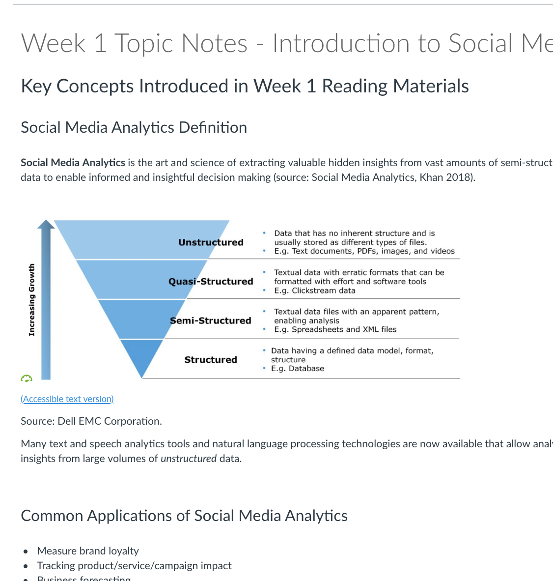
Here’s what that looks like in practice:
Notes:
Natalie
Here’s how that looks in practice:
The examples here are from a Digital Marketing and Data Analytics course, part of an online graduate degree program.
The first image is that of user's Canvas calendar, which lists course events as well as discussion and assignment due dates across multiple classes, which helps students combat cognitive overload.
Second image is of Canvas’s modules page. We require all online courses to use the same basic template, so the students get clear and consistent layouts across their online classes. This image shows how each week has consistent structure: overview page, readings and resources page, topic notes, and assignments to be completed.
Third image is deepest into the course, showing a page of course content. It includes heading levels, a graphic with link to a long description, and a formatted list, as well as all the other things that are generally built into a LMS, like high contrast colors. Not pictured: descriptive wording for hyperlinks, tagged PDFs, clear instructions and rubrics for assignments, and an orientation module and Canvas help.
https://canvas.emerson.edu/courses/1631581/pages/week-1-topic-notes-introduction-to-social-media-analytics?module_item_id=21014084
Timed at 3:35

Slide 12
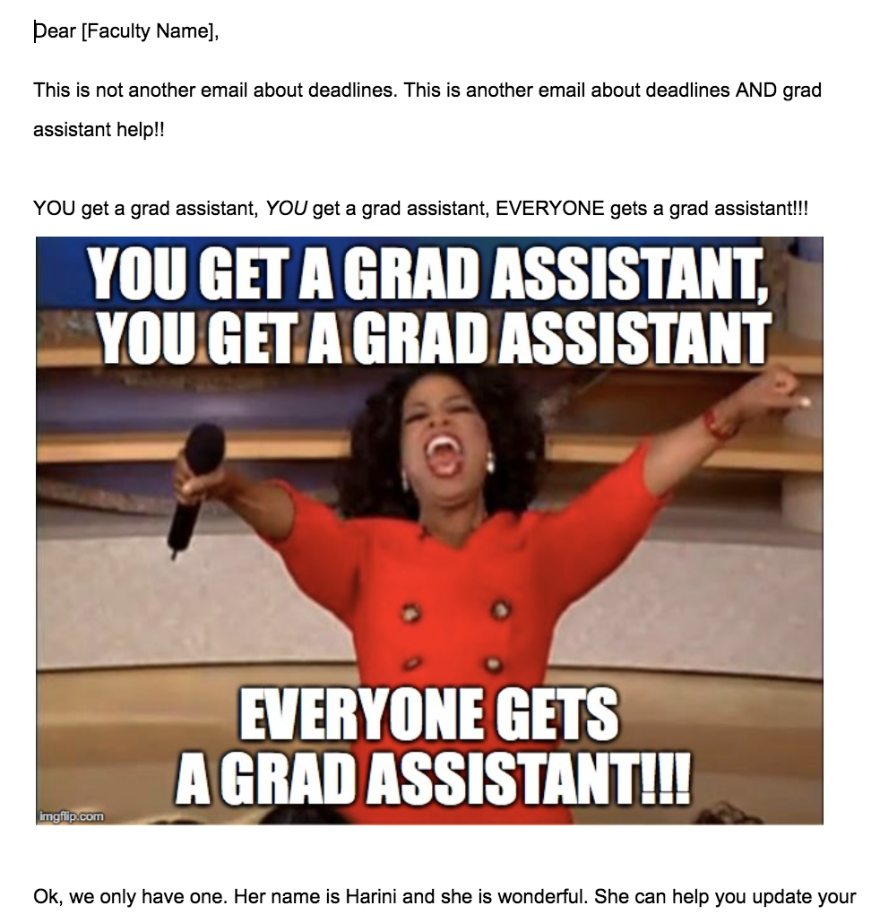
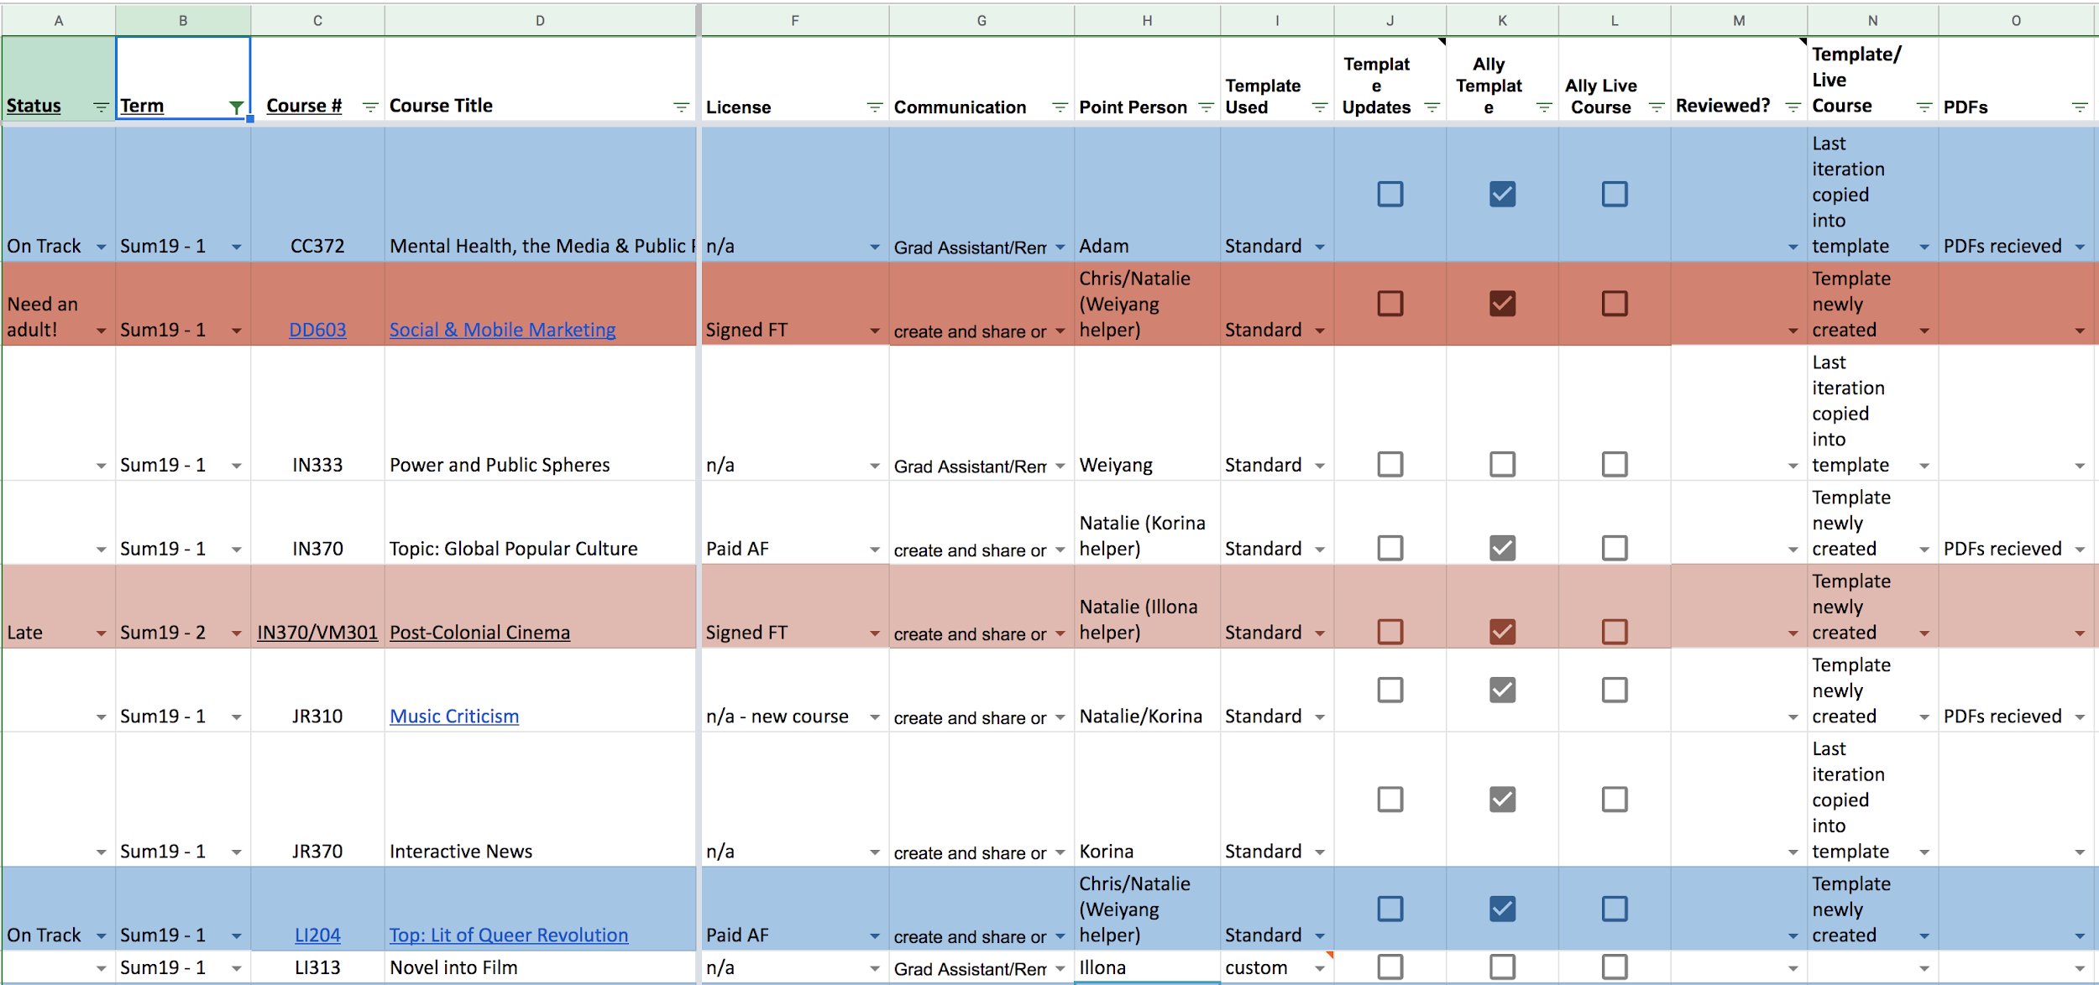
Here’s how we make it happen:
Notes:
Natalie
Getting and tracking all of these assets requires a lot of communication and organization.
For new faculty, we use the Canvas training courses to keep them on track with deadlines.
For repeat faculty, we have a communication schedule that we follow with all the online faculty, and the first image here is one example of that: it’s an email about deadlines to give course material to ITG, and announcing availability of grad assistant help to update their classes. It has an image of Oprah proclaiming "You get a grad assistant, you get a grad assistant, everybody gets a grad assistant!"
Second image is that of our shared Success Board: it has many different columns track things like what template the course is using, if the materials have been submitted to ITG, and which staff member is in charge of preparing that course. Conditional formatting tracks which courses are on schedule or behind.
We refer to this as our “Success Board” (formerly called it the Murder Board but then thought that could be misinterpreted if someone saw it out of context). Items on it include checkboxes for Ally being turned on, stages of PDF remediation. Use Google Drive extensively, every course has its own spreadsheet. Automated so that when PDFs are added to the course’s folder, that creates a Trello card for our interns to start to work on it.
Timed at 2:05

Slide 13
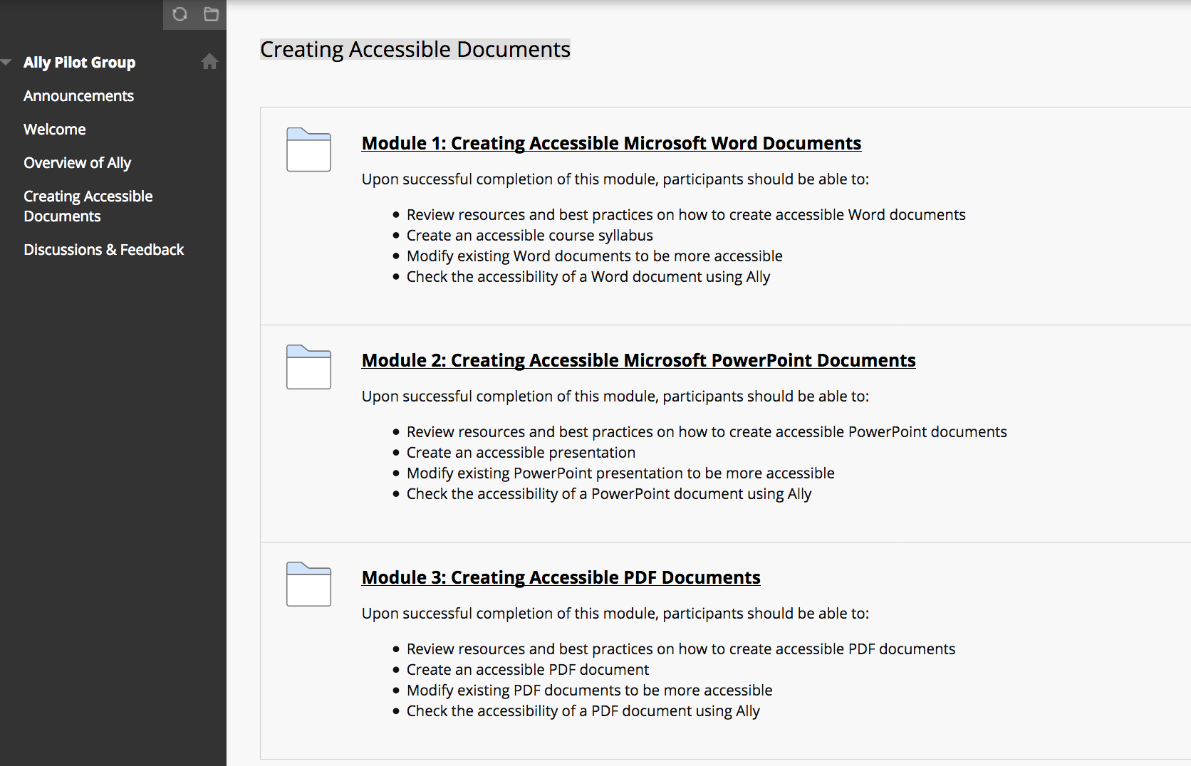
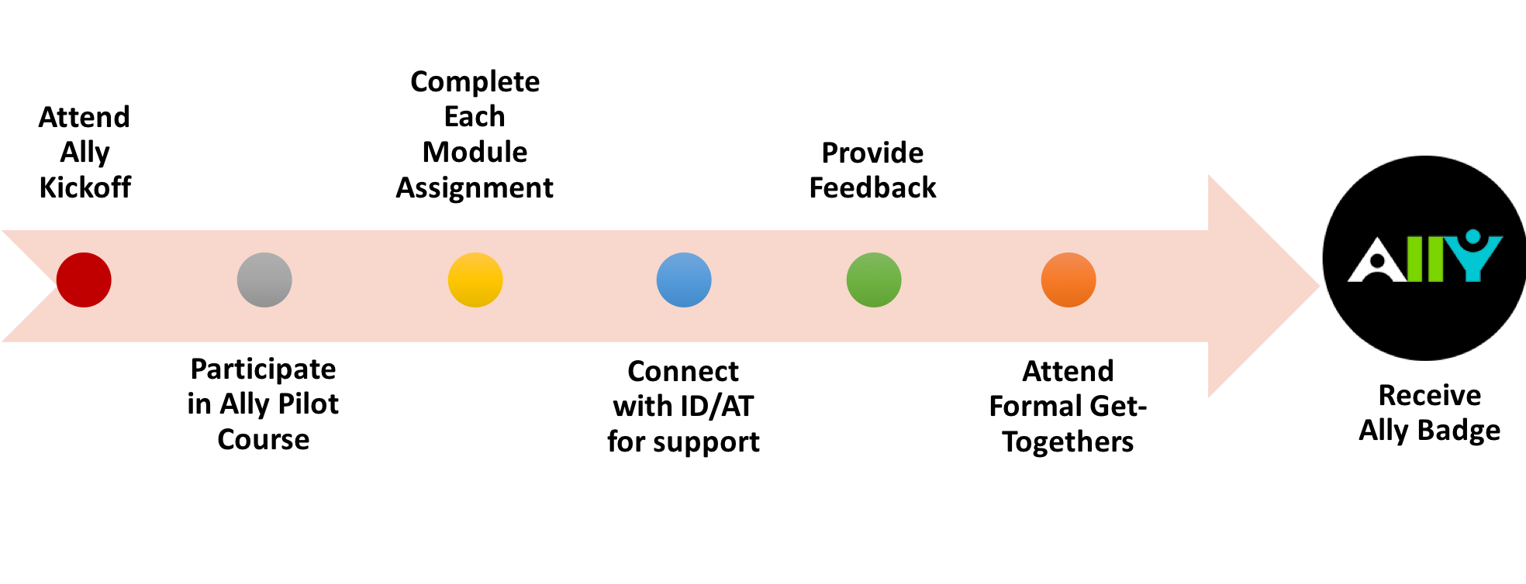
Wentworth Accessible Course Pilot
Notes:
Ke’Anna In common with Emerson: Ally tool integration with LMS
We created a course site in Blackboard for faculty to learn how to use the Ally tool; especially how to make Word, PowerPoint and PDF documents accessible.
Here is an outline of the Bb Ally pilot for Wentworth (11 Faculty joined the pilot):
Pilot expectations for badge/certification completion: Submit 3 main assignments using Ally and provide feedback via the discussion boards for each module working with ID/AT for support and consultations.
Also attend 2 Lunch and Learn sessions that focus on Library Resources and Making Accessible PDF Documents using Adobe Professional and Video Captioning Guidelines and Workflow.
Our goal is to aim for green indicators for the documents that faculty create and we want incremental progression!

Slide 14
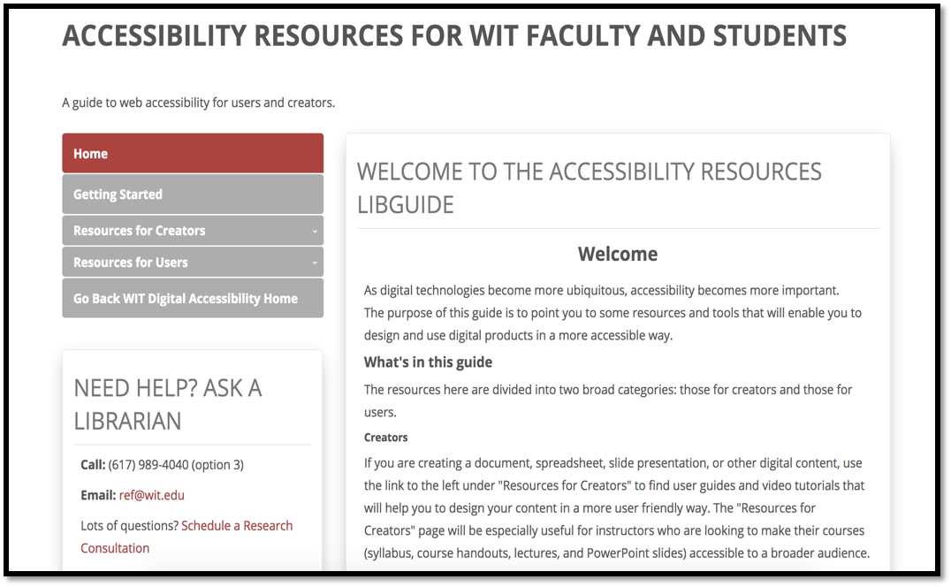
Wentworth Accessibility Resources
Accessibility guidelines and best practices:
All videos captioned using 3Play or Panopto
Basic LMS course navigation
Online resource guide and Acrobat Pro software
Course readiness checks (CPCE Online)
Notes:
Ke’Anna
Here’s a few accessibility guidelines and best practices that we have put into place at the course level to support faculty and our students:
Created guidelines and workflow for all videos to captioned using 3Play or Panopto
Reordered Basic LMS course navigation (left aligned on main page)
Curated online resources for faculty support and budgeting for accessible software (ie Acrobat Pro)
Conducted course readiness checks (online and hybrid courses in Continuing Ed)

Slide 15
Poll Time!
What policies/guidelines for documents (pdf, doc, ppt, etc.) does your institution have?
Answer at https://www.sli.do/
Event code fluffylion
Notes:
Bridget
Poll Question: What policies/guidelines for documents (pdf, doc, ppt, etc) does your institution have?

Slide 16
Open Discussion
Resource doc available: http://ec1880.us/5398L
Answers at https://www.sli.do/ Enter event code fluffylion
Notes:
Karina and Adam (in audience)
Show live poll results – be logged into polling tab – open Q/A
Begin discussion about audio description for videos – Bruce can speak to ways to minimize needs for it and when it’s required.

Slide 17
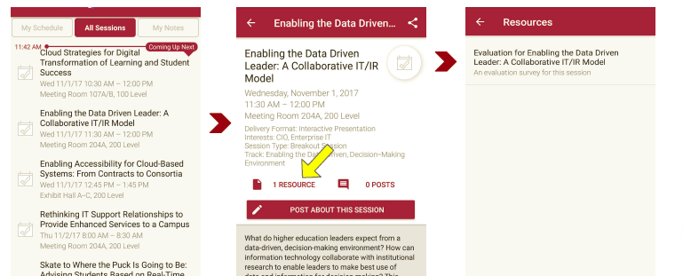
Complete Session Evaluation
There are two ways to access the session and presenter evaluations:
1
2
First you can access by the online agenda: Click on the “Evaluate Session” link
Or secondly you can access it from the mobile app: click on the session you want from the schedule > then click the associated resources > and the evaluation will pop up in the list
Notes:
Reminder to complete the session evaluation.

