Slide 1
Enhancing Teaching and Learning on a Shoestring Budget

Slide 2
Notes:
Logos and introductions

Slide 3
Getting a small college involved in OERs without a Grant.

Slide 4
“Can I teach a Sociology course?”

Slide 5
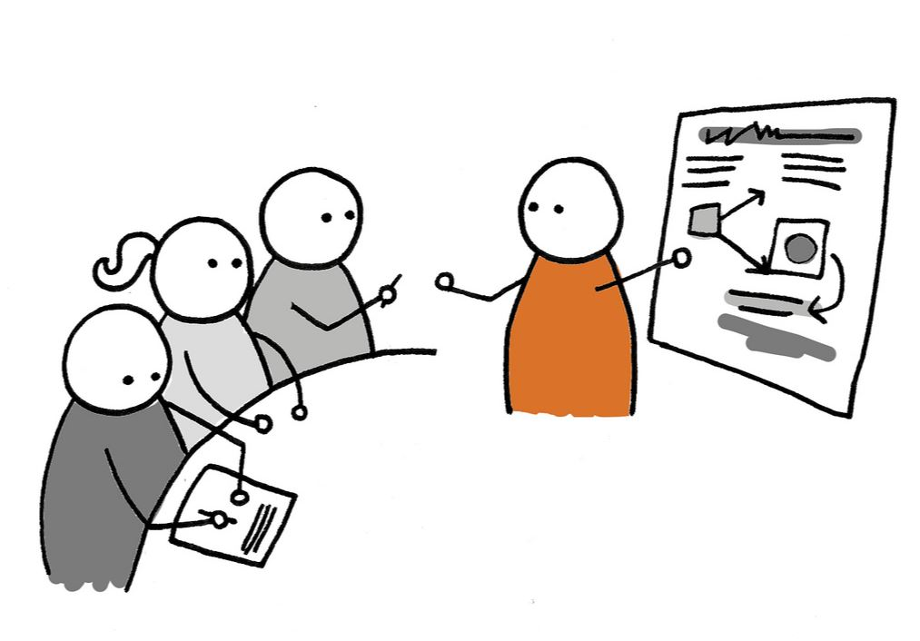
Training
Image Attribution: Claire Murray
CC-BY-SA

Slide 6
Introduction to the types of OERS
Open educational resources (OER) are free and openly licensed educational materials that can be used for teaching, learning, research, and other purposes.
Definition Attribution: What is OER? by Creative Commons is licensed under CC BY 4.0
Material you can REVISE, REMIX, REUSE, REDISTRIBUTE!
Our goal at Becker: ZERO cost
Textbooks
Open Access Articles/Materials
Games
Images/Infographics
Library access
Image Attribution: Alan O’Rourke
CC-BY

Slide 7
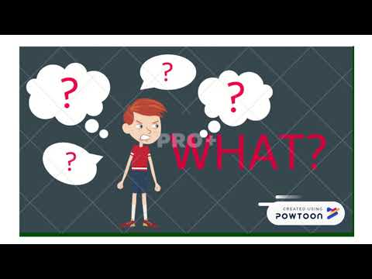
Hit them multiple times!
Step #1: Broad Introduction
Key concepts
Repository
Next steps
Step #2: Follow-up
Engage them
Recognize Accomplishment
Provide stats
Step #3: Follow-up again (TBD)
Engage them
Provide Examples
Video Attribution: Rachael Kline
CC-BY

Slide 8
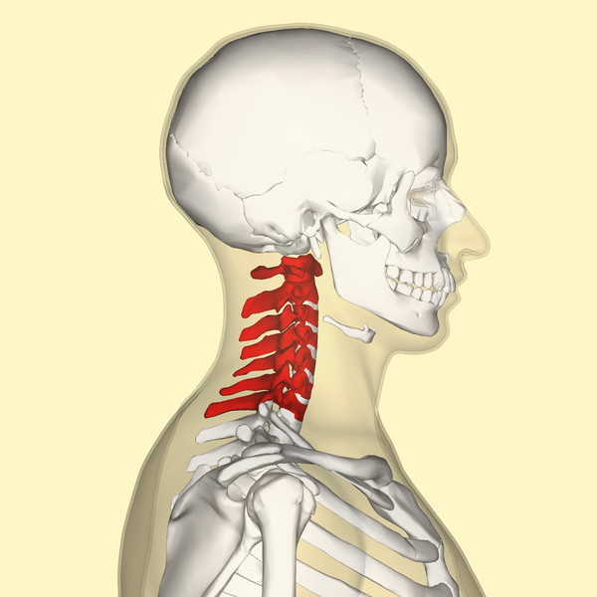
Relate
Image Attribution: BodyParts3D/Anatomography
CC-BY-SA

Slide 9
Collaboration
Instructional Designers
Library Staff
Other Faculty
No Attribution Required.

Slide 10
Libguide OER
CORE ENGL
Deviance and Social Control
Introduction to Drama
Image Attribution: Max Pixel CCO

Slide 11
OER Instructor Resources
tinyurl.com/BeckerOER

Slide 12
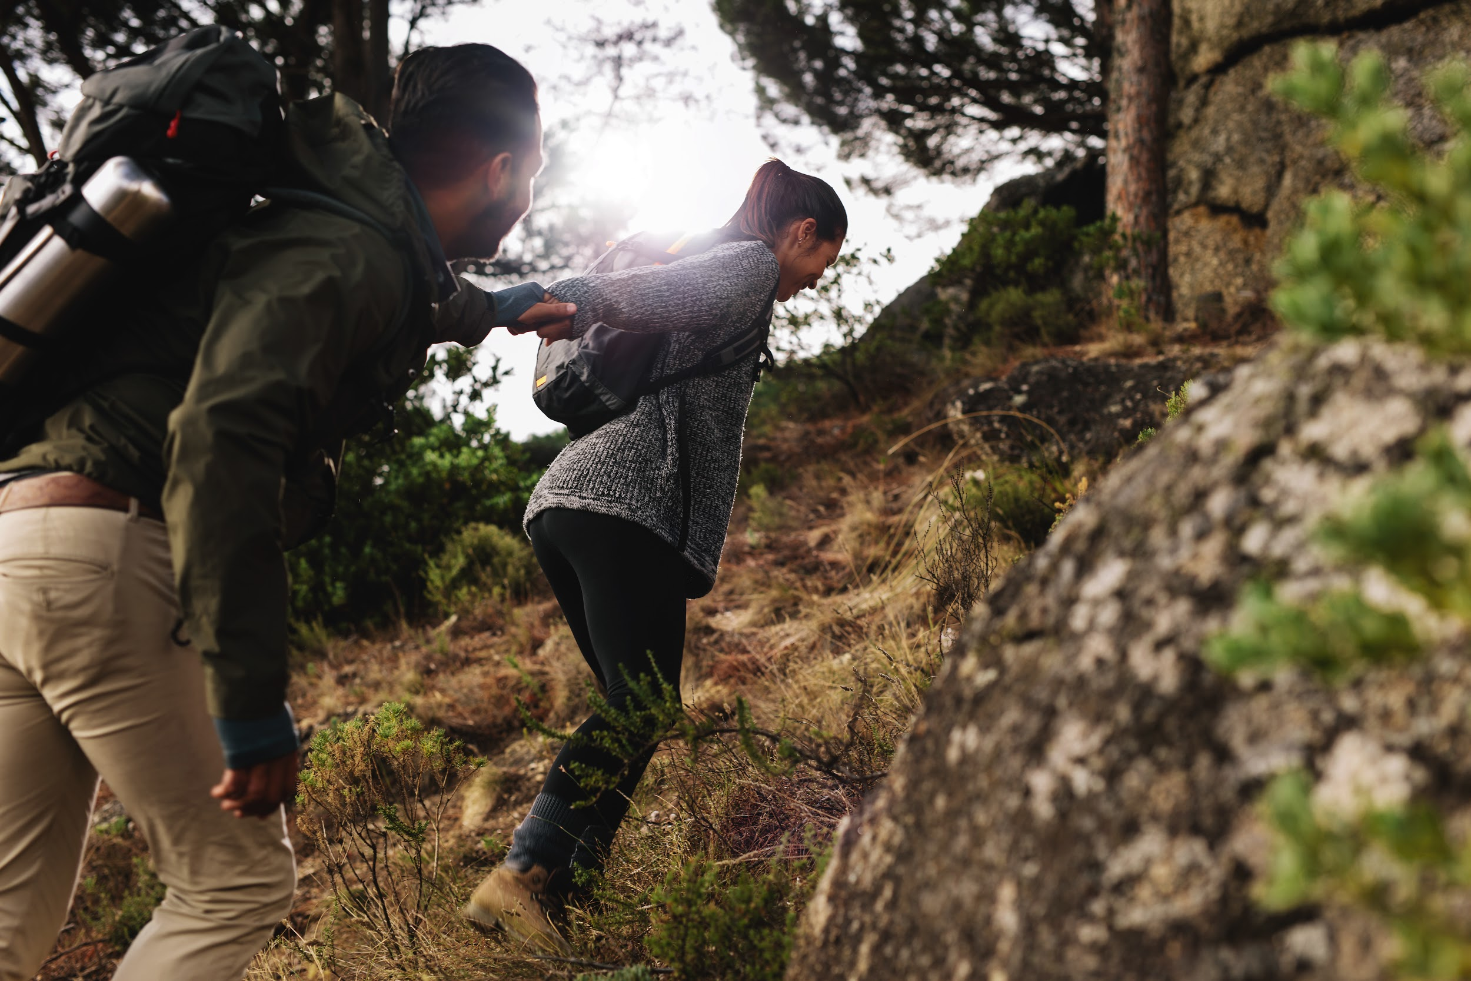
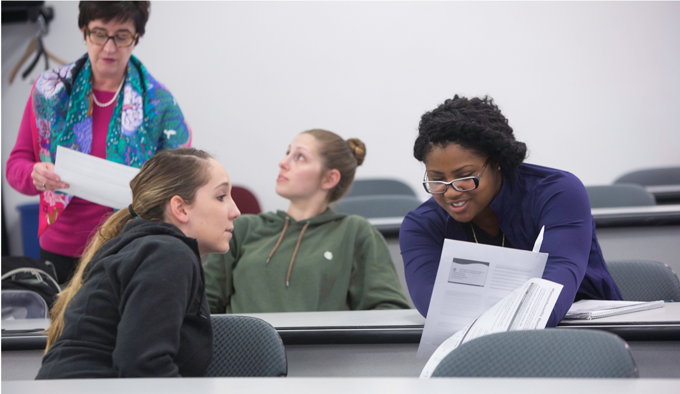
Recognition & Leadership

Slide 13
Known savings
$677,061.28 in total from our efforts, as of 7-March-2019
Highlights:
One math professor contributed over $200,000 to this.
PSYC1001 saved students over $300,000
Future development contracts specify OER use.
How was this calculated:
Took previous textbook, and multiplied by number of students enrolled since the change took place.

Slide 14
Rebooting the Tutorial
Enhancing Learning with Instructional Design and Technology @
Sacred Heart University
Notes:
For our portion of the presentation, Dan and I want to speak to our experiences making digital learning objects, specifically tutorials, and then developing a portal to share them all using LibGuides. I will talk about developing the content and Dan will speak to designing the portal.

Slide 15
Background
Need to reach students beyond face-to-face
Tutorials!
Not a “do more with less” situation.
Notes:
Sacred Heart University or SHU is located in Fairfield,CT and is a rapidly growing masters level 3 institution with more than 80 undergraduate, graduate, doctoral, and certificate programs. We have 8,958 total students. In Fall 2018, we had 1463 students come to SHU in the new freshman class. And we have large online programs.
In contrast, the SHU library has 17 full-time staff, 2 part-time librarians, and about a dozen undergraduate and grad student workers.
With such a large student population and a small staff size, my colleagues and I realize that we need to be able to reach students beyond face-to-face interactions. When I joined the staff in January 2017, there was a lot of talk about doing so particularly in regards to creating tutorials, but no plans had been put into action, aside from some one-off videos. We knew we wanted to make tutorials to be able to reach students but did not want to overburden ourselves.
I think it is important to mention that we were not seeking to “do more with less.” Although our staffing situation is not ideal, we did not want to push ourselves so that we went above what was possible for us. This project became a way to see what we were capable of doing within our constraints. I think we were able to stay within our means by following some basic principles of Instructional Design.

Slide 16
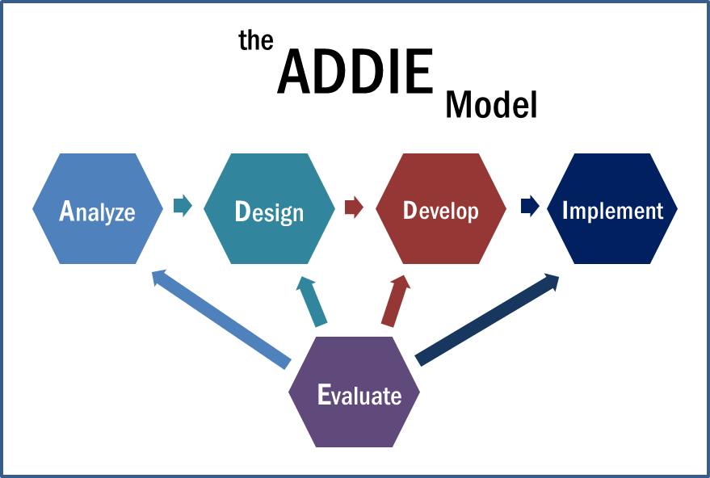
The Addie Model
Notes:
Char Booth, in their Reflective Teaching, Effective Learning, describes instructional design in this way: “instructional design consists of principles that explain how learning occurs in different situations and models that explain how to put theory into practice.” Influenced by cognitive psychology, pedagogical theories, and the science of learning, ID helps us understand how people learn, while ID models help us create the conditions necessary to ensure that people actually do learn.
The process we followed at the library loosely mirrored the ADDIE model which stands for Analyze, Design, Develop, Implement, and Evaluate.

Slide 17
Instructional Design Best Practices
Needs assessment
Strengths/Interests
Storyboard
1
2
3
Notes:
Based on our experiences, here are three instructional design best practices for developing instructional content.

Slide 18
Best Practices
Establish a basic understanding of your users’ needs
What tools do you need in order to move forward?
Needs assessment
1
Notes:
Needs assessments allow you to establish a basic understanding of your users’ needs. This can be a formal assessment, but it can also be informal through conversation or interactions. In my case, conversations with fellow librarians revealed a need for basic videos about some of the library’s services, such a reserving study rooms, printing, and the library’s chat service. The videos would be a way to market these services while also teaching people how to use them.
At this stage, you should also consider the question: What tools do you need in order to move forward? We had access to a suite of resources through Springshare (the vendor that provides LibGuides) but we needed software to edit and export videos. We only considered free or low cost options since we essentially had no budget, and decided on Active Presenter. There is a radio studio on campus, which we were able to use to ensure quality sound for our videos. We started with a Vimeo account and have since moved to a YouTube channel.

Slide 19
Best Practices
People
Many hands make light work→ Collaborations
Tools
What is the best method of instruction?
Don’t try to reinvent the wheel
Strengths/Interests
2
Notes:
Although I am the Instructional Design Librarian, and many in my position have to work independently to get online tutorials up and running, it was impossible for me to do a major project on my own. Thankfully, I had a group of people who were excited about working on creating digital learning objects. The old adage is true that many hands make light work--we had several people writing and editing scripts, being voice actors, and a dedicated video editor. This helped to build our team, especially when we couldn’t stop laughing at the recording studio. We worked together using cloud file sharing, first GoogleDrive and now Office365 since our institution switched over last summer.
I also considered the strengths of our tools. What is the best method of instruction considering the learning outcomes and the impact versus our effort level? I did not, for example, want to create videos about how to use specific databases when vendors often have created that type of content already. With specific databases, we went the route of creating Guided Tours using another Springshare platform called LibWizard.

Slide 20
Best Practices
Outline content before developing
But be flexible to make some changes as you go
No surprises (at least very few)
Storyboard
3
Notes:
Storyboarding allows you to plan for the end product. When working with other stakeholders, the storyboard becomes a unified vision and then there are no surprises for anyone involved. Nothing is worse than collaborating with someone on content, and then realizing you had different ideas once the project is almost done. For our project, storyboarding included scripts with screenshots, and a review period for feedback.
With that said, you also want to be flexible during the storyboarding process. You might realize that something doesn’t sound right only when someone is reading it, not when it was written.

Slide 21
Learning from failure
Things move quickly--too quick for video content?
Why isn’t this getting used?
Notes:
Failure can be a scary word, and while the project in and of itself was a success, there are a few things I have reflected on. First, things move very quickly, maybe too quickly for video content. Changes to our services quickly make the videos outdated--and sometimes we cannot predict changes (i.e. printing on campus). Videos take a lot of effort to put together, so is the investment worth it when things can change? I don’t have an answer to this right now.
The other failure was that it seemed like no one was using these videos and tutorials we created. I expect librarians to use them at least, but even my colleagues did not know where to locate what we had created together. That’s when Dan and I started talking.

Slide 22
We Built Them,
But Where Are They?
We needed a way to bring all the tutorials together to enhance discoverability and facilitate use.
Notes:
As Ula just explained, after our initial phase of creating these tutorials, they were not getting much use. Sort of “We built them, but nobody is coming!” They lived on various platforms depending on their type, which made them difficult to find. We quickly realized that we needed a way to bring them all together in one place, so we began discussing creating a portal for all the tutorials to facilitate access and discoverability.
The development of the portal would happen alongside during the second phase of tutorial creation, which I believe shows how well the relatively simple process of creating tutorials was working for us.

Slide 23
Designing the Portal
Use
Who are the potential users?
What are the potential use cases?
Are there ways to facilitate use?
Technology
What technology is available to us?
Does the technology help us?
Is the technology customizable?
Notes:
Before building the portal for our Tutorials, we spent a lot of time thinking about the actual design. In the design process, we were guided by two main ideas: the Use of the materials and the Technology that we would to build it.
When thinking about the Use of the materials, we kept three questions in mind during our discussions and planning: 1. Who are the potential users? 2. What are the potential use cases? 3. Are there ways to facilitate use with the design of the portal?
Since the technology was also going to drive the design of the portal, we made sure to keep a few question in mind: 1. What technology is available to us? 2. Does the technology help us in any way? 3. Is the technology customizable?

Slide 24
Designing the Portal:
Use
Notes:
First, let’s take a look at how we let the Use of the materials drive the design.

Slide 25
Designing the Portal:
Use
Users
Students, Faculty, and Librarians
1
Notes:
Identifying who the Users were going to be was pretty straightforward. The users are clearly the students and faculty at Sacred Heart and potentially beyond. Additionally, we saw librarians as users as they use them to inform students. We kept these users and their needs in mind throughout the design process.

Slide 26
Designing the Portal:
Use
Users
Potential Use Cases
Students, Faculty, and Librarians
Self helpers; Reference interactions; Self helpers; Blackboard courses
1
2

Slide 27
Designing the Portal:
Use
Users
Potential Use Cases
Facilitating Use
Students, Faculty, and Librarians
Reference interactions; Self helpers; Blackboard courses
Bring everything together; Simple linking to tutorials
1
2
3

Slide 28
Designing the Portal:
Technology

Slide 29
Designing the Portal:
Technology
Availability and Cost
LibGuides CMS: no additional cost and staff familiarity
1

Slide 30
Designing the Portal:
Technology
Availability and Cost
Added Value
LibGuides CMS: no additional cost and staff familiarity
Springshare API brings our LibGuide content directly into Blackboard.
1
2

Slide 31
Designing the Portal:
Technology
Availability and Cost
Added Value
Customizability
LibGuides CMS: no additional cost and staff familiarity
Springshare API brings our LibGuide content directly into Blackboard.
LibGuides CMS is very customizable: we can edit HTML code and CSS styling.
1
2
3

Slide 32
Key Design Features
Build for different learning preferences
Browsable
Simple, clean and easy to use
Each tutorial on its own page

Slide 33
Building the Portal

Slide 34
Building the Portal
Be flexible

Slide 35
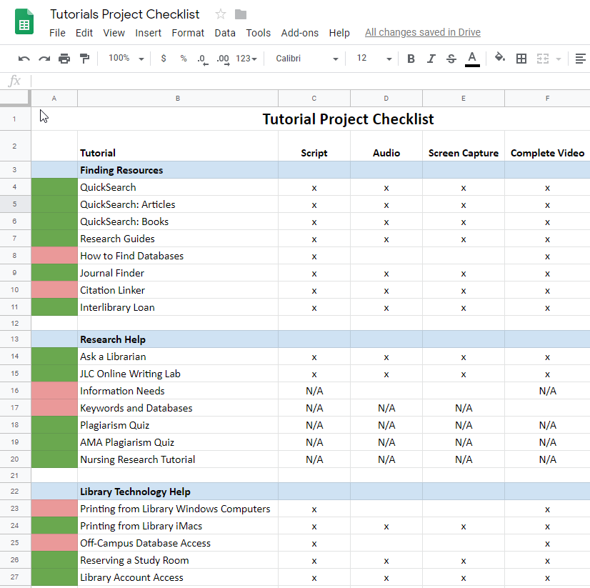
Building the Portal
Be flexible
Project management
Google Sheets

Slide 36
Building the Portal
Be flexible
Project management
Google Sheets
Leverage existing web tools
Bootstrap

Slide 37
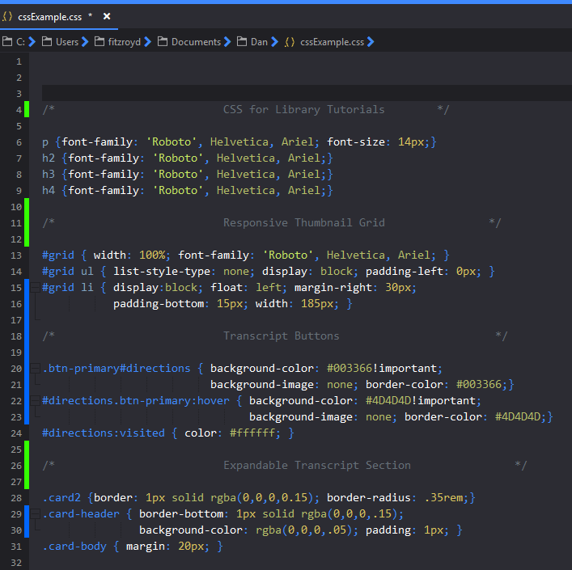
Building the Portal
Be flexible
Project management
Google Sheets
Leverage existing web tools
Bootstrap
Learn simple CSS tricks

Slide 38
Enhancing Teaching and Learning
We were able to create and deliver tutorials by:
Harnessing abilities of local staff
Leveraging capabilities of existing tools
Keeping costs minimal.

Slide 39
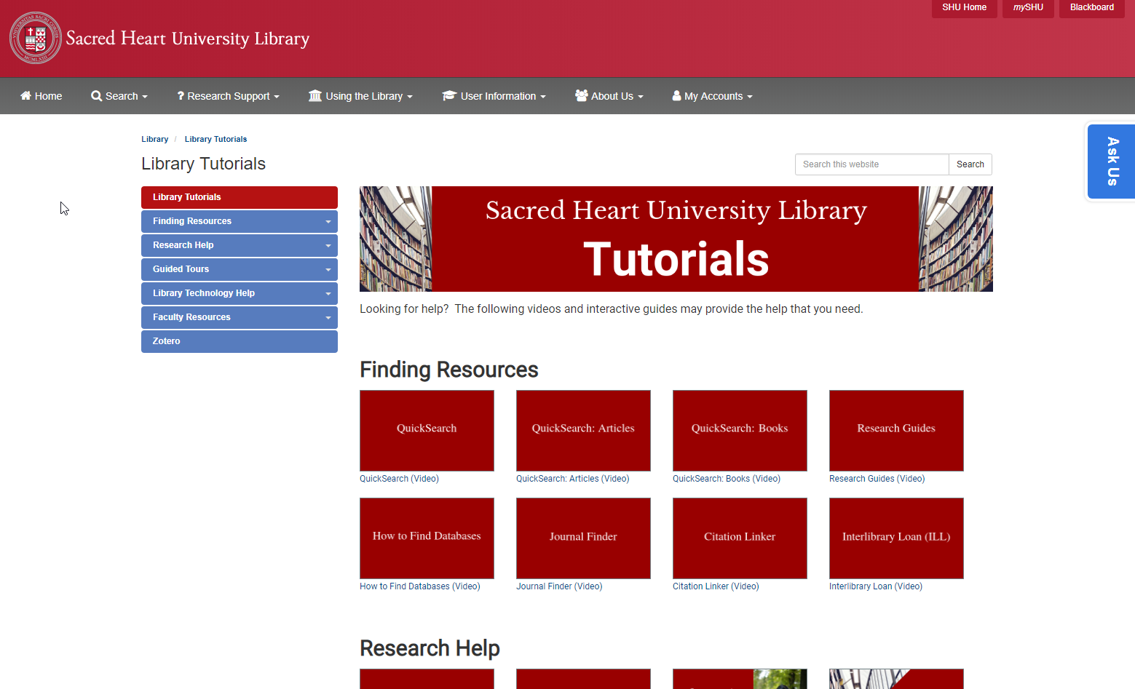
Live Demo
Place your screenshot here

Slide 40
Thanks!
Becker College
tlt@becker.edu
Sacred Heart University
Ula Lechtenberg
lechtenbergu@sacredheart.edu
Dan Fitzroy
fitzroyd@sacredheart.edu

Slide 41
Credits
Special thanks to all the people who made and released these awesome resources for free:
Presentation template by SlidesCarnival
Photographs by Unsplash

Slide 42
Presentation design
This presentation uses the following typographies:
Titles: Poppins Bold
Body copy: Poppins Light
You can download the fonts at:
https://www.fontsquirrel.com/fonts/poppins
You don’t need to keep this slide in your presentation. It’s only here to serve you as a design guide if you need to create new slides or download the fonts to edit the presentation in PowerPoint®

Slide 43
SlidesCarnival icons are editable shapes.
This means that you can:
Resize them without losing quality.
Change line color, width and style.
Isn’t that nice? :)
Examples:

