Slide 1
Streamlining Student Video
Gordon Hall-
Technology Specialist
Framingham State University
This presentation leaves copyright of the content to the presenter. Unless otherwise noted in the materials, uploaded content carries the Creative Commons Attribution 4.0 International (CC BY 4.0), which grants usage to the general public, with appropriate credit to the author
Notes:
Student created videos allow instructors to conduct a wide range of assessments, from student presentations to foreign language exercises. Previously, the video production process presented the potential for multiple technical complications in capturing, editing, and sharing videos, which can shift the focus from the learning objectives of an assignment to the technical process of video production.

Slide 2
Why use student video assignments?
allow students to demonstrate speaking and presenting skills without using class time
allow students and instructor to be available at the different times and locations
allow students and instructor to review classmates presentations multiple times
Notes:
The Education Technology Office at Framingham State has focused most of our support for video creation on helping faculty create recordings for their courses. This began with “lecture capture” where faculty would record their live classroom proceedings, and moved towards faculty creating narrated screen recordings that were specifically made to be watched online.
As video creation tools became easier to use and faculty became more comfortable creating their own materials, interest in having students create videos increased.
Faculty at FSU saw student created recordings as opportunities to:
free up class time otherwise spent delivering in-class presentations
allow students to still deliver presentations in an online course where students and faculty are available at different times and locations
Let faculty review recordings multiple times to allow for easier grading and feedback, and allow classmates to review presentations as a means of review

Slide 3
What are some instructional best practices?
Be clear on what you want in the recording
Familiarize yourself by creating your own recording
Provide students with a model for their finished product
Provide detailed step by step instructions
Notes:
As faculty have had their students create recordings across multiple courses and for multiple semesters, certain instructional practices have been identified that increase success. These include:
The instructor having a clear sense of what they want to appear in the finished recording (i.e. a powerpoint slideshow along with the student’s webcam feed, the student’s camera feed alone, just sound etc.)
The instructor familiarizing themselves with the recording process by using the same tools as the students to make their own recordings
Providing students a model finished recording
Providing detailed , step by step instructions for using the recording tools

Slide 4
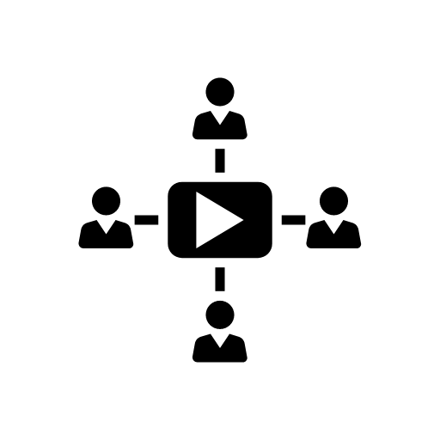
Steps to make and share a video
Record from a screen, webcam, phone, etc
Edit and caption video
Store and share video recordings
Notes:
To create a finished recording that is shared among students and an instructor, there are three stages involved.
The first is recording of the initial footage.
The second is editing the footage and providing closed captions
The third is storing the completed video recording and providing a means to link to the video.
At Framingham State University, we use Panopto. The tool can handle all three steps of the process, or start at any point by allowing users to upload edited or unedited footage.
Having a tool that is flexible enough to handle all parts of the process has made support much easier and allows us to go into the storage area of Panopto as System Admins and resolve more complex technical issues.
There are many solutions out there that can handle one of or all of the stages, such as Screencastify , Jing, Youtube. Some are free like Youtube, while some of the more robust solutions like Panopto require a license. Regardless of the tool selected, the technical steps that instructors and students need to follow to create a recording should be clearly defined so adequate support can be provided.

Slide 5
How are video assignments used at FSU?
Online Human Resource Management students are creating narrated Powerpoint presentations
French 1 students are recording video self-introductions
Nutrition students are creating audio podcasts on different nutrients
Notes:
Instructors at Framingham State have had students create recordings in a variety of formats.
Students in an Online HR Management course were asked to create narrated powerpoint presentations that captured from their webcam as well as their screen. The resulting recordings closely matched the format of video lectures that the instructor used. Since the instructor was very comfortable using Panopto, he was able to handle most of the support questions from his students.
French 101 courses needed a way to record oral exercises. Since the students were predominantly Freshman, using mobile devices to create and upload recordings through the Panopto mobile app helped provide a simplified process and did not require the instructors to be able to provide as much support.
A nutrition course had an assignment that asked students to record podcasts covering different nutrients. They had previously used audacity to create the audio recordings, but were running into issues with where to host the files. Using mobile devices to create audio-only recordings that were uploaded to Panopto resolved the issue of how to host the recordings.

Slide 6
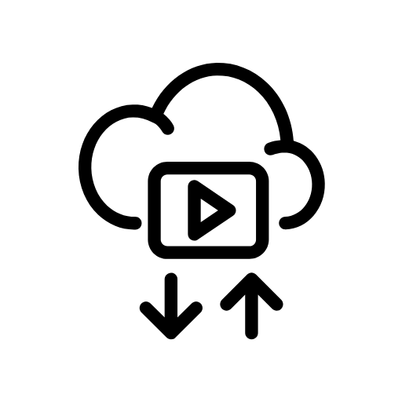
Choosing a student workflow
Panopto Recorder for PC and Mac
Panopto App for iOS and Android
Upload pre-made video or audio to Panopto
Notes:
Based on what needs to be in the final recording and the level of technical proficiency of both the instructor and students there are three workflows available through the Panopto tool for student assignments.

Slide 7
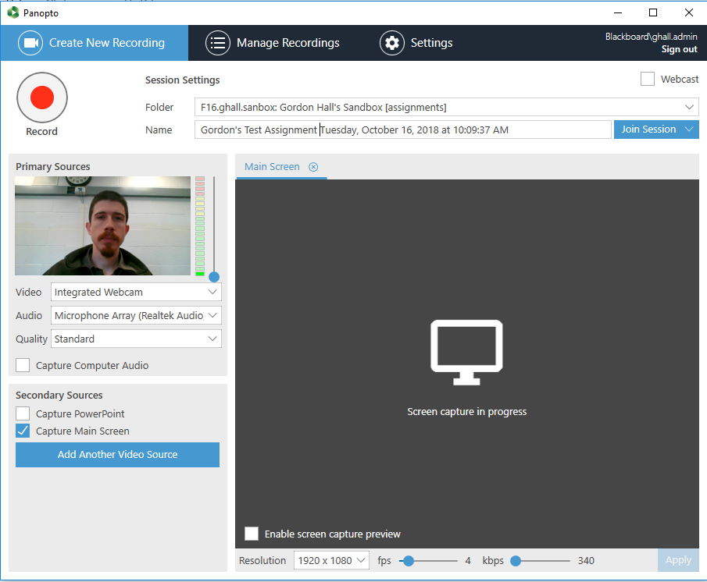
Creating videos using the Panopto Recorder
Well suited to narrated powerpoints/ screen-capture
Requires computer with microphone and webcam
Can only review recordings after uploading to panopto server
Notes:
The Panopto recorder for Windows and Mac is potentially the most technically complicated way to produce a recording, but it is the most flexible in terms of what can be recorded.

Slide 8
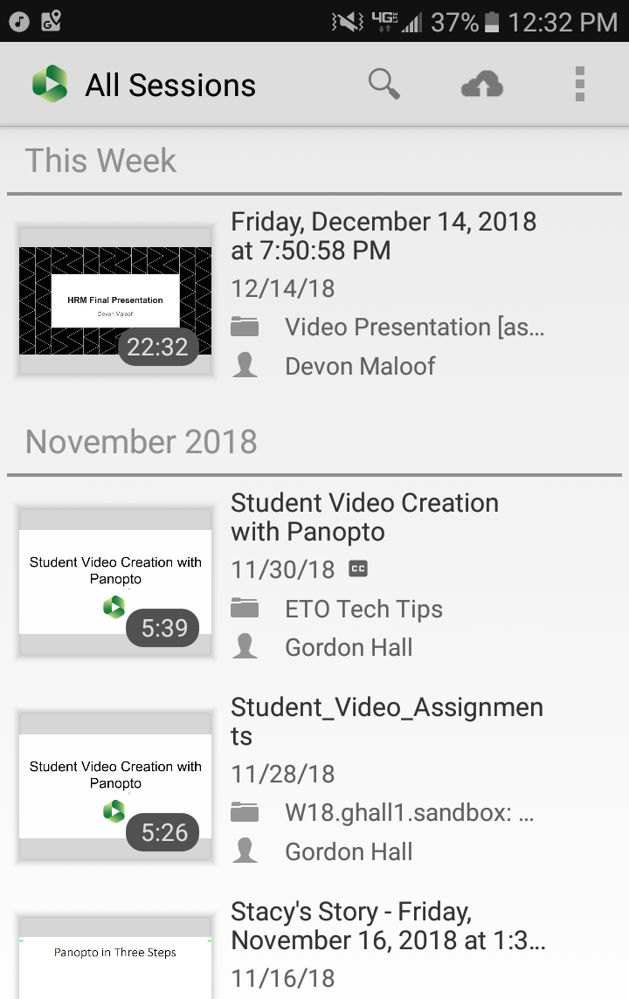
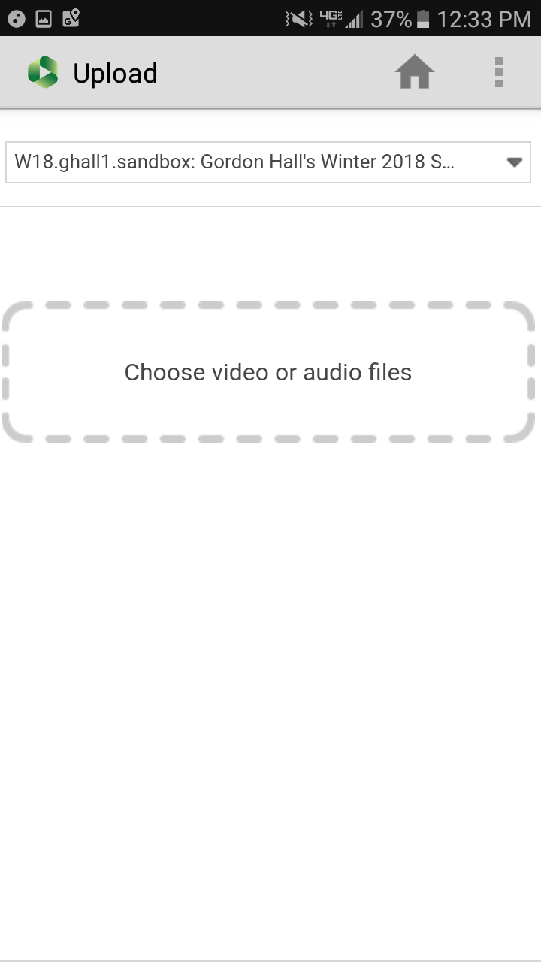
Uploading videos with the Panopto Mobile App
Well suited to video and voice or voice only recordings
Makes use of smartphones built-in camera and speaker
Can review recording before uploading
Notes:
The Panopto Mobile app uses the built in camera and microphone of the mobile device to capture the initial footage, and then allows it to be edited and shared once it is uploaded to the Panopto server. Video can only be captured from the device camera, and the mobile screen cannot be recorded.

Slide 9
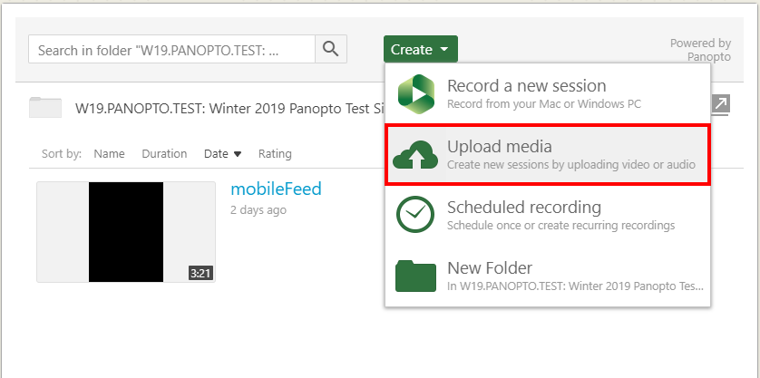
Using the Upload Option
Allows students to create recording using software of their choice
Best for students who are experienced creating recordings
Handles storage and sharing of video files
Notes:
The upload media option allows a finished recording file to be uploaded directly to the Panopto server. The video can still be edited once uploaded, but often the videos uploaded through this option have already been edited in a more powerful tool like iMovie or Adobe Premiere.

Slide 10
Steps to create video assignments
1. Define what will be covered in the videos and how they will look
2. Select your tools and define the technical process
3. Creating a sample recording yourself and use as a model, or find another model video
4. Provide technical instructions for how the students will upload their videos

Slide 11
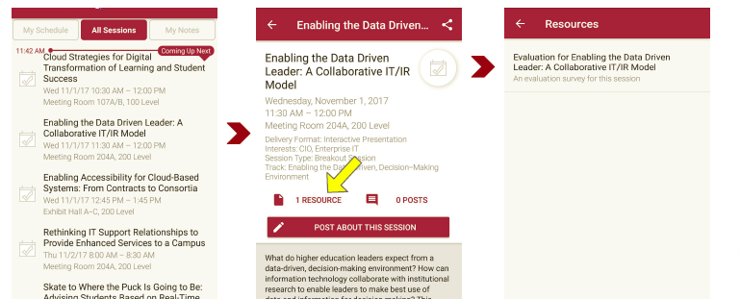
Sessions Evaluations There are two ways to access the session and presenter evaluations:
1
2
In the online agenda, click on the “Evaluate Session” link
From the mobile app, click on the session you want from the schedule > then click the associated resources > and the evaluation will pop up in the list

