Slide 1
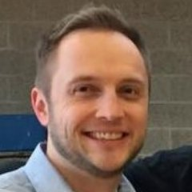
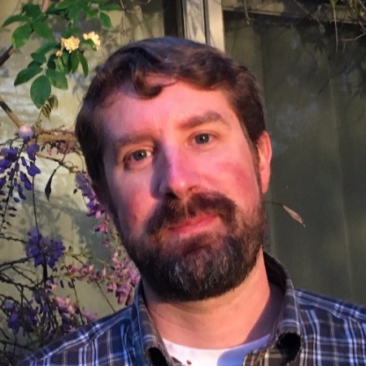
Connecting the Dots with Zeek (Bro)
Tuesday, May 14 | 2:45PM
Nick Turley
Security Architect
Brigham Young University
Vince Stoffer
Sr. Director, Product Management
Corelight

Slide 2
Zeek
Notes:
Vince introduction to Zeek and Corelight

Slide 3
Notes:
Slide is to provide a quick agenda overview and introduce

Slide 4
Background
Lack of visibility
Poor Correlation
Data Fidelity
Adaptability
Performance
Notes:
How we got here? What problems were we dealing with? What was the state of the environment when I started?

Slide 5
(2016) Student Capstone
(2017) Campus Zeek cluster
(2018) Corelight augmentation
(2018) Custom package development
(2020/2021) Full Corelight
(2018) SOC Established
Notes:
High level overview of our Zeek/Corelight progression since 2016

Slide 6
Why Zeek?
 | Adaptable
 | Event-driven and policy framework
 | Highly Stateful
 | Protocol Coverage
 | Rich Metadata
Notes:
The specific reasons we find Zeek core technology powerful

Slide 7
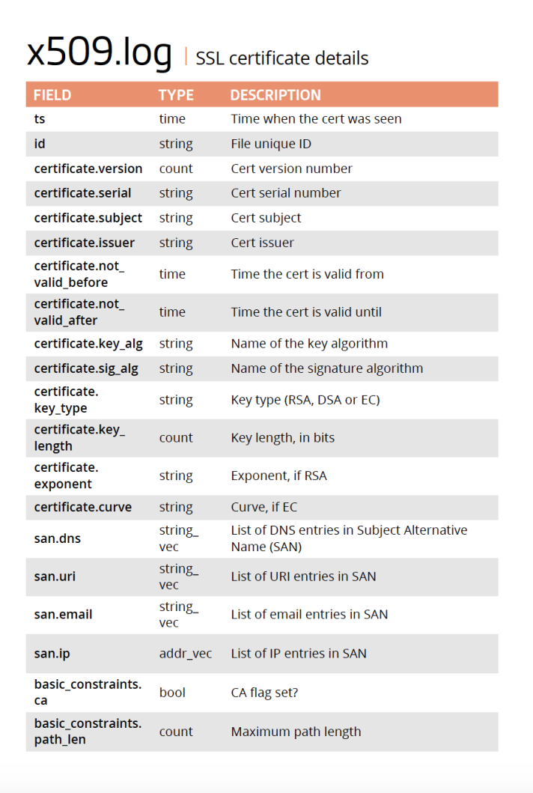
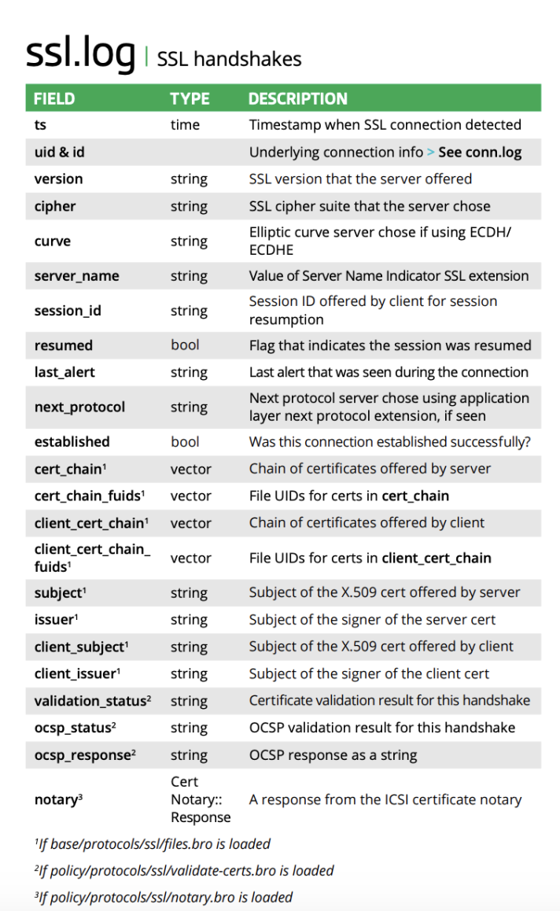
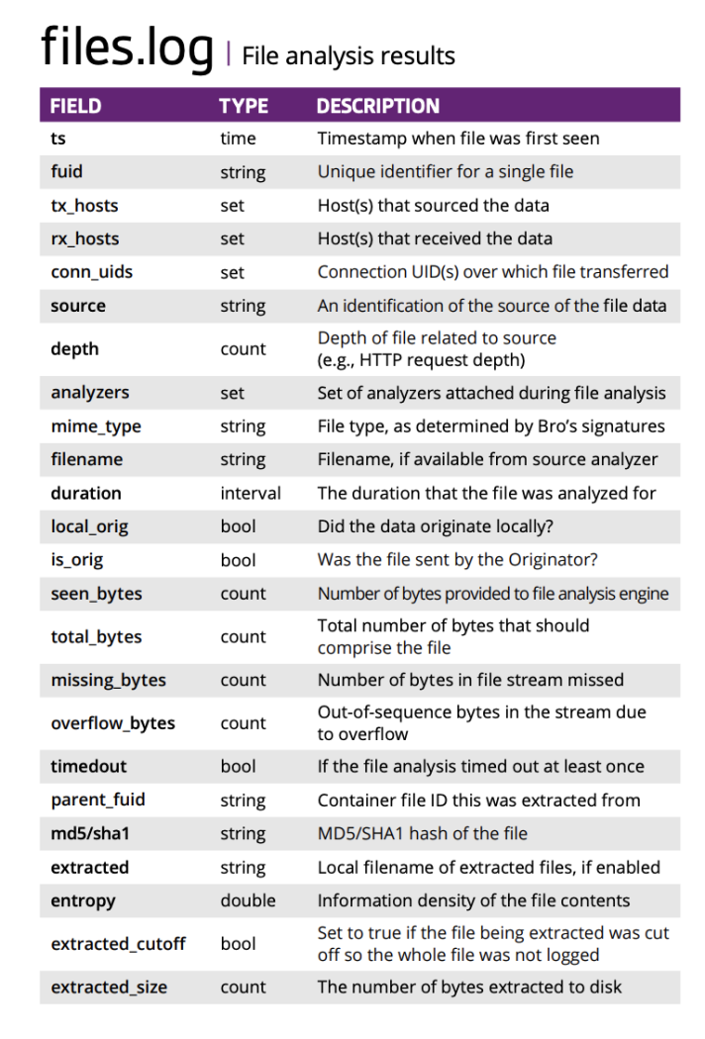
Notes:
Provide a quick example of some of the protocol enrichment provided by Zeek

Slide 8
conn.log
http.log
ntlm.log
rdp.log
files.log
ssl.log
intel.log
smtp.log
smb_files.log
smb_mapping.log
ftp.log
…
AWFyf1nfiQTBOGBY7CZc
AWFyfuQVhOOxLt6n04AI
AWFycrzUiQTBOGBY4HqB
Notes:
Some introduction to how Zeek handles logs and provides correlation

Slide 9
AWFyf1nfiQTBOGBY7CZc
AWFyfuQVhOOxLt6n04AI
AWFycrzUiQTBOGBY4HqB
conn.log
ntlm.log
smb_files.log
smb_mapping.log
files.log
intel.log
File Extraction
Session Context
Policy Automation
Notes:
While on the surface the correlation is simple, this is a very organized and powerful feature to support threat hunting and connecting the dots

Slide 10
Customization Examples
System Misconfigurations
Sensitive Data Exposure
Central Authentication Service
File Carving / Payload Analysis
Content Management Systems
SMB/CIFS
Site Defacements
Input and Intel Framework
Zeek / Corelight
Notes:
We move on to one of the areas that we are most excited about and that is the customization and flexibility of Zeek
Here we provide some examples of customizations we have written to support our operations

Slide 11
event http_entity_data(c: connection, is_orig: bool, length: count, data: string)
{
… look for suspicious HTTP payload as <body> section of document is analyzed
}
event smb2_create_response(c: connection, …)
{
… look at metadata of the SMB/CIFS file creation request, file size, file attributes looking for ransomware activity
}
event x509_certificate(c: connection, …)
{
… provides parsed certificate information. Look for expired certs, self-signed certs, specific fingerprints
}
event mysql_command_request(c: connection, …)
{
… extract payload of command request and hunt for malicious activity,
unusual request types, number of rows modified etc
}
Notes:
Quick example of the language and the event driven nature of the development with some sample actions that could be taken in these events

Slide 12
{
"cms_app": "wordpress",
"cms_success": true,
"cms_uri": “the-site.com/wp-login.php",
"id.orig_h": “23.67.123.77",
"id.orig_p": 53093,
"id.resp_h": “X.X.X.X",
"id.resp_p": 80,
"lv_dist": 5,
"password": “*****“,
"pw_length": 5,
"ts": "2019-05-07T22:31:27.552420Z",
"uid": "Chwo372Bdc6IH1a3Rf",
"user_agent": "Mozilla/5.0 (Macintosh; Intel Mac OS X 10_14_4) AppleWebKit/605.1.15 (KHTML, like Gecko) Version/12.1 Safari/605.1.15",
"username": "admin"
}
cms.log
Notes:
Here is an example of a custom module to track logins on unprotected and non-SSL CMS (Drupal, Wordpress and Joomla) which writes to custom log cms.log
Zeek tracks the login progress by monitoring the POST bodies and status of Set-Cookie response headers to determine whether the login was successful instead of just inspecting HTTP response codes which produce a lot of false positives. Usage of password length and levenshtein distance checks to determine how different the password is from the username.
Provides early warning on a CMS breach

Slide 13
Incident Examples
Ransomware
Cryptomining
Remote access attacks
Botnet, IRC C&C
Sensitive data hunting, detection, correlation
Webshell, file extraction, payload analysis
Web service error detection
Notes:
Some examples we’ve handled with both stock Zeek capability and custom modules

Slide 14
Event Enrichment
Notes:
One of the areas that we have been excited about is the ability to perform event enrichment by feeding institutional context into the system

Slide 15
{
"id.orig_h": "10.1.2.3",
"id.orig_p": 28818,
"id.resp_h": "128.187.X.X",
"id.resp_p": 80,
"ipam.orig": [ “wireless private v340" ],
"cmdb.orig_class": [ "public" ],
"cmdb.orig_supgrp": [ "Student Wireless" ],
"ipam.resp": [ “bldg-a public v220" ],
"cmdb.resp_class": [ "highly confidential“, “confidential” ],
"cmdb.resp_env": [ "PROD“ ],
"cmdb.resp_catalog": [ “Student Data Web Services” ],
"cmdb.resp_supgrp": [ "Humanities", "Todd Jensen", "name@byu.edu", "4-2345“ ],
"msg": "HTTP payload of website contains application errors - Response: 500 GET - URL: site.byu.edu/view.php?id=1234",
"note": "HTTPAppExposure::App_Error_Found",
"proto": "tcp",
"sub": "You have an error in your SQL syntax... near ''1234'' at line 1",
"suppress_for": 86400,
"ts": "2019-05-05T14:37:53.915824Z",
"uid": "CqTqsn4xuoNL54rXDk"
}
notice.log
Notes:
It’s important to note that we don’t enrich all logs to avoid data duplication, but logs such as notice.log are enriched to help analysts prioritize the events they are seeing with immediate context
The advantages of doing this early in the process versus waiting for SIEM automation down the line to enrich those events.

Slide 16
{
"host": “X.X.X.X",
"host_p": 443,
"name": "PHP",
"software_type": "HTTP::APPSERVER",
"ts": "2019-05-05T23:00:23.670413Z",
"unparsed_version": "PHP/5.3.3",
"version.major": 5,
"version.minor": 3,
"version.minor2": 3
}
{
"id.orig_h": "10.1.2.3",
"id.orig_p": 28818,
"id.resp_h": “X.X.X.X",
"id.resp_p": 443,
"ipam.resp": [ “bldg-a-b035 public v220" ],
"cmdb.resp_class": [ "highly confidential“, “confidential” ],
"cmdb.resp_env": [ "PROD“ ],
"cmdb.resp_catalog": [ “Learning Mgmt System” ],
"cmdb.resp_supgrp": [ “OIT", “Bob Smith” ],
“ir.resilient_id": 2438, “ir.resilient_status": “open”,
"msg": “Vulnerable PHP Found - URL: webapp.byu.edu",
"note": "HTTPAppExposure::PHP_Vuln",
"sub": “PHP/5.3.3",
"suppress_for": 86400,
"ts": "2019-05-05T14:37:53.915824Z",
"uid": "CqTqsn4xuoNL54rXDk"
}
software.log
notice.log
Notes:
This sample shows the usage of “feedback” from an IR system allowing you to provide context on alert disposition.
Show cases where this vulnerable PHP version is still being reported by Bro, with feedback from the IR system. Example of software.log
Analysts walk into the SOC and know what alerts have not been handled if alerts are not tagged.
After an incident is closed, look for new alerts of same type with “closed” tag. We then know the incident was not properly fixed by the system admin.

Slide 17
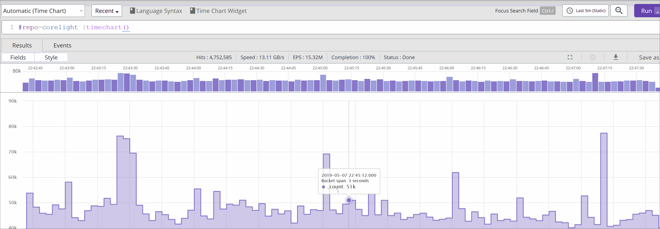
DUMMY DATA
Notes:
Example of how we can use this data to get immediate context of traffic flows showing associated campus departments and IT contact support groups
This is a simple example and can be extended like we discussed in the previous slides.

Slide 18
OK… Now what?
Notes:
As mentioned, in 2018 we launched a SOC to support our campus and our sister institutions.
Having had much success with Zeek and it’s rich data, we needed something to extend this system for multiple campuses

Slide 19
Same Family, Different Personalities
Notes:
We are part of a larger university system, but like many university systems, campuses are not the same and we deal with unique challenges at each institution

Slide 20
Our Challenge
Multiple Universities in our education system with different capabilities
Security stack needs to be lightweight and simple
Need to iterate quickly
Unique technologies/services that don’t directly integrate
Need 2-way decoupled communication (receive events, publish commands)
Scalable
Efficient (can’t send ALL the logs)
Notes:
Some of the challenges we were facing in identifying a solution

Slide 21
 | Event Driven Architecture (EDA)
 | Microservices
 | Containers
 | CI/CD
Notes:
EDA: Systems that poll are inefficient. Raise events so other systems don’t have to waste time and resources.
Systems built using microservices should be highly decoupled. Implement single business capability and have well defined interfaces. The size of the microservice is governed by the size of the associated context.
An important part of a microservices’ interface is its ability to raise events

Slide 22
Campus 1 Stack
Campus 2 Stack
Campus 3 Stack
Microservices
Microservices
Microservices
Publish
Subscribe
Publish
Subscribe
Publish
Subscribe
Event Broker
Publish
Subscribe
Microservices
Incident Management
Orchestration
Intelligence
Monitoring
Security Operations Center
Notes:
NO POLLING
Microservice layer with common event language/protocol.
Event broker to allow events to be published to all institutions or specific institutions.
2-way communication of event publication and ACKs with payload
No direct integration between systems.

Slide 23
Microservices
Microservices
Microservices
ACK
INTEL_UPDATE
ACK
INTEL_UPDATE
ACK
INTEL_UPDATE
Event Broker
Topic: All Schools
Topic: School B
INTEL_UPDATE
ACK
Intel Microservices
Intel Platform A
Intel Platform B
Intel Platform C
Security Operations Center
Notes:
Example showing how the INTEL_UPDATE event occurs with the Intel and Corelight microservices. Same principles apply to ANY system that can utilize threat intelligence
and subscribe to the INTEL_UPDATE events (e.g. Palo Alto)
Corelight and other services are decoupled from the threat delivery system and only need microservices to subscribe to relevant events. This also allows replacement of threat delivery system and modifications without needing to update any direct integrations.
Broker allows publication of events to all schools or individual schools depending on need

Slide 24
Core Technologies
Resilient IR Platform
Rundeck Orchestration
ActiveMQ Local and Managed Cloud
Docker Local and Cloud (e.g. ECS)
Humio
Python Microservices
Lambdas and API gateways
GitHub and CI/CD

Slide 25
Sample Microservices
Webhook Handler
Resilient
Corelight
Palo Alto
Intelligence Disposition
Rundeck
ETLs and Correlation

Slide 26
Sample Correlation Sources
CMS/CMDB
DNS/IPAM
VMWare
Load Balancers/WAF
Cloud Accounts
IDM/IAM
Microservices
Zeek Input Framework
Web Services
Event Publication
Notes:
An example of some of the ETLs and correlation services we have implemented to feed these services
CMS/CMDB (Service Catalogs, IT Contacts, Data Classifications)

Slide 27
Account Tracking | Monitoring of accounts (contractors, recently terminated) and behavior on network
Data Classification | Zeek detects presence of PII and reports system if classification not recorded in inventory
IR Ticket Resolution | IR ticket resolved, but Zeek alerts that the issue is still ongoing with closed ticket (i.e. sys admin didn’t fix the problem)
Environment | Environment context (production, dev, test) and inventory enrichment
Inventory Control | Zeek has identified presence of new MAC which is not reported or authorized in CMDB
Notes:
Some examples of how the combination of Zeek data combined with institutional knowledge and provide a robust monitoring platform

Slide 28
Questions?
Notes:
As mentioned, in 2018 we launched a SOC to support our campus and our sister institutions.
Having had much success with Zeek and it’s rich data, we needed something to extend this system for multiple campuses

Slide 29
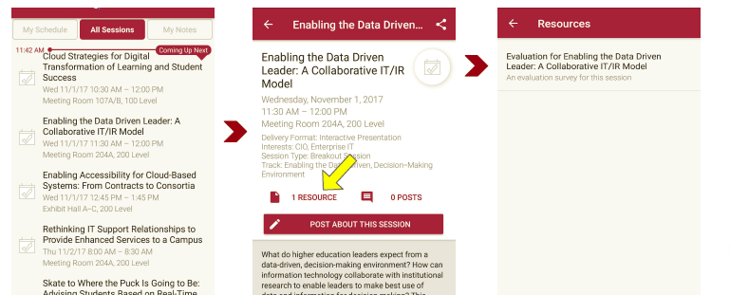
Session Evaluations There are two ways to access the session and presenter evaluations:
1
2
In the online agenda, click on the “Evaluate Session” link
From the mobile app, click on the session you want from the schedule > then click the associated resources > and the evaluation will pop up in the list

