Slide 1
Is Weird really weird? Fatema Bannat Wala Security Engineer University of Delaware

Slide 2
About Me
A big fan of Zeek IDS
Have been working with Zeek for past 3.5 years
Joined UD’s SecOps team in 2015
Passionate about Cyber-Security
Also a part-time Ph.D. student

Slide 3
Roadmap of today’s talk
What is Weird in Zeek?
Motivation
Types of Weirds in Zeek?
Where to find Weirds?
Deep dive into top most triggered Weirds
Summary
University’s Weird Profile

Slide 4
UD’s Traffic Profile
10 Gbps network links
Average ~5 Gbps network traffic per link
Peak ~8 Gbps per link
4 Zeek sensors, each getting 25% of total traffic
Each sensor getting ~300,000 pps
Overall triggered Weird notices logged in weird.log were ~21 M/day

Slide 5
What is Weird in Zeek?
Google-land - “suggesting something supernatural; uncanny.”
Zeek-land – “unusual or exceptional activity that can indicate malformed connections, traffic that doesn’t conform to a particular protocol, malfunctioning or misconfigured hardware, or even an attacker attempting to avoid/confuse a sensor.”

Slide 6
Motivation….
Curiosity to know why so many (>200) types of different Weirds getting triggered for the network traffic, whether they are serious events to be looked at, malformed packets or malformed application??
Analyzing the Weird logs might reveal information about some activity that is hard to notice in the day to day life of network/security engineer.

Slide 7
Types of Weird
There are MANY types of Weird defined in Zeek. More than 200 are triggered on our network traffic. Most common ones are:
DNS_RR_unknown_type
Dns_unmatched_msg
Dns_unmatched_reply
fragment_with_DF
bad_ICMP_checksum
DNS_Conn_count_too_large
possible_split_routing
inappropriate_FIN
TCP_Christmas
truncated_header
data_after_reset
data_before_established
SYN_seq_jump
SYN_with_data
TCP_ack_underflow_or_misorder
DNS_truncated_RR_rdlength_lt_len
line_terminated_with_single_CR
DNS_RR_length_mismatch

Slide 8
Where to find Weirds?
Definition: Weird notices are mainly defined in following locations:
In source code of Zeek IDS (in .cc files)
In “script land”, in base/ policy/ folders (in various .bro scripts)
Logging: The Weird notices are logged into a separate log file called “weird.log”. The logging of different Weirds is be controlled by base/frameworks/notice/weird.bro

Slide 9
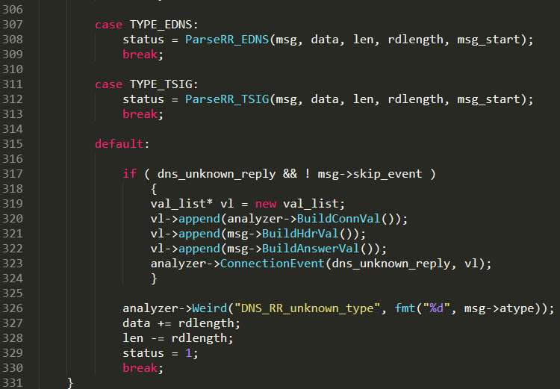
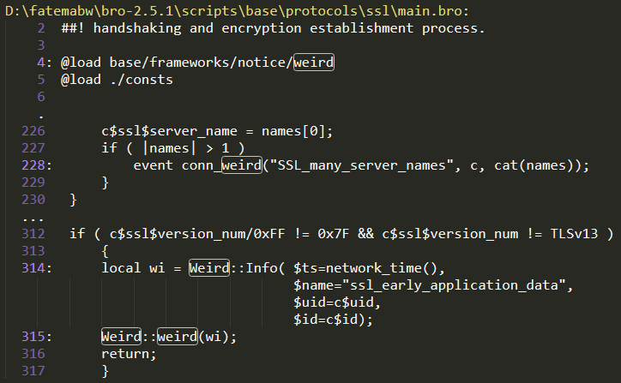
Where to find Weirds?
Definition ex: Core Layer- DNS.cc, Script Land – ssl/main.bro

Slide 10
Where to find Weirds?
Logging : Script - weird.bro, Log file - weird.log
base/frameworks/notice/weird.bro
## A table specifying default/recommended actions per weird type.
const actions: table[string] of Action = {
……
["DNS_RR_bad_length"] = ACTION_LOG,
["DNS_RR_length_mismatch"] = ACTION_LOG,
["DNS_RR_unknown_type"] = ACTION_LOG,
["FIN_after_reset"] = ACTION_IGNORE,
["non_IPv4_packet"] = ACTION_LOG_ONCE,
……
} &default=ACTION_LOG &redef;
……

Slide 11
Analysis of top most triggered Weirds
In the University’s network the following were the top most triggered Weirds in weird.log over 24 hrs period:
$ zcat weird.*.log.gz | awk -F'\t' '{print $7}' | sort | uniq -c | sort -rn
2,603,914 DNS_RR_unknown_type
2,160,812 possible_split_routing
2,092,811 inappropriate_FIN
753,398 fragment_with_DF
18,343 bad_ICMP_checksum

Slide 12
DNS_RR_unknown_type
Defined: In src/analyzer/protocol/dns/dns.cc
Cause: The RR type currently not parsed in Bro
Types seen in the traffic: Top most RR types recorded in weird.log
1,049,729 DNS_RR_unknown_type 46
234,393 DNS_RR_unknown_type 50
99,914 DNS_RR_unknown_type 43
44,346 DNS_RR_unknown_type 47
26,592 DNS_RR_unknown_type 48

Slide 13
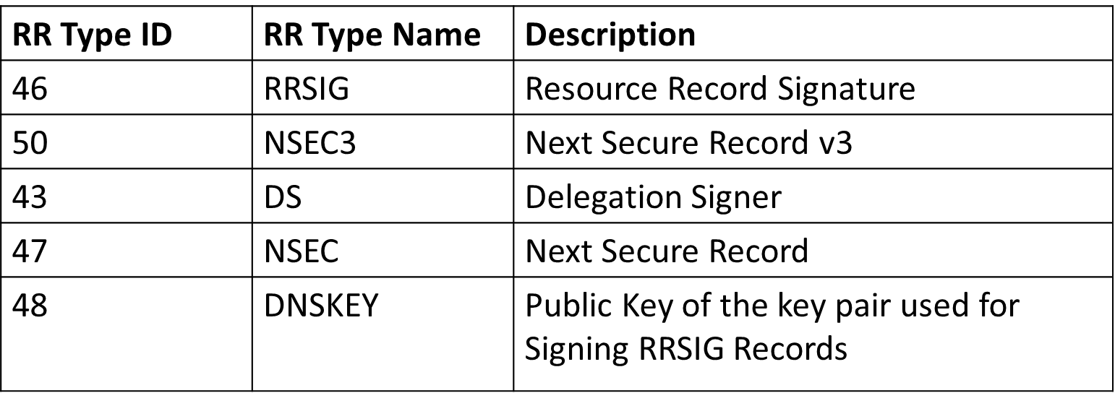
DNS_RR_unknown_type
After looking up those RR numbers, looks like they belong to DNSSEC protocol types:

Slide 14
DNS_RR_unknown_type
Reason: The DNS servers support DNSSEC and receive good amount of traffic for DNSSEC requests and responses.
Remediation: Ignore those alerts and move on, or write DNSSEC RR types parsing support in Zeek*. We chose the later ☺
Result: Compiled the code with DNSSEC RR types parsing support and aha - no more alerts for those 5 RRs, the alert count for ‘DNS_RR_unknown_type’ reduced from ~2 M to ~5 K per day.
*The code with DNSSEC support in Zeek can be found at: https://github.com/zeek/zeek/tree/master or https://github.com/fatemabw/bro/tree/master (bro2.5.4 with DNSSEC)

Slide 15
possible_split_routing
Defined: In src/analyzer/protocol/tcp/TCP.cc
Cause: When Zeek doesn’t see the other side of the connection, signifying possible split routing
Seen in the traffic: Top most destination hosts recorded in weird.log
1,515,526 128.xx.xx.xx 80 possible_split_routing
5,640 128.yy.yy.yy 443 possible_split_routing
121 5.185.16.24 443 possible_split_routing

Slide 16
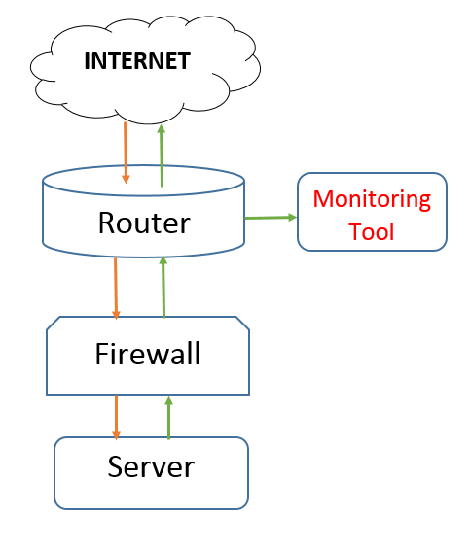
possible_split_routing
Reason: Router ACLs filtering one side of the connection, i.e. the requests from the internet to the server, so not to overwhelm the traffic from mirrored interface.
Remediation: Router ACLs now filtering both sides of the connection to reduce noisy flows. “Don’t confuse your IDS”
Result: Not seeing the possible_split_routing anymore for that server, just couple of those alerts every now and then for other IPs.

Slide 17
inappropriate_FIN
Defined: In src/analyzer/protocol/tcp/TCP.cc
Cause: When Zeek sees a packet with a FIN set during a connection not complying with TCP/IP standard.
Seen in the traffic: Top most destination hosts recorded in weird.log.
1,410,450 128.xx.xx.xx 80 inappropriate_FIN
4,840 128.yy.yy.yy 443 inappropriate_FIN
121 5.185.16.24 443 inappropriate_FIN

Slide 18
inappropriate_FIN
Reason: Because of Router filtering one side of traffic, Zeek would see the Fin sent by the server as inappropriate, as it couldn’t see the other side of traffic (was a consequence of ‘possible_split_routing’).
Remediation: Router ACLs now filtering both sides of the connection to reduce noisy flows.
Result: Not seeing the inappropriate_FIN anymore for that server, just couple of those alerts every now and then for other IPs

Slide 19
fragment_with_DF
Defined: In src/Frag.cc
Cause: When a fragmented packet is encountered with DF flag set (Don’t Fragment).
Seen in the traffic: Top most Src hosts recorded in weird.log, the top most IPs belong to the DNS servers!
336,240 128.xxx.xxx.xx fragment_with_DF
335,411 128.yyy.yyy.yy fragment_with_DF
172 130.114.200.6 fragment_with_DF

Slide 20
fragment_with_DF
Reason:
Because of EDNS0 (Extensible DNS v0)!
DNS approach to a reasonable compromise - the management of the packet MTU is passed into the application layer.
The application will conventionally operate with a maximum UDP payload size (which is 4096B in BIND 9+ by default)
It was happening because of the lower MTU (1500) of the local interface of DNS servers. But as the servers support EDNS0 and DNSSEC, the responses are bound to be greater than local interface MTU.

Slide 21
fragment_with_DF
Remediation:
could try to increase the MTU of the local interfaces of DNS servers to be 4096 bytes, so that the fragmentation doesn’t happen on the local interface.
could try to tweak maximum UDP payload size in the BIND settings, which is by default 4096, to 1472 bytes to match the MTU of the local interface to avoid fragmentation. (We chose this one)

Slide 22
fragment_with_DF
Remediation continued…
BIND 9 configuration attribute:
“max-udp-size”
Sets the maximum EDNS UDP message size named will send in bytes. Valid values are 512 to 4096. The default value is 4096.
This value applies to responses sent by a server.
The usual reason for setting max-udp-size to a non-default value is to get UDP answers to pass through broken firewalls that block fragmented packets and/or block UDP packets that are greater than 512 bytes.
Setting this to a low value will encourage additional TCP traffic to the nameserver.

Slide 23
fragment_with_DF
Result: No more "fragment_with_DF" notices in the weird logs for the DNS servers! and the alert counts was reduced dramatically from ~700K to couple of 100s for a day!!

Slide 24
Few other weirds ..
Following Weirds signify potentially bad traffic
bad_ICMP_checksum (src/analyzer/protocol/icmp/ICMP.cc)
TCP_Christmas (src/analyzer/protocol/tcp/TCP.cc)
Reason: bad_ICMP_checksum / TCP_Christmas Weird notices were seen to be triggered by the scanner IPs, sweeping the range of IPs on the network.
Remediation: Blocked the src IPs at the border. For bad_ICMP_checksum, we have a threshold of more than 10 bad checksum requests per host.

Slide 25
Summary of Weirds
Weird Type | Improvement in Network
DNS_RR_unknown_type | Implemented DNSSEC RR parsing
possible_split_routing | Fixed Router ACL filter
inappropriate_FIN | Fixed Router ACL filter
fragment_with_DF | Fixed the BIND configuration
bad_ICMP_checksum/TCP_Christmas | Blocked the Bad IPs
DNS_unmatched_msg/reply (~11M/day) | Not logging , doesn’t provide much insights
*By above improvements we got rid of ~18M/day Weird notices overall from weird.log file (85% reduction) ☺

Slide 26
University’s Profile #Before
count | y | Weird
2,603,914 | 0 | DNS_RR_unknown_type
753,398 | 1 | fragment_with_DF
164,344 | 2 | bad_TCP_checksum
13,480 | 3 | DNS_RR_length_mismatch
14,214 | 4 | DNS_truncated_RR_rdlength_lt_len
373 | 5 | premature_connection_reuse
13,474 | 6 | connection_originator_SYN_ack
9,502 | 7 | data_after_reset
27,133 | 8 | empty_http_request
26,255 | 9 | truncated_header
7,342 | 10 | Teredo_bubble_with_payload
2 | 88 | HTTP_content_range_unknown
2 | 89 | smtp_unmatched_end_of_data
1 | 90 | bad_IP_checksum_in_tunnel
1 | 91 | bad_TCP_header_len
1 | 92 | fragment_size_inconsistency
Total plotted notices: 3,847,532

Slide 27
University’s Profile #After
count | y | Weird
4,048 | 0 | unknown_SIP_method
4,433 | 1 | inflate_failed
141,307 | 2 | data_after_reset
99,757 | 3 | bad_TCP_checksum
52,007 | 4 | SYN_seq_jump
41743 | 5 | DNS_Conn_count_too_large
2,584 | 6 | above_hole_data_without_any_acks
24,120 | 7 | DNS_RR_length_mismatch
25,876 | 8 | DNS_truncated_RR_rdlength_lt_len
11,749 | 9 | data_before_established
52,388 | 10 | SYN_with_data
1 | 93 | unexpected_multiple_HTTP_reqs
1 | 94 | UDP_datagram_length_mismatch
2 | 95 | ssh_unknown_kex_algorithm
1 | 96 | unknown_protocol_7
6 | 97 | TCP_christmas
Total plotted notices: 752,977

Slide 28
Acknowledgements ☺
Thanks to the EDUCAUSE Team for the support, and for the opportunity to be a presenter at SPC’19!
Thanks everyone for your time and interest!

Slide 29
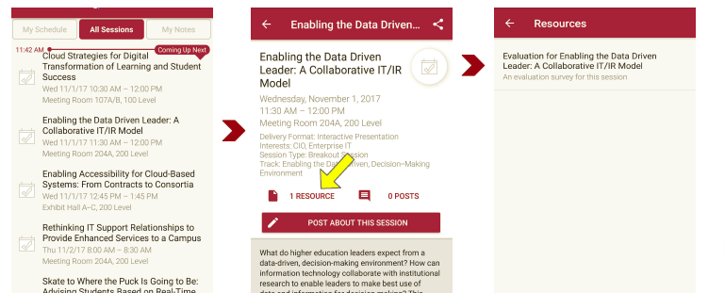
Session Evaluations There are two ways to access the session and presenter evaluations:
1
2
In the online agenda, click on the “Evaluate Session” link
From the mobile app, click on the session you want from the schedule > then click the associated resources > and the evaluation will pop up in the list

