Slide 1
Start Generating Threat Intelligence in 3 Easy Steps!
EDUCAUSE Security Professionals Conference
May 14th 2019

Slide 2
Hi, my name is Jesse.
Notes:
Large R1 University ~= Large city
As many different activities
As much top-down control
“Historical Reasons”
Been here since the inception
Budgets
Uneven across higher ed
Trending the right way, but always tight

Slide 3
2014, Changed Approach
“Automated Defense”
Scrape logs, filter, shove in border IPS
”Threat Intelligence”
…pull external TI data and also share our data
“Deception”
honeypots

Slide 4
2017, Realized Benefits
85% reduction in IPS alerts
10 million blocks-> 2.5 billion blocks
Sharing 17K unique IP/day

Slide 5
Random Points
Automated blocking, automated safelist
Safelist exception reports
Scanners aren’t worth blocking
They are if you’re fast, and you have an open network
Just use ISAC sharing
2014 Anecdata: 0.04% member contributed

Slide 6
Why isn’t everyone doing this?
…and can we help them?

Slide 7
Motivations
Operational
HiEd data applies to HiEd
Kickstart data sharing
Research
Labeled data corpus
It’s what we do ☺

Slide 8
What’s a STINGAR?
Collect
Action
Share
Shared
Threat Intelligence and Network Gatekeeping with Automated Response
Notes:
Make it easy for higher education institutions to collect, take action on, and share threat intelligence data
Collect
Honeypots provide easy data with low false positive rate
Action
Enabling data exports in formats easy to consume by devices
Share
Make sharing easy, and automatic
All of this is a stalking horse for giving orgs the building blocks for automated defense

Slide 9
Collect
Local threat intel is the best threat intel

Slide 10
Honeypots, Totally Cool Again
Honeypots == cheap source of local threat intelligence
Mature, open source options
Very low false positive rate

Slide 11
Honeypot fleet, harder
Each honeypot has unique configuration and logging options
In 2014, Duke used ModernHoneyNetwork (MHN) by Threatstream (now Anomali)
MHN solved deployment & logging (mostly)
Became unsupported right after Nick Tripp presented

Slide 12
CommunityHoneyNetwork
CHN was forked from MHN mid-2017
Break down components and Docker-ize
Focus on deployment + data

Slide 13
Action
Intelligence is: Data + Analysis -> Action

Slide 14
*waves hands*
“Waiting for the market”
API: basic feed/raw data
Best options when Sharing

Slide 15
Action Models
Share only
Everyone else thanks you (seriously)
Detection
Batch search logs for activity with indicators
Protection
Automatic blocking

Slide 16
Share
Sharing is caring!

Slide 17
Added automatic sharing
Add a container pointing to a CIF server
Automatically submits IP’s observed via HTTPS API
Duke running CIF instance for all partners
Submitters get access to all partner data

Slide 18
Architecture
v1

Slide 19
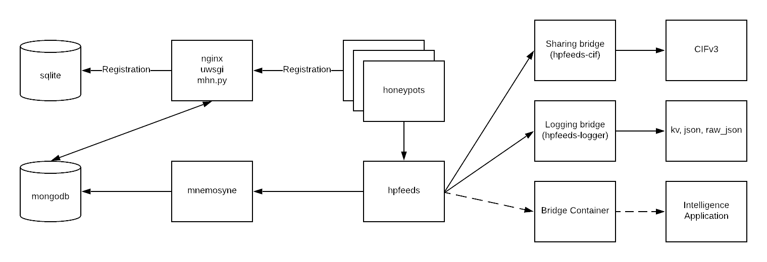

Slide 20
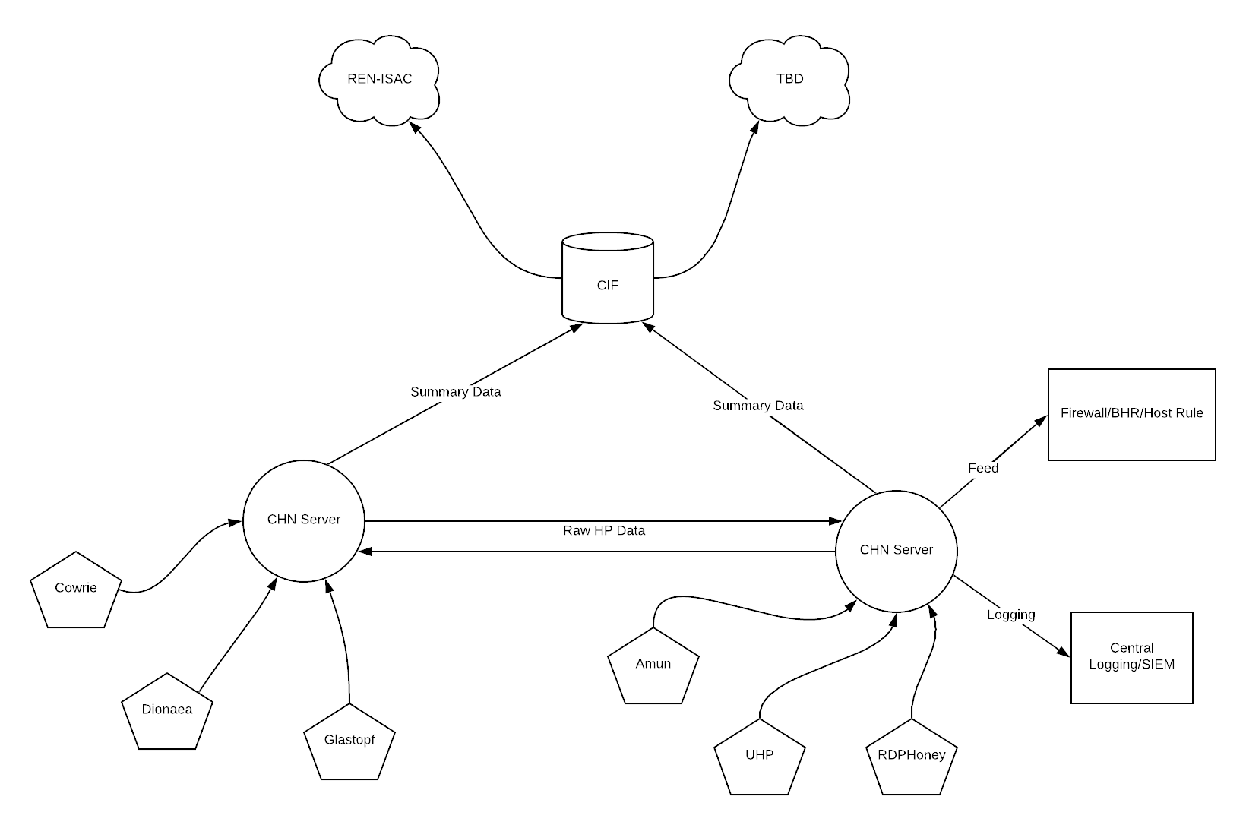

Slide 21
Data
Early metrics

Slide 22
…A month of data
Unique IP’s
115,430
Deployments
5
Sensors
58

Slide 23
Deployments
Partner | Sensor Count | Attack/Sensor | Unique IP/Sensor
Duke | 49 | 5,608 | 2,198
Partner 2 (M1) | 3 | 3,884 | 2,084
Partner 3 (INT) | 3 | 18,168 | 2,527
Partner 4 (R1) | 2 | 10,023 | 3,310
Partner 7* (R1) | 1 | 6,430 | 6,430
* Extrapolated from 3 days of data

Slide 24
Attacker IP Overlap

Slide 25
Crosstab Unique IP
 | Duke | Partner 2 (M1) | Partner 3 (INT) | Partner 4 (R1) | Partner 7* (R1)
Duke | 107,744
Partner 2 (M1) | 1,957 | 6,252
Partner 3 (INT) | 5,744 | 401 | 7,583
Partner 4 (R1) | 4,925 | 311 | 3,091 | 6,621
Partner 7* (R1) | 5,570* | 110* | 3,650* | 1,710* | 6,430*
* Extrapolated from 3 days of data

Slide 26
Benefits of Sharing (Partner 2)
Notes:
Starting in December, this partner starting blocking solely on their own honeypot data and blocked on average 4.1 million connections per day.
After adding in the shared repository containing all the participants data, they blocked on average 11.7 million connections per day, a 2.8X increase.

Slide 27
Questions?
Must have at least one!

Slide 28
Thank you!
team-stingar@duke.edu
https://stingar.security.duke.edu

