Slide 1
Clearing Skies: Managing Risk in the Cloud Shelley Rossell University of Chicago

Slide 2
Background
Where we started: storm chasing
Not like it used to be
Who cares?
Is University business or sensitive data in the cloud? Need a risk-based approach
Notes:
Story of how we got involved – metaphor for already behind cloud …
In the old days … . … we managed the network.
Now People don’t need to go through central procurement. They didn’t need to talk with central IT. Faculty, staff, students, researchers, IT groups … were already in the cloud. Most notably Amazon Web Services and Google Cloud Platform. I’m talking IaaS specifically. “The known unknowns”
Show of hands:
How many of you have a central IT investment in the cloud … AND
know if other campus IT groups are using the cloud … AND
know what those groups are doing in the cloud … AND
know what institutionally sensitive data is being stored in the cloud … AND
where … AND
… everything is working out as you had expected.
Do we need to care? YES: comes Limited resources. Need a strategy?

Slide 3
Mitigating risk: First, make a gate

Slide 4
Mitigating risk: First, make a gate
Corral interest toward your gate:
Your ideas …
AWS vendor, like DLT – send our way
Procurement
List of technology services offerings
Socialize it
Notes:
A ”gate” will help you to identify what is being moved to the Cloud, so you can triage.
Ideas from the audience?

Slide 5
Mitigating risk: Second, know the data
Someone’s at the gate:
Want a discount?
Complete this form …

Slide 6
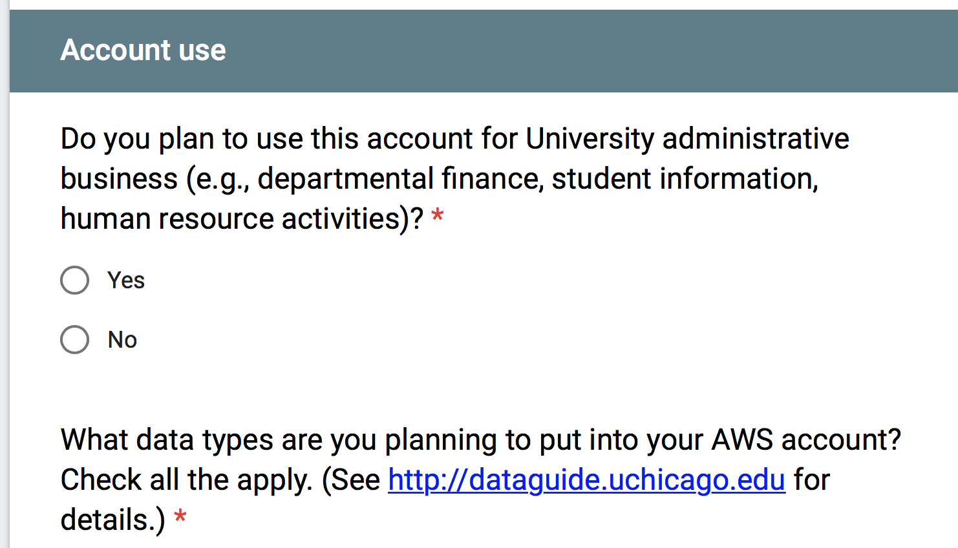
Mitigating risk: Second, know the data
I do NOT plan to put any of the above data types in my AWS account.
Notes:
Attorney/Client Information
Payment Card Information
Private Personal Information (PPI)
Protected Health Information (PHI)
Sensitive Identifiable Human Subject Research Data
Student Education Records
Student Loan Application Information
I do NOT plan to put any of the above data types in my AWS account.

Slide 7
Mitigating risk: Second, know the data
Notes:
I plan to use this account primarily for:
Running websites
Storage
Processing power
Virtual desktops
Research computing
Other ________________________

Slide 8
Mitigating risk: Accept or deflect
Accept
Deflect
RISK SLIDER
You’re coming with us.
Here’s your discount.
Goodbye.
Notes:
RISK-BASED – we cannot take on monitoring of all AWS activity ….

Slide 9
Mitigating risk: Accept or deflect
Non-sensitive data backups or storage
Individual faculty
Research group – non-sensitive
Sensitive data … deflect … but not necessarily to own account
Deflect

Slide 10
Mitigating risk: Accept or deflect
Accept
Should service by part of central IT? (data center consolidation)
… but what about other IT groups?
You’re coming with us.
Notes:
Data center consolidation

Slide 11
Mitigating risk: Accept or deflect
Case Study:
“Screw you and your on-prem data center”
Hybrid solution: the furnished account

Slide 12
Anatomy of a furnished account
University URL, Shibboleth and 2FA
Grouper to self-manage roles and access
Logging and monitoring enabled, sending to central security account
Secure configurations
Root credentials 2FA and secured
A central IT reserved role

Slide 13
Anatomy of a furnished account
“There will be some monitoring but you are responsible for the security of your account.”

Slide 14
Mitigating risk: Consistency
Cloud and on-premises
Policies and procedures
Security guides
Monitoring and audit
Notes:
I came around ….
NIST 800-171 standards

Slide 15
Monitoring and audit
Trusted advisor
GuardDuty
CloudTrail
Central IT accounts
Security SIEM
Security
Account
Generatesticket for Security
GuardDuty
CloudTrail
Security Hub
Set of rules and logic to trigger on events of concern
Furnished
accounts
Training
Account
Training
Account
Notes:
Get stats on our monitoring

Slide 16
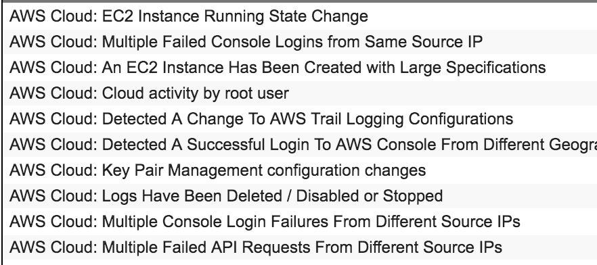
Monitoring and audit

Slide 17
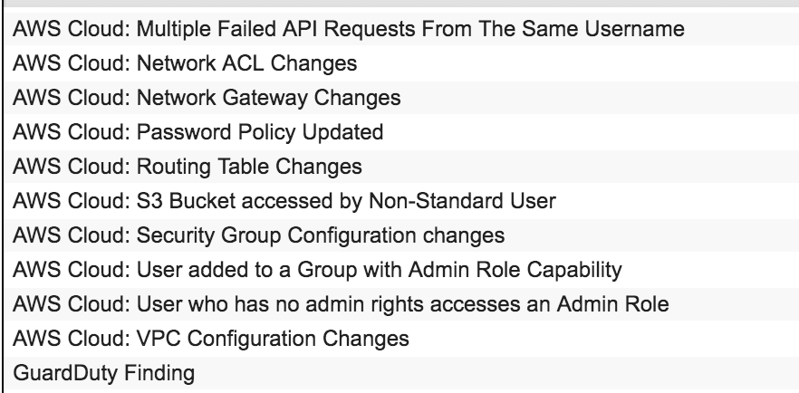
Monitoring and audit

Slide 18
On to our Google
Cloud Platform
experience …
Notes:
Show of hands:

Slide 19
Managing risk in the cloud: Key points
Make a gate
Know the data
Accept or deflect
Consistency of on-premises and cloud

Slide 20
Managing risk in the cloud
Thank you!
Questions and discussion
shelley@uchicago.edu

