Slide 1
David and Goliath: Small and Large Institution Information Security Collaboration
Lanita Collette – CISO, University of Arizona
Sean Hagan – CISO, Yavapai College
Tina Thorstenson – Deputy CIO, Arizona State University
Michael Zimmer – CISO, Northern Arizona University
Notes:
ABSTRACT (for reference):
Higher education institutions often embrace collaboration and
knowledge sharing, but does that extend to your information
security program? Will you collaborate with institutions much
larger or much smaller than your own? In this session, you’ll
learn how four schools of very different sizes and with very
different resources work together – both directly and indirectly
– to derive value and share unique institutional knowledge
and capabilities for the collective benefit of all.

Slide 2
48,000 Students
11,000+ Employees
$687M Research Expenditure
Land-grant university
Two medical schools
300+ Majors

Slide 3
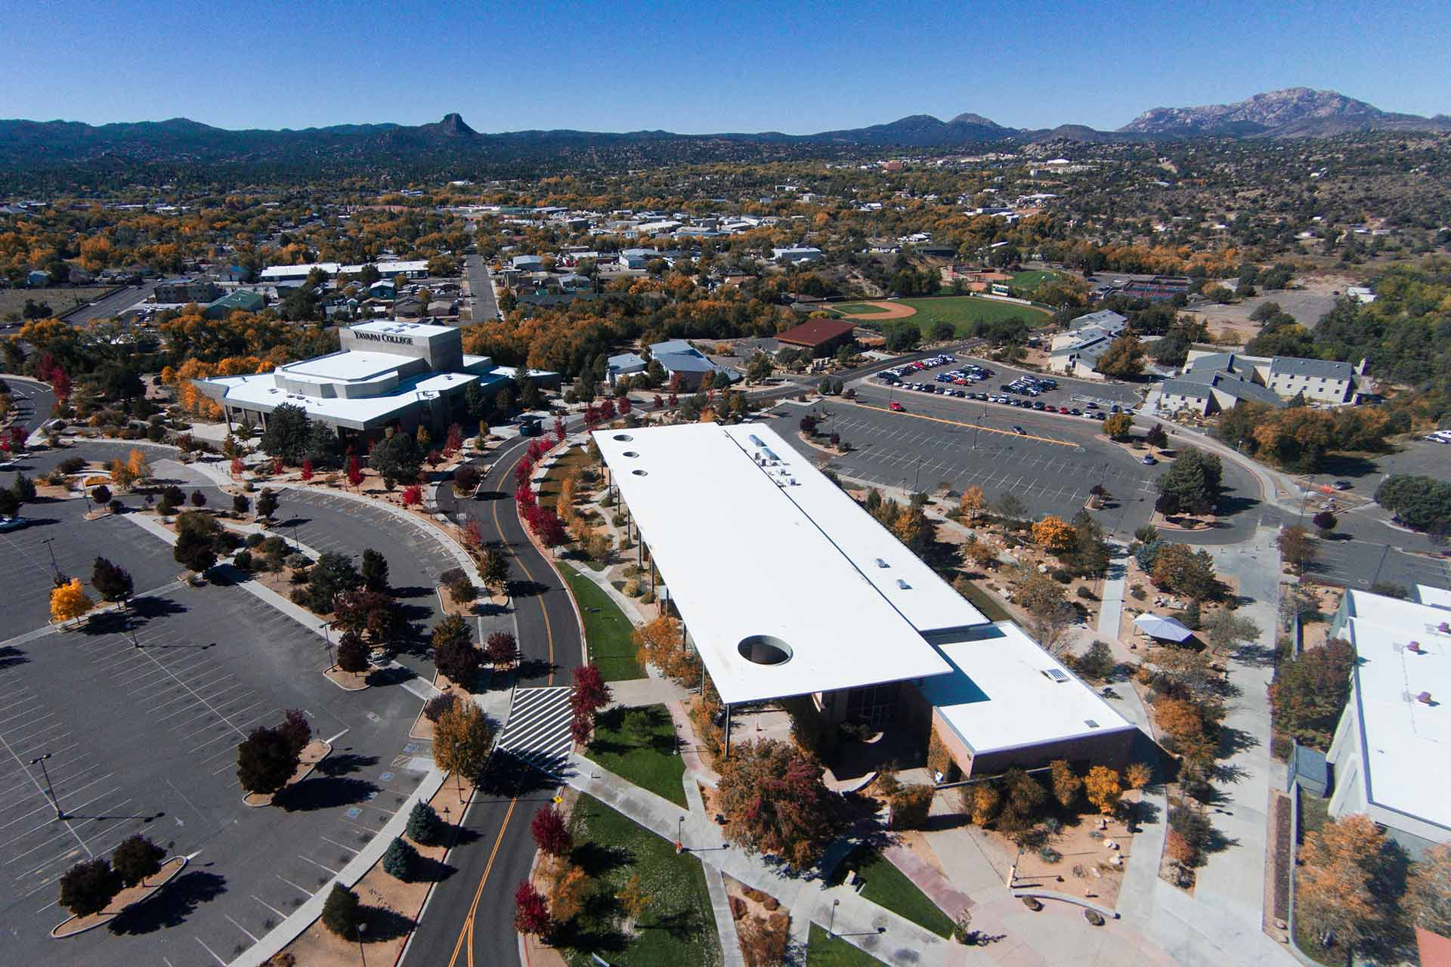
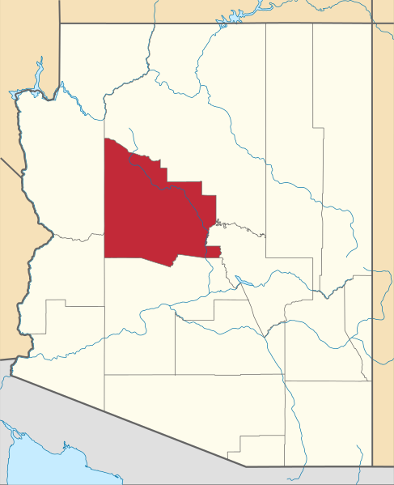
Yavapai College
~7,400 FTSE
Open Admissions
Residential CC
6 Campuses
Bigger than MA

Slide 4
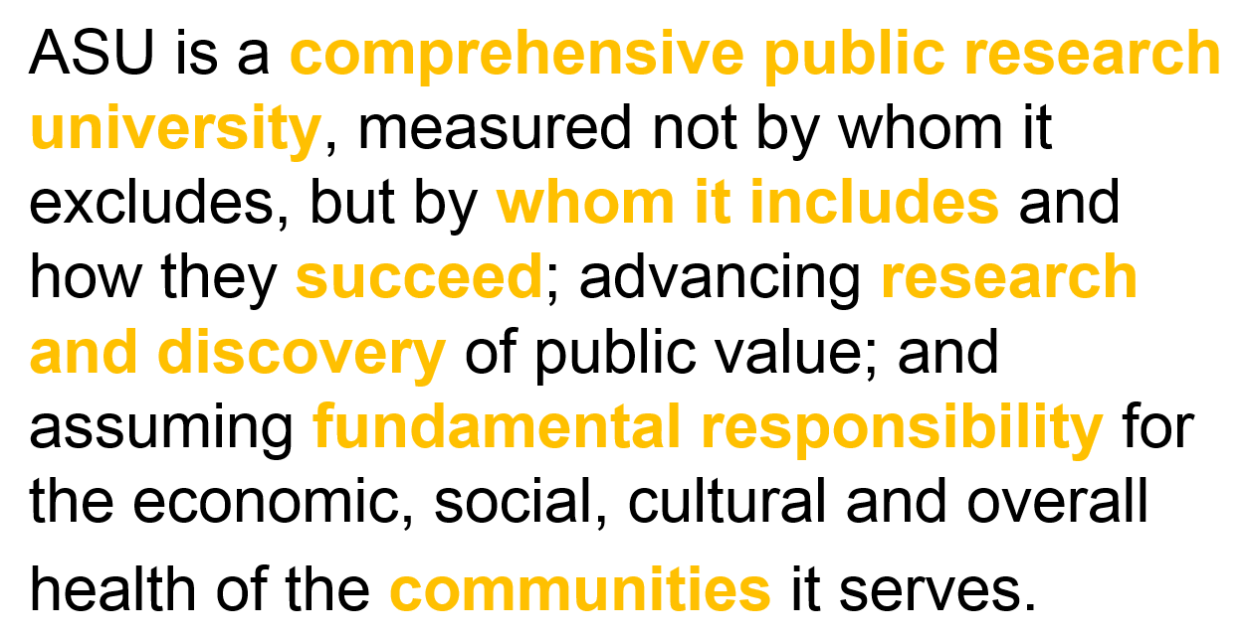
ONE UNIVERSITY / MANY PLACES
Metropolitan Phoenix AZ (5 Campuses), Washington, D.C., Havasu City, AZ, Santa Monica, CA, & Global Locations
“NEW AMERICAN UNIVERSITY” CHARTER
RECENT RECOGNITION
“Top 1% of world’s prestigious universities” - Times Higher Education
“#5 in graduation employability” -Wall Street Journal
“#1 chosen by international students” –Institute of International Education
BY THE NUMBERS
NOTABLE COLLABORATIONS
ABOUT ME
111K Students – ~86% 1st Year Retention!
15K Employees (3,600 Faculty)
19K Graduates
$604M Annual Research Expenditures
Starbucks (2014)
Mayo Clinic Alliance (2016)
Adidas/ASU Global Sports Alliance (2017)
Uber (2018)
TINA THORSTENSON
Deputy CIO & CISO
ASU since 2006
Higher education since 1995
Other Industry Experience: Transportation

Slide 5
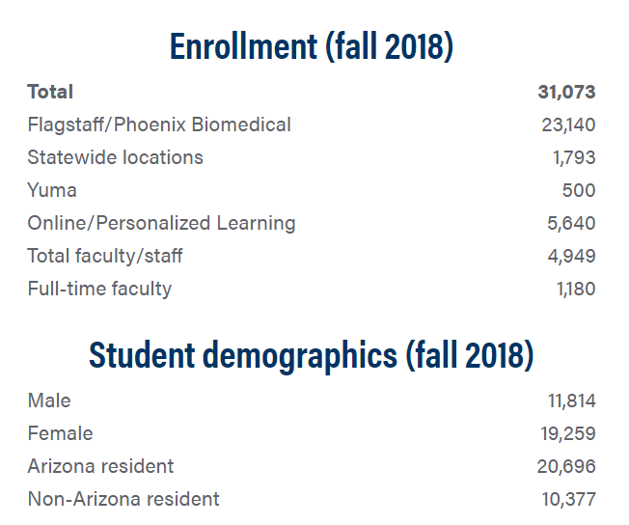
Michael Zimmer
Director of Information Security, CISO
22.5 Years in Higher Ed IT
InfoSec Program @ NAU
7 full time, 1-2 students, plus me
SOC (3+1+me); Compliance (1+me)
IAM (3 and not much of me)

Slide 6
How large is your InfoSec program now? www.slido.com – event code #F247

Slide 7
Differences & Similarities
We are all audited by the Office of the Auditor General
We all face similar threats and risks
Drop in State Aid and Funding
Resources, employee count, Infosec program size/maturity/make-up
Notes:
There’s so many things we could cover, but with limited time we’ll focus on these – some of them will pop up again in the presentation …
Audits occurring annually, recent IT/Infosec work in Financials Audits (all of us), and the Performance (for three of us).
Drop in state aid and funding → we have a slide coming …
Differences in resourcing, employee count, size of program, CISO as tactical or not – Reminder note: regardless of differences we find value in sharing and make time to do so.

Slide 8
Comparing InfoSec Resources
 | YC | NAU | UofA | ASU
InfoSec FTE | 2 | 8 | 14 | 25
Security Operations | Yes | Yes | Yes | Yes
Identity/Access Management | Yes | Yes | No | Yes
ISO Program - Training | Yes | Yes | Yes | Yes
Compliance | Yes | Yes | Yes | Yes
IT Department FTE | 29 | 192 | 350 | 550
Full Time Student Equivalent | 7,370 | 31,051 | 44,216 | 103,203

Slide 9
Evolution of Collaboration
Arizona Board of Regents Schools
NAU was the first to name a CISO (mid 2000’s)
U of A and ASU followed suit in the years that followed
Challenging in the beginning; turnover; by 2009 universities collaborating frequently
Last Two Years
Tina, Lanita, Michael have known each other a (very) long time
Michael and Sean crossed paths in a couple ways, stayed in touch, grew partnership
Tina recently established collaboration with K-12 community
Community Colleges
2009 – Arizona Community College Technology Officers (ACCTO) Formed
2013 – Inaugural Community Colleges of Arizona Information Technology Symposium (CCOAITS)
2017/2018 – AZCC Slack Channel Created; NAU/CCC/YC collaboration; TriU+1
Notes:
Community Colleges or smaller schools: don’t be afraid to reach out and contact larger schools!
Larger schools: take them up on the offer to share – they have a lot to offer!
Tina-Lanita-Michael knowing each other so long….. we admit that this made the current state of sharing VERY easy for us – not so for all

Slide 10
Public Higher Education in Arizona
Notes:
Idea here to show where we are located in comparison to one another, but also mention or try to point out that AZ is a very large state and we are quite geo-sep from each other.
Describe that it’s two hours from NAU to ASU, etc … could ask audience if they have the same challenges?
if feeling like it, bring up the trivia point of one community college needs to cross four state lines to support remote site!!

Slide 11
Do you collaborate with others now? www.slido.com – event code #F247
Notes:
Sean

Slide 12
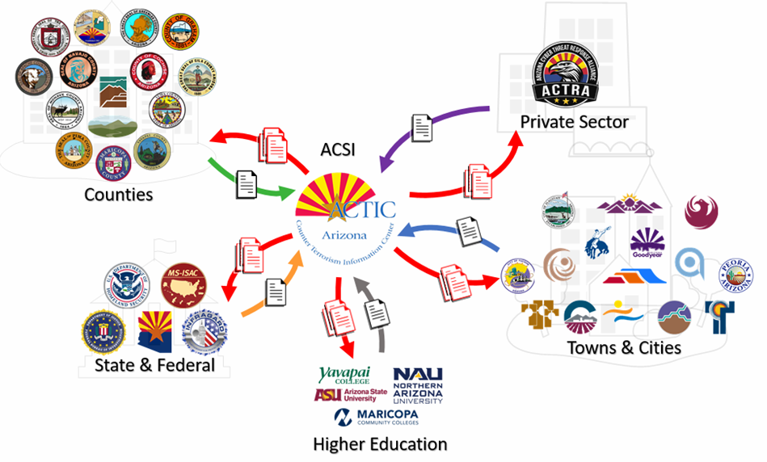
Why Collaborate?
Budget Pressures
Increased Challenges
Leverage Increased Purchasing Power
Unified State Audit Response
Regional Awareness & Sharing
ACSI = AZ Cyber Security Initiative
ACTRA = AZ Cyber Threat Response Alliance
AZCCIS = AZ Community Colleges
Governor’s ACT Program
InfraGard
Notes:
Everyone of us is facing similar challenges and could benefit from collaboration – we won’t go into details here, but we will cover some of our wins and successes later.
*** We will likely “ad-lib” this slide based on the audience… do we have a sense of large schools, medium, small schools?? Does it matter? BUT KEEP THIS SHORT AND FOUNDATIONAL FOR LATER.
Increasing Challenges are related to Research Growth, Regulations/Compliance (GDPR), very constant audits; Governance
Stories of centralized vs de-centralized

Slide 13
Shared Board Metrics
Security Awareness Training
Measurement: Percent completion annually
Multi-Factor Authentication
Measurement: Adoption number, percentage, rate – by affiliation
Scan/Testing coverage on (university-deemed) critical/sensitive systems and web apps
Measurement: Percent of critical applications that meet scanning standards
Risk Assessment
Measurement: Percentage of departments who completed a Risk Assessment
Enterprise level projects that receive a security review
Measurement: Percent of enterprise projects that have completed security review
System control or management – Servers, Endpoints
Measurement: Inventory of systems, patching of systems, % of endpoints encrypted
Notes:
Tina – could just refer to the slide where more information can be found, touching on the idea of shared metrics during presentation.
Let’s take a moment to show our agreed upon dozen or so board metrics – just as a demo or real life story from the last slide.
More info about/with the slide info:
1. Security Awareness Training
Measurement: Percent completion annually
NIST CSF Controls relating to Security Awareness Training
2. Multi-Factor Authentication
Measurement: Adoption number, percentage, rate – by affiliation
NIST CSF Controls related to MFA
3. Scan / Testing coverage on (university-deemed) critical/sensitive systems and web apps
Measurement: Percent of critical applications that meet scanning standards
NIST CSF Controls relating to scan/testing coverage
4. Risk Assessment
Measurement: Percentage of departments who completed a Risk Assessment
NIST CSF Controls relating to Risk Assessment
5. Enterprise level projects that receive a security review
Measurement: Percent of enterprise projects that have completed security review
NIST CSF Controls relating to security reviews
6. System control or management – Servers, Endpoints
Measurement: Inventory of systems, patching of systems, % of endpoints encrypted
NIST CSF Controls relating to system control or management

Slide 14
State Aid Per FTSE: FY08 vs. FY18
Notes:
illustration of the situation.

Slide 15
Have you lost funding from primary revenue sources? www.slido.com – event code #F247
Notes:
Possible follow-up question is how are you adjusting your security program as a result of the funding decreases.

Slide 16
Collaboration Successes
Audits
Governance, Risk, Compliance
Key Performance Indicators and Metrics
New Technologies and New Vendors
Policies, Standards, Procedures, Guidelines
Similar Technologies (Compare Notes, Best Practices)
Strategic Planning and Roadmaps
Tips, Tricks, Head’s Up (IOCs, etc.)
Vendor Negotiations
Notes:
This is where we allocate the “most” time for a single slide… provide some examples of wins, successes.
Some of this is reiteration of previous items… such as Audits, Governance, metrics…
* Collaborate on educational/awareness process and risk based approach.
NOTE: We have far more similarities than differences… sometimes you don’t know this until you start talking and sharing!!
Difference can still be helpful – it’s good to compare notes, eg, for future changes or renegotiations with vendors and campus leadership.
Similar Technologies – Compare Notes, Support
Firewalls, Endpoint Protection, SIEM, etc.
New Technologies (or Vendors)
“This is cool, you might find it useful for X”
Policies, Standards, Procedures, Guidelines
GDPR, Purchasing T&C’s (Thanks ASU!)
Audit – Prep, Reports, Response, Group “push-back”
Strategic Planning and Roadmaps
Governance, Risk, Compliance
Key Performance Indicators and Metrics
Vendor Negotiations
Splunk, Adobe, Microsoft, etc.
Tips, Head’s Up, BOLO (IOCs, etc.)

Slide 17
Collaboration Challenges
Differences in Approach or “Coverage” Duties
Different Maturity Levels
Different Technologies
Vendor Variations & Contract Limitations
Notes:
Centralized IT versus de-centralized IT.
How CCs are architected (opposed to the state institutions) the vendor negotiations are very different…
Difference can still be helpful – it’s good to compare notes, eg, for future changes or renegotiations with vendors and campus leadership.

Slide 18
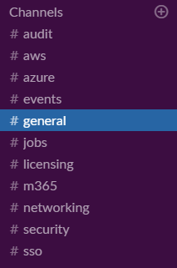
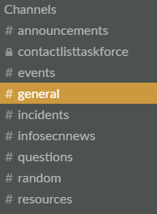
How We Share Information
Web Conference (Skype, Zoom)
Phone and Email
In-Person
Slack (ACSI, AZCC)
Conferences (CCOAITS)
Notes:
Some of these may seem obvious, but that’s because it is how it gets done. Remember how geo-spaced we are in AZ.
Sean will describe the CC history of Slack (and issues of governance – succession planning, openness [can anyone create channels, can you edit your posts, etc.])

Slide 19
Sharing Beyond AZ Higher Education
ACSI (VISE)
Educause
InfraGard
MS-ISAC
REN-ISAC
Vendor/Partner Communities
Notes:
National, Global, and different segments/industries – beyond Higher Ed as well.
Audience Participation – ask the question for a show-of-hands… “who participates in these, or previous slide’s types of sharing?” -- list one by one for show of hands, then ask for “what has worked best, worst”?
We could “close” this slide and transition to next one by someone saying “the type of information we are sharing may determine how we share or how we are connecting…”

Slide 20
Considerations When Sharing
More People = Greater Scheduling Difficulties
Balance Cost / Lost Time vs. Collaboration Value
Focused Meetings (Compliance, SOC, IAM, etc.)
ASU-led Executive Compliance Focused Meeting
NAU-led Splunk Hands-On
Agendas are Really Helpful

Slide 21
Audience Participation Time
Notes:
we ARE here to share after all, right?!
Overall Idea = ask the questions of audience and seek hands/volunteers.

Slide 22
How would you create a relationship with that school, college or university down the road or across the state?
Is there something stopping you? If you’ve done it, tell us about it.
Notes:
Raise your hand and share approach.
15 second intro
3 minute discussion
3 minute feedback

Slide 23
Getting started.
What would you share and what would you want to learn?
Notes:
15 second intro
3 minute discussion
3 minute feedback

Slide 24
What experiences do you have with collaborating with teams external to your school, college, or university?
What’s one thing that worked and one thing you’d do differently?
Notes:
15 second intro
3 minute discussion
3 minute feedback
… the good, the hard, is it still in place, lessons learned?

Slide 25
Key Takeaways
Work smarter, not harder
Build some governance around collaboration
Build partnerships in your community
If you are going to make a mistake make it a new one; learn from the stories of others
An emergency is not the time to forge new relationships

Slide 26
Questions and Discussions
Notes:
Thank you for joining us – we know you had a great set of presentations at 11am today to choose from.
Wrap-Up, Questions and Discussions
Want More Sharing?
Lunch is next on the agenda (sorry we kept you from it)
… join us or your new-found friends to keep the discussions going!

Slide 27
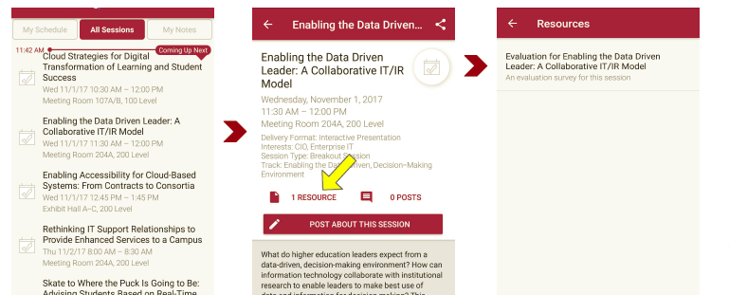
Session Evaluations There are two ways to access the session and presenter evaluations:
1
2
In the online agenda, click on the “Evaluate Session” link
From the mobile app, click on the session you want from the schedule > then click the associated resources > and the evaluation will pop up in the list

