Slide 1



Say YES to CreAtive Cybersecurity
See, Say, and Do. Together.
Erika Powell-Burson, MSIA, CISA, CISSP
CISO, Bentley University
Notes:
Introduction – Welcome to this session on Creative Cybersecurity!
I am thrilled that YOU are here, and that we can spend our hour together looking at cybersecurity through new and colorful lenses.
“Passion is one great force that unleashes creativity, because if you're passionate about something, then you're more willing to take risks.” Yo-Yo Ma

Slide 2

Burson
Clan - Summer 2018
Notes:
I am a first time attendee at SPC, and I am relatively “green” to higher-ed. (18 months at Bentley University --- private business university.
Before higher-ed, I worked at Fidelity Investments for over 20 years. I left Fidelity to build a cybersecurity program “from scratch” and lead it to maturity. I’ve since built up programs at two start-up SaaS companies and one community hospital (all in the Boston area).
With the exception of one organization, I was a ”department-of-one” and there was little-to-no budget. If I didn’t create or invent or co-erce it, it wasn’t happening!

Slide 3
Session Objectives
See It. Visualize your strengths. Identify needs/gaps in context the university needs and the cybersecurity program. Create a strategy and roadmap working with CIO / stakeholders.
Say it. Connect with your team. Communicate a compelling vision to supporters and advocates, then move the program / initiatives forward. Create partners; recruit evangelists.
Do it. Seed a creative awareness program, start small based on core policies/controls to address top risks, then mature collaboratively.
Together.

Slide 4
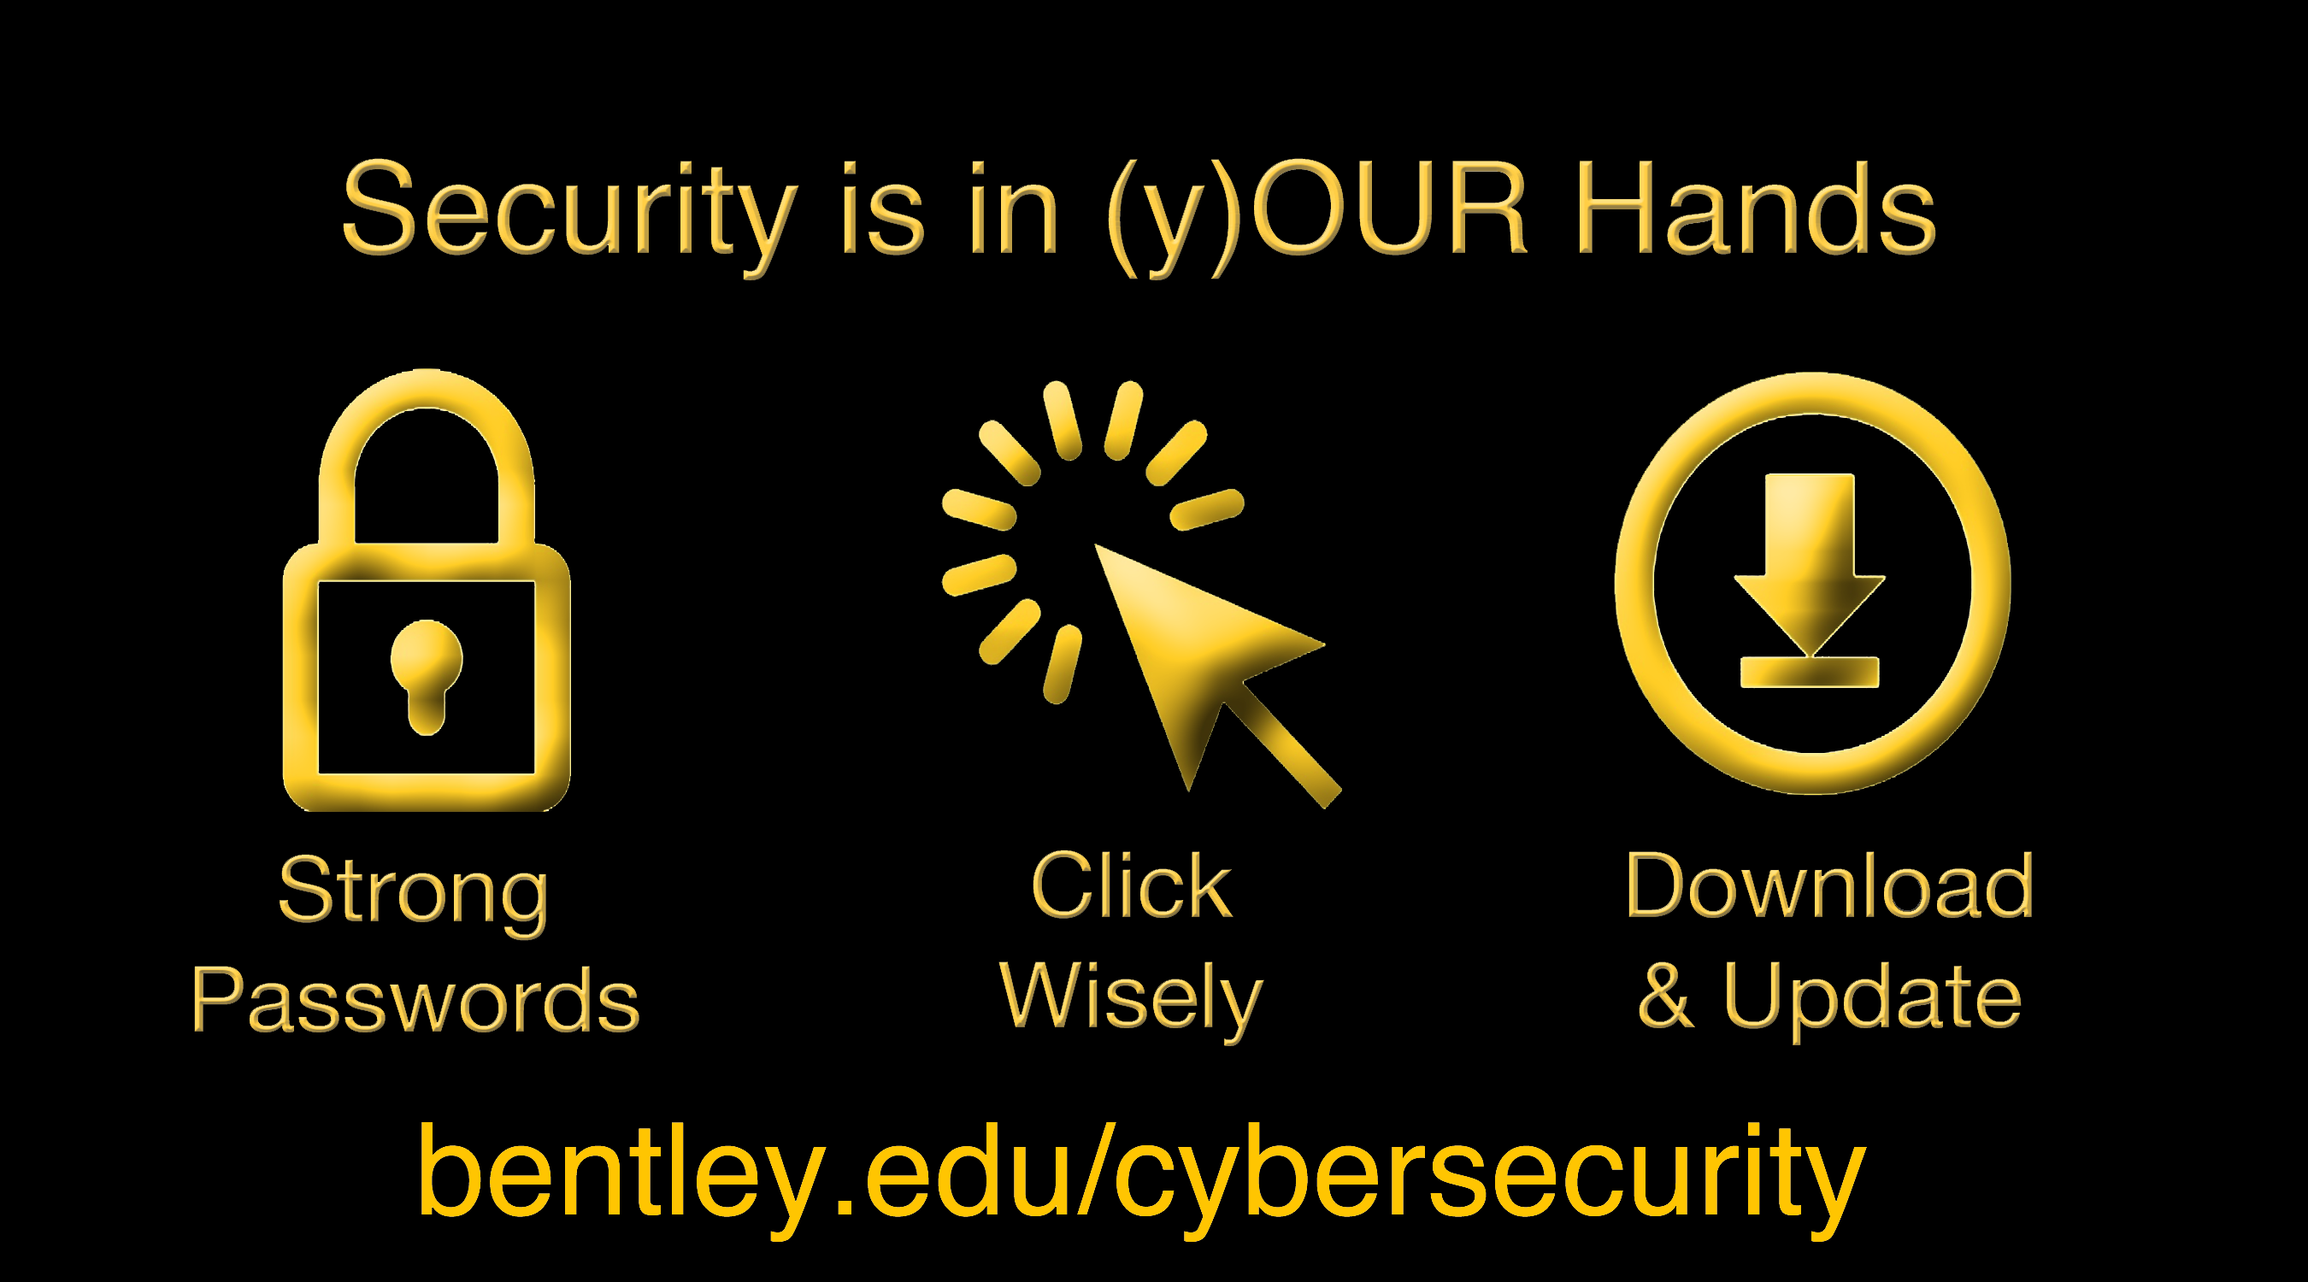
Cyber Monday
Notes:
Share video: Cybersecurity Monday… Engagement and total support from faculty, students and staff, including our new president and the CIO.
https://videos.bentley.edu/media/A+Cyber+Security+Monday/1_tjuaieiw/65552731

Slide 5
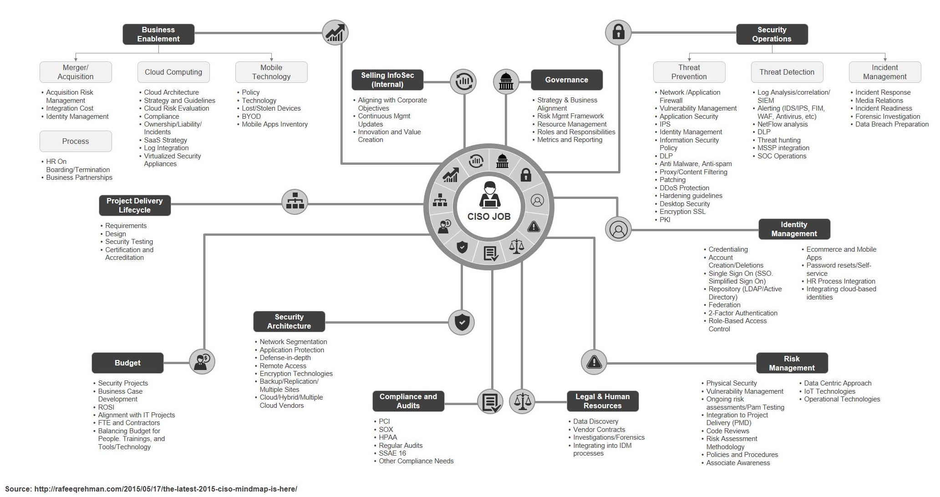
See: the job
Notes:
Let’s start with the work and your role… you may be a one-person shop, or have a large team. You may have some of these functions in your scope, or all.
Note, since the 2015 version, the cybersecurity job/role has expanded even more. 2018 Version: http://rafeeqrehman.com/wp-content/uploads/2018/05/CISO_MindMap_2018.pdf
New adds include:
(Business Enablement): Emerging tech, e.g.SDN; augmented reality; autonomous vehicles; connected medical devices
(SecOps): Automated threat hunting
(Skills development): e.g. machine learning skill development; understanding algorithms; drones; medical devices; industrial control systems
DevOps Integration
Data Analytics – Computer vision in physical security
Log anomaly detection

Slide 6

See: you.
  super-power(s) krypto-weakness(es)
Notes:
Jot down a super power (or two) that you have, and a couple examples of how you are using it.
Jot down a weakness you have (or two) that may be hampering the realization of your full talent. Examples of how you are/will compensate.
Think of this like a risk assessment… accept the risk, mitigate, use compensating controls, and/or remediate ☺
Consider:
Power of Positivity. Change from the “FUD” factor to C3… from Fear, Uncertainty, Doubt → to → Courage, Confidence, Clarity
Power of Vulnerability. Understanding yourself so that you can maximize your strengths, develop and/or augment weak areas.
Give yourself credit for interpersonal, leadership, communication and technical skills (etc.) as well as experience, training and education (all transferrable skills)
Taking it a step further, consider: Self eval quiz / 360 feedback

Slide 7
Finding Flow
The state of (creative) FLOW is “being completely involved in an activity for its own sake. The ego falls away. Every action, movement, and thought follows inevitably from the previous one, like playing jazz. Your whole being is involved, and you’re using your skills to the utmost.”
- Mihály Csíkszentmihályi
Notes:
Ideally, we’d find FLOW as we take our tasks and goals and seek for innovation and collaboration
Csikszentmihalyi did a 12-year study with people all over the world. He discovered that, regardless of age, nationality, or conditions of life, almost everyone described optimal experience in a very similar way. That helped him reach a definition of some of the things that come up when you enter a state of flow. Here they are:
A challenge that makes you use all your skills. If the challenge demands the highest level of your skills, it’s very likely you’ll start to flow.
Focus and concentration. In a flow state, your focus is so centered that the world and your ego completely disappear. Your whole being focuses on one thing, and you enter an extreme state of concentration.
Clearly defined goals. Csikszentmihalyi found that we get more enjoyment out of things when we have clear goals. If they’re vague or unclear, your attention will fade.
Direct, immediate feedback. People need to get short-term feedback to reinforce their behavior. Feeling like you’re on the right track adds intensity to your experience.
Exclusion of other information. In a state of flow, there’s no room for information unrelated to the activity at hand.
A feeling of control. When you’re flowing, you feel very in control of what’s happening. It’s like a compass for your self-knowledge.
You lose your sense of self-awareness. In these kinds of states, it’s almost like your sense of self has completely disappeared. What this does is create a kind of “freedom” effect inside you.
A change in your perception of time. Experiencing this state gives you the feeling that time has compressed. Three hours will feel like 30 seconds in a state of flow.
Image: https://static.freepsdfiles.net/uploads/2011/04/Creativity-Flow1.jpg

Slide 8
See it. framework & strategy.
Notes:
If you don’t have a graphical representation already of your strategy/framework (which I didn’t), creating one will help engage stakeholders and help them understand “what you do”
Use your visual examples to tell a compelling story/stories. Make them relatable for the key stakeholders, and personal when/if able.
Operations – Creative in the buy-in but as regimented/documented/templatized as possible in
IRP – plan, run books, IRP; after action
Tool selection / implementation / optimization
Collaboration – vendor; assoc
Awareness – free online vids / content Educause +
Training
https://sites.google.com/view/tty-csgame/english?authuser=0

Slide 9
See it. assess target and current state.
Weak | Partial / Reactive | Risk-Informed/ Proactive* | Repeatable/Managed | Adaptive/Optimized
Level 0 | Level 1 | Level 2 | Level 3 | Level 4
COMPOSITE RISK
Limited Risk Management
Formal Risk Management Process
Practices Adapt Based on Lessons-learned and Predictions
Policies & Procedures Defined
Governance Body Established
IT Centric
CISO Appointed
Security Organization Defined
Info-Centric Approach
Two-way Info-Sharing with External Organizations
Ad-hoc Activities
Formal Program Initiated
Risk Assessments Conducted
Metrics In Place
Initial Executive Awareness
Limited Awareness
Improving User Awareness
Cybersecurity Risk Management is Part of the Culture
InfoSecurity Program Working Well
SECURITY MATURITY
* Current Security Level = 2
Ref: NIST CSF/Gartner
Notes:
This maturity model is a hybrid of the NIST Cyber Security Framework (CSF) and Gartner’s Maturity Model. And after a first pass assessment, the security maturity was found to be Level 2. A goal of Level 3 may be generally acceptable, as this is higher-ed.
If using NIST CSF, a more in-depth tool to use that is free is: https://expel.io/blog/get-started-with-the-nist-csf

Slide 10
Example:
A Vintage
Circus was my Vision for our 2018 October
Tent Event

Slide 11
Say it. build a team. it takes work.
Patrick Lencioni – The Five Dysfunctions
Notes:
Patrick Lencioni’s The Five Dysfunction of a Team book
Trust first: Lead the way with a willingness and a demonstration of authentic vulnerability. Believe each team member has “good intentions” Ref: HBR – What Bosses Gain By Being Vulnerable by Emma Seppälä https://hbr.org/2014/12/what-bosses-gain-by-being-vulnerable
Address Conflict: Look for and mine for conflict in order to pull out all the difficult issues to address and create trust as well as get ‘unstuck’ and move forward as a high-performance team. Ref: HBR - True Leaders Believe Dissent is an Obligation by Bill Taylor https://hbr.org/2017/01/true-leaders-believe-dissent-is-an-obligation and Conflict Keeps Teams at the Top of Their Game by Mark de Rond https://hbr.org/2012/07/conflict-keeps-teams-at-the-to and HBR Difficult Conversations: 9 Common Mistakes https://hbr.org/2010/10/difficult-conversations-9-common-mistakes
Commit: Get to an “All – In” state. Facilitate clarity and agreement. Encourage, engage, and assure team commitment. http://usmanconsulting.com/wp-content/uploads/2015/05/Decisive-The_WRAP_Process_one_pager.pdf
Be Accountable and Promote it: Set goals and expectations and hold individuals and team accountable. Confront difficult issues and help individuals and the team to ‘own’ and resolve issues. HBR - Four Tips for Building Accountability by Rosabeth Moss Kanter https://hbr.org/2009/08/looking-in-the-mirror-of-accou.html and Inc. Magazine - 5 Ways to Raise the Accountability Bar https://www.inc.com/david-finkel/5-ways-to-raise-the-accountability-bar-inside-your-company.html
Measure Results: Focus on delivering measurable results – collective and deliverable. Measure effectiveness. Get feedback. Establish understanding of the team ‘mission / vision’ and expect individuals to align their priorities and focus for collective success. Inc. Mag How to Create a Results-oriented Culture by Lou Adler https://www.inc.com/lou-adler/how-to-create-a-results-oriented-culture.html

Slide 12
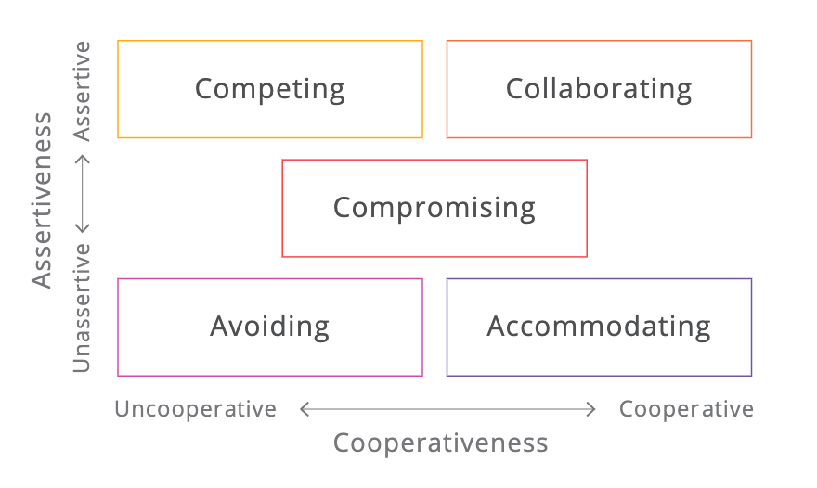
Say it. be creative to resolve conflict.
Thomas-Kilmann Conflict Mode Instrument (TKI)
Notes:
Competing - Assertive and uncooperative behavior where an individual looks to satisfy their own concerns to win a position, potentially at others’ expense
Collaborating - Assertive and cooperative behavior where an individual will look to work with another to find a solution that satisfies the concerns of both
Compromising - Mid-way in assertiveness and cooperativeness. When compromising, an individual looks to find an expedient, mutually acceptable solution
Avoiding - Unassertive and uncooperative behavior where an individual pursues neither their own or the other party’s concerns and does not address the conflict
Accommodating - Unassertive and cooperative behavior where an individual neglects their own concerns to satisfy those of another. The opposite of competing

Slide 13
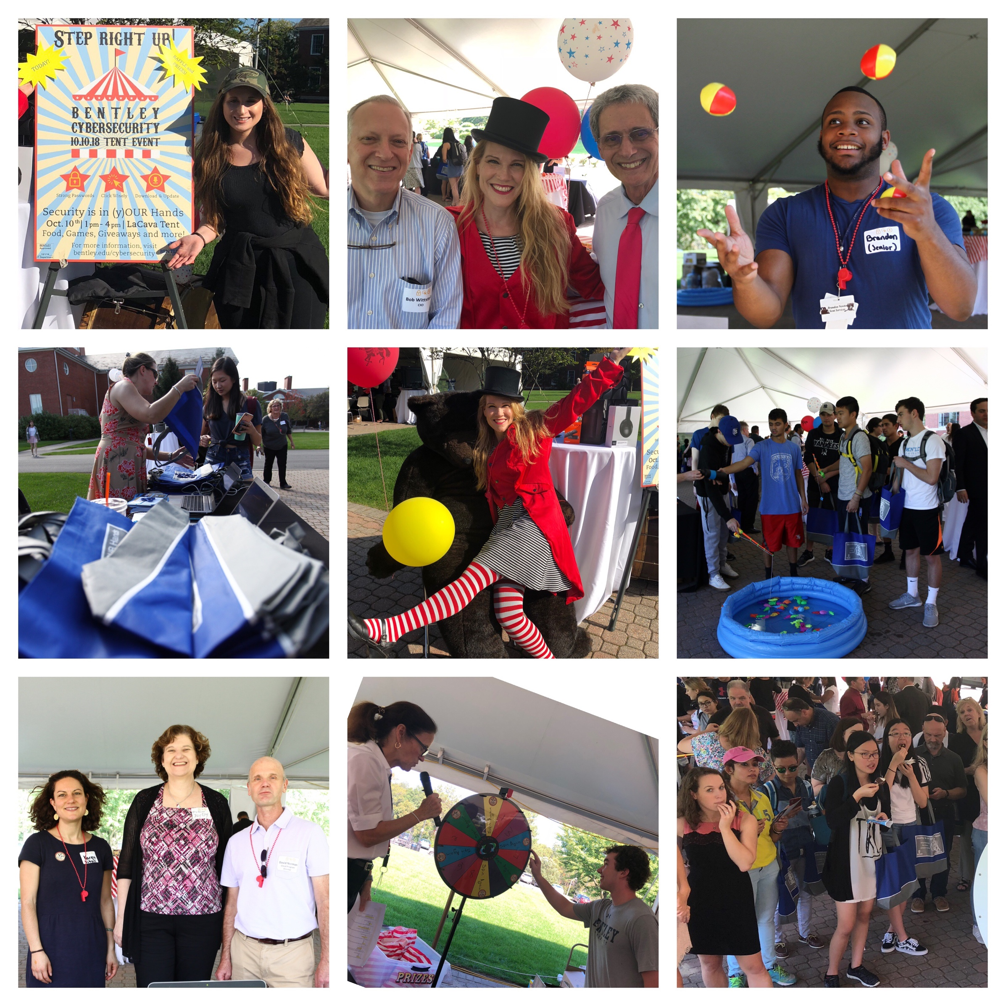
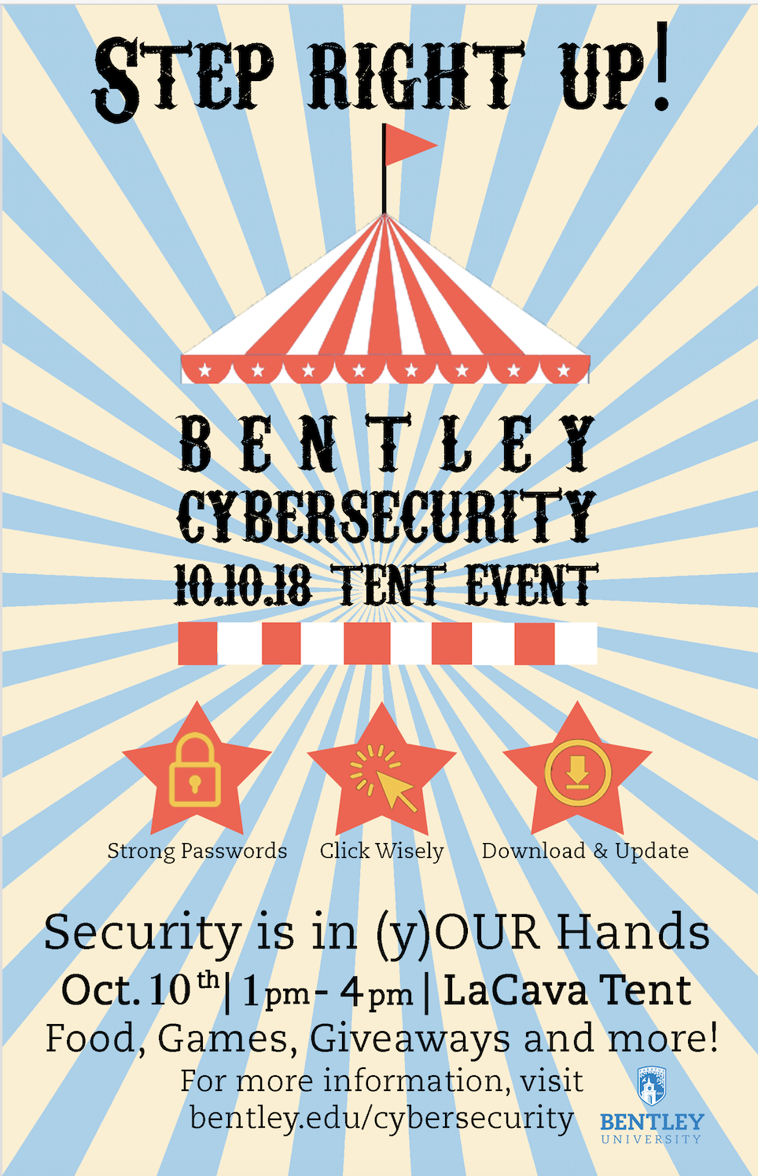
Notes:
The culmination of our 10-10-Tent Event involved faculty, students and staff, including the president, CIO, interim provost, student workers, etc.
We had the marketing group help with posters; a student designer collaborate with us on the poster. Lunch-and-Learns by professors, including Steve Weisman who has written books, many articles (e.g. USA today) and runs the blog https://scamicide.com

Slide 14
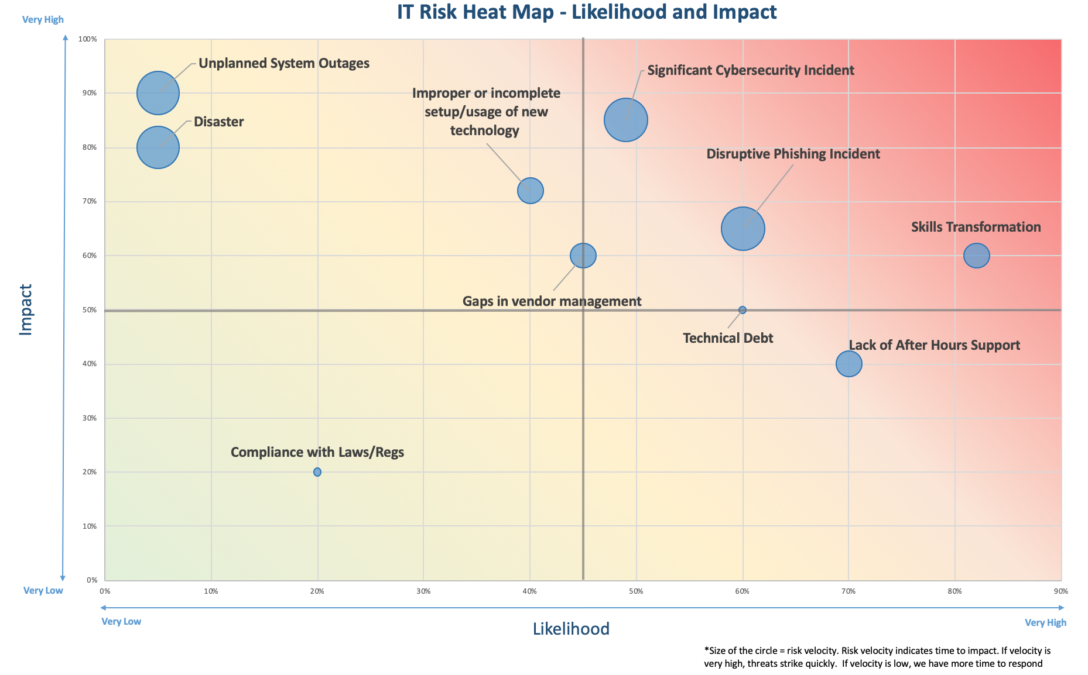
Example:
Product of positive conflict

Slide 15

Example: Engaging Others
HOW TO CREATE IT VID:
< L I N K >
Create a script
Choose your location
Draft actors
Feed them
Use iPhone / iMovie
Notes:
I was a department of 1 at a SaaS company. It was a start up with a creative and engaged culture/community. I fostered relationships with several groups, especially those high risk (sys admins, web-app developers) and high impact (e.g. office manager, helpdesk) and deputized some as ambassadors.

Slide 16
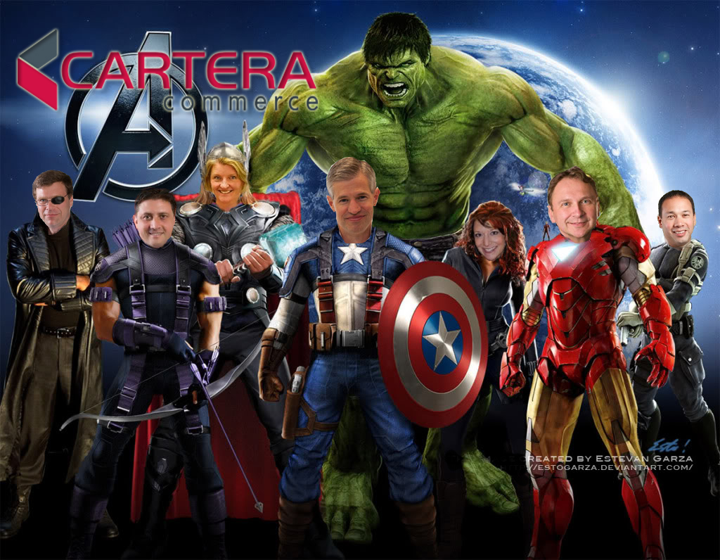
Example - Engage Broader Leaders:
1. Brainstorm Ideas
2. Pick the BEST one relevant to YOUR culture
3. Pitch it to Exec Team
4. Get the GREEN Light!
JOIN the team of DATA SECURITY Heroes
16
Notes:
Our Executive Team underscored the primary reason WHY we need to be diligent with Data Security…
We have commitments to Partners & Customers re: “C-I-A”.
Meanwhile, external threats persist AND the “weakest link” can innocently jeopardize security.
We each need to Manage RISK appropriately based on our responsibilities.

Slide 17
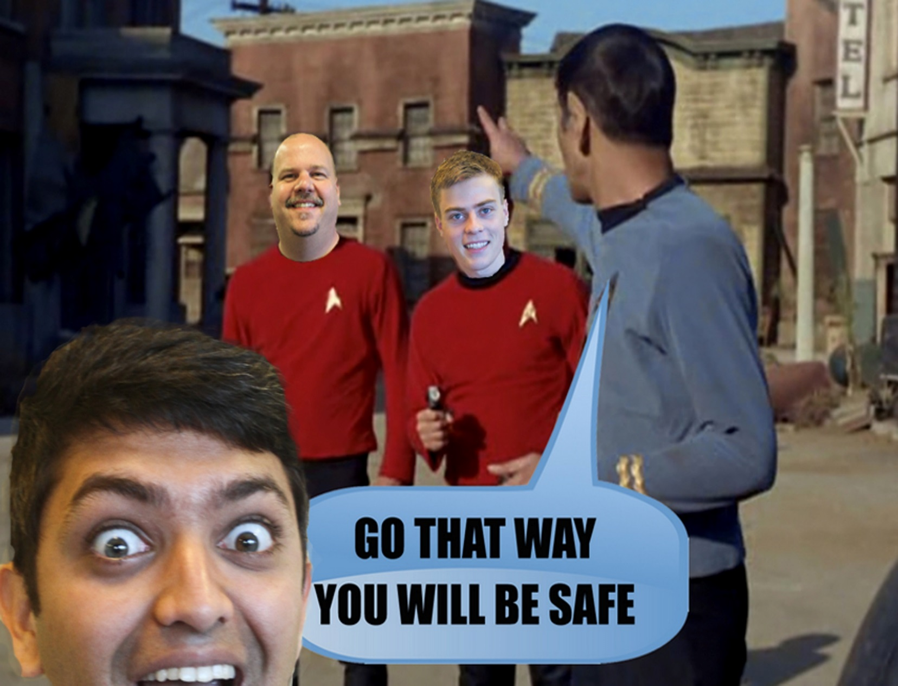
The REAL Spoc Wouldn’t LIE… Don’t be PHISH-FOOLED
Example - Create Thematic Memes:
Take Headshots of willing individuals
Pick a THEME for your MEME
Engage Help (contest?)
Share at an ALL HANDS Training
Use elsewhere, e.g. intranet; screensaver

Slide 18
Do it. puzzle it out.
“If I had an hour to solve a problem I'd spend 55 minutes thinking about the problem and 5 minutes thinking about solutions.”
- Albert Einstein
Which challenge to tackle now?
Notes:
“It’s the Start that STOPS most people” – Don Shula
Creative talent needs .. Problem assessment, questioning, before jumping to solutions.
EX: AI/Machine learning to reduce risk of human error? https://www.forbes.com/sites/forbestechcouncil/2019/01/30/three-trends-that-could-keep-cybersecurity-on-its-toes-in-2019/#238903b27e4e
https://www.scmagazine.com/home/security-news/missing-qualified-cybersecurity-pros/ March 4 2019 Rob Able
Armen Marsh said “Even more so we need the creative side of humans,” Marsh says. “If you are looking to raise a new generation of cyber professionals, find someone who besides having an analytical mind, also is creative and has an abundance of emotional intelligence, because that goes deeper than just what our logical part of mind does when we are doing the reasoning.
Carmen Marsh says that “people with a high EQ can see different dimensions of everything including people and have a better understanding of what the “other side” thinks and feels, which is different from what our cognitive ability gives us.A creative cybersecurity professional may also have a different demeanor than one might traditionally expect in the role, one that may initially come off as shocking or atypical, but researchers warn certain exceptions to these norms may have the most potential.
That’s much more telling and productive than the standard interview questions,” Pearson. “I don’t want to know if they can memorize and repeat things, I want to know that they can think on their feet and have a drive to solve puzzles and get to the bottom of a challenge. In fact, I’m just as happy if people ask questions during an interview versus always answering them.”
Pearson says when you give those types of people ownership and an ability to prove themselves, it lifts them up and drives success and that one person’s success breeds more success.
Cybercrime is increasing and by 2021 could cost companies $6 trillion, making it more profitable than the global trade of all illegal drugs combined, according to Cybersecurity Ventures. O’Gorman says there is no shortage of awareness of cybercrime’s importance but there is a significant lack of action in addressing it

Slide 19
Brainstorm 3 scenarios.
  faculty students staff
Notes:
Consider:
Power of Positivity
From: Fear, Uncertainty, Doubt → Courage, Confidence, Clarity
Power of Story Telling
Power of Vulnerability
Transferrable skills
Self eval quiz / 360 feedback
Leadership materials/classes
Words matter e.g. “Leadership skills” vs.”Soft Skills”

Slide 20
Notes:
https://www.creativelive.com/blog/creative-education-importance/ - Hillary Grigonis July 12 2018
latest news in science suggests that creativity comes from our own unique personalities, experiences, and visions, creative education can help turn that spark of an idea into a finished creation.

Slide 21
Do it. many layers. better security.
Image: MalwareFox
Notes:
A focus on architecture requires someone who can create original ways to deploy security infrastructure for maximum impact and efficiency. Separately, transformation managers guide investment prioritization, align projects and capabilities, and ensure proper resourcing is in place.
Machines aren’t replacing humans in cybersecurity, but rather displacing them — pushing them to evolve their skills and take on jobs that serve as important enablers to the machines.
MORE FROM FEDTECH: Find out how the government plans to reskill workers for cybersecurity roles.
Humans Need Timeless, 'Soft' Cybersecurity Skills
What’s special about the jobs listed above is that they’re not machine-driven. While machines might support them, these jobs rely on innately human skills centered on the “four C’s”: critical thinking, communication, collaboration and creativity. These are the skills that change hearts and minds, inspire a following, devise compelling technical solutions and — ultimately — change the world.
The four C’s are timeless skills that don’t get nearly enough attention in the cybersecurity field, either on the job or in formal education forums. Cyberprofessionals moving up the ladder or simply seeking to exert more influence will find these are make-or-break skills that can propel them forward.
Matthew Doan - https://fedtechmagazine.com/article/2019/01/creative-cyberworkers-retain-their-place-workforce

Slide 22
Example:
Layered Security

Slide 23
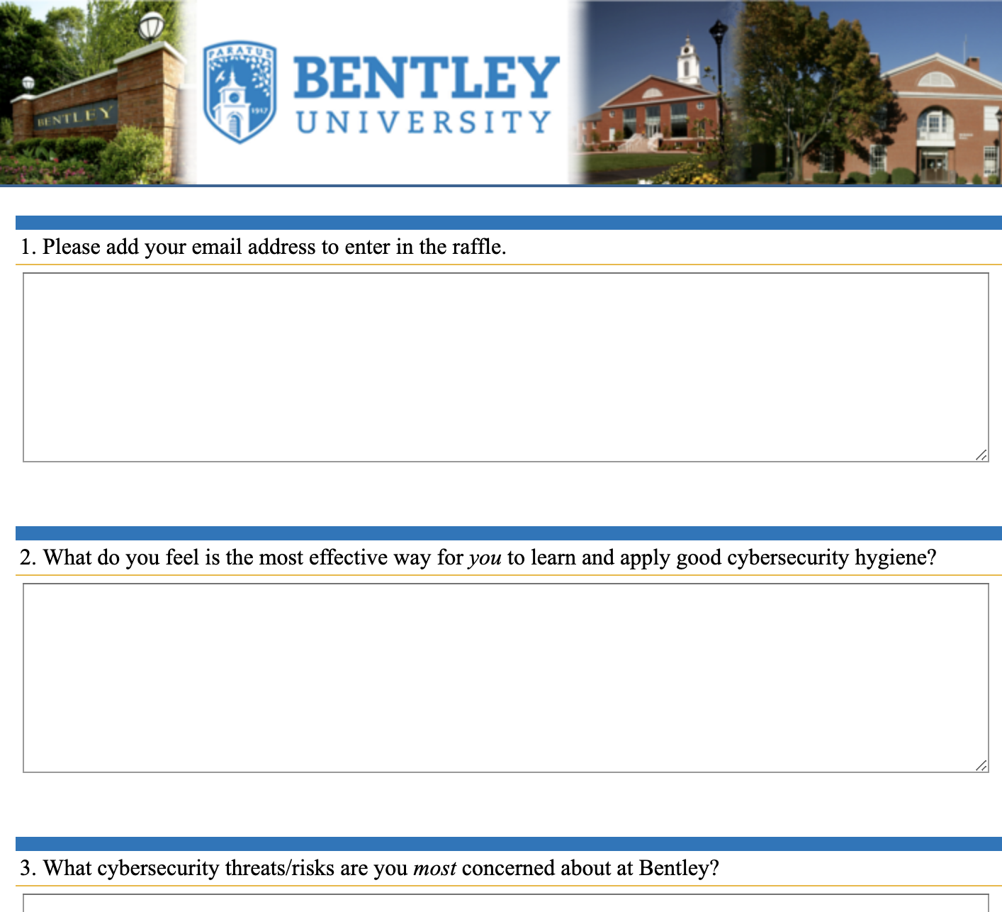
measuring
# of people trained
Result scores for quizzes
# of attendees at an event
Qualtrics survey (incent if able)
Comparison on phishing campaigns

Slide 24
Your favorite creative examples?
  University GRC Industry Operations Awareness Other?
Notes:
Consider:
Power of Positivity
From: Fear, Uncertainty, Doubt → Courage, Confidence, Clarity
Power of Story Telling
Power of Vulnerability
Transferrable skills
Self eval quiz / 360 feedback
Leadership materials/classes
Words matter e.g. “Leadership skills” vs.”Soft Skills”

Slide 25
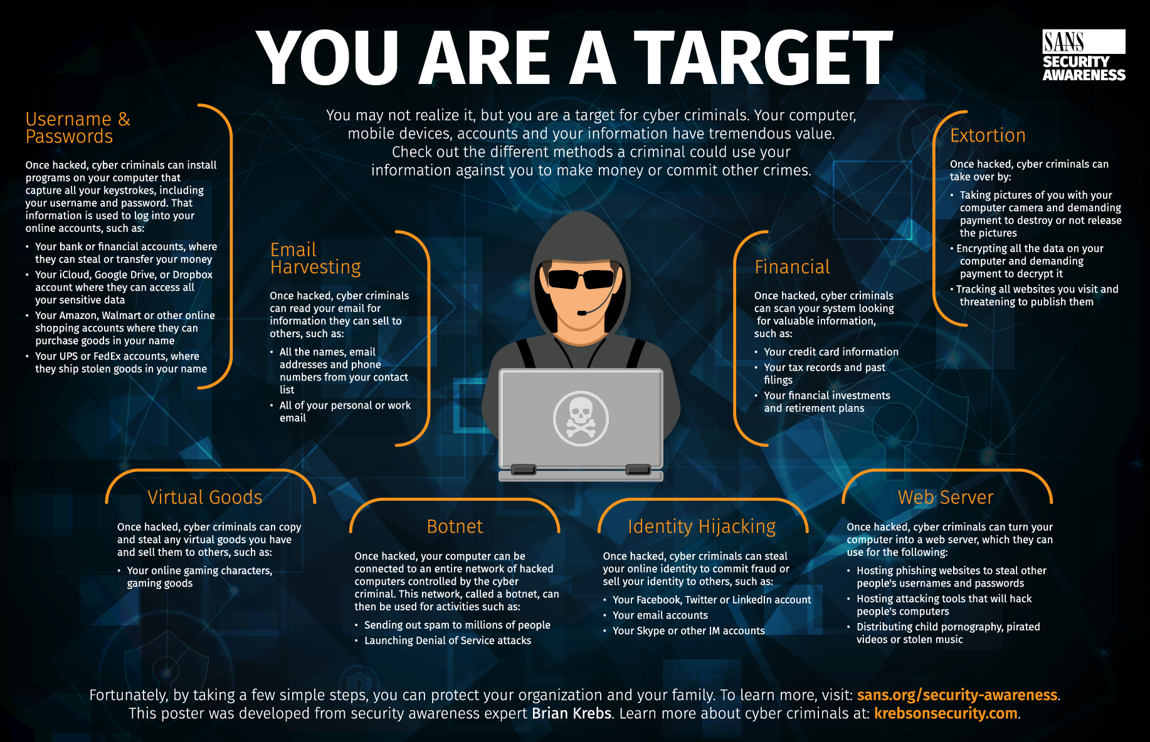
https://www.sans.org/security-awareness-training/resources/

Slide 26
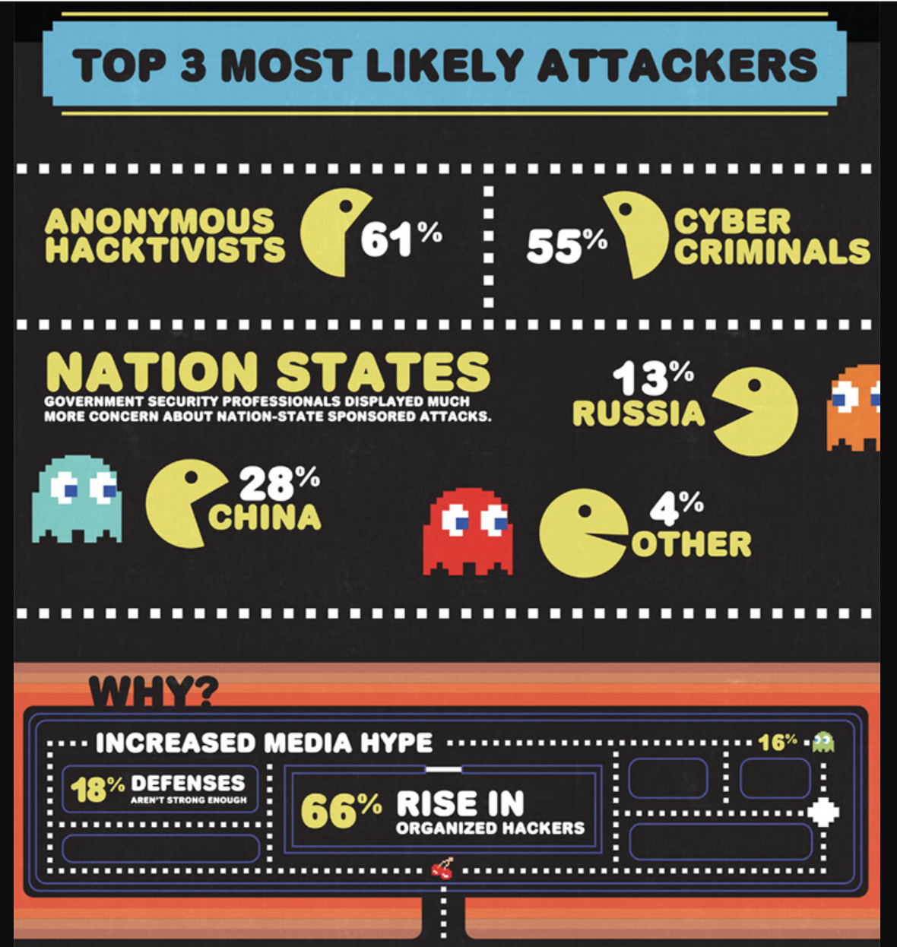
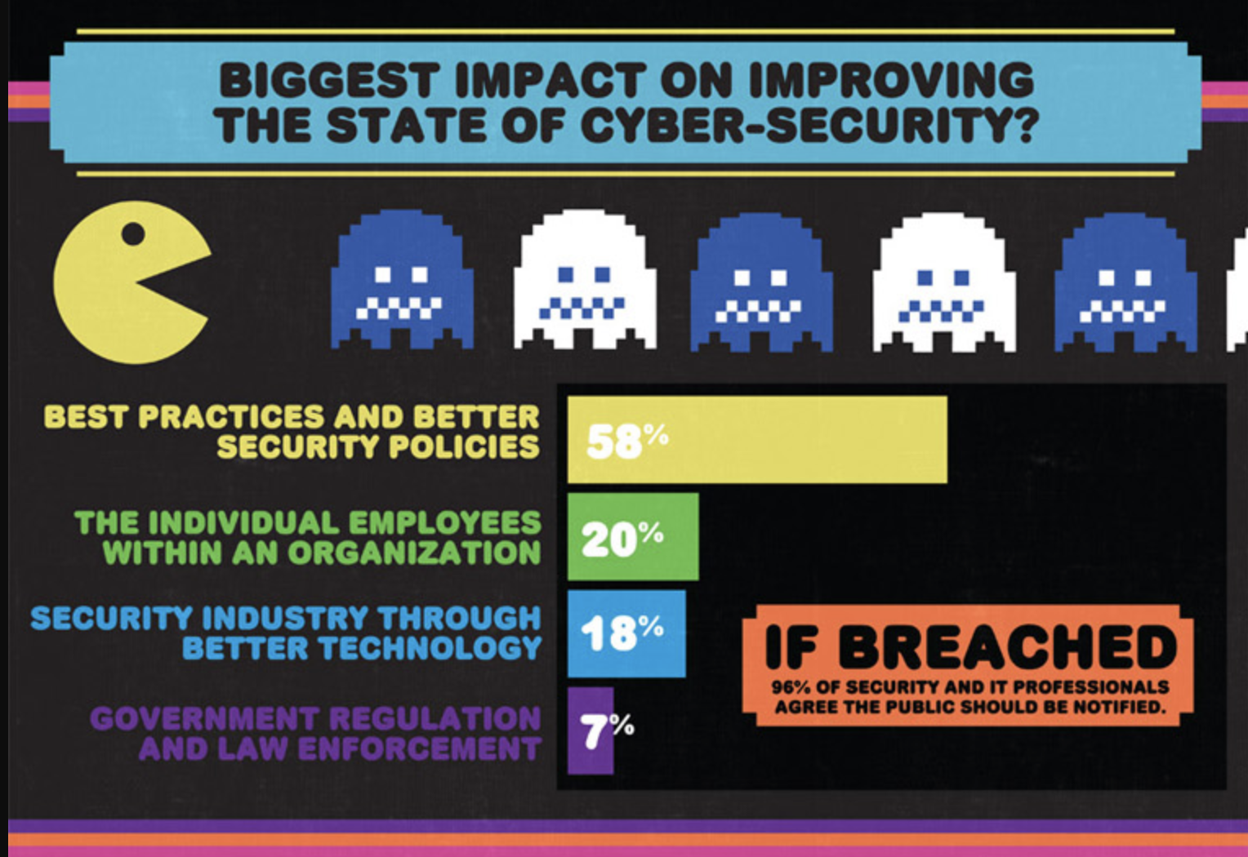
Pacman Fever
Notes:
https://fedtechmagazine.com/article/2012/08/pac-man-chews-cybersecurity-infographic
We all remember the age-old video game where the hungry Pac-Man chews up dots while pixel ghosts run around trying to obstruct Pac-Man’s path.
Imagine your software is Pac-Man, and the ghosts are hackers you’re constantly running away from. We fear the ghosts, but sometimes we run into a trap, and there’s no way out.
There are certain ways to keep hackers from chasing you in the first place. This Bit9 infographic has interesting facts on cybersecurity, malware and hackers.
A few notable takeaways:
Government officials are among the most concerned about cybersecurity.
61 percent of security and IT professionals think they will be attacked within the next six months.
Organizations are most likely to be attacked with some form of malware.
The best way to improve the state of your cybersecurity is by promoting better security policies.

Slide 27

Do it. game plan.
One Week (see it.): Conduct a self assessment and team assessment of ”powers”. Construct a problem statement, and prioritize based on risk and department/university goals. Formulate and depict a strategy in graphic form. Pick 1 or 2 ideas to develop that will turn the problem into an opportunity.
One Month (say it.): Identify partners and stakeholders, and brainstorm ideas and methods to reach the desired goal.
Three Months (do it.): Establish criteria to evaluate success. Formulate a plan. And do it.
Together.
Notes:
Focus. Discipline. And Compassion.
Word Choice is Important
Look for ways to measure results
Survey (possibly incent to complete)
Reports up
Incidents down
Clicks down

Slide 28
session evaluation
Please complete an evaluation of this session
  on the mobile app
  in the online agenda

Slide 29
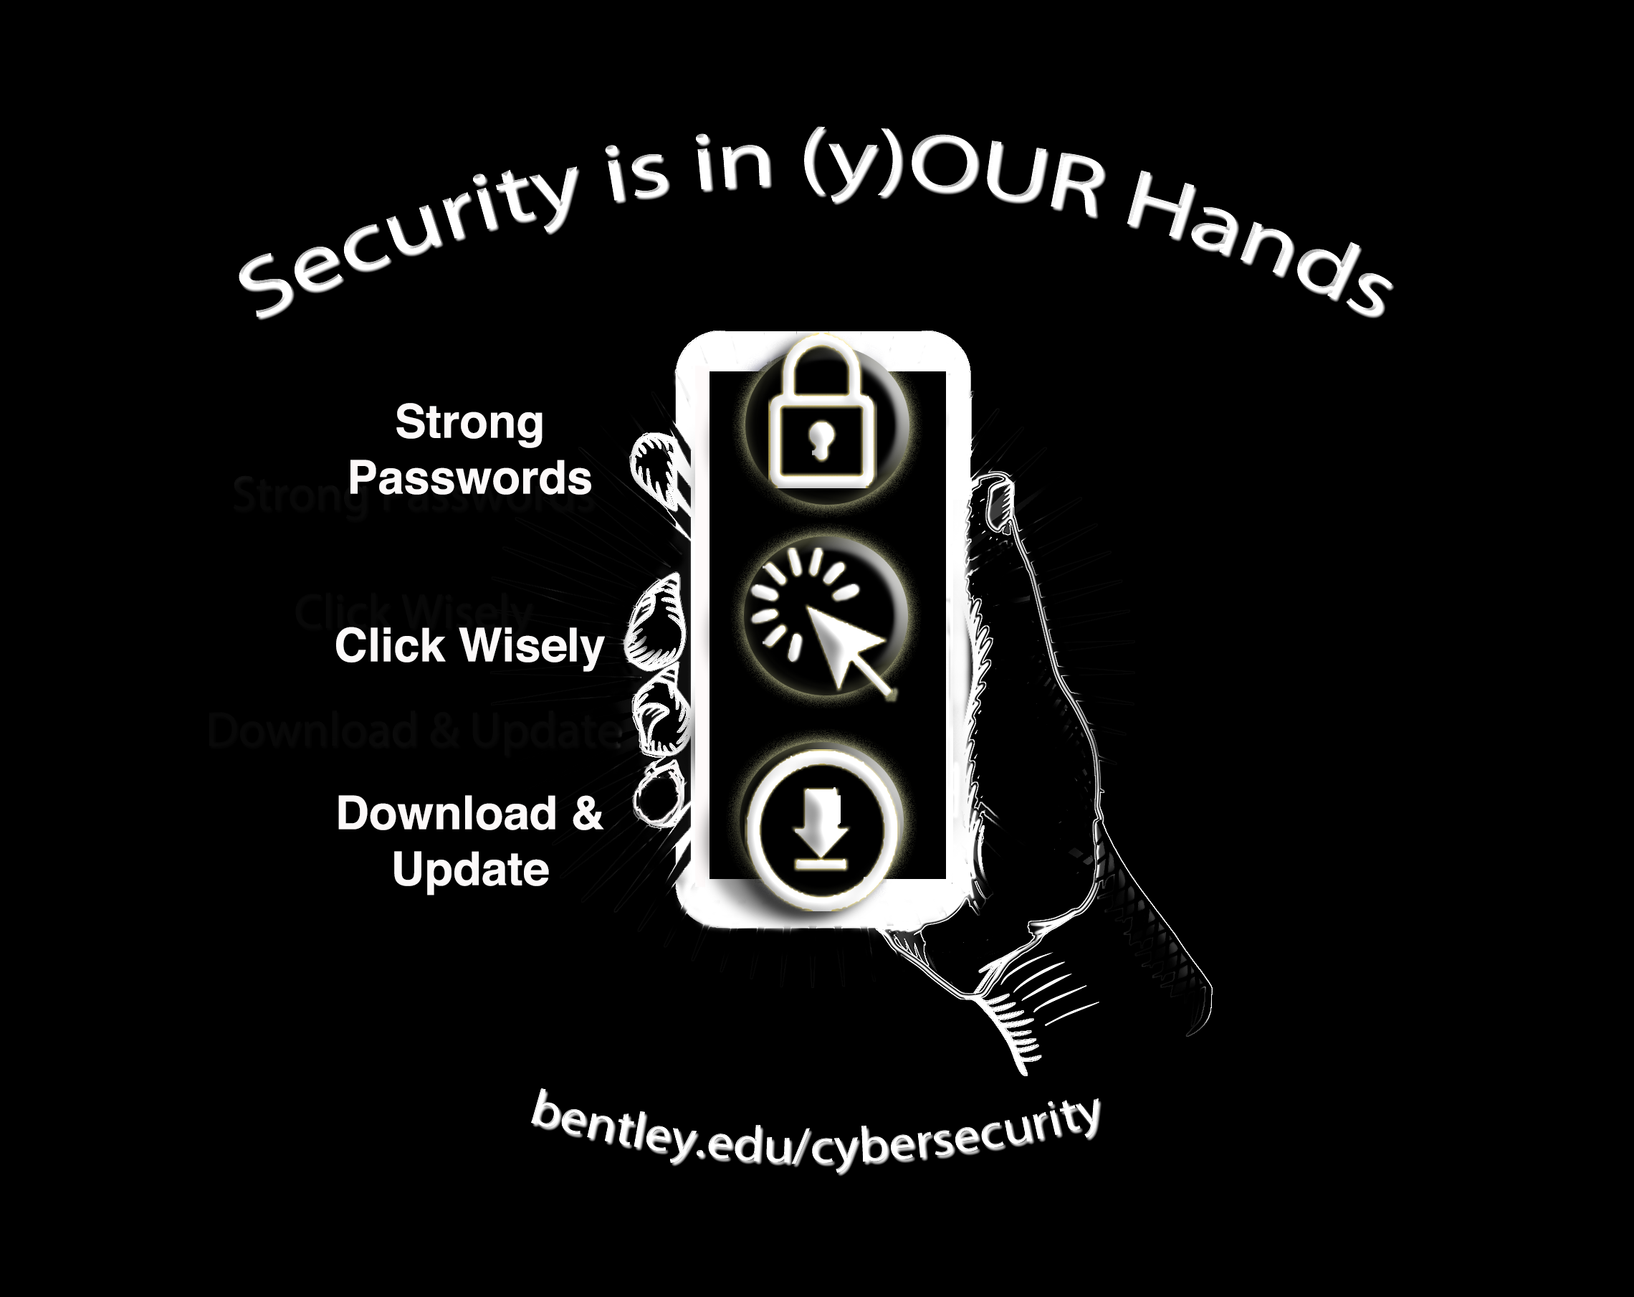

Slide 30
free resources
See It:
  You
    Creativity & “Flow” - https://exploringyourmind.com/mihaly-csikszentmihalyi-flow/
    Focus areas - CISO Mind map http://rafeeqrehman.com/wp-content/uploads/2018/05/CISO_MindMap_2018.pdf ;
    Self Evaluation - https://www.cio.com/article/2386859/careers-staffing-10-tips-for-making-self-evaluations-meaningful.html
  Program/Plan
    NIST CSF self-eval - https://expel.io/blog/get-started-with-the-nist-csf
    Workplace security risk calculator - https://www.emc.com/microsites/workplacesecurity/index.htm
Say It
  See/address team dysfunctions - https://www.linkedin.com/pulse/deep-dive-five-dysfunctions-team-summary-notes-tons-more-omar-usman/
  Slack Channels – e.g. REN-ISAC ; NewEnglandSecurity
  Verizon DBIR - https://enterprise.verizon.com/resources/reports/dbir/
  CIS – Tabletop Exercises - https://www.cisecurity.org/wp-content/uploads/2018/10/Six-tabletop-exercises-FINAL.pdf
Do It
  SANS Securing the Human - https://www.sans.org/security-awareness-training/resources/
  Stay Safe Online - https://staysafeonline.org/resources/ ; http://www.onguardonline.gov/
  Educause – DIY Poster/Video contest - https://www.educause.edu/focus-areas-and-initiatives/policy-and-security/cybersecurity-program/resources/information-security-guide/toolkits/diy-video-and-poster-security-awareness-contest
  Educause Guides and Toolkits - https://www.educause.edu/focus-areas-and-initiatives/policy-and-security/cybersecurity-program/resources/information-security-guide/toolkits
  Security Awareness Company - https://free.thesecurityawarenesscompany.com/
Be Creative. Together
  CyberStories Game - https://sites.google.com/view/tty-csgame/english
  Kids Activity Book https://www.knowbe4.com/hubfs/FINAL_NCSAM_ActivityBook.pdf
Notes:
RSS feeds

