Slide 1
Automating IT Security
Letting Security Analysts Be Analysts
By Steve Huff

Slide 2
Taking Stock of the Mundane
As a Security Analyst, how much time is spent…
Performing data entry?
Upgrading hardware?
Doing system administration and software update tasks?
Dealing with legacy systems and outdated interfaces in the cloud era?

Slide 3
“If You Do Anything More Than Three Times… AUTOMATE IT!” --Dr. Scot Ransbottom
I’m lazy. Be lazy like me. Commit to your laziness so that you find ways to remove boring and repetitive tasks from your life.
Convince management of the payout: Automation scales.
While I did have to dedicate time away from Security Analysis work while creating these tools, all IT Analysts and the Call Center staff at VA Tech now avoid time consuming data entry tasks.
Don’t reinvent the wheel.

Slide 4
FEINT – FireEye ITSO Notification Tool
Integrates FireEye, Service-Now and ITSO’s custom malware database to automate Service-Now Incident creation
FEINT went live in May, 2017 and has become a daily driver for the ITSO SOC and the Call Center, handling over 475 Incidents as of July 1, 2018
Streamlines a once tedious, manual data entry process subject to human error that might take 5-10 minutes into a two-click, 20 second review and confirm procedure
Automates FireEye alert acknowledgement and adds connective tissue with Service-Now that prevents duplicate Incident submissions
Includes CAS/Login protection, multi-tiered feature access and runs as a Docker container for flexibility (separate production and development instances)

Slide 5
FEINT
Alert Listing

Slide 6
FEINT
Alert Review

Slide 7
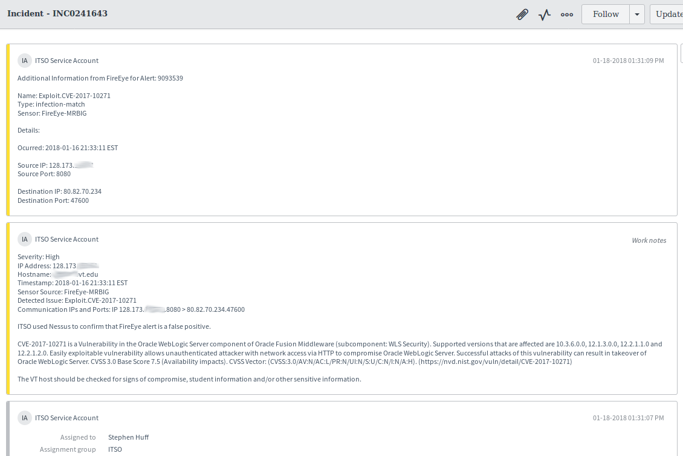
FEINT
SN Submission

Slide 8
HOIST – Hands-Off ITSO Scanning Tool
HOIST integrates with ITSO’s existing “Request Vulnerability Scan” Workflow in Service-Now
Scan Requests from Service-Now populate a Job Queue in HOIST for review and auto-organizes accepted jobs using Department names pulled from Service-Now
Repeating scans, like the weekly Foundation Scan, are completely automated and have not required ITSO attention since initial submission
Includes CAS/Login protection and runs as a Docker container for flexibility (separate production and development instances)

Slide 9
HOIST – Hands-Off ITSO Scanning Tool
Once a scan is approved and submitted, HOIST performs the following automated tasks that used to require manual attention from ITSO staff:
Runs the scan as scheduled
Auto-generates the Nessus report
Uploads the report to ITSO’s Google Team Drive
Sets user-specific permissions on the report ensuring access only for the intended recipients
Notifies recipients of the report’s Google Drive link through Service-Now
Closes the Requested Item and all related tasks in Service-Now

Slide 10
HOIST
Scan and Report Status

Slide 11
HOIST
Scan Scheduling

Slide 12
HOIST
Scan Details

Slide 13
HOIST
Service-Now Requested Item and Google Drive Links

Slide 14
HOIST
Google Team Drive Repository with user-specific permissions

Slide 15
CRIT – Credential Reset Incident Tool
Arose out of the need to standardize and streamline the procedures for credential resets following a credential compromise and improve communication across all involved departments (ITSO, Call Center, NI&S)
Automates submission of Compromised Credential Reset Incidents into Service-Now
Provides a Standard Operating Procedure (SOP) checklist within the incident Work Notes to ensure proper completion of the incident
The development version of CRIT has already helped draft consistent and efficient responses to a number of compromised account incidents despite not yet reaching production status
Includes CAS/Login protection and runs as a Docker container for flexibility (separate production and development instances)

Slide 16
CRIT
Account Reset Selection

Slide 17
CRIT
Preview before submission

Slide 18
CRIT
Service-Now Incident (DEV)

Slide 19
SLIC – Security Log Incident Creator
Integrates Bro (Zeek), Service-Now and ITSO’s custom malware database to automate Service-Now Incident creation
SLIC is still in development. Its intent is to streamlines tedious, manual data entry processes subject to human error that might take 5-10 minutes into a two-click, 20 second review and confirm procedure
Adds connective tissue with Service-Now that prevents duplicate Incident submissions
Includes CAS/Login protection, multi-tiered feature access and runs as a Docker container for flexibility (separate production and development instances)

Slide 20
SLIC
Filter Interface

Slide 21
SLIC
Alert Listing

Slide 22
SLIC
Notice Log Example

Slide 23
Low Hanging Fruit for Automation
BRAINSTORM TIME
Data entry
Hardware Maintenance
Software updates
Legacy systems
Systems that do not communicate, but should

Slide 24
Deep Dive into FEINT

Slide 25
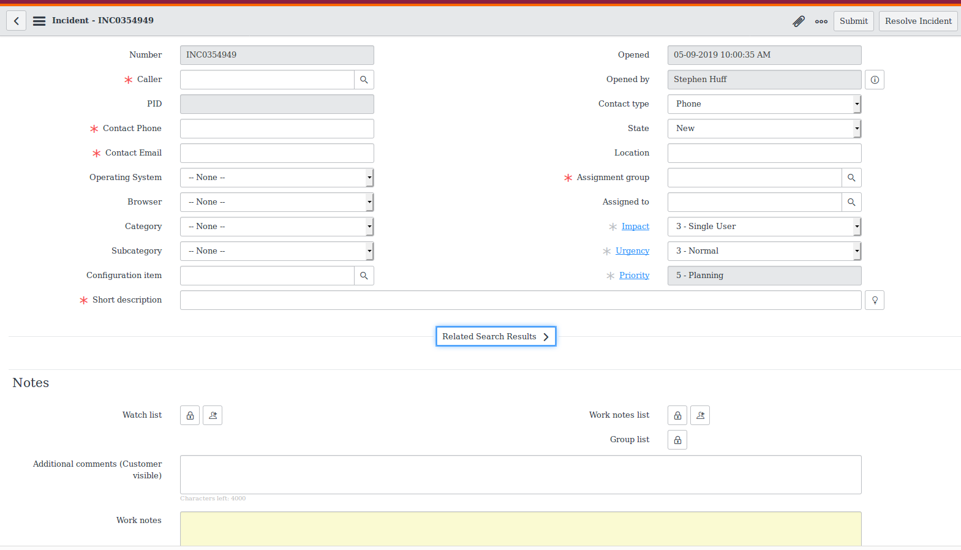
FEINT
Blank SN Incident

Slide 26
FEINT
Alert Deep Dive

Slide 27
FEINT
Alert Deep Dive

Slide 28
FEINT
SN Submission

Slide 29
Virginia Tech GitHub – code.vt.edu
https://code.vt.edu/sthuff/feint
https://code.vt.edu/sthuff/hoist

Slide 30
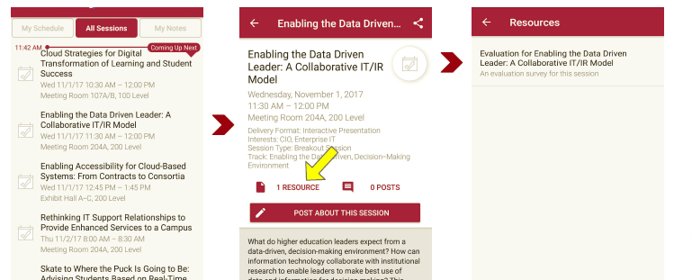
Session Evaluations There are two ways to access the session and presenter evaluations:
1
2
In the online agenda, click on the “Evaluate Session” link
From the mobile app, click on the session you want from the schedule > then click the associated resources > and the evaluation will pop up in the list

