Slide 1
This presentation leaves copyright of the content to the presenter. Unless otherwise noted in the materials, uploaded content carries the Creative Commons Attribution 4.0 International (CC BY 4.0), which grants usage to the general public, with appropriate credit to the author.
RAEngine:
Scoring, Prioritizing and Automating your Vulnerability Risk Assessment
Presenters:
Winston Armstrong
Daniel Quach
Special Thanks to:
Apurva Goenka Dani Whitehair Hua Uy Paul Norton Elliot Pfarr
Sandeep Chandra Leslie Morsek Brian Hom Anthony Boyd Taufiqul Islam
Kyle Barber David Beitler Edward Wade Steven Blair
Chicago, IL
May 14, 2019

Slide 2
Background: SDSC & Sherlock
San Diego Supercomputer Center (SDSC), University of California @ San Diego
-One of nation’s 1st supercomputer centers (1985)
-Funded by National Science Foundation (NSF)
-Leader in:
-Data-intensive computing (Comet Supercomputer)
-Cyberinfrastructure (Sherlock Cloud: Secure computing & data management)
Sherlock Cloud
-HIPAA & CUI hosting environment
-Built on FISMA/NIST 800-53 requirements
-On Premise or Hybrid Cloud (AWS or Azure) hosting environments
-Turnkey Big Data platforms to support Data Science & Analytics

Slide 3
Background: Problem & Solution
The problem:
-Patches constantly released to address Critical, High, etc vulns
-Critical vulns must be patched quickly-can’t always wait for next patch cycle
-If patched every release...constant outages...would lose all customers
-Began performing risk assessment of each vuln
-Good news: Decreased patch outages
-Bad new: Risk Assessments are time consuming
Our Solution:
-Automate the risk assessment of vulns using Sherlock specific criteria
=RAEngine

Slide 4
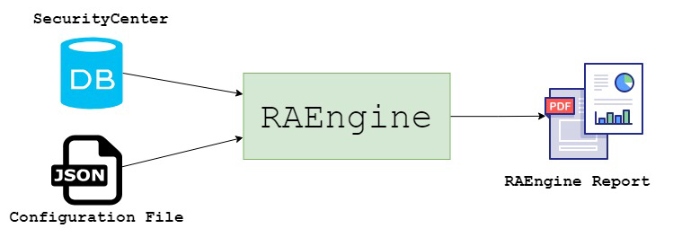
RAEngine
Automates vulnerability risk assessments
A framework coded in Python
Works with Tenable SecurityCenter

Slide 5
RAEngine
Sherlock’s Vulnerability Risk Assessment Criteria:
Severity : type of vulnerability, exploitability
NVD CVSSv3 Score
Number of systems affected
System Sensitivity Score = (e.g. Database)
Location of System within Project Architecture

Slide 6
RAEngine’s Super Secret Formula
Final Score
Vulnerability Score
Impact & Threat Likelihood

Slide 7
RAEngine’s Super Secret Formula
Vulnerability Score
NIST NVD CVSSv3 Score
Sherlock Weighted Score
Impact & Threat Likelihood
Number of Systems
System Sensitivity
System Placement Score (inc. Mitigating Security Controls)

Slide 8
RAEngine Output
Vulnerability Risk Assessment Reports
Email alerts when vulnerabilities require emergency patching

Slide 9
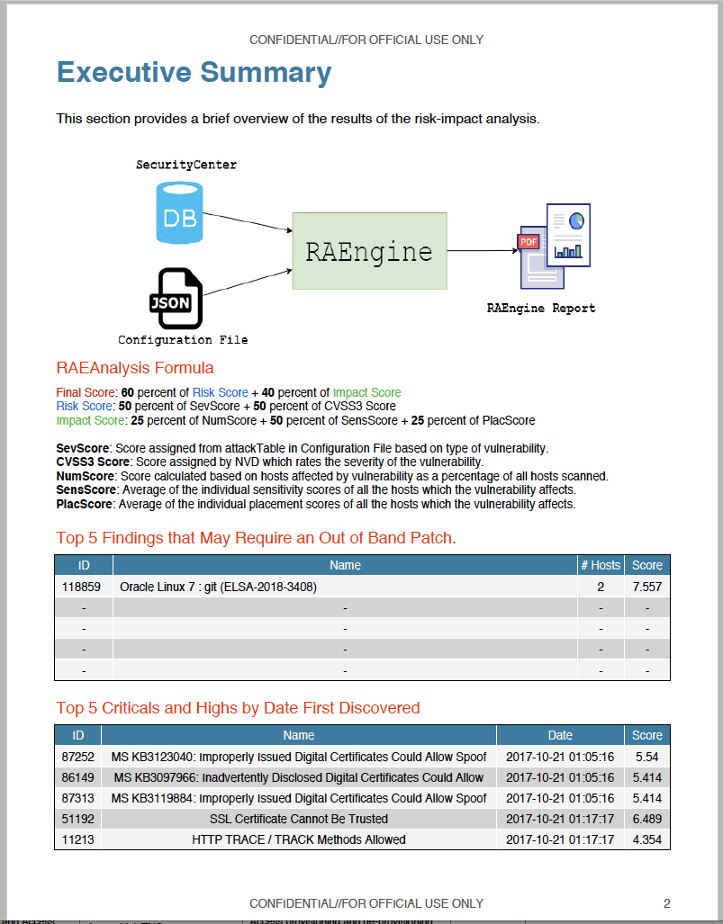
RAEngine Alerts
If RAEngine Score > specific value
And vulnerability has known exploits
Then:
Generate report and alert management team

Slide 10
RAEngine Benefits & Savings
Filters out vulnerabilities that do not require emergency patching
Allows focus on important vulnerabilities to patch
Reduction in risk analysis labor hours

Slide 11
Thank you / Questions?
Winston Armstrong
warmstrong@sdsc.edu
Daniel Quach
dan@ucsd.edu

