Slide 1
Reading SMTP Headers
Craig Drake – University of Chicago

Slide 2
Reading SMTP Headers
Why read SMTP headers?
How do we get the headers?
Examples
Helpful tools

Slide 3
Retrieving Headers
Outlook: Right click message > View Source
O365 Outlook Web: More Actions > View Message Details
Gmail: More > Show Original
Apple Mail: View > Message > All Headers

Slide 4
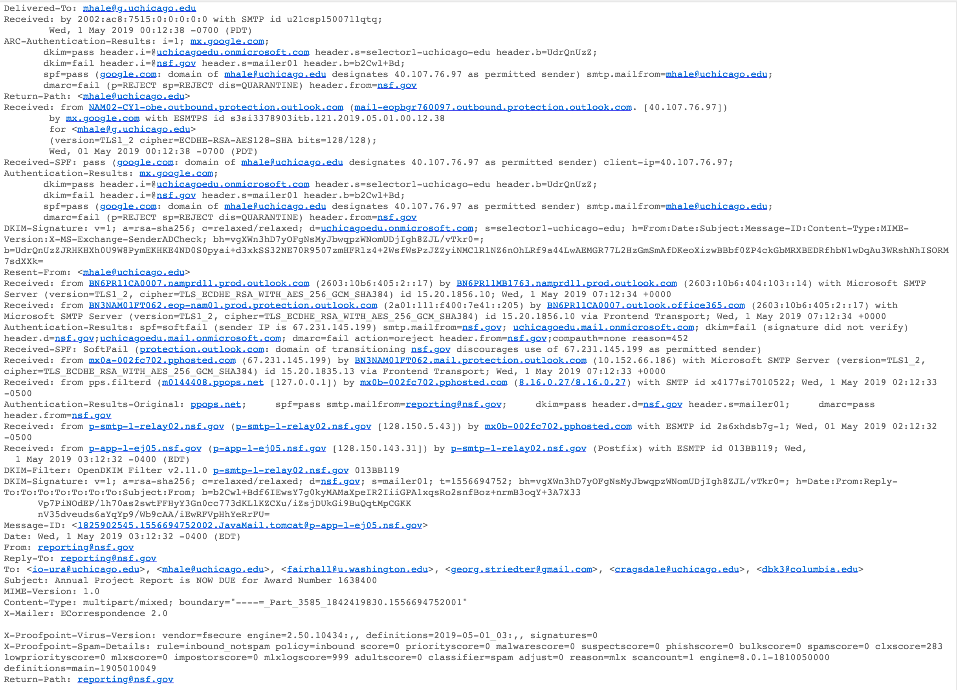
False Positive - Quarantined

Slide 5
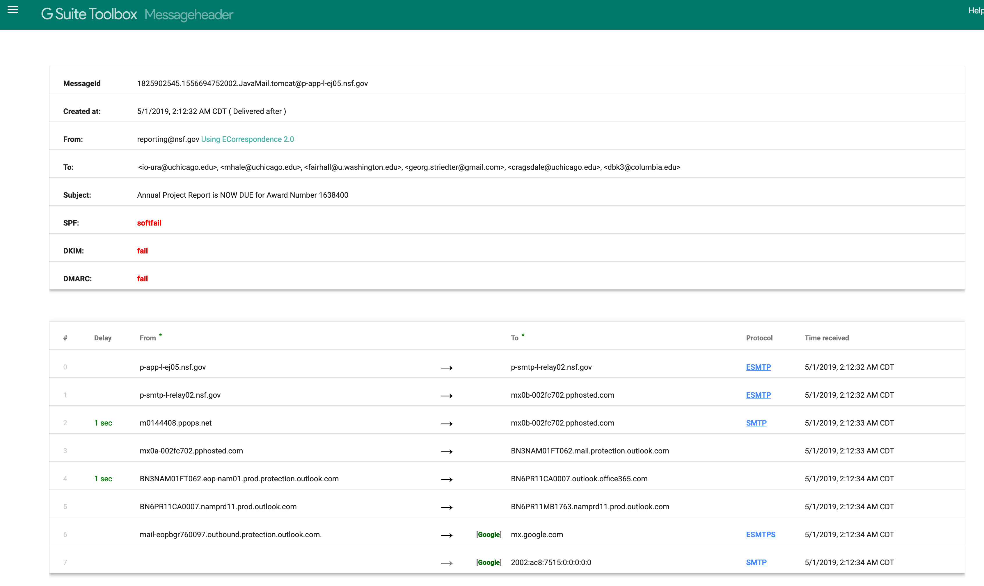

Slide 6
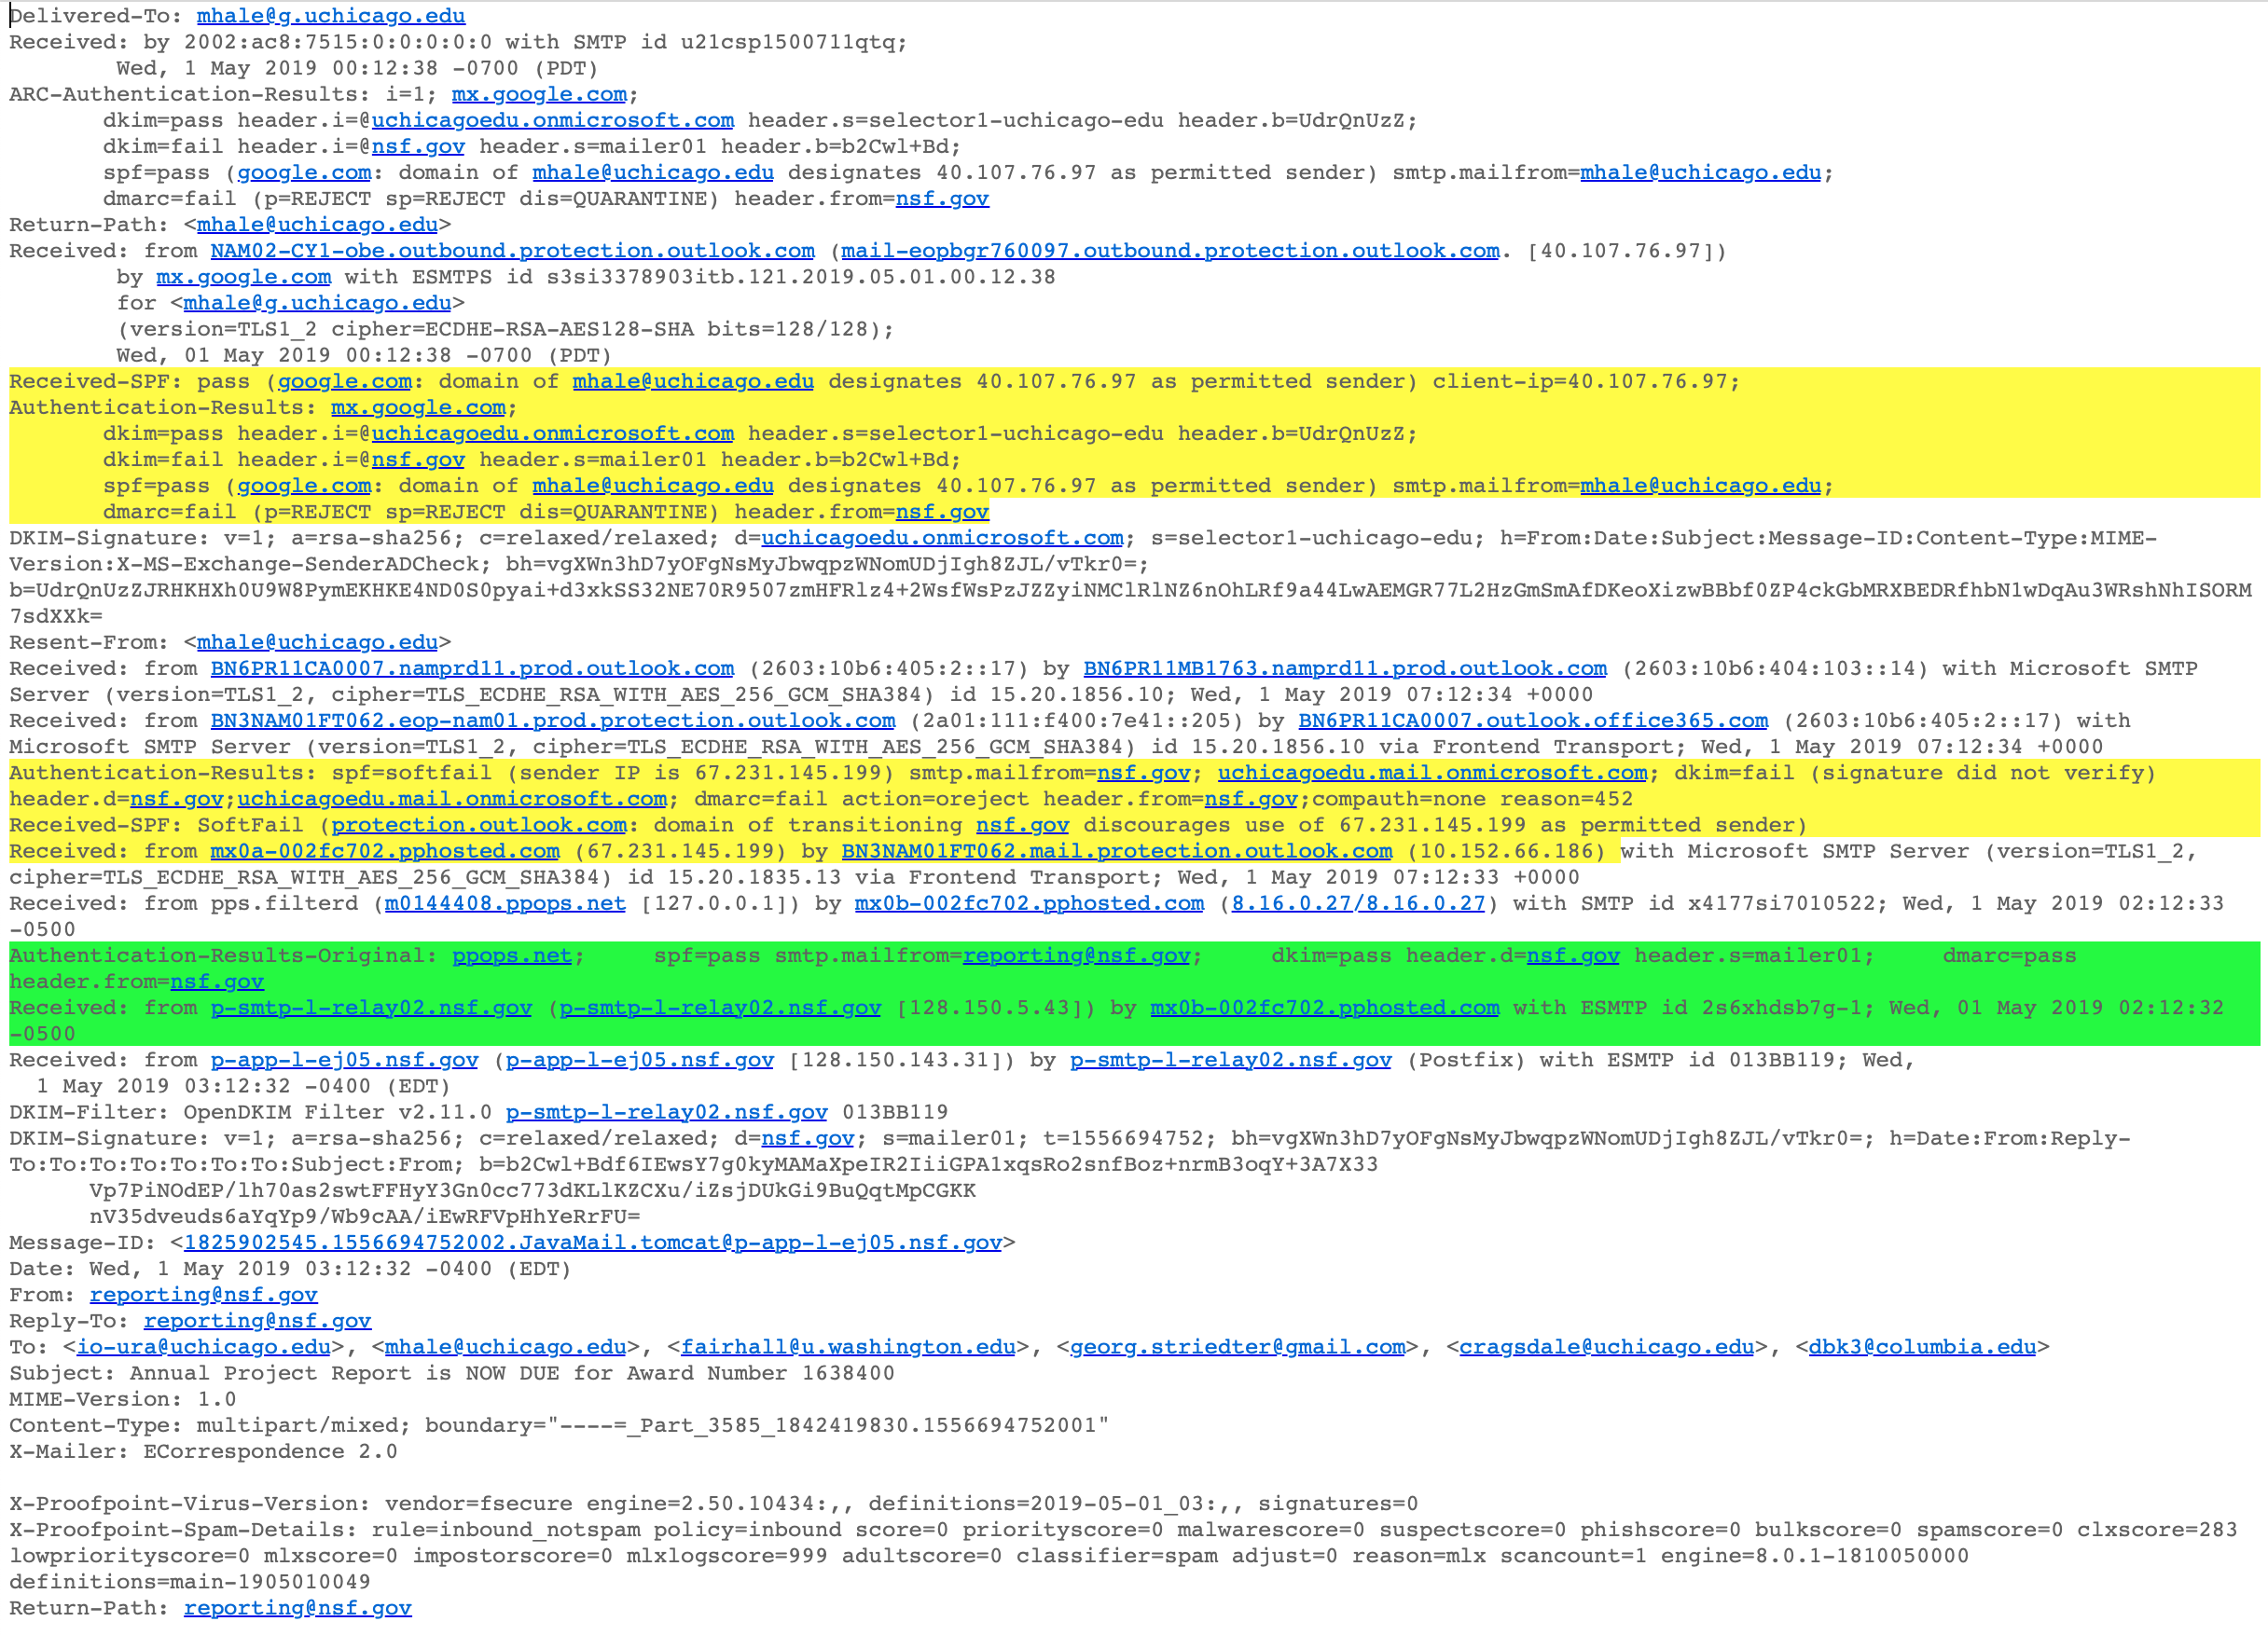
False Positive - Quarantined

Slide 7
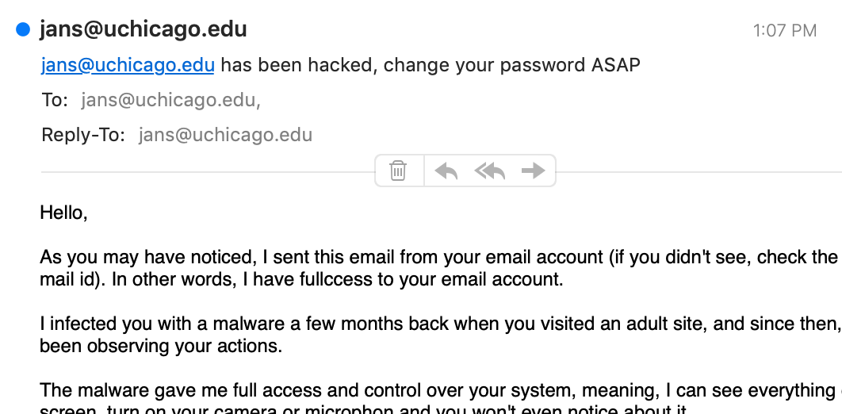
False Negative – Ransom Hoax

Slide 8
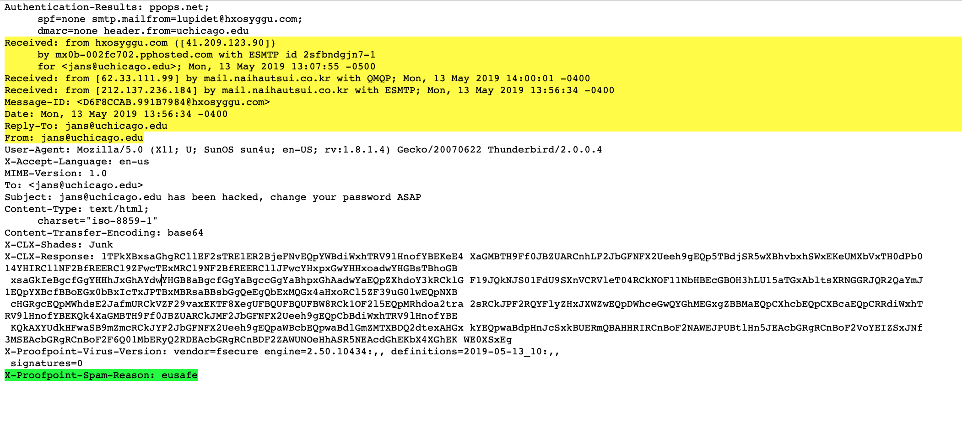
False Negative – Ransom Hoax

Slide 9
Helpful tools
https://toolbox.googleapps.com/apps/messageheader/analyzeheader
https://mxtoolbox.com/EmailHeaders.aspx

Slide 10
Questions?
Craig Drake, CISSP/GCIH/GMON
Information Security Engineer
University of Chicago
cwdrake@uchicago.edu

Slide 11
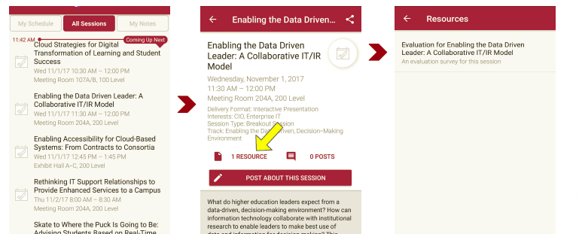
Session Evaluations There are two ways to access the session and presenter evaluations:
1
2
In the online agenda, click on the “Evaluate Session” link
From the mobile app, click on the session you want from the schedule > then click the associated resources > and the evaluation will pop up in the list

